Slide 1

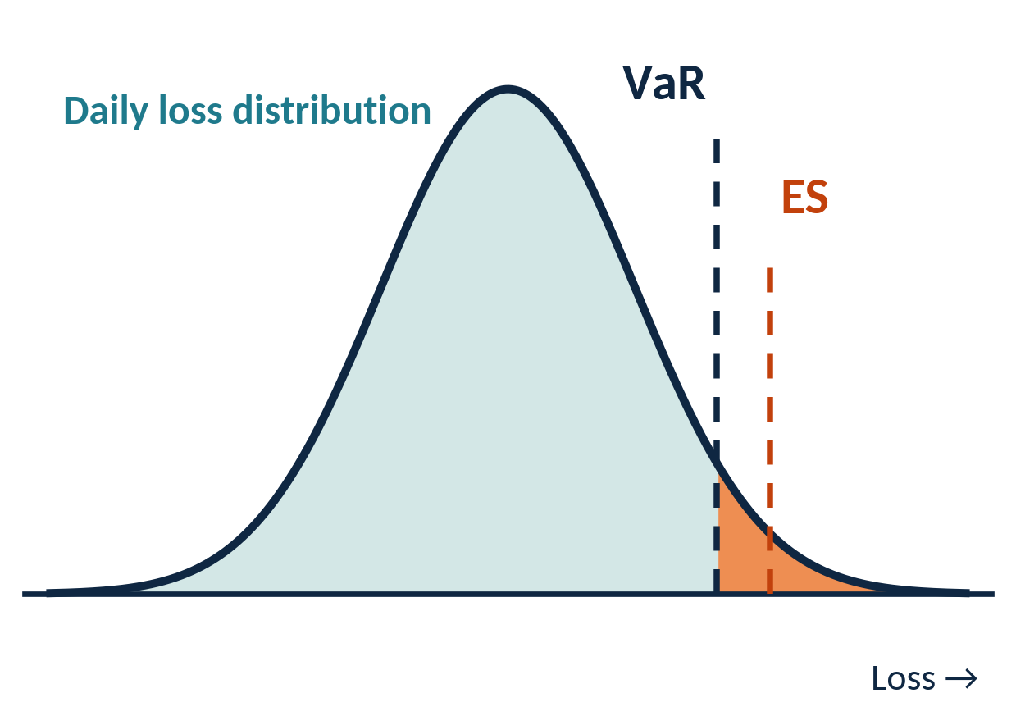
Financial Risk Management of Food & Beverage and Retail Sales
INTERNSHIP YEAR 4 | DEFENSE DAY, 23RD-24TH
A Quantitative Risk Model Using Value at Risk, Stress Testing and Store-Level Risk Scoring
PRESENTED BY
SUPERVISOR
ADVISOR
ACADEMIC YEAR
Sor Raksmey
Mr. Som Seab
Mr. Toem Touch
2026-2027

Slide 2
Host organization: Newrest Cambodia
1
PRODUCT CATEGORIES IN THE SALES DATA
THE COMPANY
Newrest Cambodia
1
2
The study analyses point-of-sale records from its restaurants, cafés and retail shops, covering food, beverages and retail products.
Food
Beverages
FINFOOD
FINBEVERAG
21
4
3
4
Alcoholic drinks
Retail goods
outlets analysed
product categories
FINALCOHOL
RETAIL

Slide 3
Dataset: Sales.csv
2
2,000,000
21
Jan – Dec 2022
1,998,500
sales lines in the raw file
stores
1 January to 31 December
rows kept after validation
FIELDS IN EACH RECORD
DATA QUALITY
Store
Ticket
Date and time
481,140
Product identifiers
Category
Quantity
exact duplicate rows (24.06%), flagged but not deleted
Gross sale
Net sale
Discount
1,500
Payment method
VAT
Unit cost
rows with non-positive net sales (0.07%), excluded from the modelling sample
Unit price

Slide 4
Objectives
3
GENERAL OBJECTIVE
Build and document a quantitative risk model for the food, beverage and retail sales of the organisation.
SPECIFIC OBJECTIVES
Validate and clean the transaction data and document every exclusion rule.
Build daily revenue, cost, profit and loss variables and a business-performance baseline.
1
2
Estimate Historical, Parametric and Monte Carlo VaR and Expected Shortfall (ES) on the same one-day loss definition, and compare them.
Stress test annual profit under sales declines and cost increases of up to 20%.
3
4
Measure concentration, discount, margin and demand risks and combine them in an entropy-weighted risk score for each store.
Translate the results into a risk register and management recommendations.
5
6

Slide 5




Key Formulas
FORMULAS IN THIS DECK
· DETAIL CONCEPT
Financial Risk Management of Food & Beverage and Retail Sales

Slide 6












Transaction-line features
5
Cost
Profit
Margin rate
Discount rate
PARAMETER MEANINGS
Identifies a transaction line
Cost of one unit on line t
Units sold on line t
Revenue before discount
Amount discounted on line t
Revenue collected after discount
Unit cost times quantity
Net sale minus total cost
Profit divided by net sale
Discount divided by gross sale

Slide 7
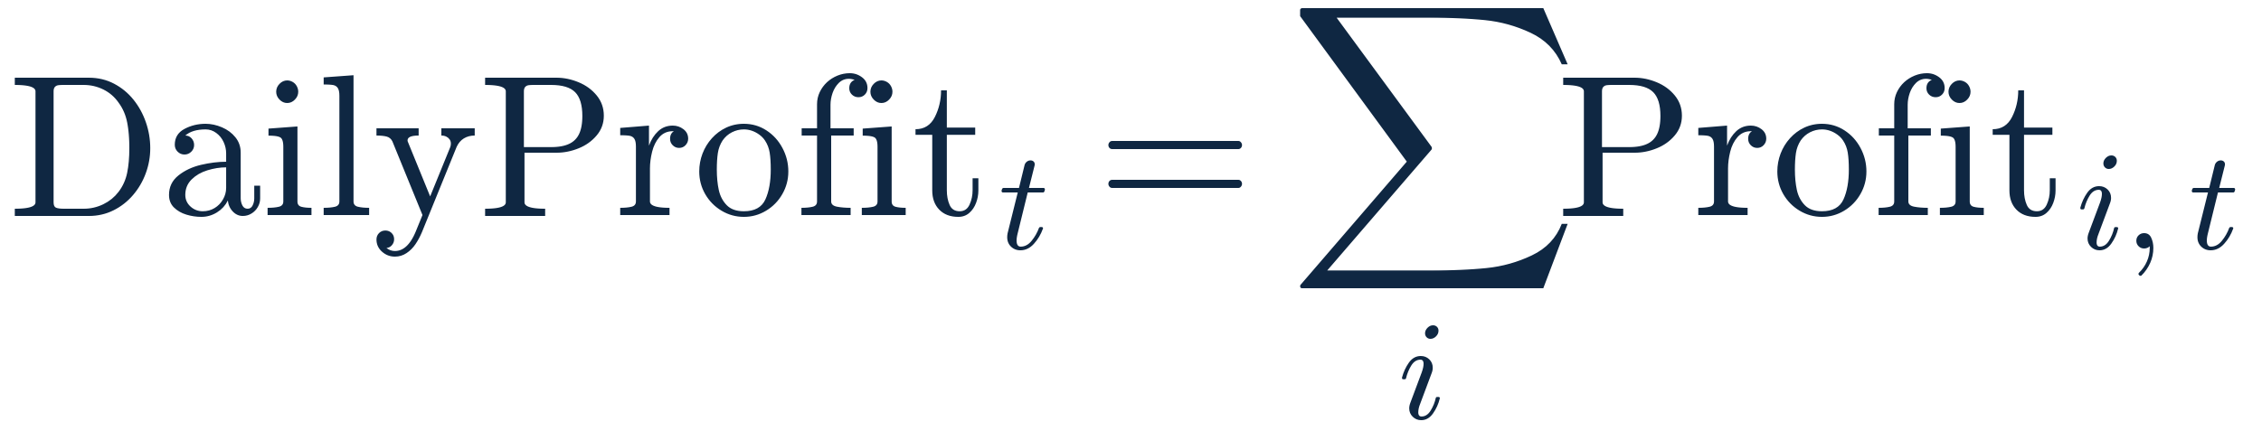


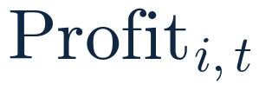



Daily profit and daily loss
5.1
Daily profit
Profit change
Daily loss
PARAMETER MEANINGS
Identifies a day
A transaction occurring on day t
Profit of transaction i on day t
Total profit of day t
Change in profit from day t−1 to day t
Negative of the profit change; a fall is a positive loss

Slide 8
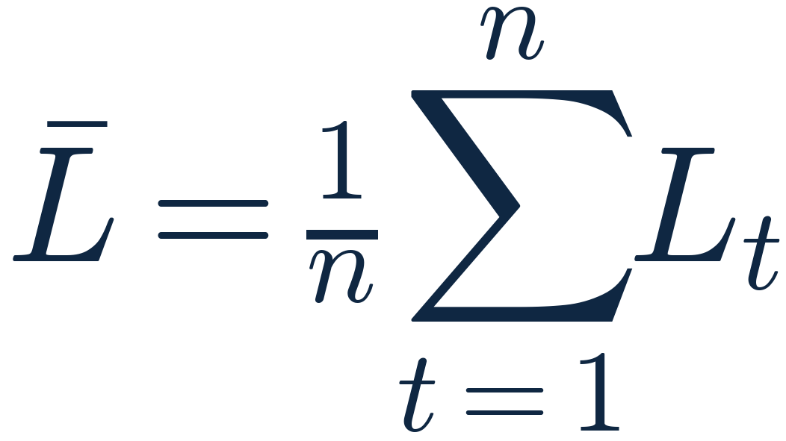
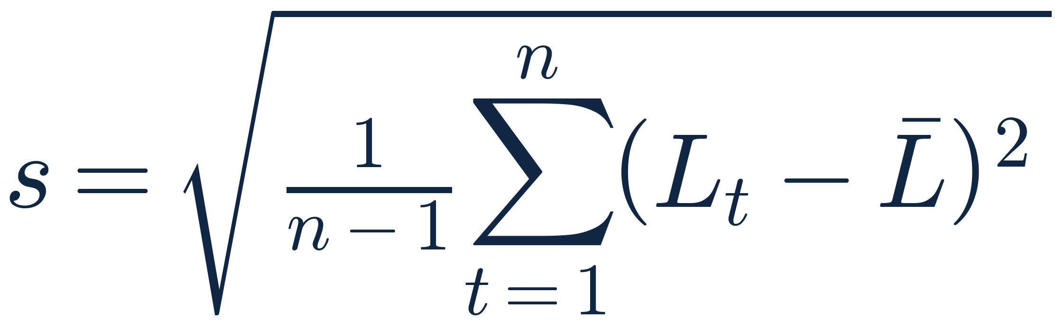




Sample mean and standard deviation
5.2
Sample mean
Sample standard deviation
PARAMETER MEANINGS
Number of daily-loss observations
Loss recorded for observation t
Sample average of the daily losses
Sample standard deviation of the losses

Slide 9
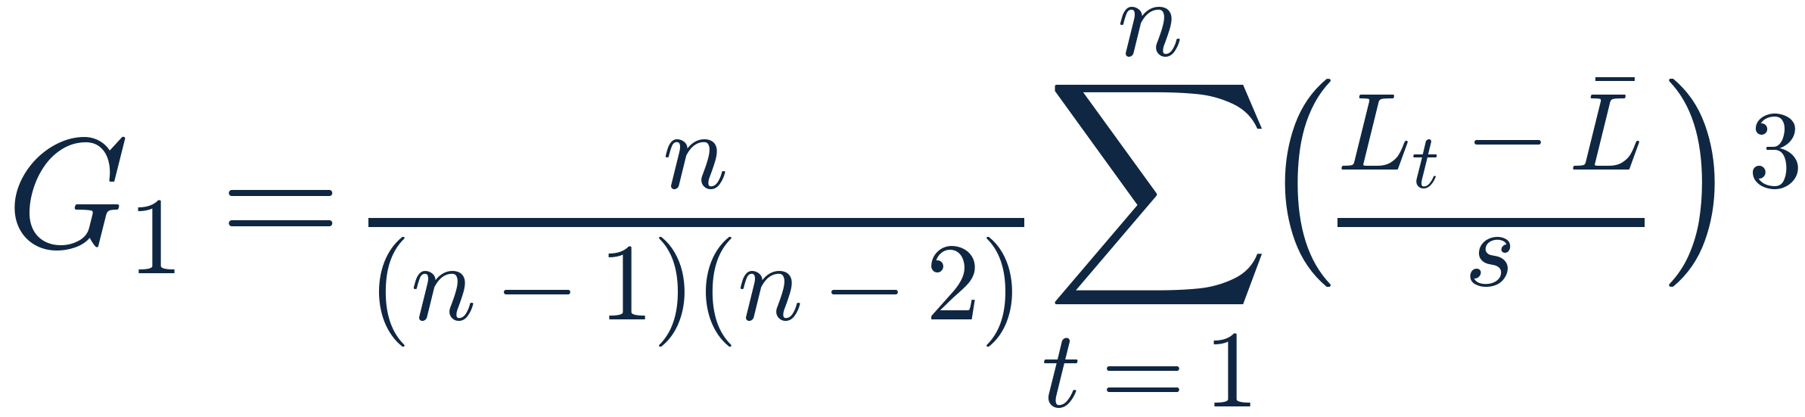
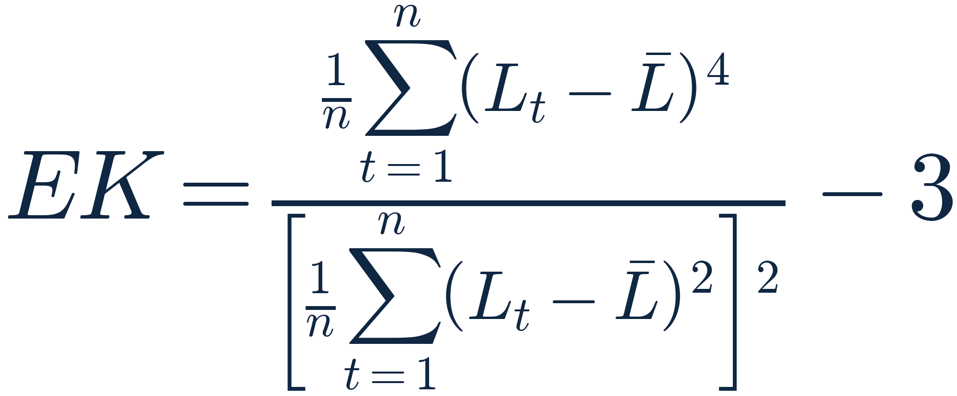


Skewness and excess kurtosis
5.2
Skewness
Excess kurtosis
PARAMETER MEANINGS
Number of daily-loss observations
Loss recorded for observation t
Sample average of the losses
Sample standard deviation
Sample skewness: asymmetry of the loss distribution
Excess kurtosis = kurtosis − 3; zero means Normal tails

Slide 10
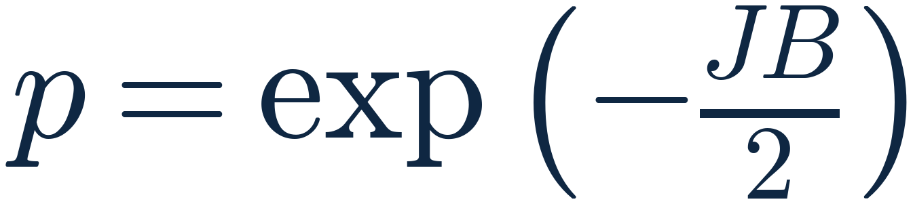


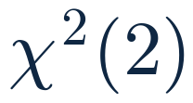

Jarque-Bera normality test
5.2
Jarque-Bera statistic
p-value, 2 degrees of freedom
PARAMETER MEANINGS
Number of observations in the sample
Sample skewness
Sample excess kurtosis
Jarque-Bera test statistic
Chi-square law with 2 degrees of freedom under Normality
p-value: reject Normality if p < 0.05

Slide 11

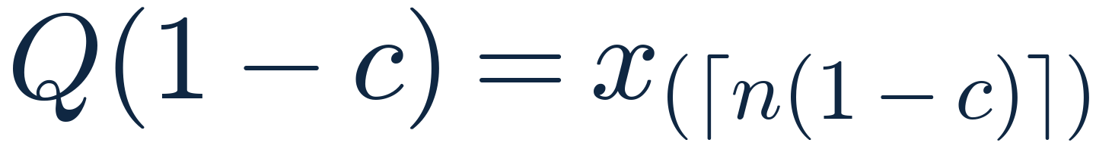
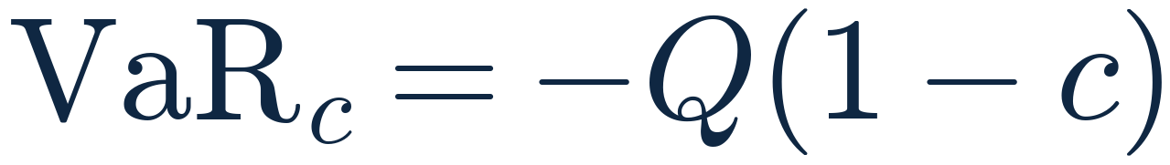









Historical simulation VaR
5.3
Definition of VaR at level c
Empirical quantile
Order statistic
Loss VaR (sign reversed)
PARAMETER MEANINGS
Confidence level (95% or 99%)
Probability in the adverse tail
Daily loss; positive when profit falls
Loss threshold at confidence level c
Risk factor: the daily profit changes
Length of the observation window
Empirical quantile at probability τ
Number of observations used
Ceiling: round up to the next integer
k-th smallest observation after sorting

Slide 12
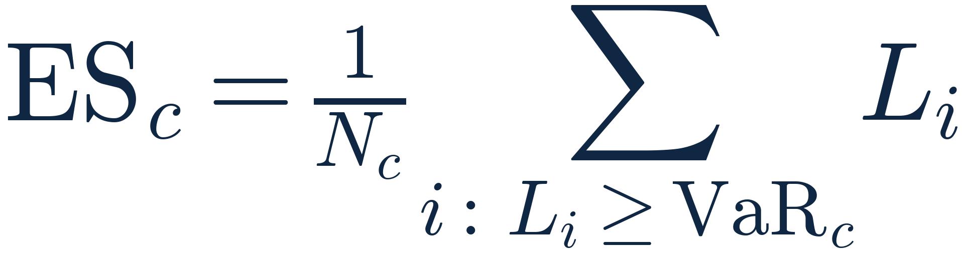



Expected Shortfall
5.3
Average loss beyond VaR
PARAMETER MEANINGS
Confidence level of the VaR threshold
Average loss at or beyond the VaR threshold
Loss threshold at confidence level c
Number of days with a loss of at least VaR
Loss on observed day i
Index of the days included in the tail

Slide 13
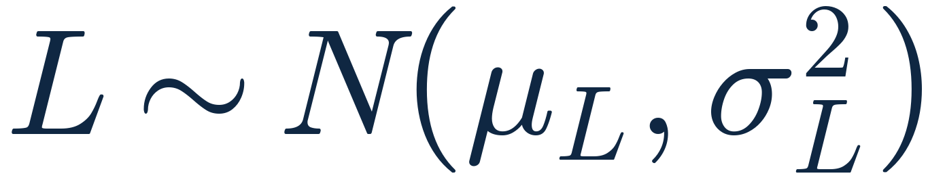

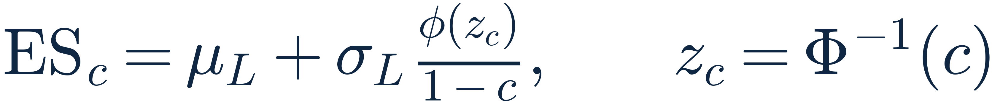





Parametric (Normal) VaR and ES
5.4
Normal loss model
Parametric VaR
Parametric ES
PARAMETER MEANINGS
Daily loss, assumed Normal
Mean of the daily losses
Standard deviation of the daily losses
Confidence level
Standard Normal quantile at probability c
Inverse standard Normal distribution function
Standard Normal density function
Loss threshold at level c
Mean loss beyond VaR under the Normal model

Slide 14
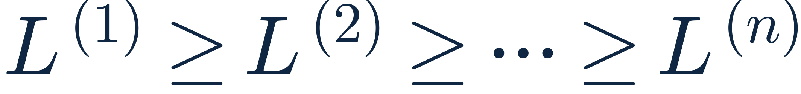




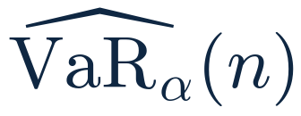
Monte Carlo: ordering and VaR
5.5
Simulated losses, ordered
VaR position
Monte Carlo VaR
PARAMETER MEANINGS
i-th simulated loss, sorted from largest to smallest
Number of simulated scenarios (100,000)
Confidence level; 1−α is the tail probability
Position in the ordered list
First ordered position that crosses the tail boundary
Loss threshold estimated from the simulation

Slide 15
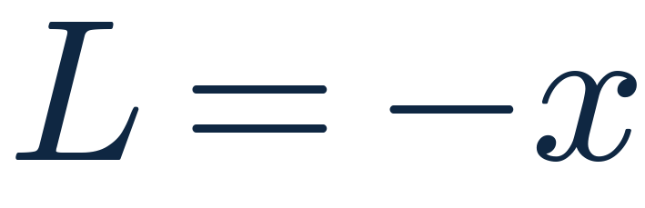
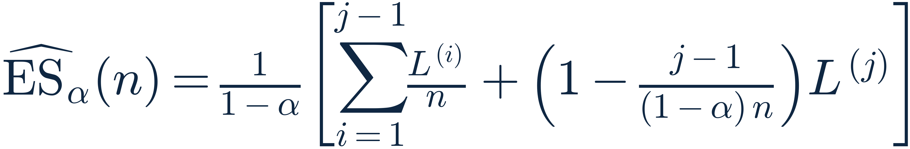

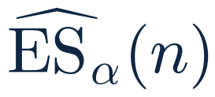
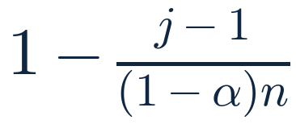
Monte Carlo: Expected Shortfall
5.5
Loss of a simulated profit change
Monte Carlo ES
PARAMETER MEANINGS
Simulated profit change
Loss of the scenario
Estimated average loss in the tail
i-th simulated loss after sorting
Number of simulated scenarios
Confidence level
First position crossing the tail boundary
Weight of the j-th loss; zero if (1−α)n is an integer

Slide 16









Stress testing
5.6
Stressed sales
Stressed cost
Stressed profit
Profit change
Profit change in %
PARAMETER MEANINGS
Observed annual sales
Observed annual cost
Observed annual profit
Change in sales (−0.10 = 10% fall)
Change in cost (0.10 = 10% rise)
Costs not in the data; set to zero
Sales after the sales shock
Cost after the cost shock
Profit under the scenario

Slide 17
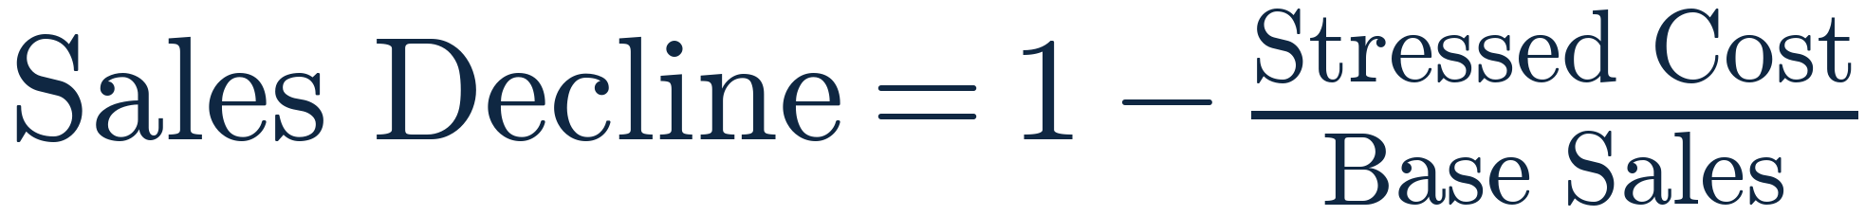

Stress rule of thumb and break-even
5.6
Rule of thumb
Sales decline that cancels all profit
PARAMETER MEANINGS
Observed annual sales
Scenario change in sales
Observed annual cost
Scenario change in cost
Cost after the cost shock
Fall in sales that wipes out all profit

Slide 18
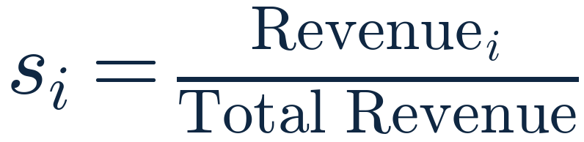

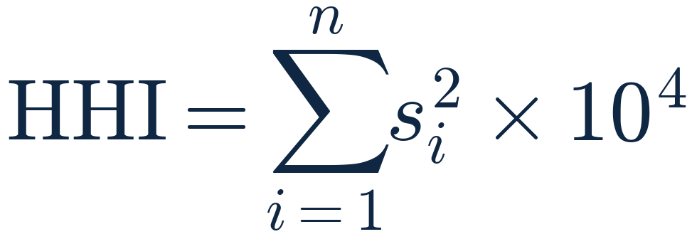






Concentration risk
5.7
Revenue share
Largest share
Top 5 share
Herfindahl-Hirschman Index
PARAMETER MEANINGS
Number of entities (stores or categories)
Index identifying one entity
Revenue of entity i
Share of total revenue of entity i (0 to 1)
Shares ordered from largest to smallest
Largest entity share, in %
Sum of the five largest shares, in %
Sum of squared shares times 10,000

Slide 19

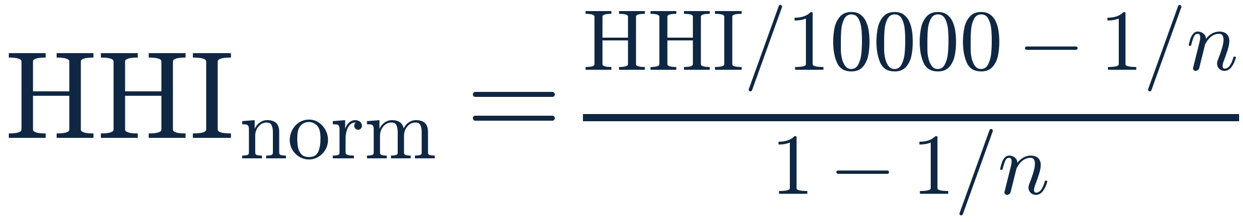


HHI floor and normalised HHI
5.7
Minimum HHI for n equal entities
Normalised HHI
PARAMETER MEANINGS
Number of entities compared
Observed index, from near 0 to 10,000
Lowest possible HHI with n equal entities
HHI rescaled to the range 0 to 1

Slide 20
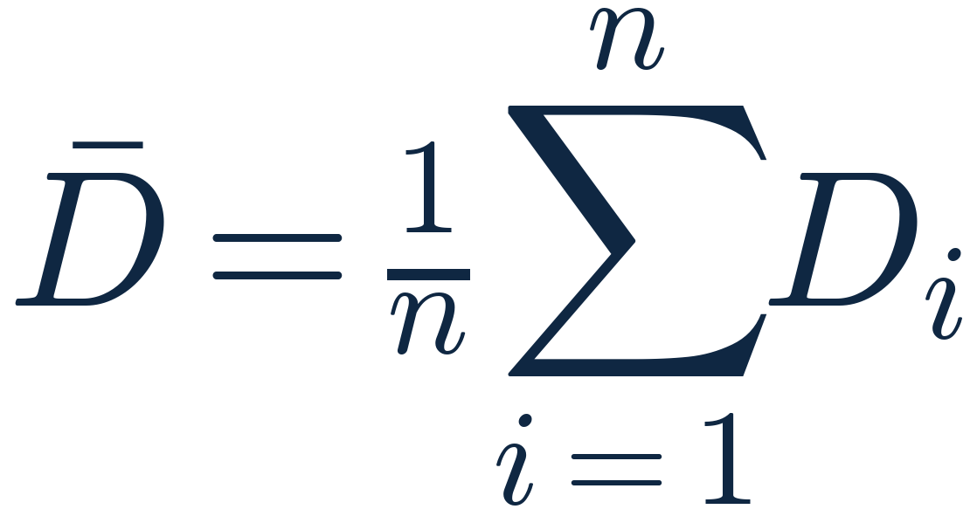
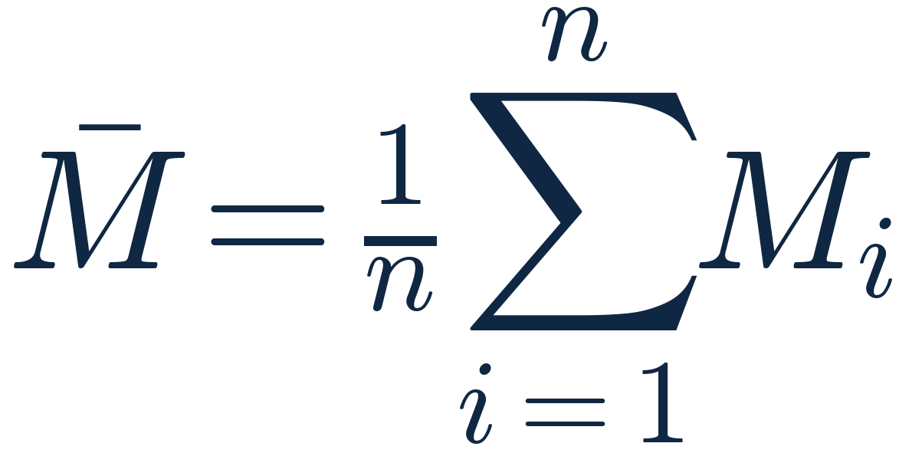




Average discount and margin rates
5.8
Average discount rate
Average margin rate
PARAMETER MEANINGS
Index identifying one transaction
Discount rate of transaction i
Margin rate of transaction i
Number of transactions included
Arithmetic average of the discount rates
Arithmetic average of the margin rates

Slide 21
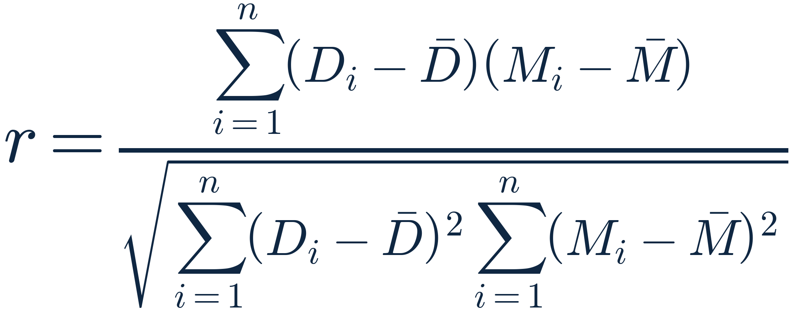
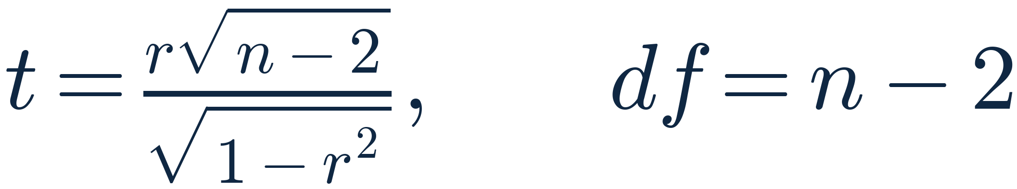

Correlation between discount and margin
5.8
Pearson correlation
t statistic
PARAMETER MEANINGS
Discount rate of transaction i
Margin rate of transaction i
Number of paired transactions
Sample average discount rate
Sample average margin rate
Pearson correlation, from −1 to 1
Tests whether r differs from zero
Degrees of freedom of the t statistic

Slide 22



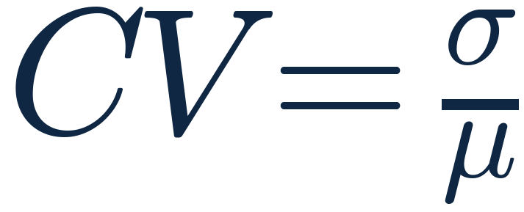

Demand volatility
5.9
NUMERATOR
DENOMINATOR
RESULT
÷
=
Standard deviation of the category's monthly demand
Mean monthly demand of the same category
Coefficient of variation: no unit, or in % after ×100
COEFFICIENT OF VARIATION
IN PERCENT

Slide 23
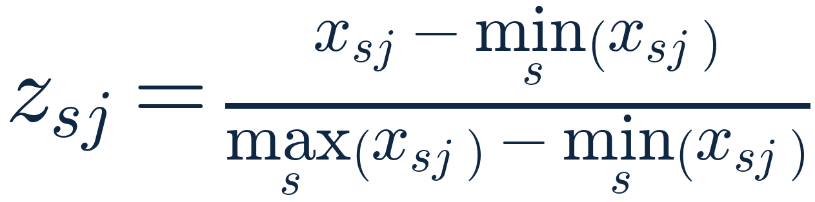
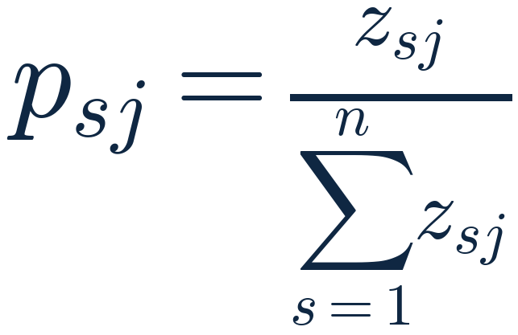
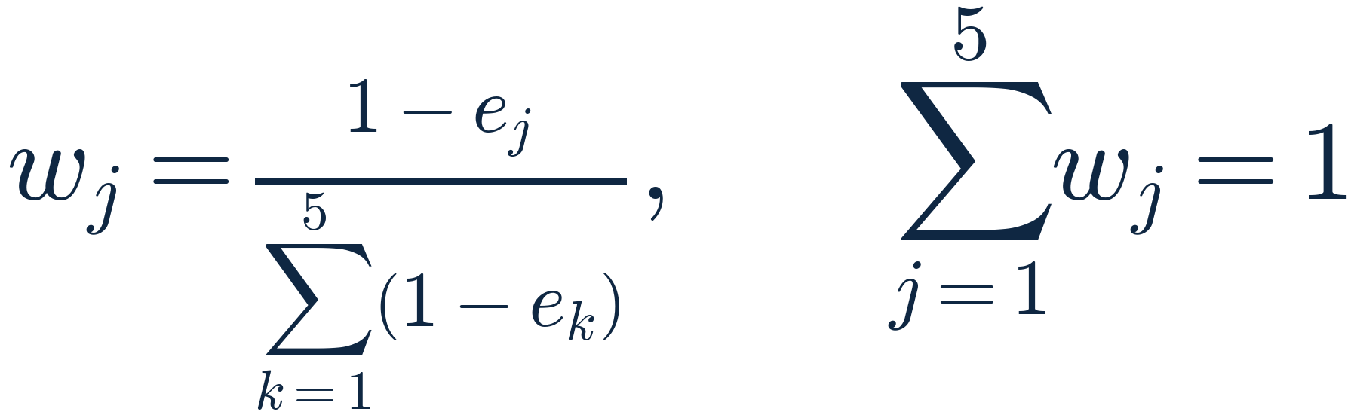
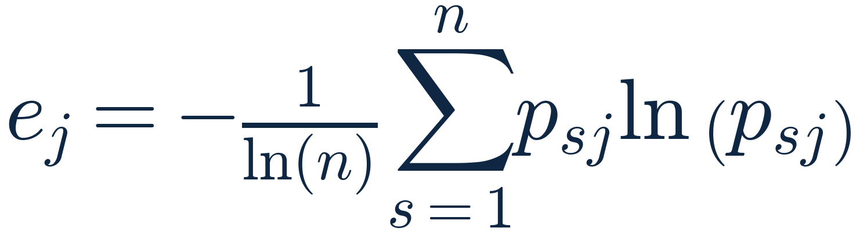






Entropy weights of the risk indicators
5.10
Min-max normalisation
Share of each store
Entropy of indicator j
Weight of indicator j
PARAMETER MEANINGS
Index identifying a store
One of the five risk indicators
Number of stores
Raw value of indicator j for store s
Min-max normalised value (0 to 1)
Share of store s in indicator j
Entropy of indicator j (ln = natural log)
Data-derived weight; the five weights sum to 1
Summation index over the indicators

Slide 24
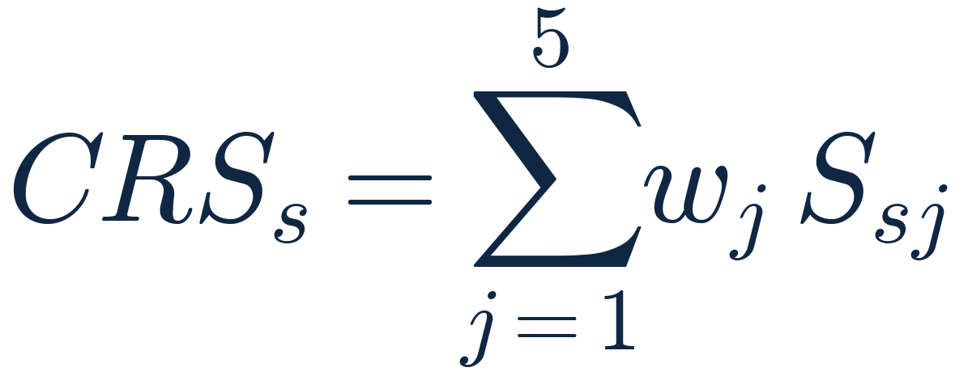








Composite store risk score
5.10
Indicator score
Composite risk score
Expanded form
PARAMETER MEANINGS
Percentile rank of store s on indicator j
0 to 100 risk score; reversed for margin
Entropy weight of indicator j
Composite risk score of store s (0 to 100)
Revenue volatility
Margin risk
Discount risk
Concentration risk
Demand volatility

Slide 25
Risk model walkthrough
DEMO
THE ANALYSIS PIPELINE, FROM TRANSACTION DATA TO MANAGEMENT REPORTING
1
2
3
4
5
6
7
Data
Quality control
Risk drivers
Risk measurement
Stress testing
Risk aggregation
Management reporting
Sales.csv: 2,000,000 lines from 21 stores
Duplicates flagged, 1,500 invalid rows excluded
Cost, profit, margin, discount and daily loss
Historical, Parametric and Monte Carlo VaR and ES
Sales declines and cost increases up to 20%
Entropy-weighted risk score for each store
Risk register and recommendations

Slide 26
Thank You
Questions and discussion are welcome

