Slide 1

Can the US. Census Data be used as an accurate predictor for Covid Mortality?
Presented by: Raksha Karthikeyan, Alexander Melamed, Erickson Vo and Stephanie Garrett

Slide 2
Research Question:
Is the US census bureau (CRE) data with additional data from John Hopkin’s University (JHU), significant enough to be a predictive power for anticipating COVID- 19 mortalities at a state and county level?
(“who knows…?”)
(“Only our machine learning will…”)

Slide 3
So….Why Covid and The U.S. Census Bureau?
Because …. 2020 was a difficult year for everyone. . . Well maybe not for everyone. But we all know what happened, March of 2020. The Virus COVID -19 has taken over the globe with a wave of devastation and many lives were at stake. Confusion, fear, and uncertainty were struck into the minds of the people. Questions like, How and When will this end? Will we have a vaccination? Will the world ever be the same again? These questions were bouncing around like unstable molecules…however, fast forward to 2023. We decided to look into covid-19 and the CRE. We thought it would be interesting to see if machine learning can predict the mortality rate of covid-19. This insight could be very helpful for future pandemics

Slide 4
US Census Bureau’s CRE (Community Resilience Estimates) Data:
The CRE, evaluates the capacity of individuals and households within a community to absorb , endure and recover from external stresses of a disaster or pandemic.
Examples: extreme weather , economic collapse or a viral pandemic (covid-19)
The CRE contains data for all states and counties within the United States
The CRE also utilizes aggregated risk factor data that might help with predicted covid mortality rate such as zero risk, one to two risk , and three plus risk.
These risk factors include : Income to Poverty Ratio, SIngle or Zero Caregiver Household, Crowding, Households without Full-time Employment, Communication Barrier, Disability, No Health Insurance, Age 65+, No Vehicle Access and No Broadband Internet Access.

Slide 5
John’s Hopkins University (JHU) Data:
Join Hopkins data is a resource to help the understanding of the virus, inform the public to help guide a response and save lives.
This data is very helpful with gathering covid-19 raw data such as confirm cases and death for all states, counties and countries.
The covid data that were used in our data set were from start of pandemic until now
We hope this data will help us and our machine learning in predicting the covid mortality with the CRE.

Slide 6
Data Description:
The data used in this analysis were provided by John’s Hopkins University which documents reported cases and deaths attributed to Covid-19 and The data from the U.S. Census Bureau’s CRE (Community Resilience Estimates)
From the John’s Hopkins Data we used the Covid-19 cases and deaths
From the U.S Census (CRE) we used the State/County names, Risk factors aggregates and the many risk factors.
For the purpose of this project the two data set has been cleaned and merged using python and SQL alchemy for DB

Slide 7
Week 1 (Data Exploration) :
Data used in our project were from the US Census Bureau (CRE) and John hopkins covid-19.
R statistics
Tableau for visual charts / dashboard
Heat maps to find correlation between variables

Slide 8
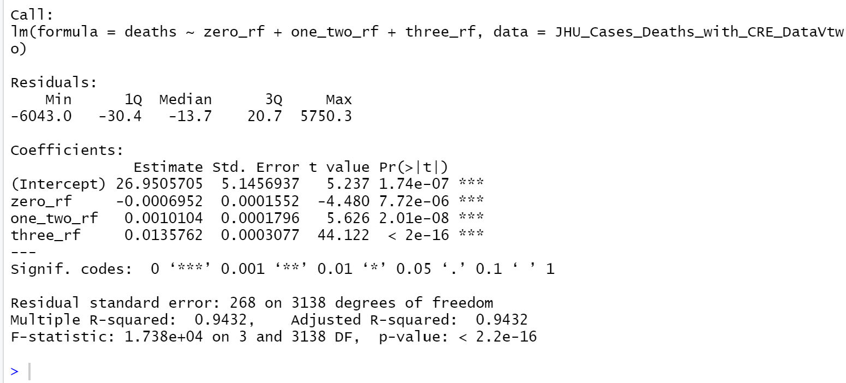
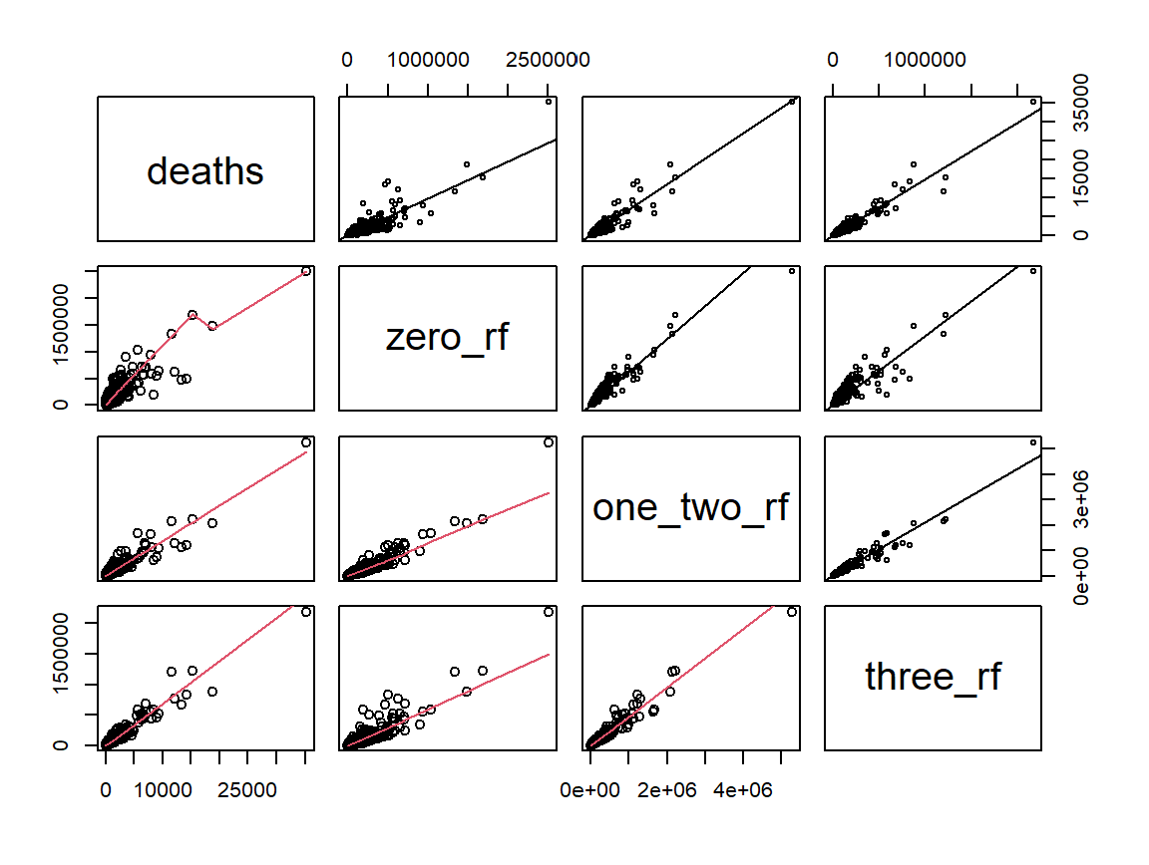
Scatterplot Matrices: Deaths vs. Risk Factors

Slide 9
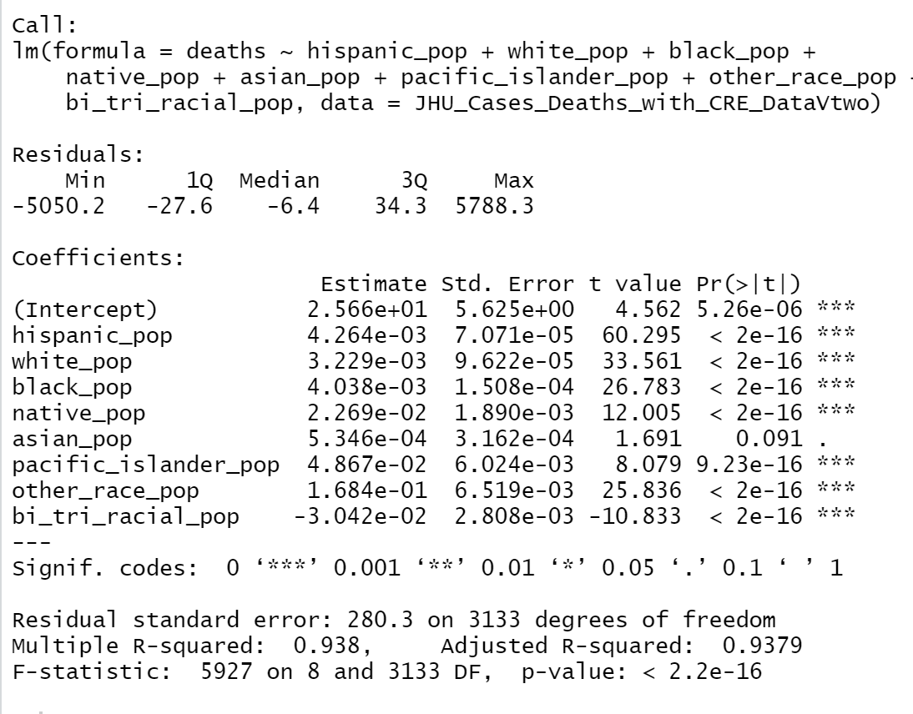
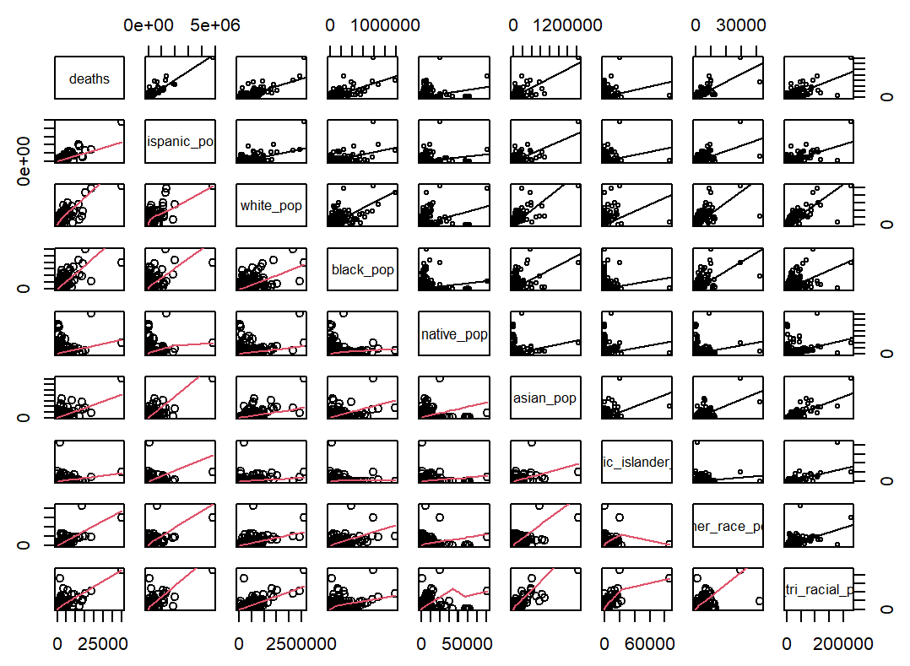
Scatterplot Matrix: Deaths Vs. Race

Slide 10
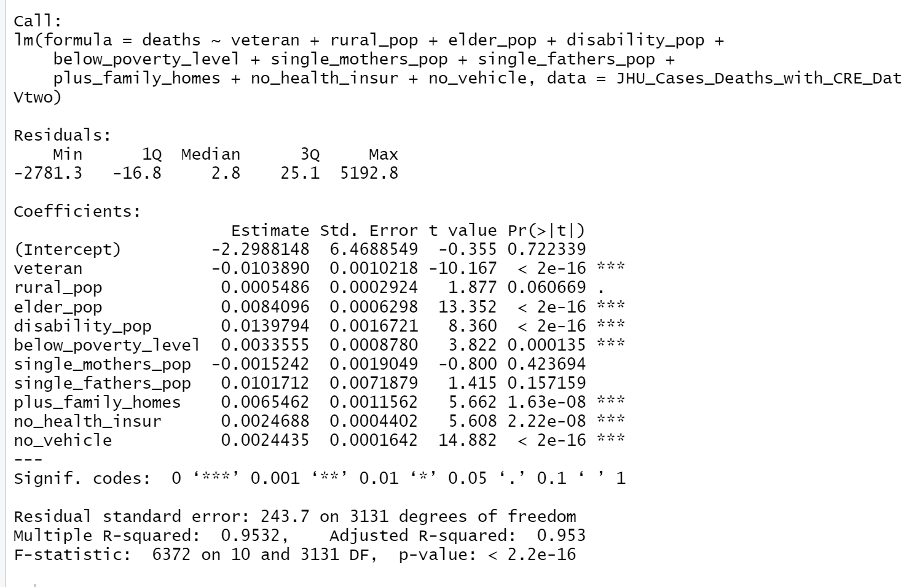
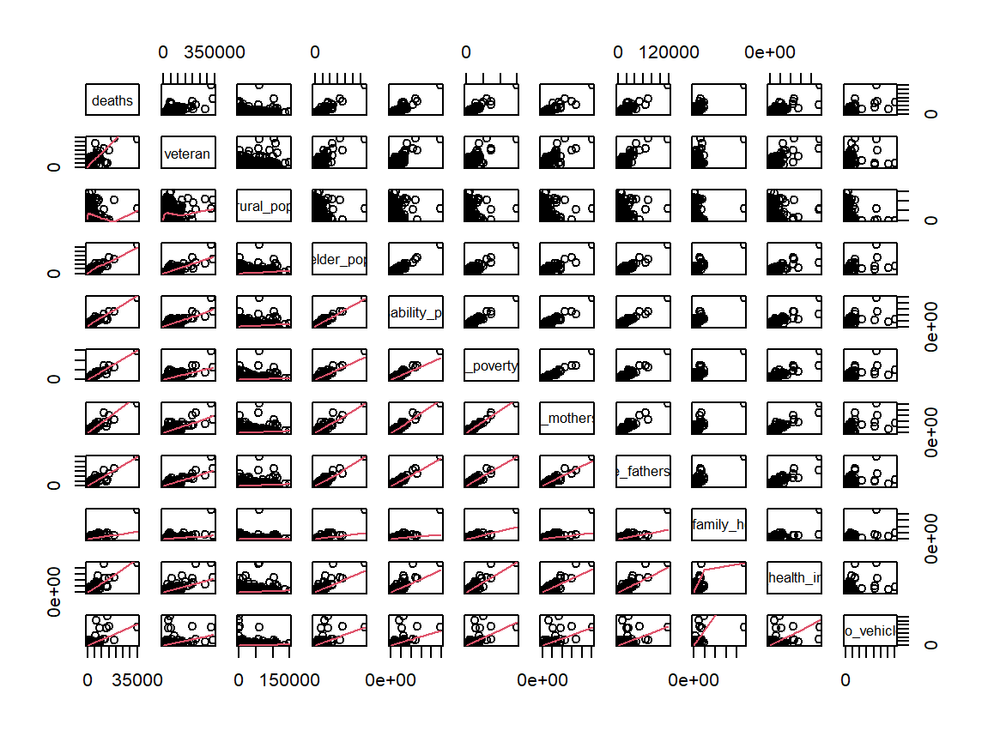
Scatterplot Matrix: Deaths Vs. Vulnerable Pops

Slide 11
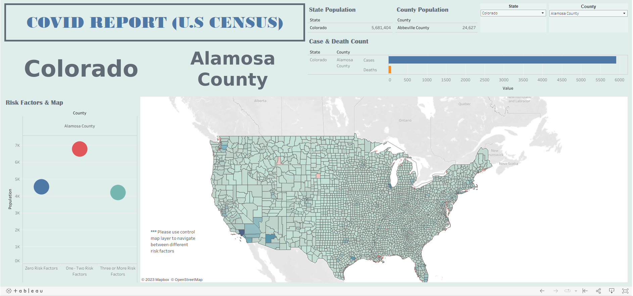
Charts (Tableau): Interactive Covid Report Dashboard

Slide 12
Week 2 (Analysis Phase):

Slide 13
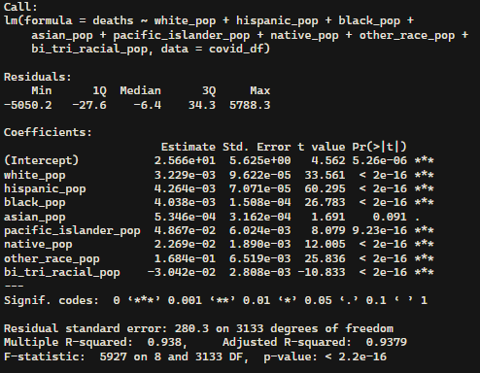
Charts (R Statistics): feature engineering
In order to determine what factors we should focus on out of the options we have available with the CRE vulnerabilities and different populations, we employed R and used a linear regression model.
Using R ‘s linear regression function, we compared deaths to the race independent variables. We can say races with t-values greater than 2 is acceptable, and anything less than -2 is acceptable.
This model shows statistical significance with the R-Squared value of 0.938, and a low p-value (2.2e-16). And given that the R-Squared is 93.8%, we can say that this model is effective at predicting deaths based on race.

Slide 14
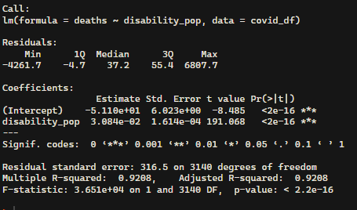
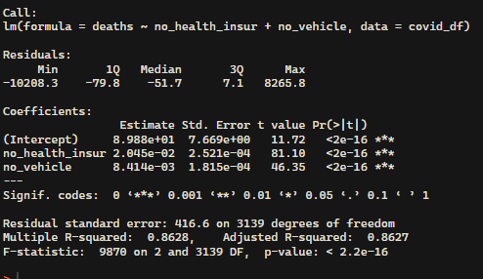
Charts (R Statistics): feature engineering cont…
Using R ‘s linear regression function, we compared deaths to the race independent variables. We can say people disability, no health insurance, and no vehicle with t-values greater than 2 is acceptable, and anything less than -2 is acceptable
This model shows statistical significance with the R-Squared value of 0.9208, and a low p-value (2.2e-16). And given that the R-Squared is 92.08%, we can say that this model is effective at predicting deaths based on disability
And
Significance with the R-Squared value of 0.8627, and a low p-value (2.2e-16). And given that the R-Squared is 86.27%, we can say that this model is effective at predicting deaths based on no health insurance and no vehicle

Slide 15
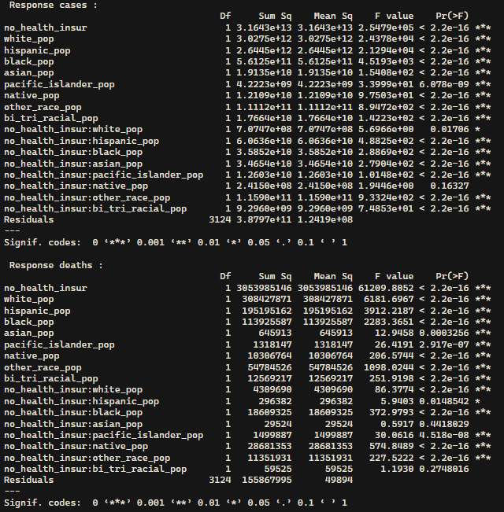
Charts (R Statistics): feature engineering cont…

Slide 16
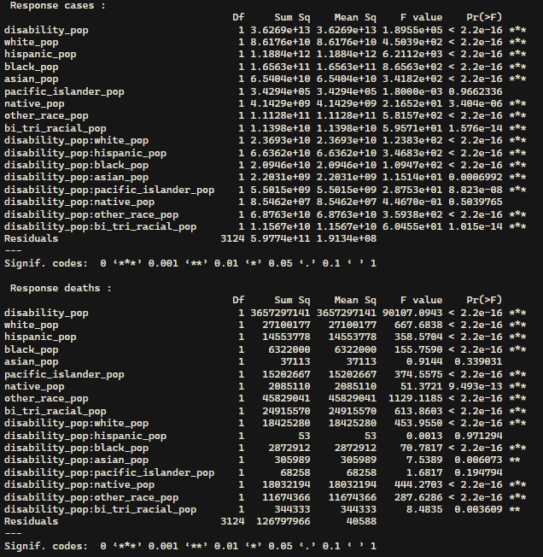
Charts (R Statistics): feature engineering cont…

Slide 17
Week 3:

Slide 18
Findings:

Slide 19
References
1. Module 16
2. Karthikeyan, R. (2020, November 28). Adult Obesity in the US 2017. [Raksha’s College Paper in Regression Analysis using R]

