Slide 1

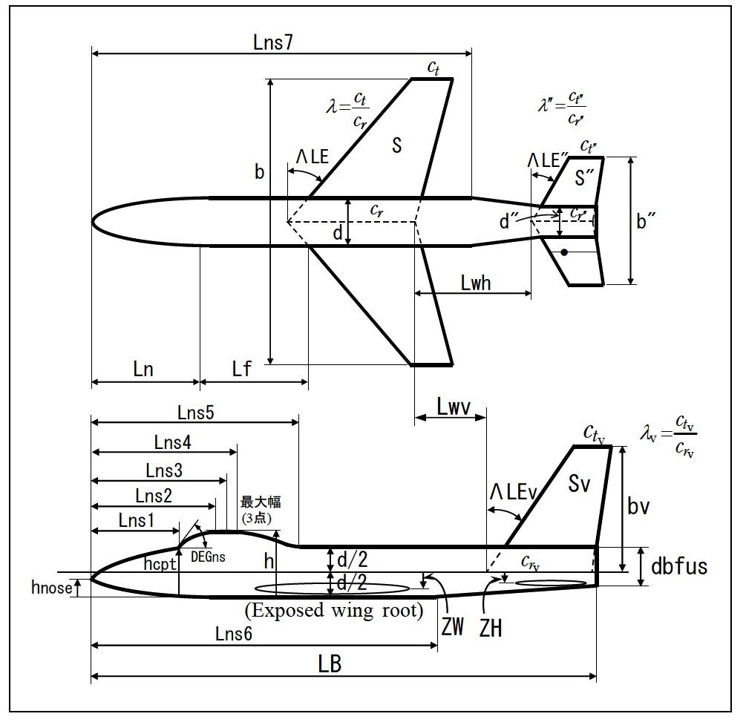

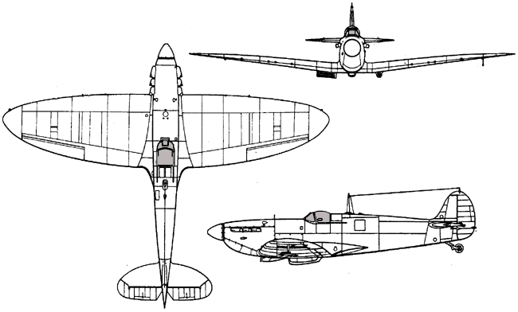
Retractable Wings with Machine Learning
Group 6 - Planes on a Snake
July 23 2016
Notes:
Hello, we are Group Six, planes on a snake, and Nihao to everyone.

Slide 2
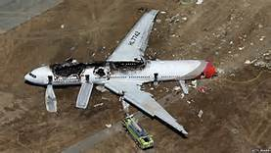
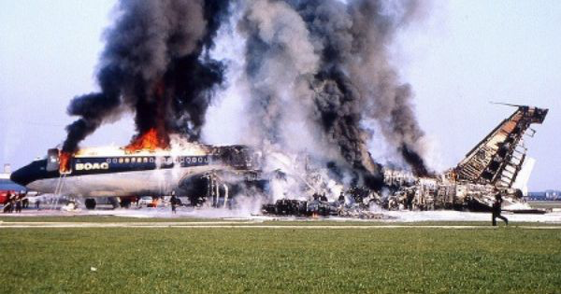
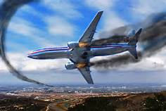
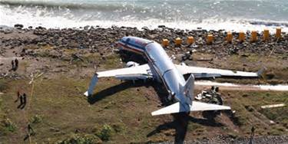
Engineering Through Chaos
Notes:
If there is one constant humanity has always struggled with, it is our inability to predict the outcomes of our own ingenuity and engineering. When we try to control nature, ultimately, many things can go awry. And this is no different in the world of aviation.

Slide 3
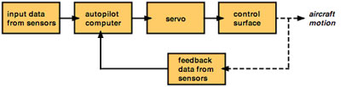
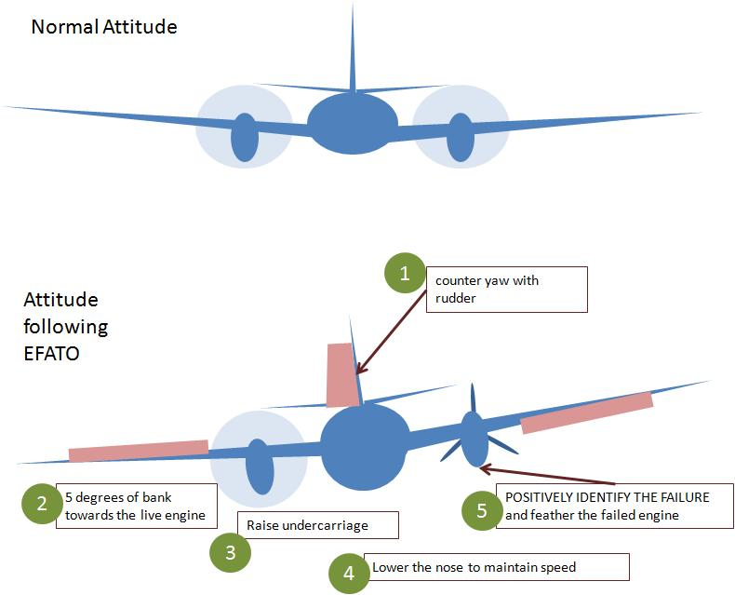
Current Solutions
Pilot techniques
Autopilot systems
Notes:
In 2016 alone, there have been seventeen serious accidents that involved fatal crashes. As such, it is important to explore the current ways pilot’s deal with the the loss of power in one of their engines. Generally speaking, when a pilot loses power, they are trained to make their plane simulate the flight of a glider. This means they must counteract the increasing yaw force in the failed engine by rotating certain degrees opposite the failed engine. This is to reduce the parasitic drag force that is occurring with the yaw and prevent rolling. Secondly, the planes have various automated systems in these scenarios to provide feedback to the pilot.

Slide 4
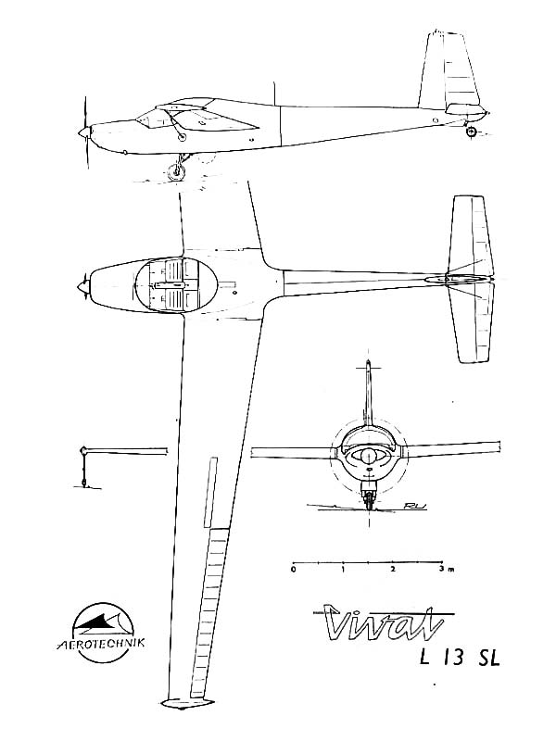
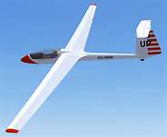
Gliders
They can fly several hours in a single take-off!
Schematic Drawing
Notes:
And lastly, aircraft designers have made planes more glider like. A great example is the Boeing 747 Dreamliner design where the wings have a high aspect ratio, and leading edge sweepbacks. It should be mentioned with the design of glider there is a sacrifice between wing span to parasitic drag.

Slide 5
Proposed Solution
Retractable wings system
Notes:
And as such, with all these three techniques now understood, we decided to design a system that combined all of them in one neat package. The result was a Retractable Wing design informed by Reinforced Learning Algorithms to ultimately be used to safely land the Bombardier Q400 airplane.

Slide 6
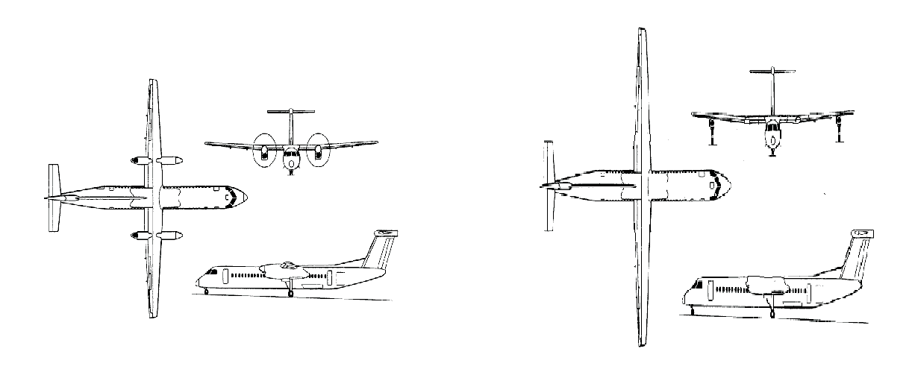
How it works
Increase Aspect Ratio of the wings to increase Glide Ratio value.
Operated by Reinforced Learning.
Increase Flight distance
Longer and narrower wings
Wheels on the wings
No engines
Notes:
Generally speaking, what this means is we are simulating the advantages a glider has with cutting edge software techniques. To do so, we have to increase the aspect ratio of the wings. This is defined as the length of the wingspan divided by the area. To increase the aspect ratio, we have suggested either building retractable, narrow wings underneath or within the current wings, and extending them when the time is necessary. A longer aspect ratio is loosely correlated with the larger glide ratio, which is a good indication of how long a plane can fly without power. By increasing the flight endurance, the airplane has more time to find a safer place to land, and thus have a controlled landing compared to a regular flight.

Slide 7
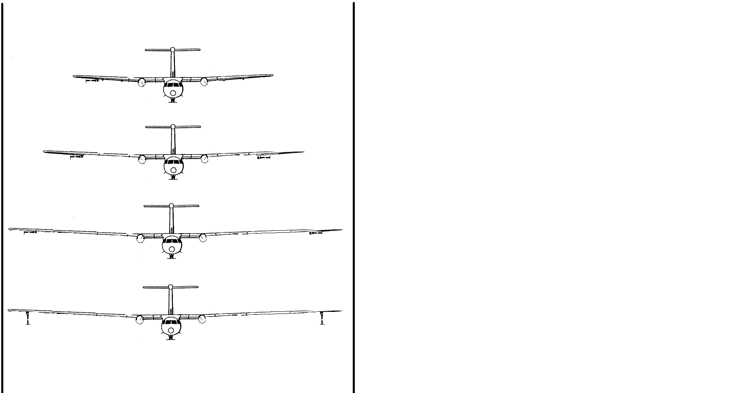
Retractable Wings
Allows plane for a better gliding;
It can be adjusted for different velocities;
In case of failure it doesn’t compromise the flight;
Notes:
The retractable wings are thus dependent on simulating the glider structure of a plane. To do so, we need a longer wingspan and lighter weight. The design not only retracts, but does so at various modes of extension, seen here. These various modes allow us to take advantage of different speeds for gliding, creating a more efficient gliding hybrid.

Slide 8
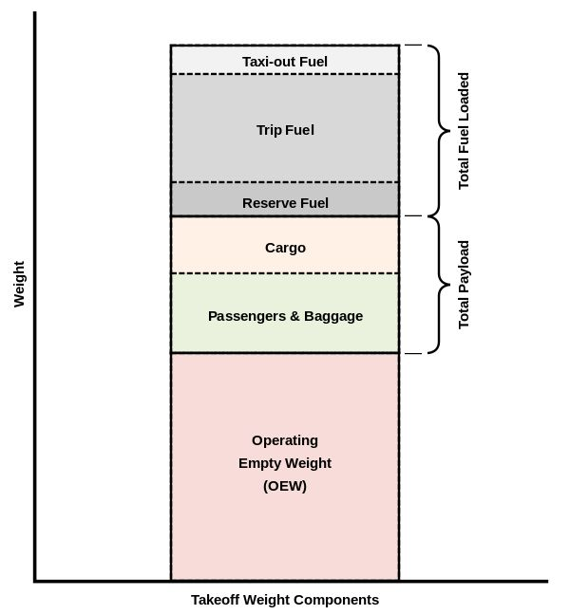
Weight loss
Reduce all useless weight possible.
Notes:
To allow for a lighter aircraft, we decided to jettison the failed engines, and unneeded fuel, as we no longer will be using propulsive thrust, but instead only buoyant gliding forces.

Slide 9
Glider Justifications
Higher aspect ratios of the wing
Longer gliding distances
Notes:
The ultimate result of the gliding structure is an increased aspect ratio of the plane. This results in an increased glide ratio. We can see here that we are given a few minutes for every small addition in length of wingspan we provide. By increasing the glide ratio, we have decreased the touchdown speed and the landing impact energy of the aircraft which results in allowing for a safer landing overall.

Slide 10
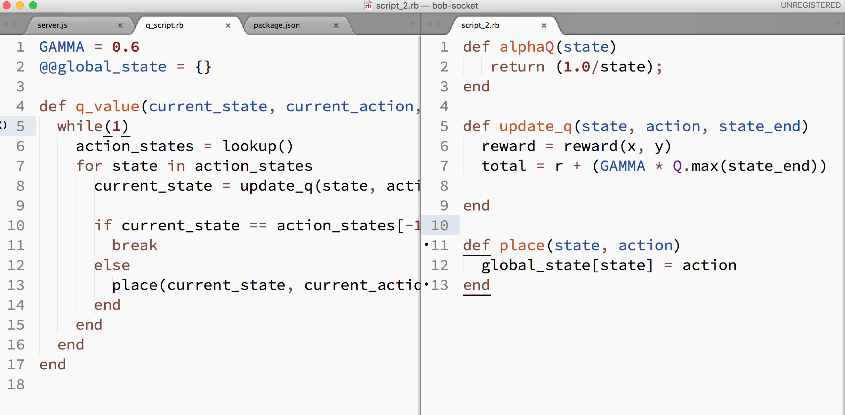
Reinforced Learning System
Software takes over.
Reinforced learning to not introduce errors.
Notes:
However, the main problem with retractable wings is that it is difficult to predict when to extend the wings. This is why most telescopic systems have not worked up until now. However, if we pair the retractable wings with smart software, we could be successful. What we are suggesting is pairing it with reinforced learning algorithms. From a macroscopic view, this means that the aircraft’s software knows that when power loss occurs, we must likely begin a gliding descent. And importantly, the software will know how long to extend the wings based on current conditions and speed.

Slide 11
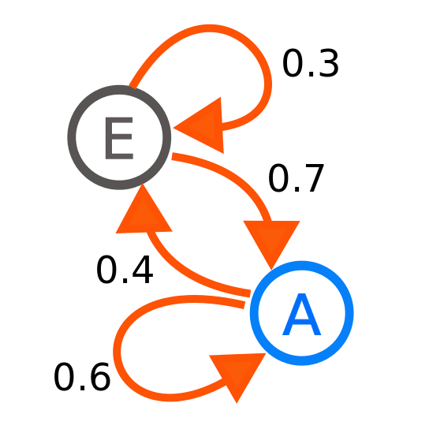
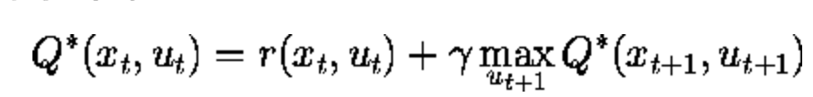
Reinforced Learning - Overview
Dataset of the best gliders in the world;
Model of similar scenarios with the Q400 aircraft;
Q-Learning with probabilistic Inferences;
Notes:
Yet to explain how this all works, a greater depth into machine learning is necessary. Very quickly, we build a dataset of the best gliders in the world, and how they respond to similar scenarios with the Q400 aircraft. Once the data is collected, we built various regression models and associations which map our simulated data accurately to the real world glide data. Thus the software itself, through q-learning, builds an accurate scenario of how to respond to certain speeds, and how to mimic what a pilot does in gliding, providing the best way to land given loss of power. Yet most interestingly, future states can be mapped based on our model. For example, in a situation of uncertain altitude and velocity, we use probabilistic inferences to allow us to extrapolate what the best mode of extraction would be for smooth gliding. This informs the pilot about the correct action and how to respond accordingly.

Slide 12
Summary
A system that knows how to glide in unknown scenarios;
Glider-like Aircraft ;
gliding flight distance Crucial time
Notes:
Thus It is important to state again what this means: that we have designed a system that behaves like a glider in loss of power scenarios, by reducing the weight and having retractable wings. In addition to predict when and how to extend the wings, we use a system that can understand the plane’s current aero-elastics and predict future lengths of retraction based on reinforced learning. By simulating a glider’s design, we have extended the flight endurance of the aircraft, and gave crucial time to the pilot to find a safe landing. As such, we think that although we cannot predict the outcomes of our own engineering, through reinforced learning and retractable wings, we can certainly prepare for it. Thank you and xiexie.

