Slide 1
RaktarPro
Warehouse Management Web Application
A customer-focused warehouse and webshop management platform built for modern commerce.
Created by: Molnár Dániel · Molnár Máté · Trubics Gorán
WAREHOUSE MANAGEMENT
WEBSHOP PLATFORM
FULL-STACK WEB APP

Slide 2
Presentation Overview
A structured walkthrough of RaktarPro — from concept to implementation.
01
02
Introduction & Problem
Project Goals
What RaktarPro is and the challenges it addresses in modern webshop design.
Customer-first experience, secure backend, reliable database, and modern frontend.
03
04
Development Process
Features, Technologies & Future
Frontend, backend, and database design decisions and architecture.
UX highlights, tech stack overview, and plans for what comes next.

Slide 3
What is RaktarPro?
A modern, customer-focused warehouse and webshop platform built with a clean three-tier architecture.
A wide selection of products
Full Webshop
Across multiple categories, featuring advanced browsing, filtering, and sorting options.
Shopping cart, favorites, order management, and complete account system.
3-Tier Stack
Adaptive UI
SQL → PHP REST API → JavaScript frontend for clean separation of concerns.
Dark/light mode toggle and fully responsive design for all screen sizes.

Slide 4
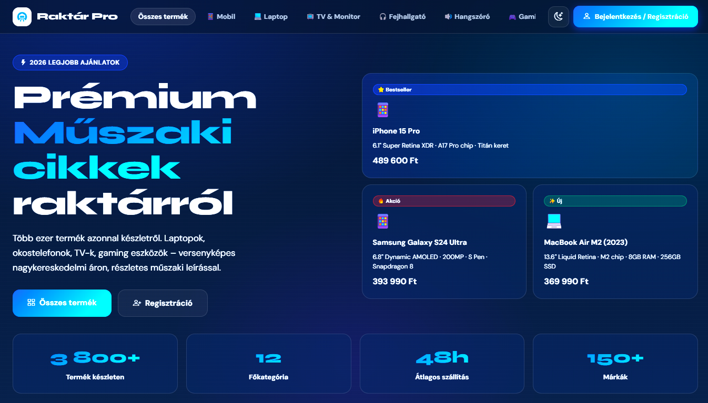
Problem Statement
Before RaktarPro
After RaktarPro
Poor UX, slow pages, lost sales
Modern UI, fast API, happier users
Common Webshop Failures
Many existing webshops suffer from the same recurring issues that drive customers away and reduce conversions.
RaktarPro was designed from the ground up to solve these problems — delivering a modern UI, fast API communication, and a strong, accessible user experience that converts visitors into customers.
Cluttered Interfaces
Slow & Outdated Design
Weak Mobile Support
Poor Search & Filtering
Confusing layouts that overwhelm users and obscure key actions.
Poor performance and visually dated experiences that erode trust.
Non-responsive layouts that break on phones and tablets.
Limited discovery tools that make finding products frustrating.

Slide 5
Project Goals
RaktarPro was built around four core pillars that guided every design and development decision.
Customer-First Experience
Secure Backend
Products, reviews, favorites, shopping cart, and a complete ordering system designed around the user.
JWT authentication, bcrypt password encryption, and fully secured API endpoints.
Reliable Database
Modern Frontend
Structured relational database with connected tables and clean, consistent data handling.
Responsive interface with dark/light mode support and smooth, intuitive navigation.

Slide 6
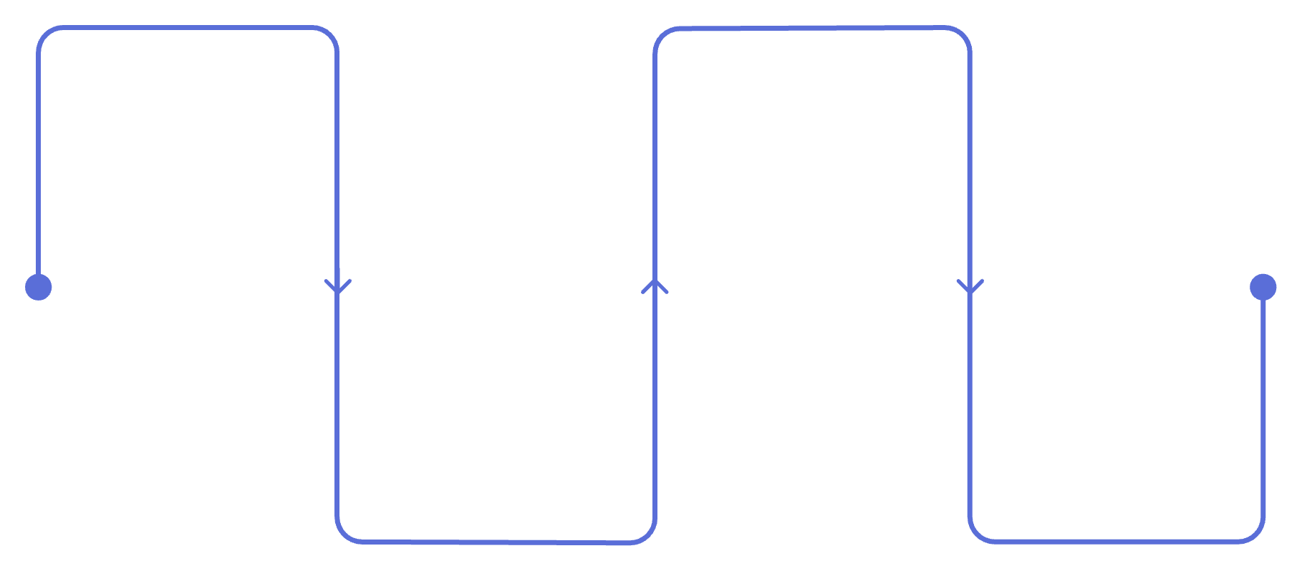
Frontend — User Interface & Experience
Browse
Add
Key Frontend Features
Discover and filter products
Add to cart or save favorites
Product browsing, filtering, and sorting
Detailed product pages with ratings and specifications
Cart and favorites stored using localStorage
Full account management system
Bootstrap 5.3 responsive design framework
Dark and light mode support
Details
Checkout
View product info and ratings
Complete purchase and manage account
The frontend delivers a seamless end-to-end shopping experience, from product discovery through to order completion.

Slide 7
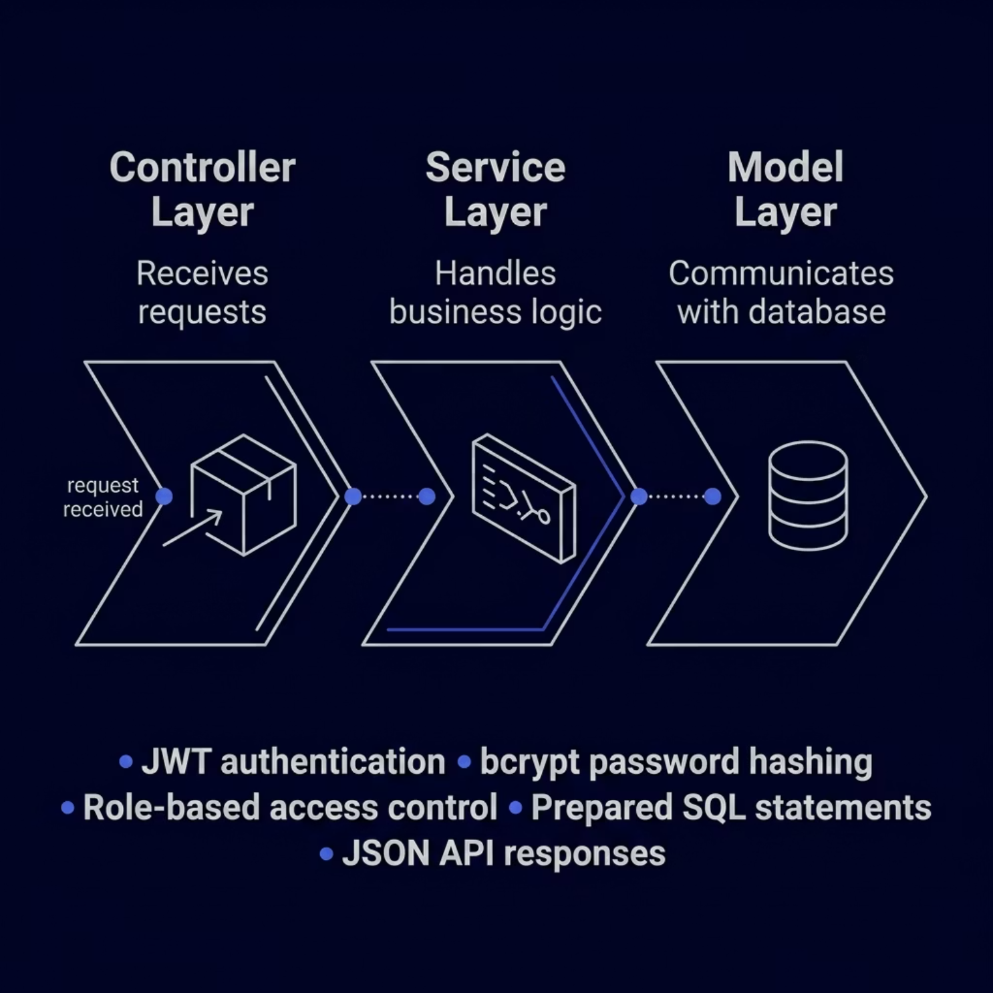

Backend — Architecture & Logic
A robust PHP backend built on the MVC pattern, ensuring clean separation of concerns and maximum security.
Architecture Highlights
MVC Pattern
JWT Authentication
Controller → Service → Model structure for clean, maintainable code.
Token-based auth protecting all sensitive routes and user data.
Security First
JSON API
bcrypt hashing, role-based access control, and prepared statements against SQL injection.
Clean, structured JSON responses for seamless frontend integration.

Slide 8
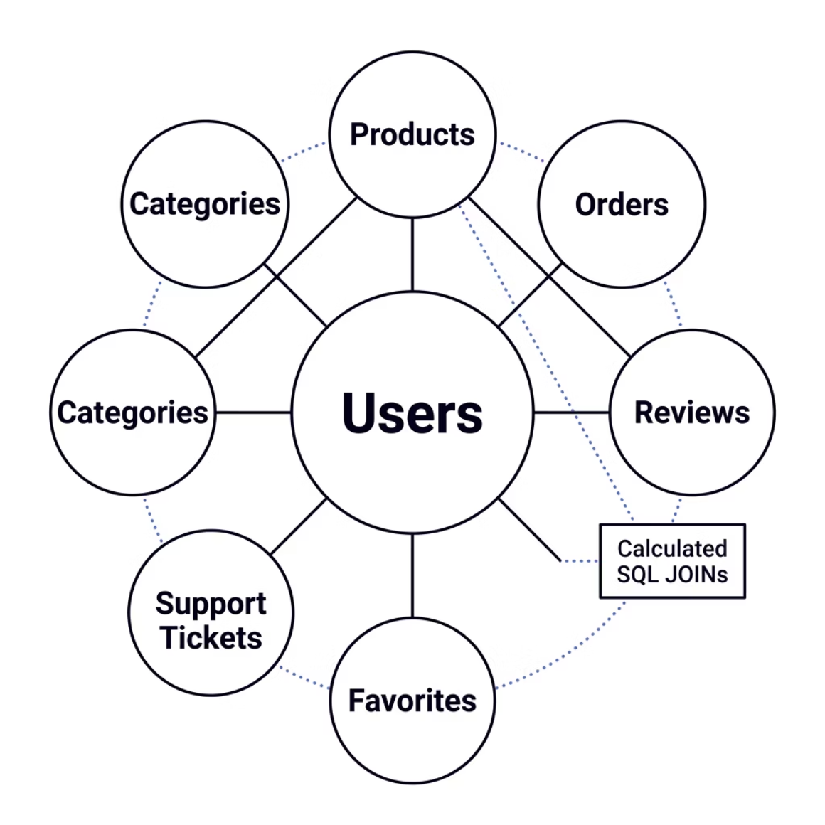

Database Design
A structured relational database system powering every feature of RaktarPro with integrity and performance.
Database Structure
Eight interconnected tables form the backbone of the RaktarPro data layer, ensuring referential integrity and efficient querying.
1
2
3
8 Connected Tables
Relational Integrity
SQL JOIN Queries
Users, products, categories, orders, reviews, favorites, and support tickets.
PRIMARY KEY and FOREIGN KEY relationships enforcing consistent, clean data.
Calculated ratings and aggregated data retrieved efficiently via

Slide 9
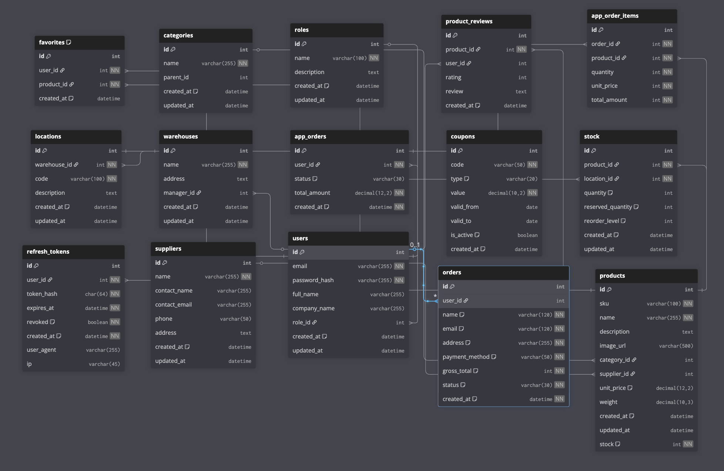

Slide 10
DEVELOPMENT
Development Process
How the RaktarPro team collaborated, tracked progress, and delivered a complete full-stack system.
1
2
Team Collaboration
Git Version Control
Structured task distribution across frontend, backend, and database roles to ensure parallel progress.
All code changes tracked via Git with consistent commit history and branch management.
3
4
Worklogs & Timeline
Continuous Testing
Development milestones documented through detailed worklogs and a structured project timeline.
Testing integrated throughout the development cycle to catch issues early and ensure stability.

Slide 11
ADMIN PANEL
Key Features & Admin Panel
RaktarPro's admin panel provides powerful tools for managing every aspect of the webshop and warehouse operations.
Product Management
Order Management
Admin Support System
Manage products, prices, stock levels, images, and categories from a unified interface.
Track customer orders, monitor revenue streams, and access detailed financial summaries.
Handle support tickets and manage customer requests efficiently through a centralized system.

Slide 12
UX & DESIGN
User Experience & Design
RaktarPro was built with the end user in mind — delivering a fast, accessible, and visually polished experience across all devices.
Fast & Responsive
Product Details & Ratings
Optimized interface that loads quickly and adapts fluidly to any screen size.
Rich product pages with ratings, stock information, and detailed descriptions.
Mobile-Friendly Design
Dark & Light Mode
Fully responsive layout ensuring a seamless experience on smartphones and tablets.
User-selectable theme support for comfortable viewing in any environment.
Navigation & Filtering
Instant Feedback
Clear, intuitive navigation with powerful filtering tools to find products instantly.
Real-time user notifications and feedback for every action taken in the system.

Slide 13
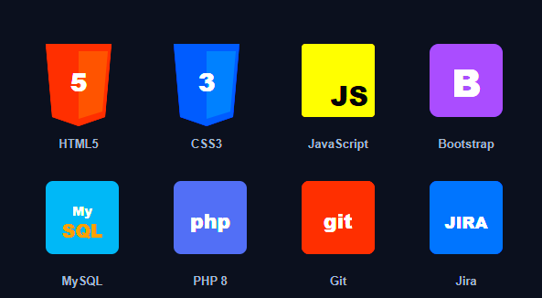
TECH STACK
Technologies Used
Frontend — Molnár Dániel
Database — Molnár Máté
HTML5, CSS3, JavaScript ES6+, Bootstrap
MySQL relational database system
Backend — Trubics Gorán
Tools
Git version control · Jira task management
PHP REST API architecture

Slide 14
WRAP-UP
Conclusion & Future Plans
RaktárPro is not just a finished project — it's a foundation. We built a complete full-stack webshop where data flows from SQL through a PHP REST API all the way to the JavaScript frontend rendered with Bootstrap. Every layer communicates, errors are handled, and access is secured. The features you've seen are working and deployed — and the three plans above are where we'd take it next.

Slide 15
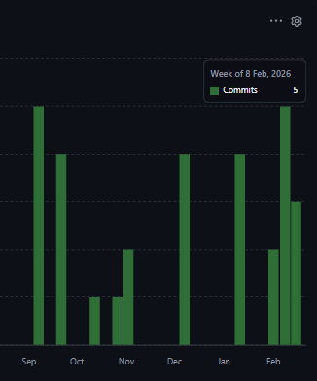
Worklogs and commits

Slide 16
Thank You for Your Attention!
RaktarPro
A complete full-stack warehouse and webshop system — built with passion, precision, and teamwork.
Questions?
We'd love to hear your thoughts and answer any questions about RaktarPro's architecture, features, or future roadmap.
Frontend
Database
Backend
Molnár Dániel
Molnár Máté
Trubics Gorán

