Slide 1
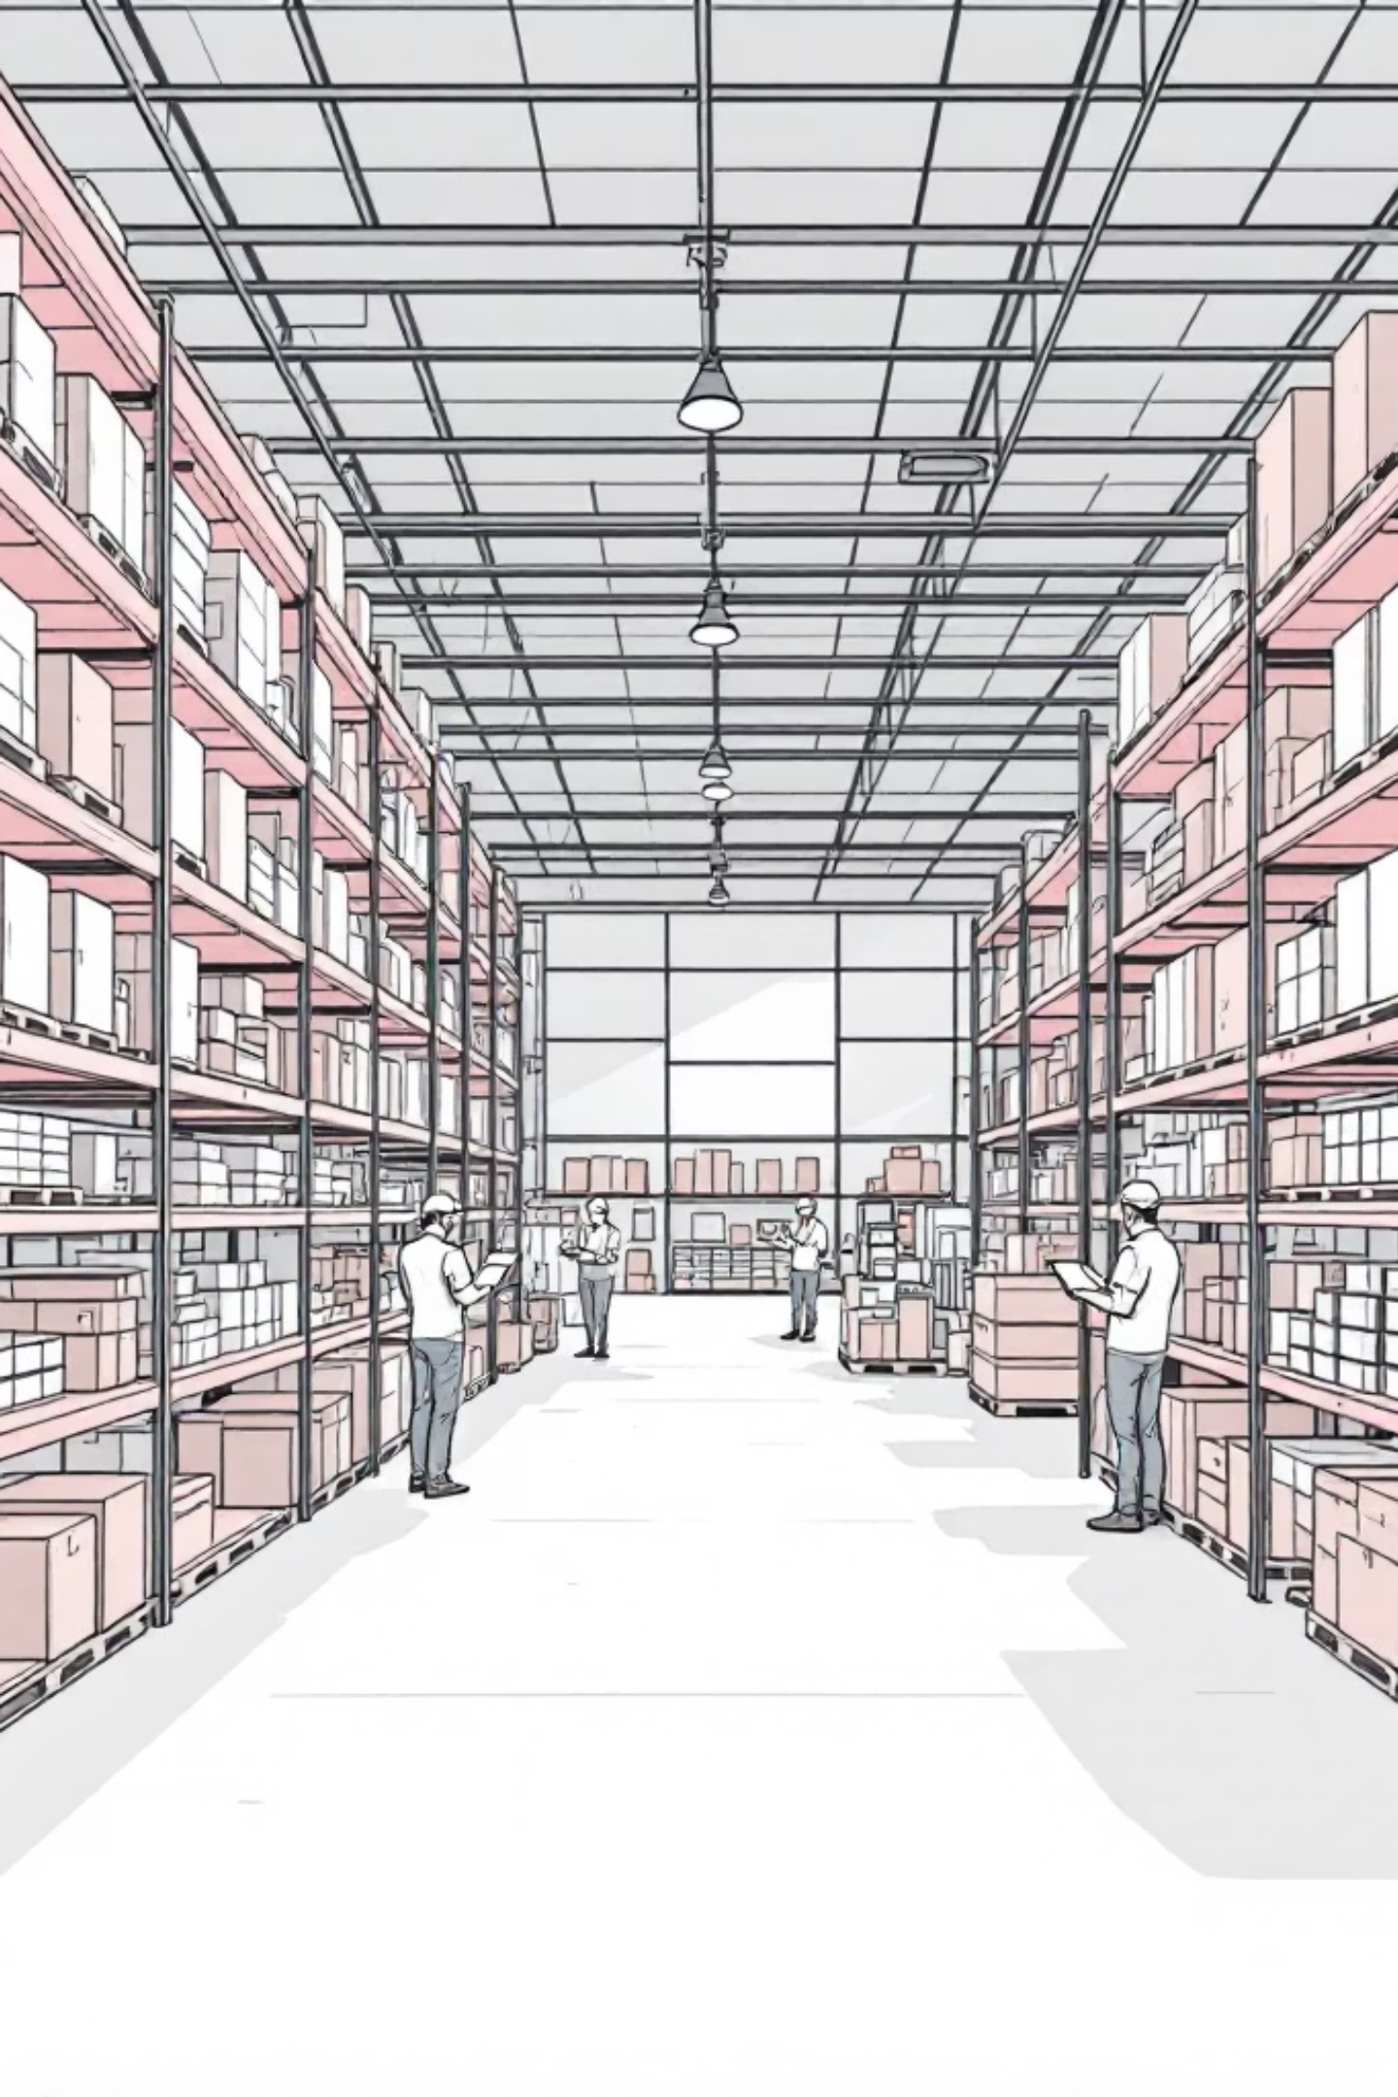

RaktarPro — Warehouse Management Web App
Made by -
Molnár Dániel
Molnár Máté
Trubics Gorán
Notes:
Gorán
Today we would like to present our project called RaktarPro.
This project is a customer-focused warehouse and online store system.
Our goal was to create a modern platform where warehouse management and customer service work together efficiently.
In this presentation, we will show the problem, our solution, the system architecture, and the main features.

Slide 2
Presentation overview
1 — Introduction
7 — Features
What RaktarPro is and who it serves.
Admin panel, inventory controls, UX highlights.
2 — Problem
8 — UX
Pain points in current warehouse operations.
Design approach and accessibility notes.
3 — Project goals
9 — Roadmap
Project objectives and success criteria.
Planned improvements and scale considerations.
4–6 — Development process
10 — Conclusion
Frontend, backend, database design.
Key takeaways and next steps.
Notes:
Gorán
First, we will introduce what RaktarPro is and who it is designed for.
Then, we will explain the main problem that our system solves.
After that, we will present our project goals and the development process, including frontend, backend, and database.
Finally, we will show the key features, user experience, future plans, and conclude the presentation.

Slide 3
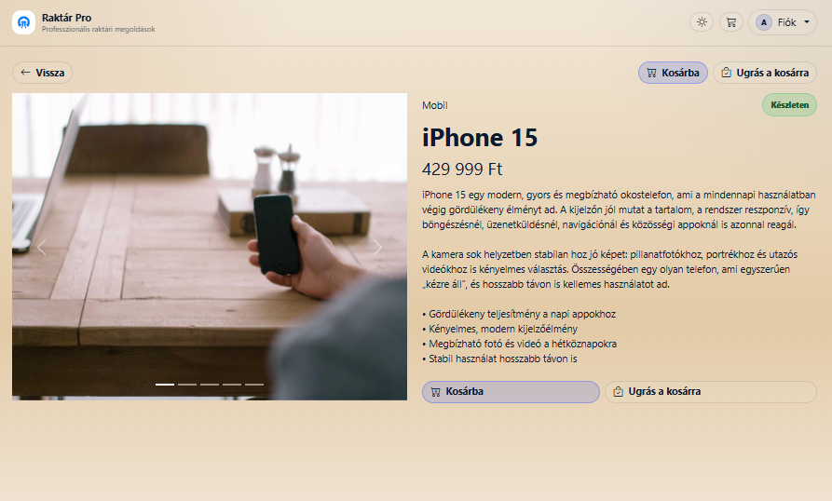
What is RaktárPro?
What is RaktárPro?
Customer-Focused Warehouse and Online Store System
• Modern warehouse and product management platform • Wide range of products with competitive pricing • Designed to serve customer needs first • Fast, reliable, and scalable system
Notes:
Dani
RaktarPro is a modern warehouse and online store management system.
Our main philosophy is customer-first.
We aim to provide as many products as possible while keeping prices competitive.
The system ensures fast product access, reliable stock management, and a smooth customer experience.

Slide 4


Problem Statement
Traditional warehouse systems often:
• Focus on internal operations instead of customer needs • Have limited product visibility • Lack fast and modern interfaces • Do not provide optimized pricing
This leads to slower service and reduced customer satisfaction.
RaktarPro targets rapid improvements in accuracy, visibility and admin efficiency.
Notes:
Máté
"One of the main problems in online shopping is that users need to search many websites to find the best price.
This process takes time and is inefficient.
Our goal was to create a system that simplifies this process and provides better results."

Slide 5
Project Goals
Customer-First Service
Secure and Scalable Backend
Reliable Database Structure
Modern & Responsive Frontend
Provide wide product selection with competitive prices.
REST API that retrieves product data, handles users, and connects the system to the database.
MySQL database storing products, prices, users, and ensuring data integrity and consistency.
User-friendly interface with dark/light mode, fast product search, and price display.
Notes:
Máté
"We developed the system in three main stages.
First, we designed the database structure, which serves as the foundation of the system.
Then the backend was developed to handle logic and communication.
Finally, the frontend was built to allow users to interact with the system."

Slide 6
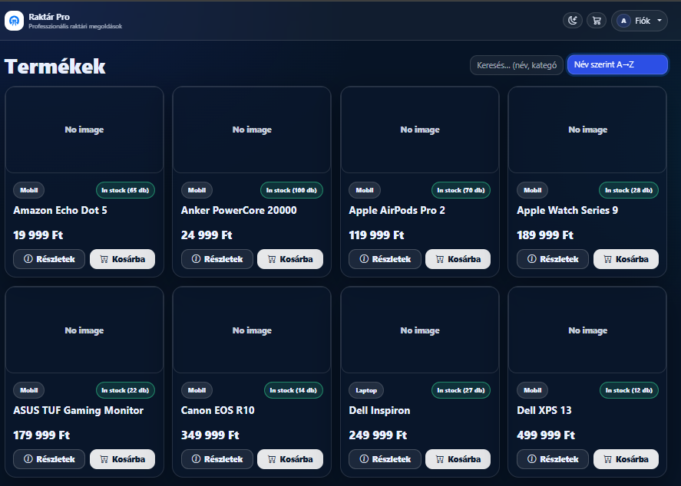
Frontend — Responsibilities
• Product browsing and search • Product details display • Shopping cart functionality • Customer-friendly interface • Responsive design
Notes:
Dani
"This is the frontend part of the system.
It allows users to browse products, view prices, and interact with the application.
We focused on creating a responsive and user-friendly interface.„
Frontend connects the backend trhu restapi, the frontend send a request and the backend send the data back using a json formatum

Slide 7
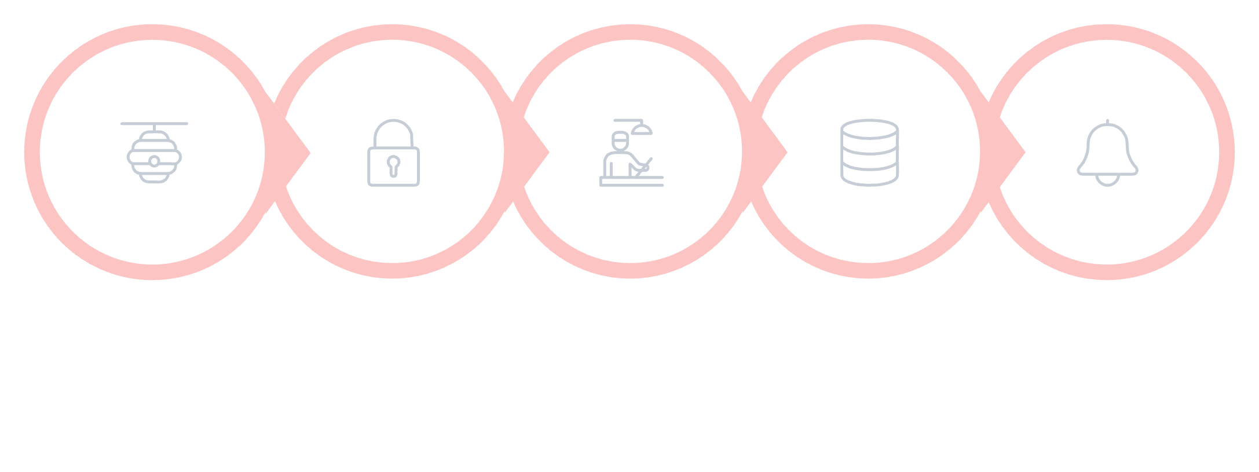





Backend — Architecture & Logic
• Retrieving product and price information • Handling user authentication • Connecting frontend and database • Returning optimized results
• Handles product requests • Processes user authentication • Manages warehouse data • Connects frontend and database • Ensures secure communication
API Request Database Transaction Product request from frontend Retrieve product and price data
Authentication Response User login and session handling Return best price to frontend
Business Logic Price comparison and product processing
Notes:
Gorán
The backend is the system core.
It handles product data, users, and system logic.
It ensures smooth communication between all system parts.
(mondj el meg par dolgot a diarol melle, es hogy milyen sorrendbe csinaltad)

Slide 8
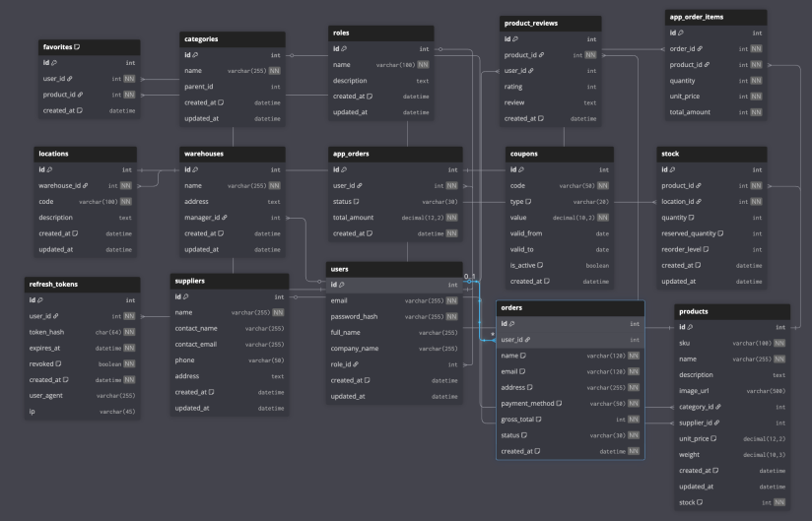
Database Design
Structured and Easy-to-Understand Relational Database
• Designed for clarity and scalability
• Stores products, users, prices, and orders
• Uses primary and foreign key relationships
• Ensures reliable and consistent data
Notes:
Máté
I use SQL to store and manage data in a database.
Columns show what kind of data I store, for example name, price, or date.
Rows show one piece of data, like one product or one user.
I connect tables with keys. A primary key identifies one record. A foreign key connects different tables.
With stored procedure, I can create, insert, select, update, and delete data

Slide 9
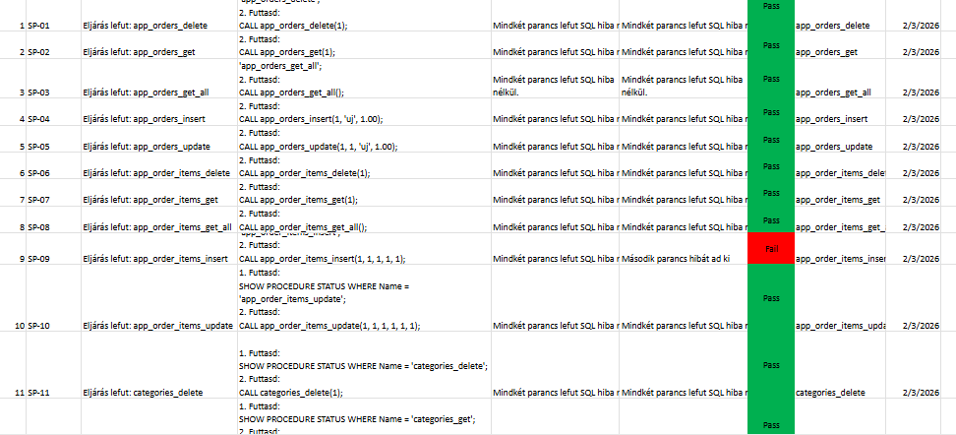
Tests
Notes:
Gorán

Slide 10
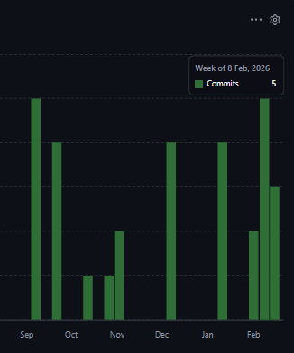
Worklogs and commits

Slide 11
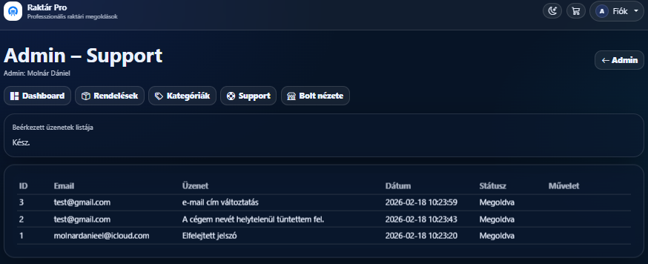
Key Features & Admin Panel
Product & Price Management
Order & System
Management
Strong Admin
Support
Admins can add, edit, and update products and prices to ensure accurate and optimal offers for users.
Admins can monitor orders, manage product data, and ensure smooth system operation.
Fast and precise admin assistance ensures smooth operation and improves the overall purchasing experience.
Notes:
Dani
"The admin panel allows administrators to manage products and system data.
A very important feature is strong admin support.
Administrators can quickly respond and provide accurate assistance to improve the user experience."

Slide 12
Tech Usagage
Trubics Gorán: Backend
RestAPI architecture
Handles business logic and data communication
Molnár Dániel : Frontend
HTML, CSS, JavaScript for structure, design and functionality
Bootstrap for responsive design
Molnár Máté: Database
MySQL relational database
Stores products, users, and orders
Git for version control
Jira for task management

Slide 13

User Experience & Design
• Fast and intuitive product browsing
• Clear product information and stock visibility
• Responsive design for all devices
• Modern interface with glass-style interface, dark and light mode
Navigation
Feedback
Future UX
Intuitive categories, fast search, SKU-first lookup.
Real-time stock indicators, toasts for actions, clear error states.
Mobile app, role-aware dashboards and custom reports.
Notes:
Máté
When designing the system, our main focus was the customer experience.
We wanted users to easily find products, view important information, and navigate without confusion.
The interface is fast, clear, and intuitive.
Customers can see product availability, details, and make decisions quickly.

Slide 14
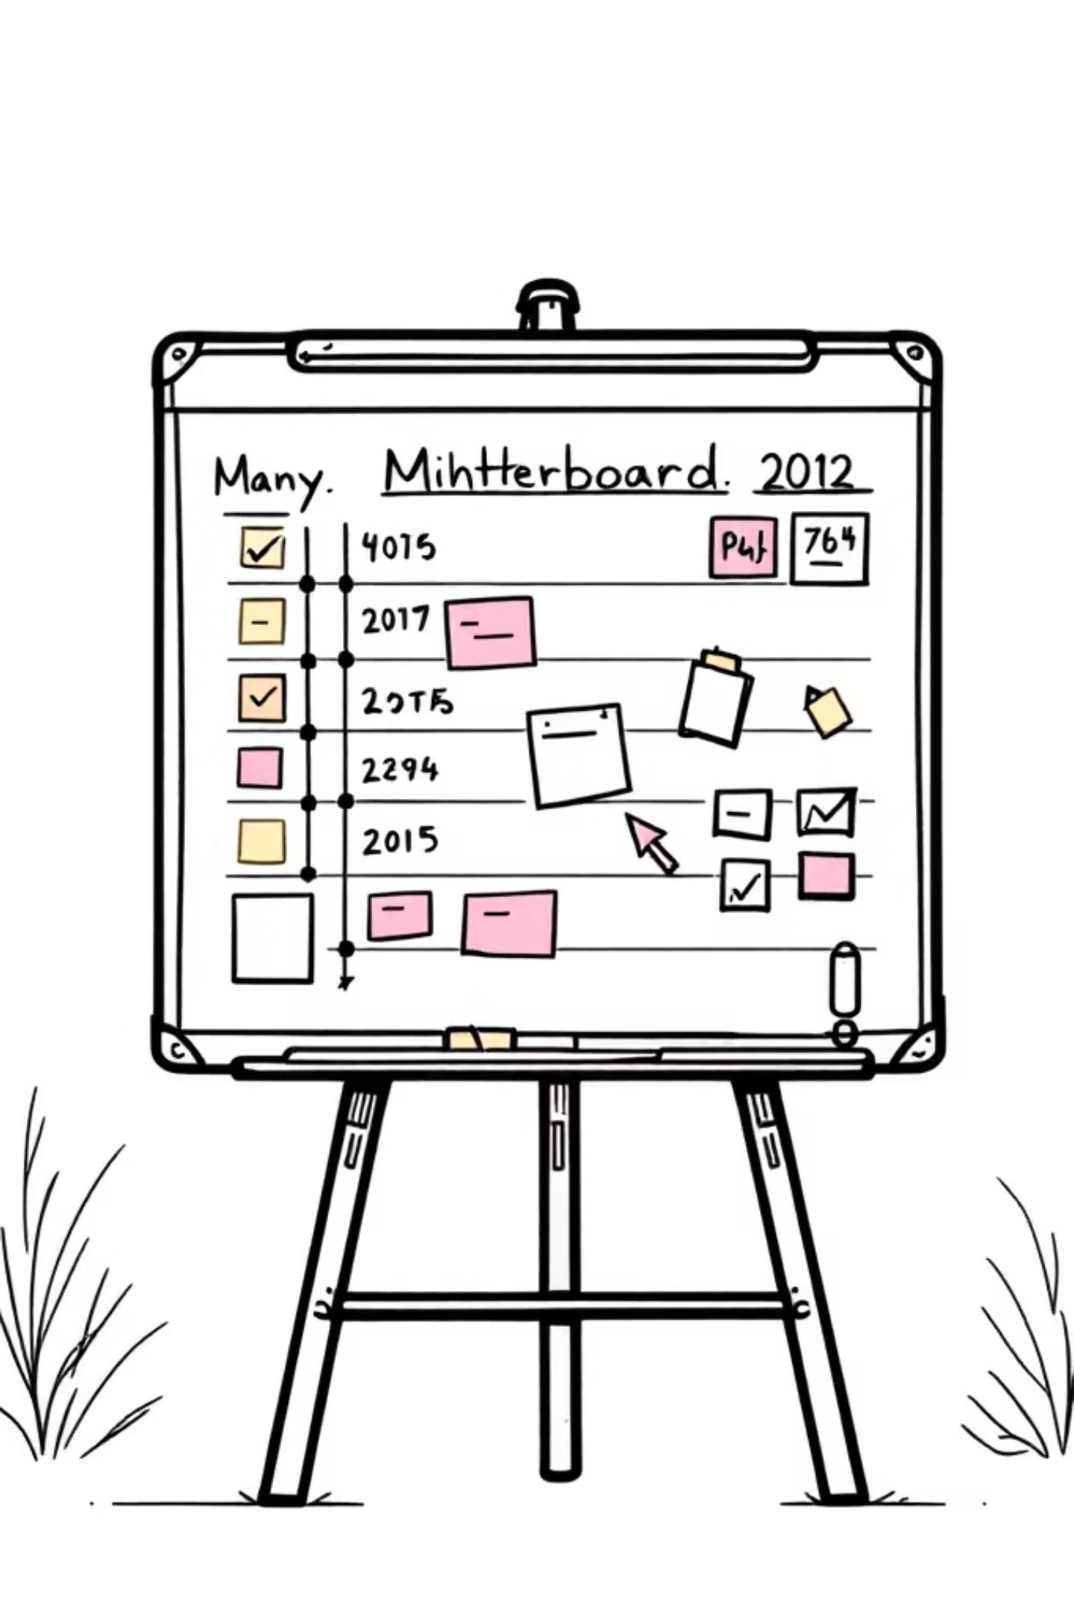
Conclusion & Next Steps
RaktarPro is a modern customer-focused warehouse and online store system.
It provides:
• Reliable warehouse management • Wide product selection • Competitive pricing • Modern user experience
Notes:
Dani
"In conclusion, we developed a full-stack price comparison system.
It includes a structured database, secure backend, and modern frontend.
In the future, we plan to expand the system and improve its functionality.
Thank you for your attention."

Slide 15
Thank you for your attention!
RaktárPro

