Slide 1
Study of Botnet spreading in a Network.
Spreading of zeuS Botnet in a network of Windows Operating system.

Slide 2
What is a Botnet?
Derived from “robot” and “network”.
Cybercriminal Performs the role of Botmaster.
Uses trojan virus to breach the security of the computers.
Connect the computers into a malicious network.
Each computer acts as a Bot.
It is also known as zombie army of computers.

Slide 3
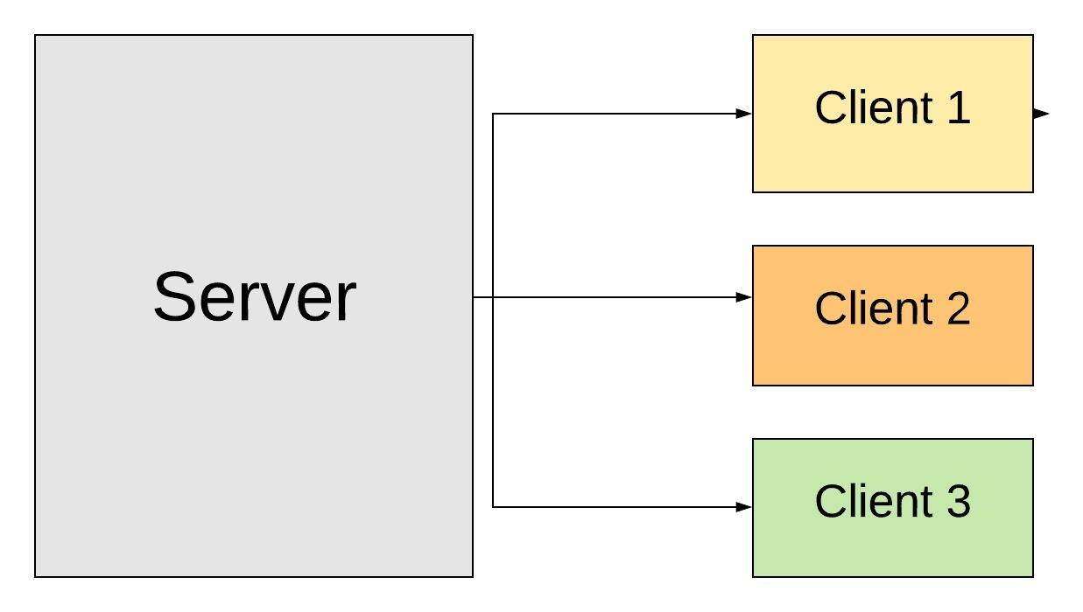
Botnet Structure
Client - Server Model

Slide 4
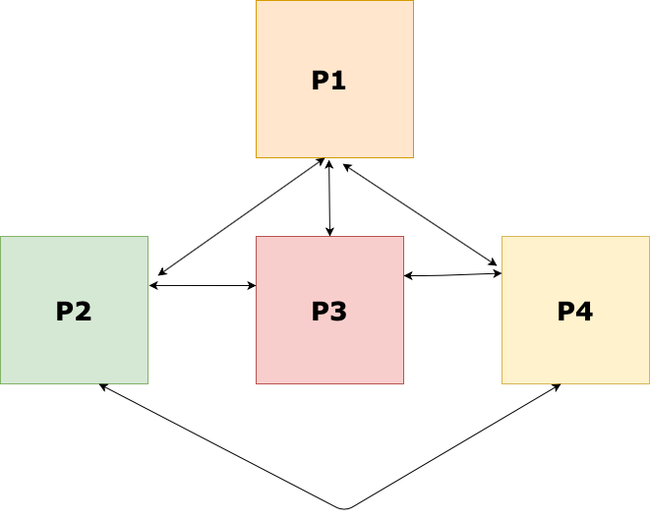
Botnet Structure
2. Peer-to-Peer

Slide 5
References
Sanghamitra De, Mridul Sankar Barik, and Indrajit Banerjee. 2019. A Percolation-based Recovery Mechanism for Bot Infected P2P Cloud. In International Conference on Distributed Computing and Networking (ICDCN ’19), January 4–7, 2019, Bangalore, India. ACM, New York, NY, USA, 6 pages. https://doi.org/10.1145/3288599.3295597
Qian Chen, and Robert A. Bridges. 2017. Automated Behavioral Analysis of Malware. A Case Study of WannaCry Ransomware.
@misc{chen2017automated, title={Automated Behavioral Analysis of Malware A Case Study of WannaCry Ransomware}, author={Qian Chen and Robert A. Bridges}, year={2017}, eprint={1709.08753}, archivePrefix={arXiv}, primaryClass={cs.CR}}

Slide 6
Problem Definition
Recovery of nodes in a P2P Cloud from botnet attack by running recovery procedures in parallel (to achieve maximum coverage) in separate nodes which can be reached from a given node, using the concept of percolation centrality.

Slide 7
Algorithm Implemented
Algorithm: Recovery procedure to run in each node to recover the node or RECOVERY_PROCEDURE(v).
Input: Node under bot attack represented by v
Output: Node recovered from bot attack after running procedure RECOVERY_PROCEDURE.
Procedure
recover(v)
if v.isAffected == true:
v.isAffected=false
v.loadStableSystemImage()
for u in v.adjacent:
recover(u)

Slide 8
Actual Network Layout
Virtual Node
192.168.54.4
node5
192.168.58.8
192.168.55.5
node4
node8
Virtual Node
Virtual Node
192.168.54.1
192.168.55.1
192.168.58.1
192.168.52.3
192.168.56.6.
192.168.52.1
IP
TABLE
192.168.56.1
node3
node6
Virtual Node
192.168.52.2
Host Machine
192.168.56.7
Virtual Node
node2
Physical Machine
node7
Virtual Node
Virtual Node

Slide 9
Conceptual Network layout
node6
192.168.56.6
node8
192.168.58.8
node7
192.168.56.7
node2
node3
192.168.52.2
192.168.52.3
node5
192.168.55.5
node4
192.168.54.4

Slide 10
Recovery Starts From Node4 having lower Degree (Percolation Centrality)
node6
192.168.56.6
node8
192.168.58.8
node7
192.168.56.7
node2
node3
192.168.52.2
192.168.52.3
node5
192.168.55.5
0ms
node4
192.168.54.4

Slide 11
Recovery Starts From Node4 having lower Degree (Percolation Centrality)
node6
192.168.56.6
node8
192.168.58.8
node7
192.168.56.7
node2
node3
192.168.52.2
192.168.52.3
24350ms
node5
192.168.55.5
0ms
node4
192.168.54.4

Slide 12
Recovery Starts From Node4 having lower Degree (Percolation Centrality)
node6
192.168.56.6
node8
192.168.58.8
node7
192.168.56.7
25000ms
node2
node3
192.168.52.2
192.168.52.3
24350ms
node5
192.168.55.5
0ms
node4
192.168.54.4

Slide 13
Recovery Starts From Node4 having lower Degree (Percolation Centrality)
node6
192.168.56.6
node8
192.168.58.8
node7
192.168.56.7
25000ms
30620ms
node2
node3
192.168.52.2
192.168.52.3
24350ms
node5
192.168.55.5
0ms
node4
192.168.54.4

Slide 14
Recovery Starts From Node4 having lower Degree (Percolation Centrality)
node6
71130ms
192.168.56.6
node8
192.168.58.8
node7
192.168.56.7
25000ms
30620ms
node2
node3
192.168.52.2
192.168.52.3
24350ms
node5
192.168.55.5
0ms
node4
192.168.54.4

Slide 15
Recovery Starts From Node4 having lower Degree (Percolation Centrality)
node6
100530ms
71130ms
192.168.56.6
node8
192.168.58.8
node7
192.168.56.7
25000ms
30620ms
node2
node3
192.168.52.2
192.168.52.3
24350ms
node5
192.168.55.5
0ms
node4
192.168.54.4

Slide 16
Recovery Starts From Node4 having lower Degree (Percolation Centrality)
node6
100530ms
71130ms
192.168.56.6
node8
192.168.58.8
node7
192.168.56.7
106020ms
25000ms
30620ms
node2
node3
192.168.52.2
192.168.52.3
24350ms
node5
192.168.55.5
0ms
node4
192.168.54.4

Slide 17
2. Recovery starts From Node 2 having higher Degree (Percolation Centrality)
node6
192.168.56.6
node8
192.168.58.8
node7
192.168.56.7
0 ms
node2
node3
192.168.52.2
192.168.52.3
node5
192.168.55.5
node4
192.168.54.4

Slide 18
node6
192.168.56.6
node8
192.168.58.8
node7
192.168.56.7
0ms
node2
node3
192.168.52.2
192.168.52.3
24250 ms
node5
192.168.55.5
node4
192.168.54.4

Slide 19
node6
192.168.56.6
node8
192.168.58.8
node7
192.168.56.7
0 ms
30310 ms
node2
node3
192.168.52.2
192.168.52.3
24250 ms
node5
192.168.55.5
node4
192.168.54.4

Slide 20
node6
192.168.56.6
node8
192.168.58.8
node7
192.168.56.7
0 ms
30310 ms
node2
node3
192.168.52.2
192.168.52.3
24250 ms
node5
192.168.55.5
36070 ms
node4
192.168.54.4

Slide 21
node6
47220 ms
192.168.56.6
node8
192.168.58.8
node7
192.168.56.7
0 ms
30310 ms
node2
node3
192.168.52.2
192.168.52.3
24250 ms
node5
192.168.55.5
36070 ms
node4
192.168.54.4

Slide 22
node6
192.168.56.6
77190 ms
47220 ms
node8
192.168.58.8
node7
192.168.56.7
0 ms
30310 ms
node2
node3
192.168.52.2
192.168.52.3
24250 ms
node5
192.168.55.5
36070 ms
node4
192.168.54.4

Slide 23
node6
192.168.56.6
77190 ms
47220 ms
node8
192.168.58.8
node7
82630 ms
192.168.56.7
0 ms
30310 ms
node2
node3
192.168.52.2
192.168.52.3
24250 ms
node5
192.168.55.5
36070 ms
node4
192.168.54.4

Slide 25
How recovery algorithm works
Run initiate.bat (background process) on all systems except the starting node. It will keep on checking the receipt status of Desert.jpg (used to emulate the recovery file ) in the default ftp folder.
If link is up
ping.bat
pingcmds.bat
checklink.bat
ftp.bat
ping.bat
Read
Check if link is up or not
Send the recovery image through ftp
ip.txt
log.txt
List of IP’s of all nodes.
Store the timestamp when file is received through ftp

Slide 26
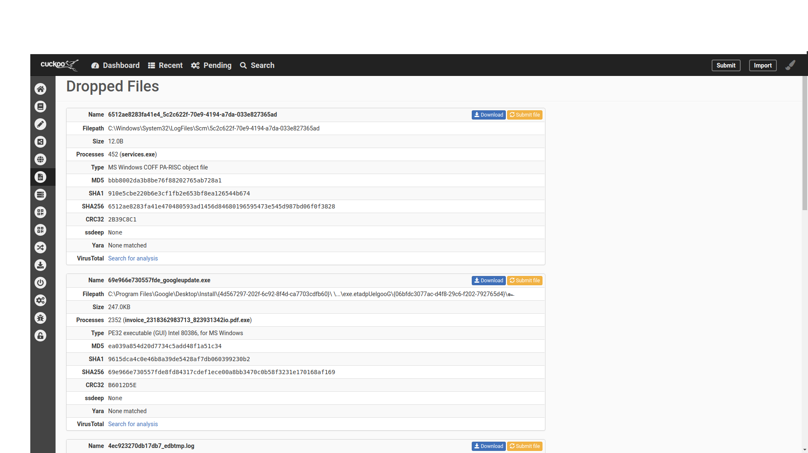
These are the downloaded files which are referred to as Dropped files. These files are downloaded automatically from random servers and may be malicious.

Slide 27
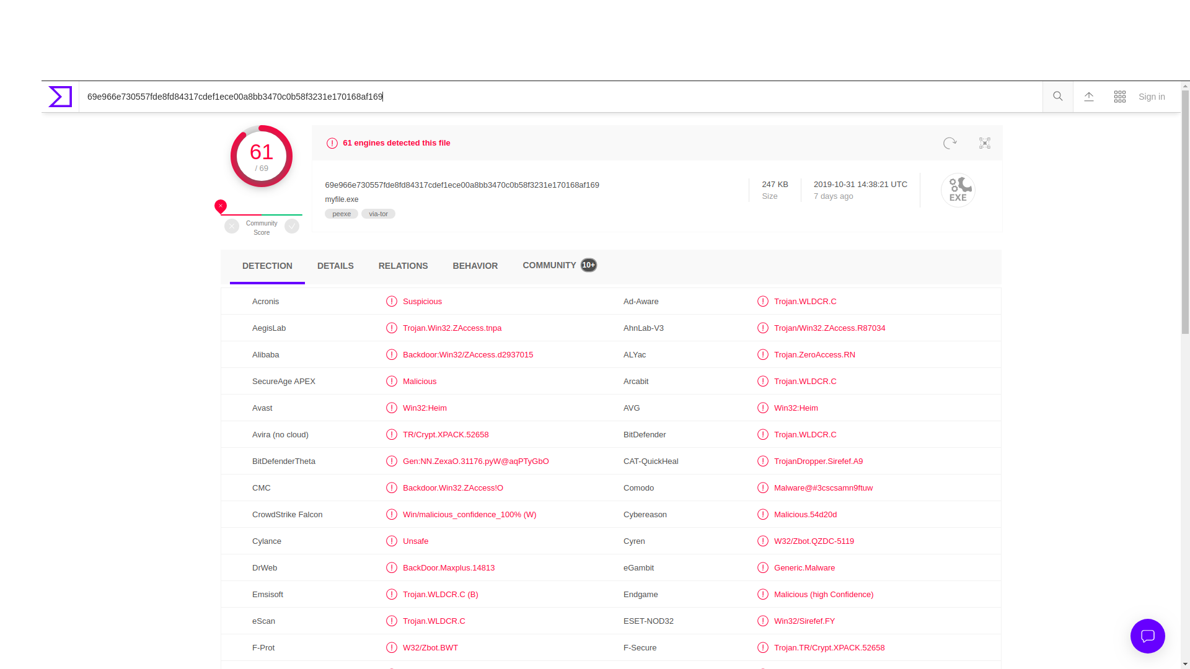
2. One of the Dropped files, when scanned using an online tool for malicious activity, was found to contain Trojans and Adwares.

Slide 28
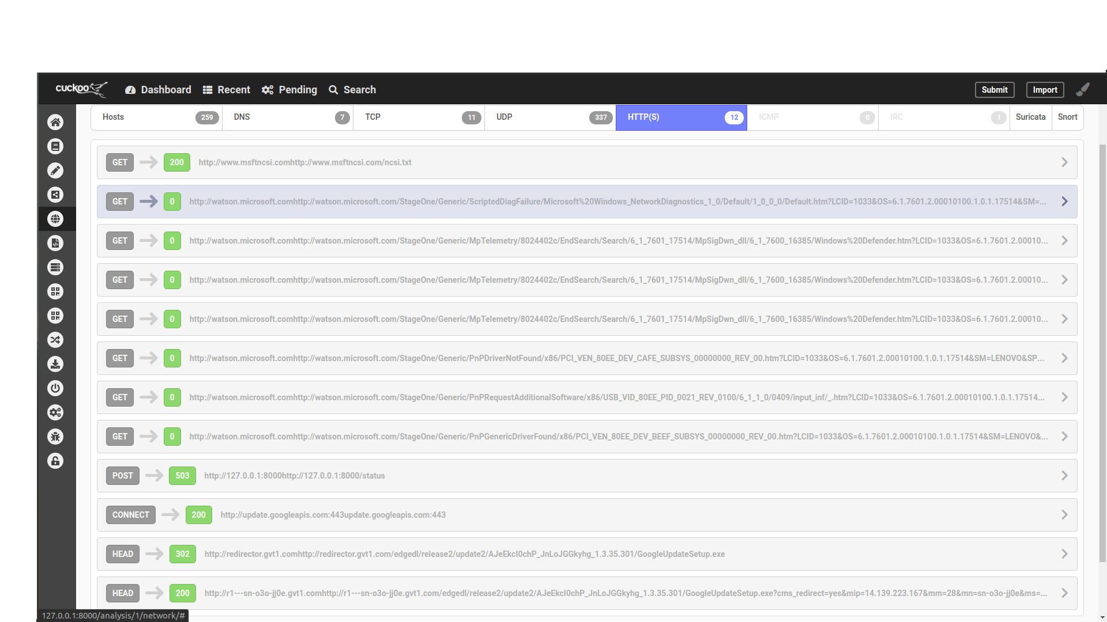
3. Over here we can see that the Botnet sends get and post requests to a plethora of IP addresses. These requests may or may not be responded with malicious files.

Slide 29
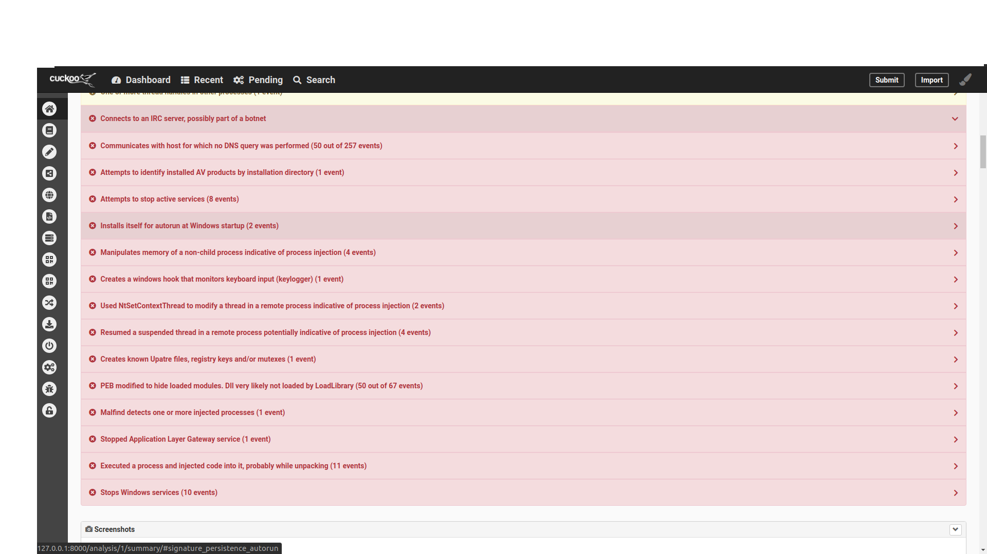
4. Collection of malicious activities that were done by the Botnet.
Includes attempts to stop Windows Services like Firewall and installing a keylogger.

Slide 30
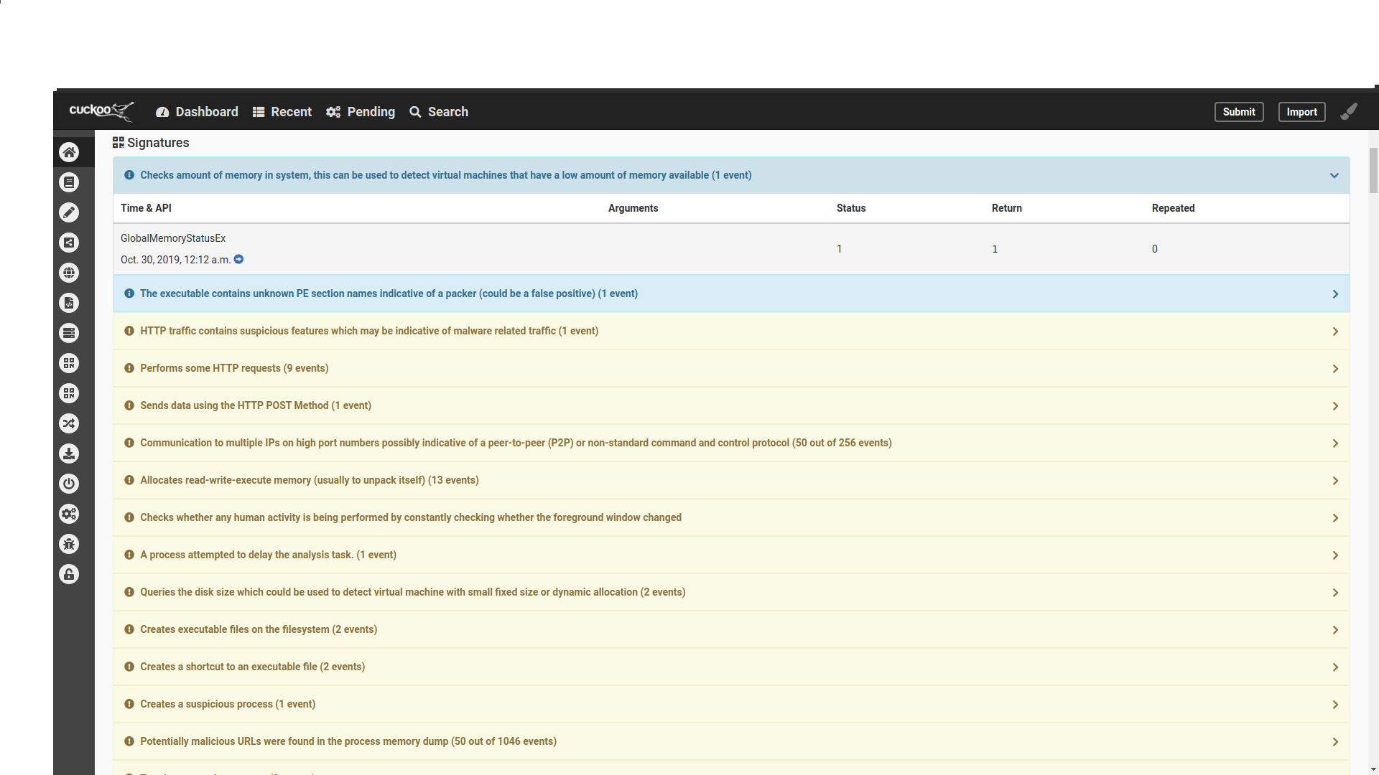
5. This shows the list of host and server to which the bots are trying to connect with download files which could contain malware to breach the system data and Information.

Slide 31
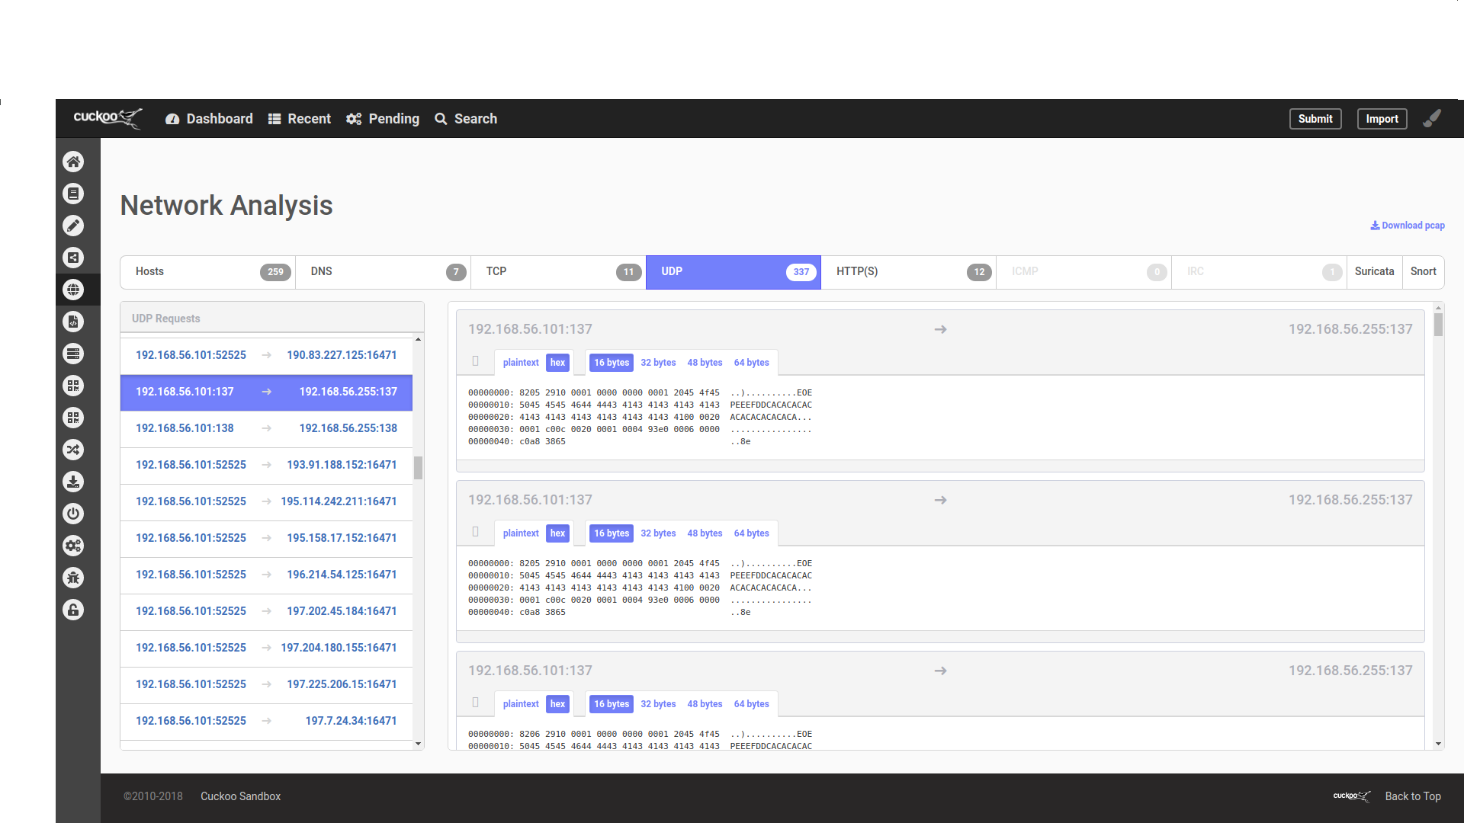
6. This shows the Network Analysis of User Datagram Protocol requests trying to establish connection with different servers and hosts.

Slide 32
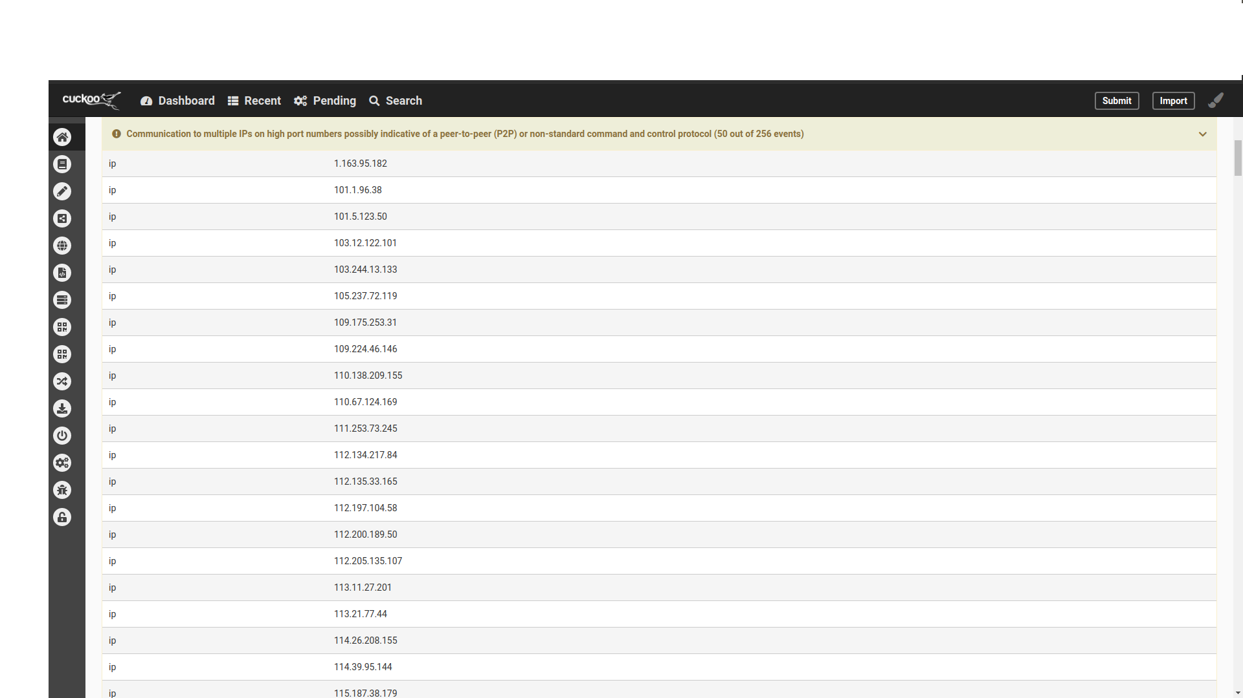
7. This is the list of IP addresses to which it is trying to connect.

Slide 33
Thank you

