Slide 1
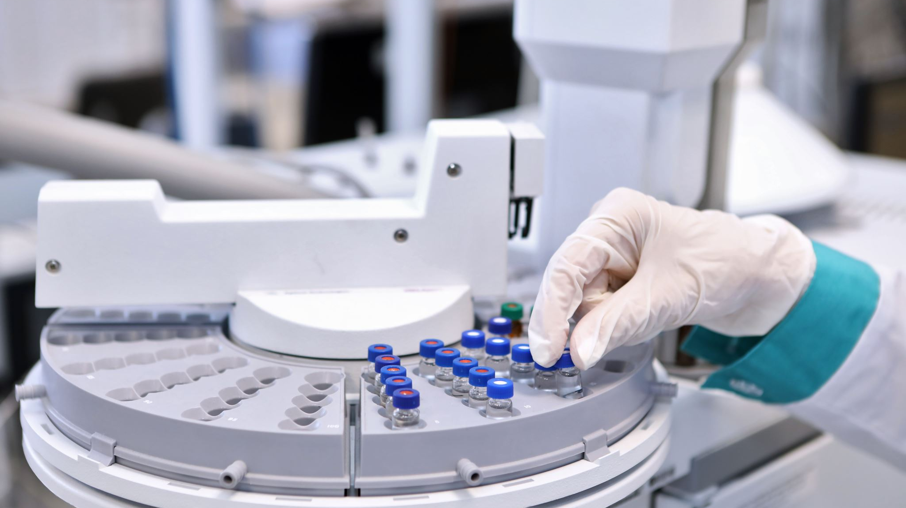
Predicting the Screening Colonoscopy Numbers in Ireland using Machine Learning
Rakesh Kumar Muraleedharan
Supervisor : Sam Weiss
CCT College Dublin

Slide 2
Objectives
To predict the screening colonoscopy numbers
To Identify the variations in colonoscopies for each gender and age groups, Hypothesis Testing to validate the primary research outcomes
To Identify the features that influence the colonoscopy predictions, using primary research, data analysis, co-relation studies
To predict the colonoscopy numbers by building and evaluating machine learning models and identify the best model for predictions.

Slide 3
High Level Design
Hypothesis Testing
Data Extraction
Exploratory Data Analysis
Primary Research Depth Interview
Machine Learning Model building and evaluation
Conclusions and Improvements
Data Preparation
Literature Review

Slide 4
Sampling Strategy:
Non – probabilistic (Judgemental ) Sampling – While sampling the depth interview participants.
Proablistic Stratified Sampling – Two populations and the samples selected from the population for statistical analysis.

Slide 5
Research Understanding
Consent
Depth Interviews
Identify the Participants
Information Leaflet
Interview
Interview Questionnaire
Literature Review
Analysis
Data Understanding
The participants identified are all over 18, consents are obtained to record and use the transcribe in the research
1. Primary Research – Depth Interviews , involves participant sampling , get their consents, Information leaflet, Questionnaire, Interview, documentation and analysis.
2. The questions selected focused on understanding the features impacting the colonoscopies , variations in census numbers and the screening register.
3.The data extraction and preparation are done based on the analysis done on the primary research outcomes.
4. Literature review done, thematic based approached , eight themes ranging from clinical understanding, topics on machine learning algorithms are reviewed in detail to be used further in the research.
5.Data Understanding once the data is extracted .

Slide 6
Data Extraction
Ethical Consideration – Select only required fields and avoid personal data of the public for the analysis
Bowel Screen Data (SQL Server)
Extract data using SQL
Identify the Data/feature Requirements
Research Understanding
Census 2022 (CSO website)
1. Three different sampling strategies will be used as part of the research, this includes probabilistic (simple and stratified) sampling and non-probabilistic sampling (judgemental) to analyse and achieve the objectives as well as to support the research and get inputs on the factors influencing the research.
2. The data is from the clinical database and the issue with regards to the bias are taken care. The samples are selected from the population based on the literature outcomes and the primary research interviews.

Slide 7
Data Preparation
Data Cleansing
Aggregated Data
Exploratory Data Analysis
Machine Learning Build and Evaluate
Data Collection
Time Series Data
Feature Engineering
Iterative process to achieve better results.
Iterative process, involving data cleansing, aggregation, feature engineering.

Slide 8
Data Analysis
Exploratory Data Analysis
Data Preparation
Descriptive Statistics
Visualisation
Hypothesis Testing
Exploratory Data Analysis involves checking for data completeness , NULL checks , datatype checks.
Detailed analysis targeting to achieve the objectives to understand the impact of features in colonoscopy predictions.
Hypothesis testing to identify if the male population has higher participation in colonoscopy compared to female.

Slide 9
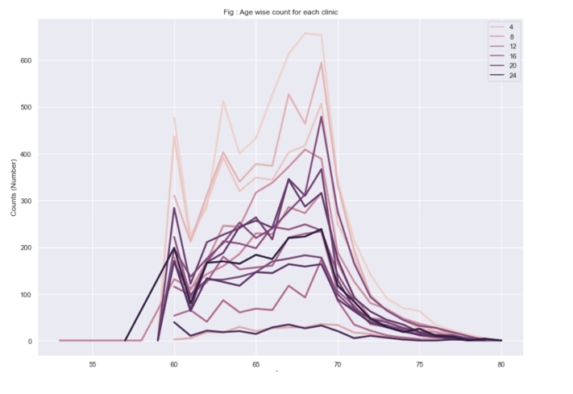
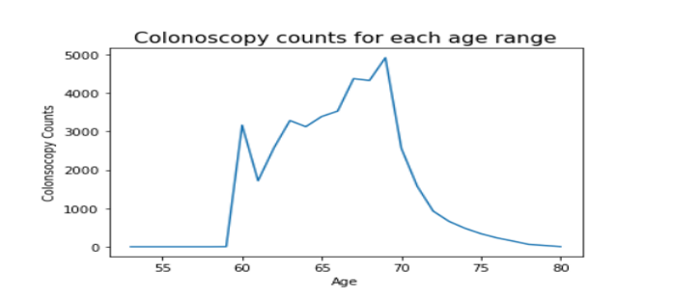
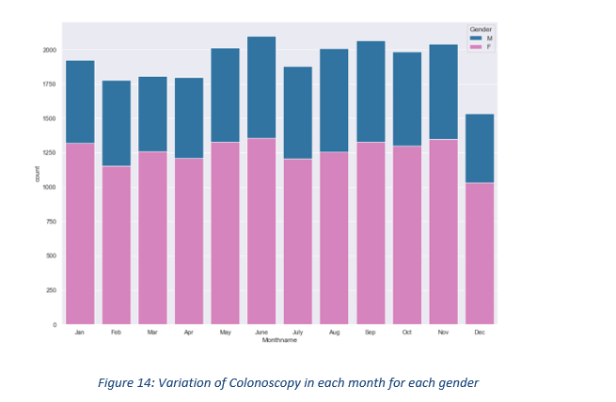
Data Analysis(contd.)
Separated aggregated datasets created using PYTHON.
Made use of seaborne library due to its simplicity, iterative until the required visualisation is achieved
Results:
The colonoscopy counts had variations in the age, and age range 65-70 showed the highest total colonoscopy counts for all years.
Monthly variations were analysed and there are no significance variations across the months.
Few clinics showed very less colonoscopy counts compared to others.

Slide 10
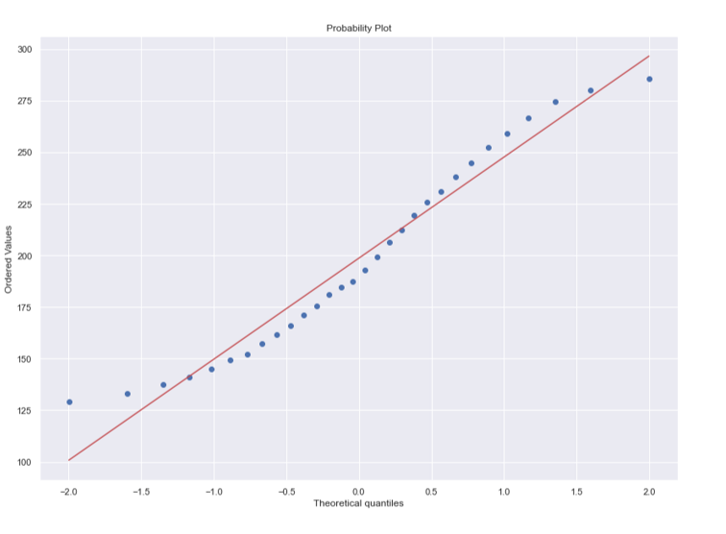
Data Analysis(contd.)
Hypothesis Testing:
Scipy Stats library is used.
95% Confidence Interval is used for testing.
ANOVA test is used to compare the male and female populations after confirming the normal distributions using probability charts or Shapiro tests.
Results: At 95% Confidence Interval, male colonoscopy number for the entire eligible population is expected to be between 270 (maximum value in the sample) and 230 (average in the sample). ANOVA tests were done, and it suggested that at 95% confidence interval male colonoscopies will be higher than the women

Slide 11
Time Series Analysis
Based on Trend/Seasonality check no variations observed, hence selected ARMA as traditional model.
Different datasets are created for time series to compare how the model evaluates for monthly/quarterly/weekly/daily datasets.
Train and test data are selected iteratively to get better results.
Regression models are developed with Hyper tuning.
Check for Trend / Seasonality
Create Datasets (Weekly/Monthly/Quarterly/Daily)
Traditional Models (Example: ARMA)
Hyper-Parameter Tuning
Train/ Test Data
Evaluate Models
Regression Models)
Data Preparation

Slide 12
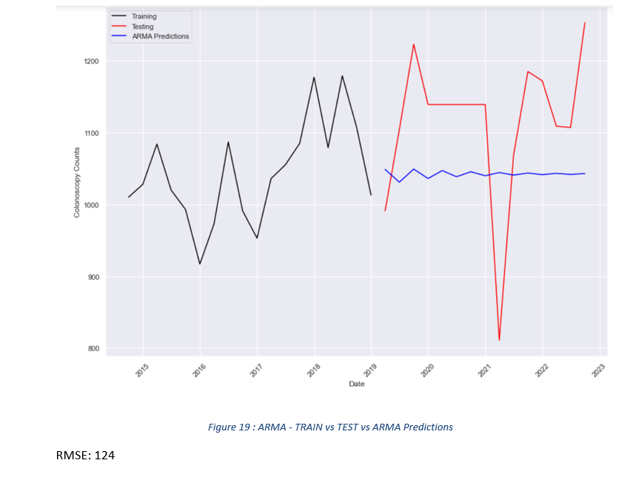
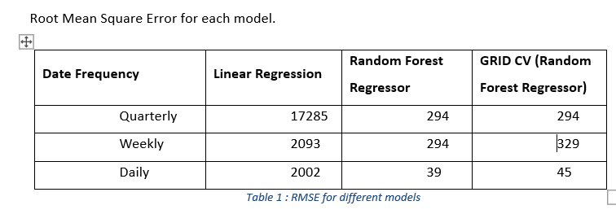
Time Series Analysis (Contd .)
Daily data with Random Forest Regressor showed the highest performance with minimum root mean square error compared to other models tested. The Quarterly data performed very poorly because the data is considered from 2014-2022(without 2020) which is very less. This is because as per the primary research depth interview 2020 colonoscopies are expected to be very low because of COVID.
The ARMA didn’t show optimal performance , attribute this to the poor data availability especially the whole of 2020 are engineered data.

Slide 13
Regression ML Models
Time series models didn’t fetch an optimal evaluated model necessitating further research on the regression models.
Models ranging from Linear Regression, Random Forest Regressor, GRID Cross Validations , Neural Networks are evaluated.
The models are evaluated with different datasets, train test data, different hyper parameters to evaluate the best possible model.
Create Datasets (Weekly/Monthly/Quarterly/Daily)
Train/ Test Data
Regression Models)
Evaluate Models
Hyper-Parameter Tuning
Iterative data preparation to achieve optimal performing model.
Data Preparation

Slide 14
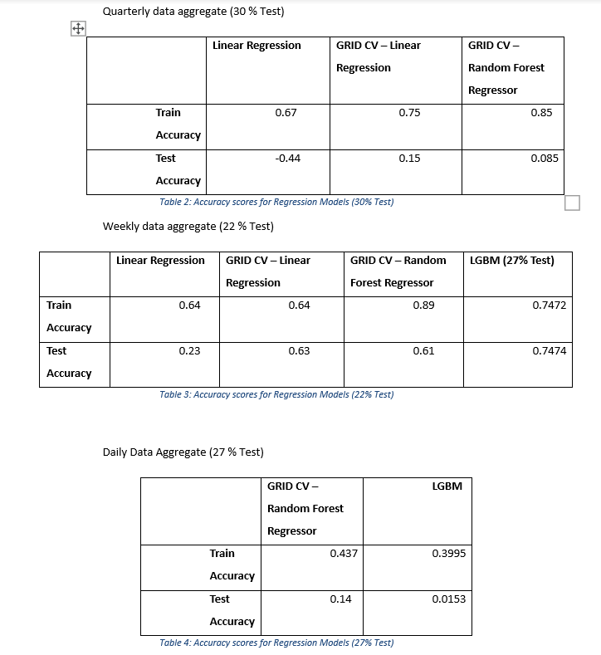
Regression ML Models (Contd .)
The daily data aggregate also showed less performance, because certain days had very less counts, and the train and test data selected couldn’t really match and comparable.
The weekly aggregate was of the reasonable blend, and shower better performance compared to others. GRID CV Linear Regression showed high Training accuracy (89%), test accuracy (61%). This is a case of overfitting. Light Gradient Booster Algorithm was applied along with hyper-tuning techniques, and this resolved the over-fitting issue to obtain train accuracy as 0.7472 and Train Accuracy of 0.7474.
Neural Network was also evaluated, no significant improvement seen, the loss value was seen reduced with the number of epochs. Hyper parameter tuning involved usage of ADAM optimiser default for regression models, relu activation function default , no improvements seen for sigmoid or tangent activation functions, controlling the number of hidden layers.

Slide 15
Summary:
Depth interview done as part of the primary research and further data analysis done on the extracted data, showed that the colonoscopy numbers vary for different age groups, with younger group showing higher colonoscopy numbers.
The primary research suggested that of the eligible population for the bowel screen programme, the male participation is less compared to female. However, data analysis and hypothesis testing showed that male colonoscopy for both the existing eligible population (60-69) and the extended age range (55-69) are high compared to the female.
Factors/ Features that impact the colonoscopy were analysed using the co-relation matrix, and there was no evidence to suggest factors like age/gender could impact the colonoscopy numbers, previous year colonoscopy numbers had reasonable co-relation for colonoscopy count predictions.
Time series models were developed using both conventional as well as machine learning regression models, of these GRID CV Random Forest Regressor showed comparatively lesser root mean square error and can be used for prediction. The higher error is attributed to the less data for time series analysis as well as inconsistent data in 2020 due to COVID and this required feature engineering.
Regression models were done to identify better models for prediction, light gradient booster regression algorithm, with 22% test data showed better results with weekly data aggregate.

Slide 16
Areas for Improvement:
The entire research here was based on the census data and the available colonoscopy data, the data for extended age range was extrapolated using the census data. However, the subject matter experts interviewed as part of the primary research have suggested that the population in the bowel screen register is from the department of social protection, there could be variations with the census data. Further research using the department of social protection data and its variation with the census needs to be considered for the colonoscopy prediction.
Primary research has suggested that there could be an impact of less privilege areas on the colonoscopy counts, however this research does not consider of the deprived areas. This would need to research using the client address. This would be classified as personal identifiable information and would require additional approvals during any research.
Feature engineering was done to handle the missing data, and to handle scenarios where the colonoscopy counts was very low, used ffill for 2020, because the 2019 was identified as reliable numbers during the primary research. However, this would mean entire data of 2020 was flat same number, month wise data preparation would have made the feature engineered data to produce better results.
Experiments on different time series level data aggregate showed different results with certain timeseries showing higher scores, this means there is a scope of further hyperparameter tuning, especially on the neural network model.

Slide 17
Thank You

