Slide 1
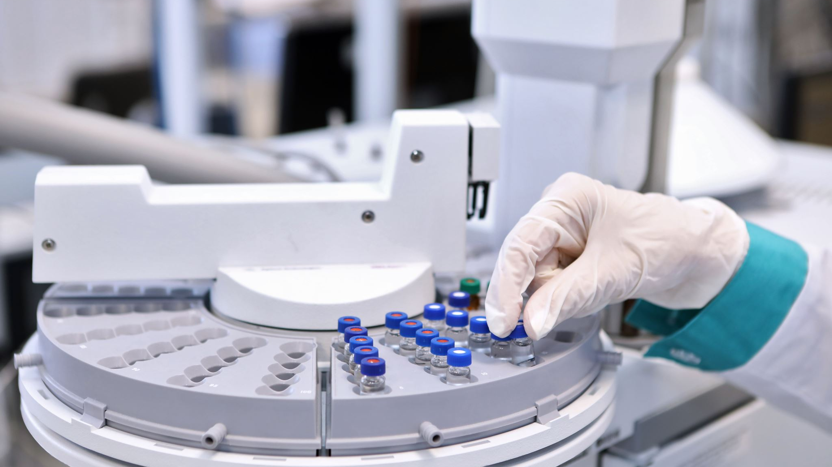
Predicting the Screening Colonoscopy Numbers in Ireland using Machine Learning
Rakesh Kumar Muraleedharan
Supervisor : Sam Weiss
CCT College Dublin

Slide 2
Objectives
To predict the screening colonoscopy numbers
To Identify the variations in colonoscopies for each gender and age groups, Hypothesis Testing to validate the primary research outcomes
To Identify the features that influence the colonoscopy predictions, using primary research, data analysis, co-relation studies
To predict the colonoscopy numbers by building and evaluating machine learning models and identify the best model for predictions.

Slide 3
High Level Design
Hypothesis Testing
Data Extraction
Exploratory Data Analysis
Primary Research Depth Interview
Machine Learning Model building and evaluation
Conclusions and Improvements
Data Preparation
Literature Review

Slide 4
Research Understanding
Consent
Depth Interviews
Identify the Participants
Information Leaflet
Interview
Interview Questionnaire
Literature Review
Analysis
Data Understanding
The participants identified are all over 18, consents are obtained to record and use the transcribe in the research
1. Primary Research – Depth Interviews , involves participant sampling , get their consents, Information leaflet, Questionnaire, Interview, documentation and analysis.
2. The questions selected focused on understanding the features impacting the colonoscopies , variations in census numbers and the screening register.
3.The data extraction and preparation are done based on the analysis done on the primary research outcomes.
4. Literature review done, thematic based approached , eight themes ranging from clinical understanding, topics on machine learning algorithms are reviewed in detail to be used further in the research.
5.Data Understanding once the data is extracted .

Slide 5
Data Extraction
Ethical Consideration – Select only required fields and avoid personal data of the public for the analysis
Bowel Screen Data (SQL Server)
Extract data using SQL
Identify the Data/feature Requirements
Research Understanding
Census 2022 (CSO website)
1. Three different sampling strategies will be used as part of the research, this includes probabilistic (simple and stratified) sampling and non-probabilistic sampling (judgemental) to analyse and achieve the objectives as well as to support the research and get inputs on the factors influencing the research.
2. The data is from the clinical database and the issue with regards to the bias are taken care. The samples are selected from the population based on the literature outcomes and the primary research interviews.

Slide 6
Data Preparation
Data Cleansing
Aggregated Data
Exploratory Data Analysis
Machine Learning Build and Evaluate
Data Collection
Time Series Data
Feature Engineering
Iterative process to achieve better results.
Iterative process, involving data cleansing, aggregation, feature engineering.

Slide 7
Data Analysis
Exploratory Data Analysis
Data Preparation
Descriptive Statistics
Visualisation
Hypothesis Testing
Exploratory Data Analysis involves checking for data completeness , NULL checks , datatype checks.
Detailed analysis targeting to achieve the objectives to understand the impact of features in colonoscopy predictions.
Hypothesis testing to identify if the male population has higher participation in colonoscopy compared to female.

Slide 8
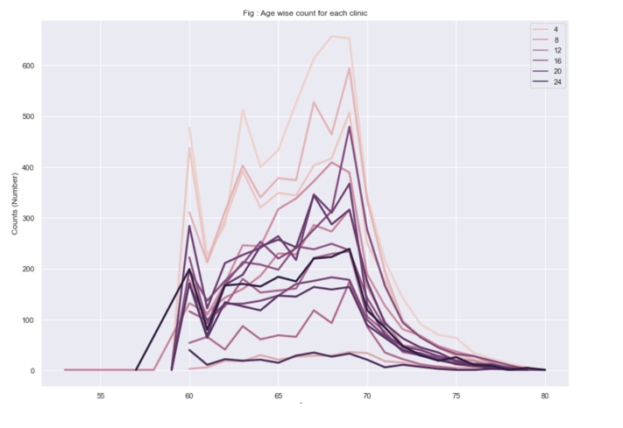
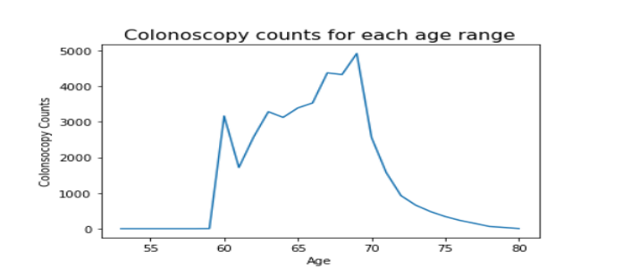
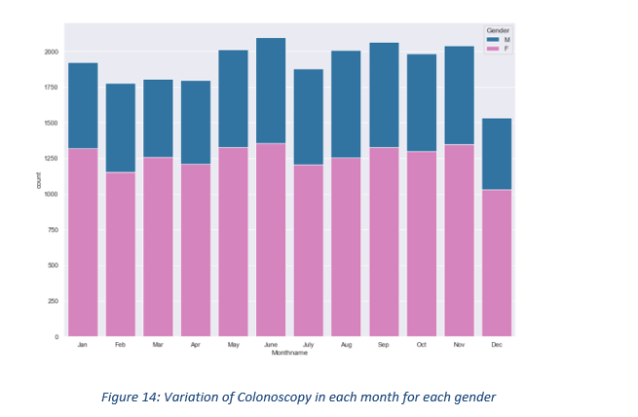
Data Analysis(contd.)
Separated aggregated datasets created using PYTHON.
Made use of seaborne library due to its simplicity, iterative until the required visualisation is achieved
Results:
The colonoscopy counts had variations in the age, and age range 65-70 showed the highest total colonoscopy counts for all years.
Monthly variations were analysed and there are no significance variations across the months.
Few clinics showed very less colonoscopy counts compared to ohers.

Slide 9
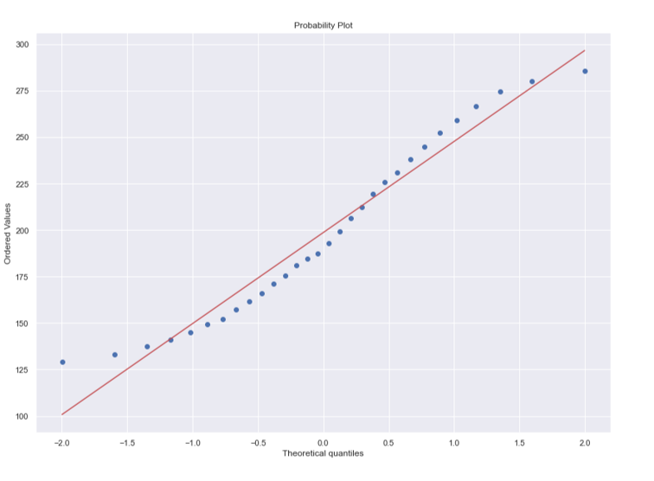
Data Analysis(contd.)
Hypothesis Testing:
Scipy Stats library is used.
95% Confidence Interval is used for testing.
ANOVA test is used to compare the male and female populations after confirming the normal distributions using probability charts or Shapiro tests.
Results: At 95% Confidence Interval, male colonoscopy number for the entire eligible population is expected to be between 270 (maximum value in the sample) and 230 (average in the sample). ANOVA tests were done, and it suggested that at 95% confidence interval male colonoscopies will be higher than the women

Slide 10
Time Series Analysis
Check for Trend / Seasonality
Create Datasets (Weekly/Monthly/Quarterly/Daily)
Traditional Models (Example: ARMA)
Hyper-Parameter Tuning
Train/ Test Data
Evaluate Models
Regression Models)
Data Preparation

Slide 11
Create Datasets (Weekly/Monthly/Quarterly/Daily)
Train/ Test Data
Regression Models)
Evaluate Models
Hyper-Parameter Tuning
Iterative data preparation to achieve optimal performing model.
Data Preparation

