Slide 1
IBM Applied Data Science Capstone
Opening an Amazon Warehouse in Republic of Ireland
-RAKESH KUMAR MURALEEDHARAN
Aug 2020

Slide 2
Introduction:
On-line shopping is the new norm in these pandemic days. Social distancing and self-quarantine have made online shopping a necessary part of our daily lives. and other consumer goods. Many of the retailers are now offering great offers for online shopping, this will not ensure their business thrive during the pandemic, but also sustain the competition. Another important aspect of online shopping is the quick delivery. Shoppers often opt for those retailers who can provide quicker delivery along with other discounts.
Amazon, the world leader in retail market, can contribute very high to the customer needs. Considering the huge market it has it is easy for it sustain with an initial investment.

Slide 3
Problem:
Amazon, is yet to enter the groceries and perishable- food delivery market in Rest of Ireland. One of the show stoppers for this is their lack of warehouse within the Republic.
While most of the retailers struggle to provide quick delivery, and they have a very high delivery charge. Amazon, can win the market because of its size, by investing in building a warehouse within the republic.

Slide 4
Data:
Source: Wikipedia https://en.wikipedia.org/wiki/List_of_urban_areas_in_the_Republic_of_Ireland_by_population
The above link contains the data for Urban Area in the Republic of Ireland, this has county wise data of the population. Web data scrapping techniques will be used to extract the data from Wikipedia page, using Beautiful Soup package. Geographical co-ordinates of urban areas will be taken using Python Geo-Coder package.
Foursquare API will be used to get the venue data for these neighborhoods. We will refer to the Shopping Mall Category, also use the population data in wiki, and collectively decide on the best place for the warehouse.

Slide 5
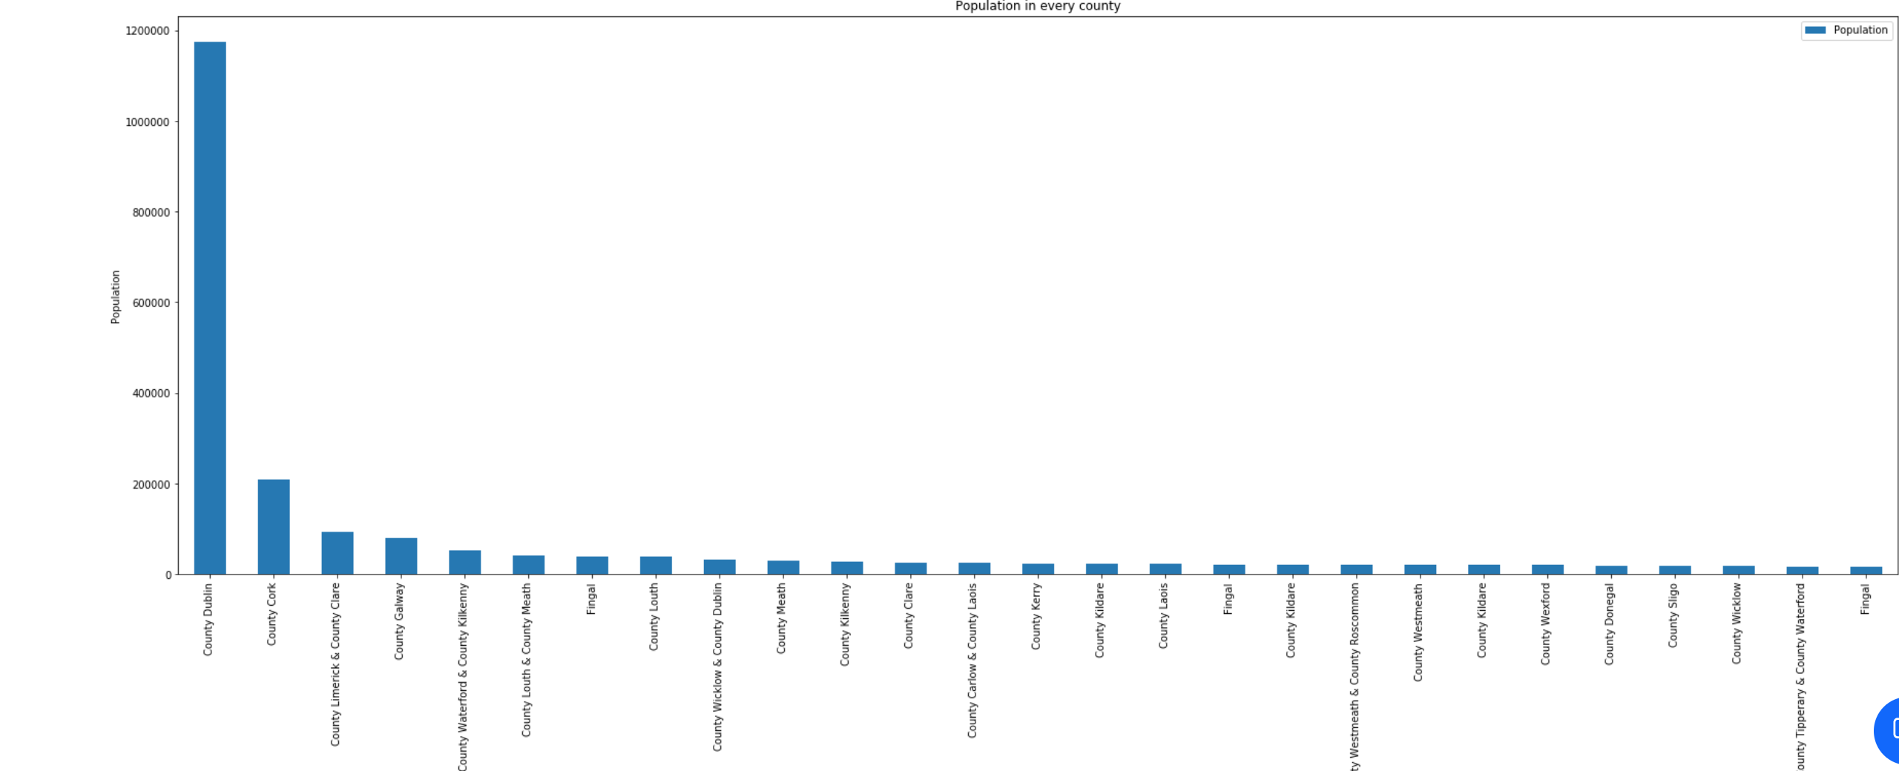
Results:
Fig 1: County v/s Population

Slide 6
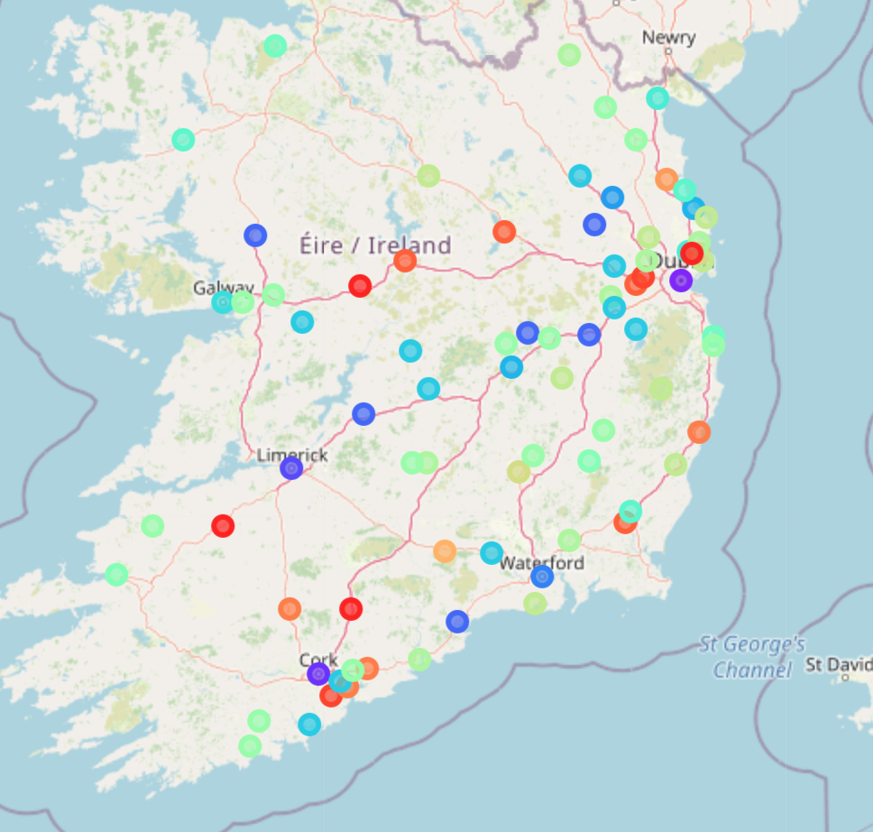
Fig 2: Clusters, showing that the maximum cluster are present around Dublin and Cork and its neighbourhood

Slide 7
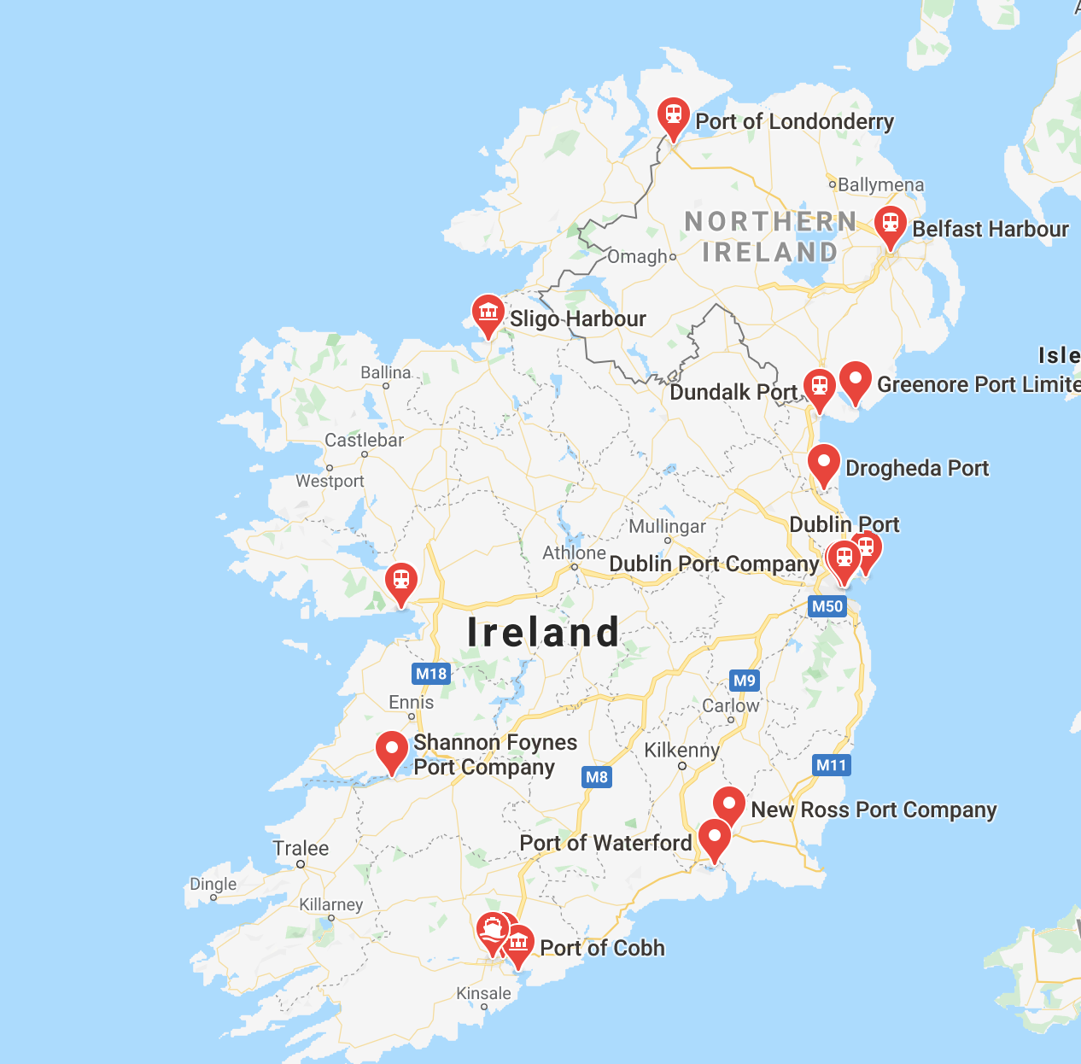
Fig 3: Google Map showing the ports in Ireland

Slide 8
Conclusion
Based on the analysis, I find that it makes Amazon to have two warehouses in the country, one in Dublin, another near Port of Waterford, and then have logistics connectivity across all the Urban Areas.

Slide 9
Thank You

