Slide 1
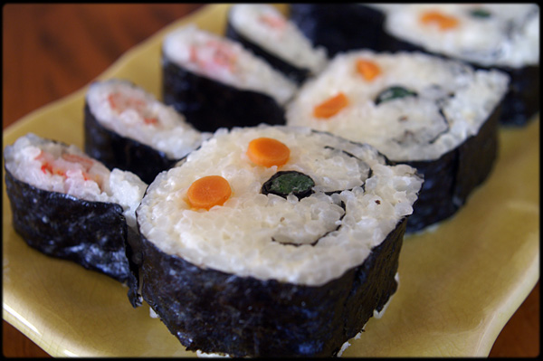
MC514 – Lab 3
Sushi Bar
Raphael Kubo da Costa

Slide 2
Imagens
Bunny-shaped Sushi: http://www.flickr.com/photos/barron/3437527445/

