Slide 1



Slide 2


JPMC: Migrations at scale through cloud blueprints and automation
FS I 2 0 2
James R. Reid
Managing Director & Distinguished Engineer, Head of Engineering and Architecture, Corporate Technology
JP Morgan Chase
Rahul Arya
Managing Director, Head of Global Technology Architecture, Incubation Engineering & Next Gen Cloud, CTO
JP Morgan Chase
Bernie Herdan
Global Financial Services Solutions Architect AWS
© 2020, Amazon Web Services, Inc. or its affiliates. All rights reserved.

Slide 3

Agenda
Context
JPMorgan Chase & Co. approach to scale Customer journey
Enabling foundations for the future
© 2020, Amazon Web Services, Inc. or its affiliates. All rights reserved.

Slide 4
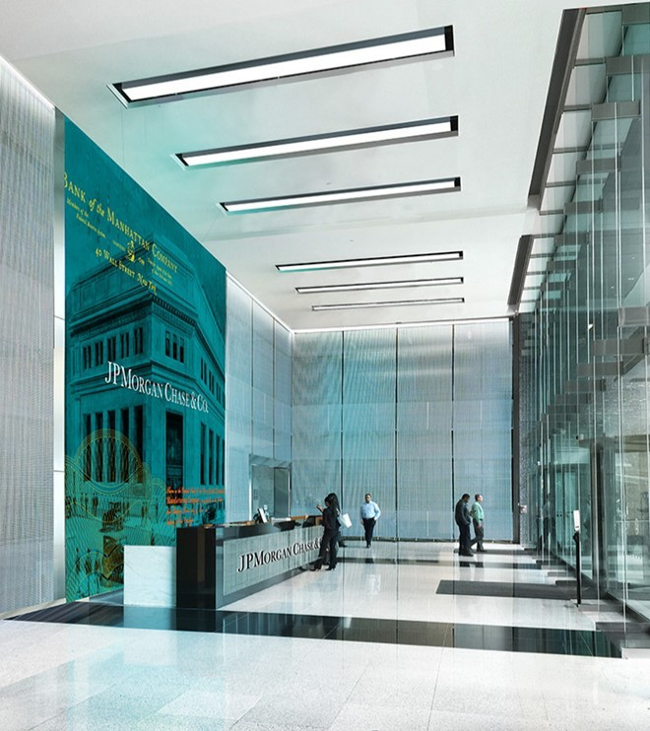
Technology investments support significant business scale
$27T
Assets under custody
52M
Active digital customers
50K+
Technologist
250K+
Virtual and mobile workspaces
$6T
Payments processed daily
43M
Debit and credit card accounts
6K+
Applications
450PB+
Data storage

Slide 5


Cloud strategy and approach
Cloud decision tree
Drives consistent disposition of workloads
Decision tree aligned to Global
Technology Architecture
Tooling and frameworks
Deliver solutions to support migration Reduce developer effort by providing bootstrapped solutions
Decision tree
Cloud parties
Validate and harden blueprints Patterns moved to “validated” Parties used to accelerate developer experience improvements and rapidly solve issues
Cloud blueprints
Deliver app arch solutions for workload migration
Blueprints “approved” by Cloud Center
of Excellence (CCoE) – balance meeting business needs while keeping blueprint volumes to minimum
Tooling and frameworks
Blueprints
Cloud parties
Cloud platform services
Cloud platform
Delivers simple solution to access the cloud
Platform abstracts away orchestration complexity and engineered to scale
Telemetry / operations
Support rapid issue resolution
Telemetry and operational readiness (SRE)

Slide 6


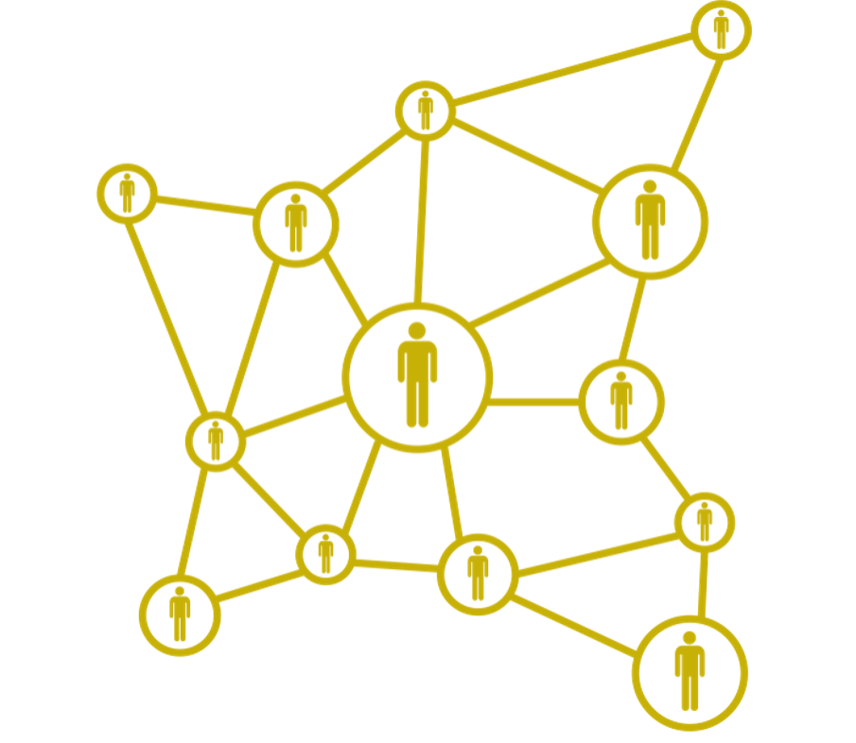
Cloud Center of Excellence
AR C H I T E C T AN D E N G I N E E R B L U E P R I N T S WI T H B U S I N E S S AL I G N M E N T
Blueprint owner
An SME in the area
Accountable for all content within blueprint
Directs the creation / update of the blueprint to ensure alignment to our strategy
Responsible for annual recertification of their blueprint
Council member
Provide guidance on enhancement to blueprints in alignment with our strategy
Ensure linkage to Cloud Engineering for unlocking required services
Approve blueprints to be published to the system of record (JPMC Architecture site)
Engineer blueprints and reliability as code
Governance
Governance of pattern review, approval and communications globally
Maintenance of council business, backlog and forward schedule of review
Publication of council minutes, decisions and actions
Ensure timely closure of decisions and actions

Slide 7






Challenges
Goals
Deployment time of one hour!
Manual provisioning
PRODUCT STRATEGY
“Run fast operations”
Inconsistent deployment
Easy standardized working methods
Manual compliance
Secure, compliant, and reliable

Slide 8


















Product development lifecycle
ASSEMBLE
SECURE
Blueprint build
JPMC Data Center IaC
Application Infrastructure Map permissions JPMC Managed Interactive Deployment Deployment from JPMC AD Certificate console access
(Prod)
SaaS
Events &
Authentication Logs Metrics
AWS
CodeDeploy
Availability Zone 1
Availability Zone 2
Elastic Load Balancer
Availability Zone 3
Chaos
AWS
CloudFormation
VPC
JPMC Routable Subnet
JPMC Routable Subnet
JPMC Routable Subnet
AWS SQS
and deploy process
EC2
EC2
Auto Scaling Group
EC2
AWS SNS
Sentinel
AWS IAM
AWS Managed Kafka
AWS
Certificate Manager
EBS
(Ephemeral)
EBS
(Ephemeral)
EBS
(Ephemeral)
AWS Managed Elasticsearch
AWS KMS
Interactive console access
(Dev, Test*)
AWS
Lambda
AWS
Session
Manager
Synchronous replication
Optional Components
Platform Components
RDS
(Primary)
RDS
(Secondary)
AWS Secrets Manager*
S3 ^{S3 VPC}
End point
RESILIENT
BLUEPRINT DEPLOY
Goal
Abstract away compliance control requirements and embed reliability to increase developer velocity

Slide 9
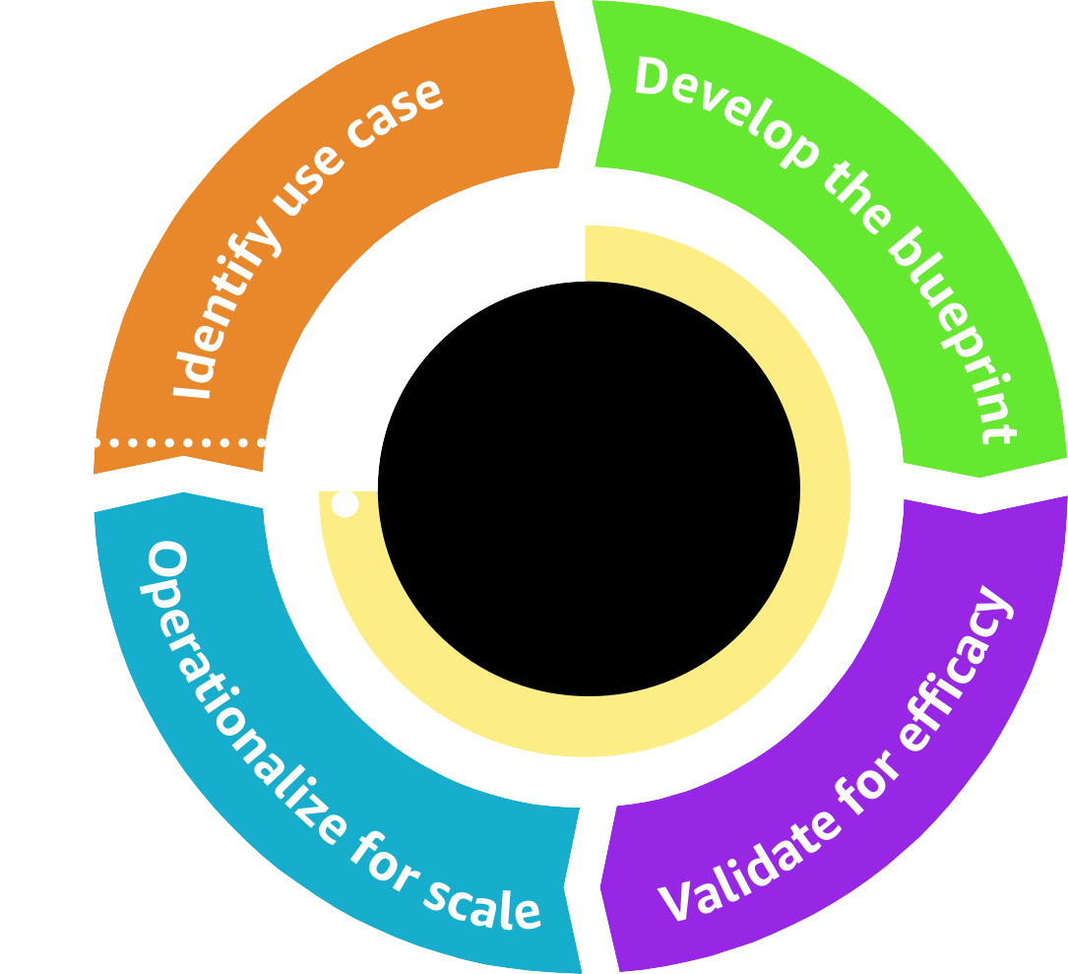
Flywheel effect – “A rising tide lifts all boats”
BL U E P R I NT S
Feedback / refinement cycle
Key activities and outcomes
Journey by blueprint type
Microservices blueprint
Domain – wholesale credit risk Use case – risk-grading service
Highly Confidential Data (HCD) ML blueprint
Domain – credit risk Use case – risk surveillance
Data lake
Domain – finance and treasury, compliance Use case – stress reporting, forecasting models

Slide 10
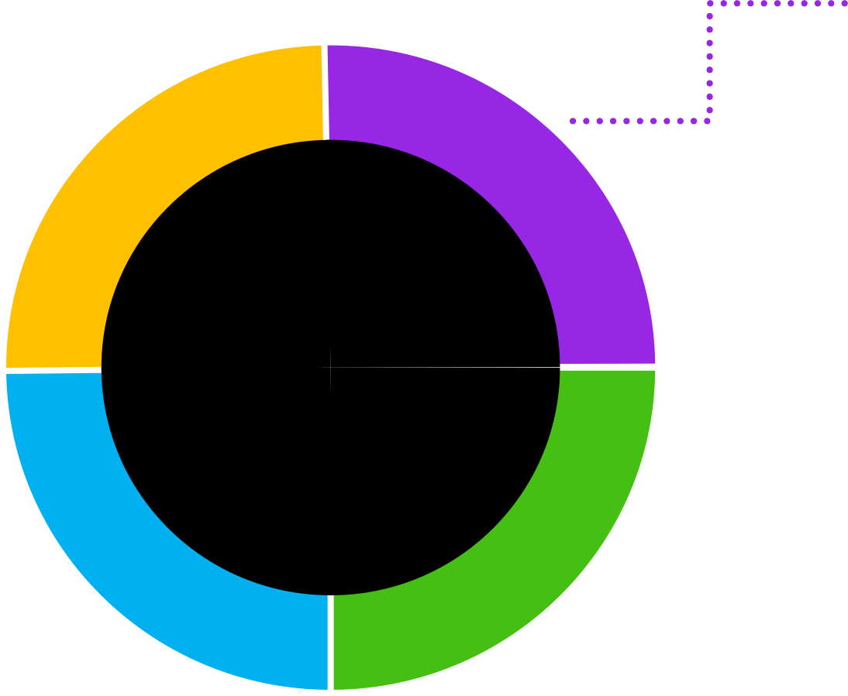





































Blueprints as products
AU T O M AT I O N AN D G O V E R N AN C E AT S C AL E
Automating a compliant, secure and reliable blueprint architecture at scale that adheres to JPMC
governance and security policies, enabling us to migrate faster with appropriate guardrails
Define blueprint products based on common architecture use cases
Microservices
Event-driven microservices
Serverless microservices
ML / AI
Data lake
“You build it, you own it, you run it” Blueprints should be owned and
managed by a cross-functional engineering team with a product manager, backlog, roadmap
and SRE team
Blueprints as products
End-to-end (E2E) automation of blueprints using the principles and operational framework of GitOps
Create a threat model for each blueprint to enforce security controls (guardrails) as code
Data flow model
Threats
Security controls
Policy as code

Slide 11



























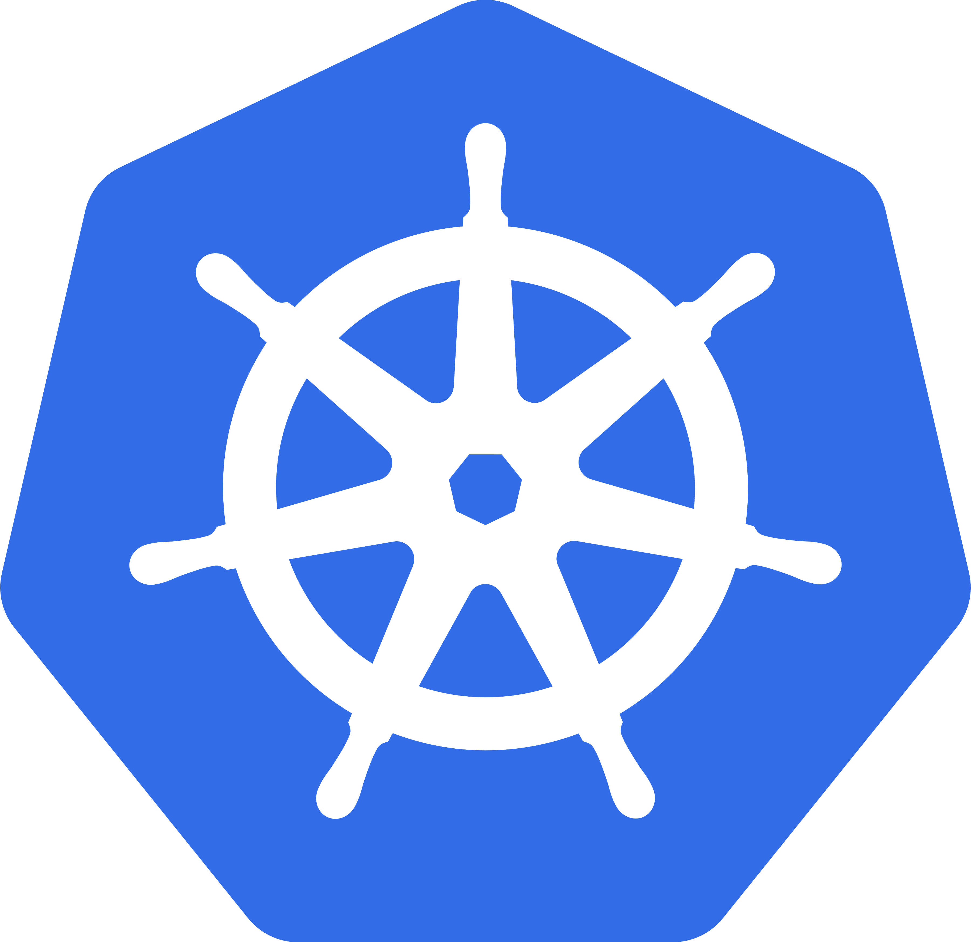












Blueprint approach to the cloud
MI C RO S E RV I C E S U S E C A S E

Slide 12
The five layers of the cloud blueprint layered model
Product
Platform architecture
Network architecture
Foundation architecture
Microservices blueprint
Layer 5
App 1
App 2
App 3
App 4
App 5
App 6
Containers, AWS Auto Scaling Groups, Amazon EC2 instances, tagging
Product
Layer 5
App 1
App 2 App 3
App 4
App 5
App 6
App 1
Platform architecture
Voice analytics
Anomaly detection
Data processing
Layer 4
Machine learning
Microservices WebApp
Voice
analytics detection
Custom
Anomaly
Security
Data Lake
Data processing
Machine learning
Elastic load balancers, Amazon S3 buckets, bucket policies, security groups, Amazon CloudWatch, tagging, managed services such as Amazon EKS, AWS Lake Formation, Amazon SageMaker
Network architecture
Layer 3
Network 1
Network 2
Network 3
External connectivity
Third-party connectivity
Cloud-to JPMC connectivity
Microservices WebApp
VPC-to-VPC
connectivity
Layer 4
App 1
Custom
Layer 2
Foundation architecture
Layer 1
Roles, users, configuration, encryption, SIEM, etc.
Data Lake
Security
Amazon VPCs, subnets, AWS Transit Gateway, route tables, NACLS, security groups
AI / ML blueprint
Network 1
Network 3
Layer 3
Network 2
App 1
Product
App 1
Layer 5
App 2 App 3
App 4
App 5
App 6
Platform architecture
Voice analytics | Anomaly detection | Data processing | Microservices | WebApp | Custom
Machine learning
Data Lake
External Third-party connectivity connectivity
VPC-to-VPC
connectivity
Cloud-to- JPMC
connectivity
AWS Direct Connect, AWS Transit Gateway, virtual gateway, VPN connection
Layer 4
Layer 2
App 1
Security
Layer 3
Network 2
Network architecture
Network 1
Network 3
Roles, users, configuration, encryption, SIEM, etc.
Users, groups, roles, policies, AWS CloudTrail, authentication, continuous monitoring (SIEM)
External connectivity
VPC-to-VPC
connectivity
Layer 2
Third-party connectivity
Cloud-to JPMC connectivity
Layer 1
App 1
Foundation architecture
Layer 1
Roles, users, configuration, encryption, SIEM, etc.
Key benefits
▪
▪
▪
Modular configuration Reusable modules Version controlled
▪
▪
▪
Modular teams Agile-lean delivery Loosely coupled
▪
▪
▪
Shared responsibility model Automate and enforce guardrails GitOps

Slide 13










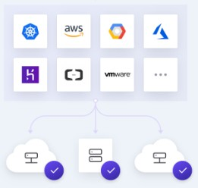


Blueprints as products – Enabling for the future
Leveraging GitOps principles – establish operational framework that takes DevOps best practices used for application development such as version control, collaboration, compliance and CI/CD and apply them to infrastructure automation
Mesh
Chaos
Private module registry
Workspace
Application LOB team
Terraform provider – Helm plugin
Workspace
publish
depends
writes
Microservices team
tf-microservices-dev
Microservices v2.0.0
tf-application-dev
depends
Workspace
Init
creates
Plan
Remote backend
publish
Sentinel policy checks
tf-eks-dev
Amazon EKS v1.0.0
executes
Apply
CI/CD pipeline
Network ops team
depends
Workspace
publish
tf-network1-dev
VPC v1.0.0
Policies as code – versioned codification of security controls

Slide 14
Summary: Opinionated blueprint architecture(s) as products
US IN G M O D UL A R D E S IG N T O CR E A T E P R E B UIL T A N D CUS T O M IZ A B L E OP I N I ON A T E D BL U E P R I N T A R C H I T E C T U R E S
Key takeaways Key benefits
Avoid “death by a thousand cuts,” which are not fatal in themselves but impede progress
Adopt product-centric delivery model within CCoE to provide continuous value
Balance cloud migration strategy between bespoke projects and blueprint as products
Build new muscle memory for the cloud through training, education, and certifications
Enable autonomy and self-service for engineers, cloud parties are great but not sufficient
Enabled ability to migrate applications at scale
Standardized and automated governance across opinionated architectural blueprints
Automated compliance and security controls as part of the blueprints
Created tooling and documentation to provide self-service capabilities to developers
Streamlined a process to get feedback and iterate on the blueprints – use cases and reference architectures

Slide 15

Thank you!
© 2020, Amazon Web Services, Inc. or its affiliates. All rights reserved.

Slide 16



© 2020, Amazon Web Services, Inc. or its affiliates. All rights reserved.

