Slide 1



Slide 2


Modernize your analytics architecture with Amazon Athena
A N T 3 2 7
Daniel Chen
Senior Product Manager, Athena
Amazon Web Services
Saurabh Bhutyani
Principal Analytics Specialist Solutions Architect
Amazon Web Services
© 2022, Amazon Web Services, Inc. or its affiliates. All rights reserved.

Slide 3
01
What to expect
UNDERSTAND
Amazon Athena and data source connectors
02
LEARN
Modern analytics architecture pattern
03
APPLY
How to implement
with Athena?

Slide 4
Common challenges we hear from customers
“It’s difficult and expensive to create data product with administrative overhead”
“Sharing data is difficult”
“I wish to focus on innovating with data, not on maintaining and administering a data lake”
“My data sits across siloed data sources, want to query them from one place”
“Current data architecture
is complex and monolithic”

Slide 5



















Companies expect more value from their data
1
0
0
Growing
exponentially
From new
sources
Increasingly
diverse formats
Used by many
internal roles
Analytics and
machine learning

Slide 6


















Data lakes and modern data architecture
Modern data
architecture
Relational databases
Business intelligence
Machine
learning
Big data processing
Non-relational databases
DW queries
Big data processing
Interactive Real-time
Data catalog
Data lake
10011000010010101110
01010101110010101000
01011111011010
0011110010110010110
0100011000010
Log analytics
Machine learning
Data warehouse
Data lake
Data warehousing
OLTP ERP
CRM LOB
Devices Web Sensors Social

Slide 7
Amazon Athena
Easy to get started
Interactive analytics
Open and flexible
Interactive analytics for all your data
Cost-effective

Slide 8








AMAZON
DYNAMODB
DATA WAREHOUSES
AMAZON REDSHIFT
BIG DATA FRAMEWORKS
AMAZON
OPENSEARCH SERVICE
DATA LAKE
DATA IN THE CLOUD
A M A Z O N
D O C U M E N T D B
DATA ON PREMISES
AMAZON NEPTUNE
ERP
A N D M O R E

Slide 9

Federated Query
D A T A S O U R C E C O N N E C T O R S F O R I N - P L A C E
A N A L Y T I C S
Integrate external databases with your data lake
No data movement
Flexible and easy way to ingest data for analysis
On premises data
Amazon S3
Amazon RDS
MySQL
Process data in place

Slide 10


Supported data sources
AWS
Amazon
Redshift
Amazon
DynamoDB
Amazon
RDS
Amazon
DocumentDB
Amazon
OpenSearch Service
Amazon Timestream
Amazon ElastiCache
Amazon Neptune
Amazon CloudWatch
Amazon CloudWatch Metrics
THIRD PARTY
N E W
Azure Data Lake Storage Gen2 Azure Synapse
Microsoft SQL Server Cloudera
Google BigQuery Teradata
SAP HANA
Hortonworks
Snowflake Oracle IBM Db2
Redis HBase MySQL
PostgreSQL
Vertica TPC-DS
Custom

Slide 11

Data source connectors use cases
Interactive query
Business intelligence
Data workflows
Analytics apps
Machine learning
Fast, scalable interactive queries on petabyte-scale data lakes
Visualizations and scheduled reporting on your data lake
Lightweight data workflows to prepare data for downstream use cases
Build applications that use Athena to surface insights
Combine raw data from multiple sources to train more diverse models

Slide 12







Operationalize ML models with Athena
Orders/Customer
/Supplier
Amazon RDS
Parts/
Parts supplier
Notebook data preparation
Notebook build
Train
Deploy
Amazon Athena
(Federated Query)
Amazon SageMaker
Amazon S3
(Model artifacts)
AWS Glue
Ana, the analyst
Amazon DynamoDB
Notebook inference
Line item
Amazon Athena
Amazon S3 (Inference results)
HBase on Amazon EMR
Maria, the scientist

Slide 13
Modern data architecture pattern: Data virtualization
© 2022, Amazon Web Services, Inc. or its affiliates. All rights reserved.

Slide 14
Data virtualization
“Data virtualization enables distributed databases and multiple heterogeneous data
Simplify data management
Improve collaboration Reduce costs Centralized access
viewed as a single database. ”
– Data Management Association International
stores to be accessed and

Slide 15


















Data virtualization with Athena
Data consumer
1
0
BI Dashboard
Mobile/web
Enterprise application
Exploration and discovery
AI/ML
AWS SDK/CLI
JDBC/ODBC
Data virtualization
AWS APIs
Amazon Athena
AWS Glue
Data sources
On-premises data
Amazon S3
Amazon RDS
Amazon ElastiCache
MySQL
Amazon DocumentDB
Amazon Redshift
Snowflake

Slide 16
Modern data architecture pattern: Data mesh
© 2022, Amazon Web Services, Inc. or its affiliates. All rights reserved.

Slide 17










Data as a product
Domain ownership
Data mesh: four core principles
Self-serve data platform
Federated computational governance
https://www.thoughtworks.com/radar/techniques/data-mesh

Slide 18
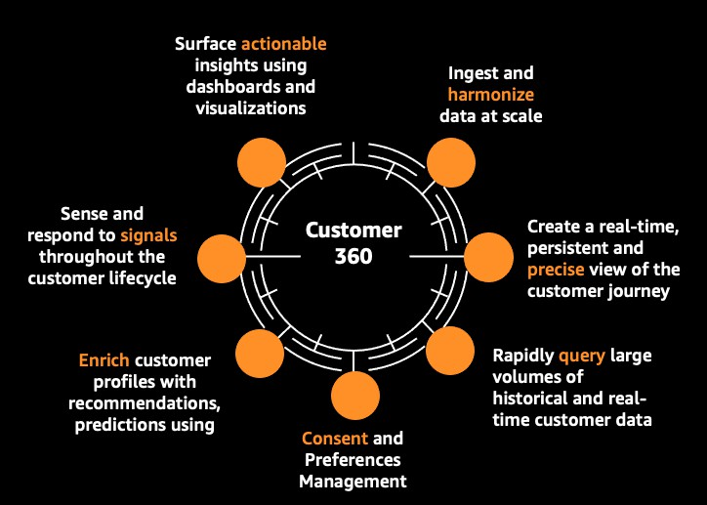
What is a data product?
Read-only analytical data organized by domains
Broad, cohesive collections of related data aligned to business use cases and goals
Each data product is autonomous and data team manages their data products independently
Data products provide a data contract to ease data sharing

Slide 19




Create data product with Athena
Data producer
Data domain producers ingest data into their respective S3 buckets through a set of pipelines that they own and operate
Application VPC
Producers are data owners responsible for the full lifecycle of the data under their control
Orders database
CTAS
Producers catalog datasets to make them discoverable by consumers
Customer metadata
Data catalog
Producers control access to data through Federated data governance model to enforce fine grained access control
Federated data governance AWS Lake
Formation
Data catalog Data attributes
Policy control Data permissions

Slide 20
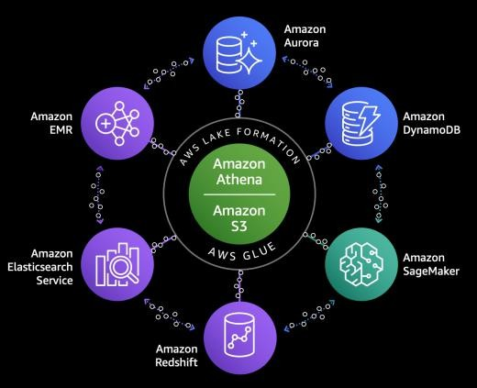

The end result
With a data mesh architecture, we aim to:
Accelerate the independent delivery of business domain data lakes
Increase data security and compliance
within domains
Enable self-service data product creation, discovery, and subscription
Access data
Consumer domain
Discover data product Request subscription
Create data product Approve subscription
Allow consumers to transparently
access data products
Data mesh
Monitor, audit, and govern
access over time
Producer domain
Monitor Audit
© 2022, Amazon Web Services, Inc. or its affiliates. All rights reserved.
Govern

Slide 21
Data mesh common patterns
© 2022, Amazon Web Services, Inc. or its affiliates. All rights reserved.

Slide 22






























































Hub and spoke
Consumer
Governed
storage
Amazon S3
Producer shares directly with consumers
Consumer
Governed storage
Amazon S3
Producer
Governed storage
Amazon S3
Consumer
Governed storage
Amazon S3
Decentralized governance
No central data catalog
Consumer
Governed
storage
Amazon S3
Simple to set up and get started

Slide 23












Data mesh with Athena: Hub and spoke
Producer
Consumer 1
Sales
Data
catalog
Data catalog
Sales
Opportunities
eu_sales
Orders
Athena
On premises data
Amazon Amazon RDS Amazon S3 Aurora
AWS Lake Formation
….
Athena
Consumer N
Orders
Data catalog
eu_orders
On premises
Amazon S3
Amazon RDS
Amazon Aurora
Athena
On premises data
Amazon Amazon RDS Amazon S3 Aurora

Slide 24

































































Centralized governance
Producer
Governed storage
Amazon S3
Governance
Data catalog
Centralized audit, policy and access management
Consumer
Governed storage
Amazon S3
Producer shares via
central catalog
Producer
Governed storage
Amazon S3
Consumer
Governed storage
Amazon S3
Centralized governance and audit
Federated access control
Producer
Governed storage
Amazon S3
Consumer
Governed storage
Amazon S3
Unified policy management

Slide 25













Data mesh with Athena: centralized governance
Consumer 1
Consumer 2
Consumer N
….
Consumers
Amazon Amazon Amazon Redshift Athena EMR
BI reports
Amazon
Notebook
Amazon Amazon Amazon Redshift Athena SageMaker
Athena
Federated governance
Unified policy management Centralized governance & audit Federated access control Organization-wide sharing
Data governance
/mesh
Blueprints Resource Enhanced ^{Centralized}
share governance data catalog
Amazon
Athena
Amazon
Athena
Amazon
Athena
Data producers
Amazon S3 data lake storage
LOB 1
Amazon S3 data lake storage
LOB 2
….
Amazon S3 data lake storage
LOB N

Slide 26

Thank you!
Daniel Chen
danchenx@amazon.com
Saurabh Bhutyani
bhutyani@amazon.com
Please complete the session survey in the mobile app

