Slide 1



Slide 2


Understanding zero-ETL with AWS analytics
ANT346 - R
Srikanth Sopirala
(he/him)
Principal Analytics Specialist Solutions Architect
Amazon Web Services
Amandeep Bajwa
(he/him)
Principal Solutions Architect, Financial Services
Amazon Web Services
© 2023, Amazon Web Services, Inc. or its affiliates. All rights reserved.

Slide 3
Agenda
Why zero-ETL?
AWS zero-ETL approaches
AWS data integration capabilities Use cases

Slide 4






















Real-time insights on operational data are critical for modern enterprises
Churn prevention
Gaming leader boards
Personalization
Fraud detection
Customer relationship management
Location optimization
Inventory optimization
Scoring
Internet of
Things (IoT)
Anomaly
monitoring
Sales
operations
Marketing
optimization
Product insights
More . . .

Slide 5


Existing operational analytics solutions are hard
SEPARATE SYSTEMS REQUIRE COMPLEX DATA MANAGEMENT PIPELINES
Data sources
Analytics
Manual data pipelines
Expensive and cumbersome
to build and maintain ETL jobs
Complex reconstruction of the data, especially with schema changes
Incomplete, inconsistent, and stale views of data, limiting insights

Slide 6







Building toward a zero-ETL future
Automated operational analytics in data warehouse
Auto- ingesting data from data lake
Streaming
ingestion
Data sharing and third- party data
Analytics ML capabilities
Federated query
Data lake federation
ETL
ZERO →

Slide 7



AWS offers unmatched capabilities for your data needs
`
Integrated
Comprehensive
Governed
The most comprehensive set of services with optimal price performance for any use case
Choices for integrating data including zero-ETL so you can easily connect to all your data
End-to-end data governance capabilities help you move faster with data

Slide 8
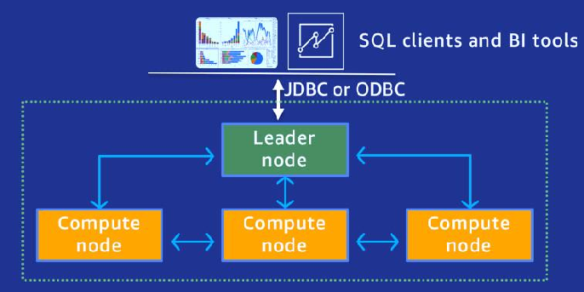
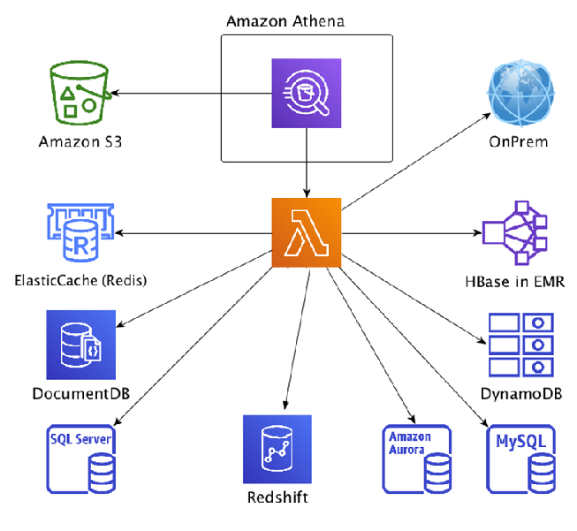



Data federation
Amazon Redshift federated queries
Amazon Athena federated queries
Amazon Redshift
ElastiCache for Redis
Amazon DocumentDB
Aurora
Amazon S3 data lake
Integrate operational data (Amazon RDS, Aurora) with data warehouse and data lake for real-time analytics
Analytics on operational data without data movement and ETL delays
Suited for in-place query with subset of data and infrequent or ad hoc querying
Run query across relational, non-relational, object, or custom data sources
Run query across on-premises or cloud data sources
Can be used for one-time investigations, complex pipelines, or applications

Slide 9







Data sharing
Amazon Redshift data shares
Data lake data shares
Producer
account 1
Amazon
Redshift
Producer
account 2
Amazon
Redshift
Consumer
account 1
Amazon Redshift
Producer account
Consumer account
Database
Data catalog
Tables & columns
Governance account
AWS Lake Formation
Register data
share
Governance
account
Grant
Database
Share
Data lake
Data
catalog
AWS Lake
Formation
Consumer account 2
Amazon Redshift Serverless
Tables & columns
Share data without copying
Live and consistently updating views of data
across all consumers
Peer-to-peer or centrally manage access to Amazon Redshift data shares
Secure and governed collaboration within and across organizations
Share data without copying
Independently manage producer and consumer permissions

Slide 10


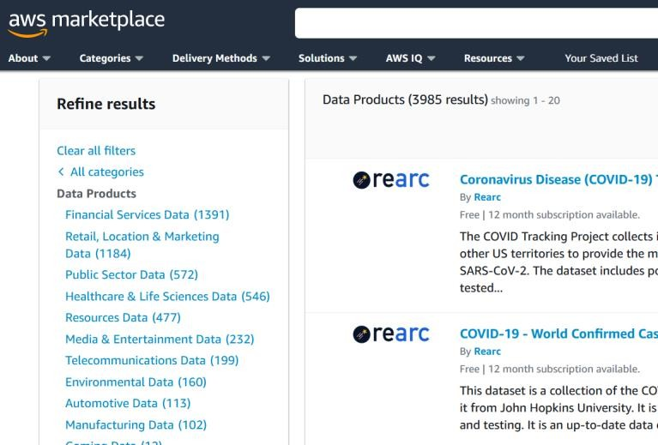




AWS Data Exchange allows you to easily find, subscribe to, and use third-party data in the cloud
Ingest or access files directly
Query tables
AWS Data Exchange for Amazon Redshif t
Call APIs
AWS Data Exchange for APIs
Available now
AWS Data Exchange for Dat a Files
AWS Data Exchange for AWS Lake Format ion (Preview)
AWS Data Exchange for Amazon S3
300+ data providers and
3,500+ public data products
2,000+ free trial data products to easily evaluate the data you need
350+ open data products
5 data delivery methods through files, tables, and APIs
Support for private products and private data trials

Slide 11

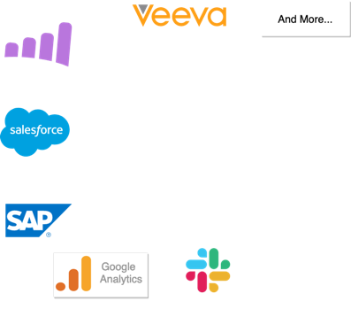









Amazon AppFlow
A N A P P L I C A T I O N I N T E G R A T I O N S E R V I C E T H A T E N A B L E S B I D I R E C T I O N A L D A T A F L O W S B E T W E E N SAAS APPLICATIONS AND AWS SERVICES
Key benefits
Data lakes
M A C H I N E L E A R N I N G
Custom Connector SDK
Veeva
No/low code
Cost savings
OPEN FORMATS
(CSV, JSON, Parquet)
B I +
A N A L Y T I C S
Amazon AppFlow
D A T A
W A R E H O U S I N G
CENTRAL CATALOG
Speed and agility
SAP
Secure and scalable
Google Analytics

Slide 12



Amazon Redshift streaming ingestion
N A T I V E I N T E G R A T I O N W I T H S T R E A M I N G E N G I N E S F O R F A S T A N D E A S Y D A T A INGESTION
Speed
Support 300K rows per second (2 KB size) with
<30 s latency
Near real-time analytics – IOT devices, system telemetry, or clickstream data from a busy website
Amazon Redshift
Real-time materialized view
Ease of use
Entirely configurable with SQL; connect to an existing Amazon Kinesis data stream and bring data into Amazon Redshift table in real time
Streaming
data
Permanent tables
Refresh MV to get latest data and perform filtering and aggregation on the stream data as part of the MV definition
Amazon Kinesis
Data Streams
Amazon MSK
Flexible schemas
Define a schema or ingest semistructured data with the SUPER data type
And others

Slide 13







Introducing: Amazon Aurora zero-ETL integration with Amazon Redshift
An easy and secure way to enable near real-time analytics
on petabytes of transactional data
Transactional
applications
Zero-ETL
integration
Amazon Aurora
Amazon Redshift
Analytics Analyst
Data engineer
Analyst
Analytics applications

Slide 14








Support for auto-copy from Amazon S3
Simple, low-code data ingestion
Avoid re-ingestion and manual tracking of loaded files
Simplified & automated file ingestion from Amazon S3 into Amazon Redshift
Easily convert your existing COPY statements into automatic ingestion jobs
Continuously monitoring S3 folder
Amazon Redshift Copy Job
Automatic ingestion of new data from Amazon S3 based on user- defined configurations
Amazon S3
New file(s) detected
Amazon Redshift Table
Ingestion automatically starts

Slide 15




AWS Glue: Complete data integration capabilities in one place
Stream processing
More easily integrate with Amazon MSK, Amazon Kinesis, and Apache Kafka
Batch processing
Combine, enrich, and transform data using AWS Glue Studio
Event processing
Adapt to varied and
changing schemas

Slide 16
Use case – Customer dashboard
Consolidated view of customer

Slide 17










Analyze and share all your data
Streaming ingestion
Data sharing
Amazon MKS
AWS Data Exchange
Streaming ingestion
Amazon Kinesis Data Streams
Data sharing
Zero-ETL integration
Amazon Aurora
Data sharing
Amazon Redshift
Amazon Redshift
AWS Lake Formation
Federated query
Data sharing
Amazon RDS/Aurora
Auto copy
Data lake
querying
Amazon Redshift
Amazon Athena
Data sharing
Other data sources
ETL integration
AWS Glue
Amazon S3 data lake
Keep up to exabytes of data in Amazon S3
Logs/unstructured

Slide 18


Thank you!
Please complete the session survey in the mobile app
Srikanth Sopirala
sopiral@amazon.com
Amandeep Bajwa
amanbajw@amazon.com
© 2023, Amazon Web Services, Inc. or its affiliates. All rights reserved.

