Slide 1



Slide 2


Data modeling best practices with Amazon DocumentDB
D A T 2 0 1 - R
Douglas Bonser
Sr. DocumentDB Specialist SA
AWS
Cody Allen
Sr. DocumentDB Specialist SA
AWS
© 2022, Amazon Web Services, Inc. or its affiliates. All rights reserved.

Slide 3
Agenda
Relational vs. NoSQL terminology/concepts
NoSQL data modeling approaches Whiteboarding and open discussion

Slide 4
Relational vs. NoSQL terminology/concepts
Database – Database
Relational database
© 2022, Amazon Web Services, Inc. or its affiliates. All rights reserved.
Document database

Slide 5
Relational vs. NoSQL terminology/concepts
Database – Database
Table – Collection
name | company | userID | state
Relational database
© 2022, Amazon Web Services, Inc. or its affiliates. All rights reserved.
Document database

Slide 6
Relational vs. NoSQL terminology/concepts
Database – Database
Table – Collection
Row – Document
name | company | userID | state
Relational database
© 2022, Amazon Web Services, Inc. or its affiliates. All rights reserved.
Document database

Slide 7
Relational vs. NoSQL terminology/concepts
Database – Database
Table – Collection
Row – Document
Column – Field
name | company | userID | state
Douglas | AWS | dbonser | TX
Cody | AWS | allco | TX
{
"name": "Douglas",
"company": "AWS",
"userID": "dbonser",
"state": "TX"
}
{
"name": "Cody",
"company": "AWS",
"userID": "allco",
"state": "TX"
}
Relational database
© 2022, Amazon Web Services, Inc. or its affiliates. All rights reserved.
Document database

Slide 8
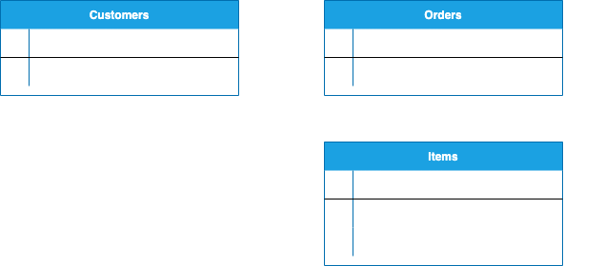
Why is a different approach needed?
2. Write data
INSERT INTO Customers(customer_id, customer_name) VALUES("181276", "Mary Major")
INSERT INTO Orders(order_id, customer_id)
VALUES("87652", "181276")
INSERT INTO Items(item_id, order_id, item_description) VALUES("00157-383", "87652", "chair")
INSERT INTO Items(item_id, order_id, item_description) VALUES("ad14-3372", "87652", "table")
1. Define the data model
Relational database

Slide 9
Why is a different approach needed?
3. Read data
SELECT Customers.customer_name, Items.item_id FROM Customers
JOIN Orders
ON Orders.customer_id = Customers.customer_id JOIN Items
ON Orders.order_id = Items.order_id
WHERE Customers.customer_id = "181276" AND Orders.order_id = "87652"
4. Convert result to application model
customer_name | item_id
Mary Major | 00157-383
Mary Major | ad14-3372
{
"customer_name": "Mary Major", "items": [
{ item_id: "00157-383" },
{ item_id: "ad14-3372" },
]
}
Relational database

Slide 10
Why is a different approach needed?
1. Write data
db.orders.insertOne(
{
"customer_id": "181276", "customer_name": "Mary Major", "order_id": "87652",
"items": [
{
"item_id": "00157-383", "item_description": "chair"
},
{
"item_id": "ad14-3372", "item_description": "table"
}
]
})
2. Read data
db.orders.find(
{
customer_id: "181276",
order_id: "87652"
},
{
customer_name: 1,
"items.item_id": 1,
_id: 0
}
3. Use result as is
{
"customer_name": "Mary Major",
"items": [
{ item_id: "00157-383" },
{ item_id: "ad14-3372" },
]
}
)
Document database

Slide 11
NoSQL data modeling approaches
© 2022, Amazon Web Services, Inc. or its affiliates. All rights reserved.

Slide 12
Embedding
{
Embed related data in a single document
"customerId": "181276", "customerName": "Mary Major", "orders": [
{
"orderId": "87652",
"orderDate": "2022-11-01",
"orderTotal": 750.00, "items": [
customer
{
"itemId": "00157-383",
"description": "chair", "price": 100.00,
"quantity": 4
orders
},
{
"itemId": "ad14-3372", "description": "table", "price": 350.00,
"quantity": 1
}
items
]
}
]
}
© 2022, Amazon Web Services, Inc. or its affiliates. All rights reserved.

Slide 13
Referencing
Reference data in other documents
{
"customerId": "181276", "customerName": "Mary Major"
{
}
"customerId": "181276",
"orderId": "87652",
"orderDate": "2022-11-01",
"orderTotal": 750.00, "items": [
{
"itemId": "00157-383",
"quantity": 4,
"price": 100.00
},
{
"itemId": "ad14-3372", "quantity": 1,
"price": 350.00
}
]
order
{
customer
"itemId": "00157-383",
"description": "chair",
"price": 200.00
}
items
{
"itemId": "ad14-3372", "description": "table", "price": 500.00
}
}

Slide 14
Summary
Not bound to rigid, pre-defined schemas
Data model based on read/write access patterns & relationships
Mix of embedding & referring
Different models for different use cases

Slide 15
Whiteboarding and open discussion
© 2022, Amazon Web Services, Inc. or its affiliates. All rights reserved.

Slide 16

Thank you!
Douglas Bonser
dbonser@amazon.com
Cody Allen
allco@amazon.com
Please complete the session survey in the mobile app

