Slide 1



Slide 2


Goldman Sachs: Accelerating time to value in data analytics
F S I 2 0 1
Francesco Pontrandolfo
Product Manager
Goldman Sachs
Gerrard Cowburn (he/him) Ram Rajamony (he/him)
Senior Solutions Architect
AWS
Vice President & Tech Fellow
Goldman Sachs
© 2022, Amazon Web Services, Inc. or its affiliates. All rights reserved.

Slide 3
The rundown
1
2
Who, what, why
Introduction to Goldman Sachs and Goldman Sachs Financial Cloud
Goldman Sachs Financial Cloud Bringing financial services to customers
3
Deep dive: data-driven analytics
GS Financial Cloud + Legend + AWS services = Real-time insights!

Slide 4

$2T+
assets under
supervision
What does Goldman Sachs do?
A leading global investment bank and financial services company
Customers include institutions, corporations, consumers
Increasingly tech-forward platforms and engineering-led businesses
Data is the lifeblood of everything we do
12,000+
engineers
~100
locations
© 2022, Amazon Web Services, Inc. or its affiliates. All rights reserved.

Slide 5





The data-driven investment process . . .
Set up
Build
Analyze
Productionize
Investment hypothesis
Source data
Clean and normalize
Model
Create a strategy Optimize Backtest
Compare metrics
Run scenarios
Execute trades
Monitor risk

Slide 6
. . . has many challenges!
Set up Build Analyze
Unrelated data sources with different stores and granularities
Multiple distribution mechanisms with integration and scalability challenges
Inconsistent semantics and data models
Multiple programmatic interfaces to access data
Productionize
Investment hypothesis

Slide 7
GS Financial Cloud for Data
A modular set of cloud-native services to help clients accelerate their technology strategy and deliver enhanced financial market analytics
Curated
data
Data management
Data analytics
GS proprietary data
Third-party data products
Consistent data model
Normalized and curated reference data
Fully managed time-series DB, specialized for financial data
Integrated Security Master Service
REST APIs
GS Quant – Goldman Sachs open-source Python SDK
PlotTool Pro – data visualization and analytic engine

Slide 8

Part 2: Goldman Sachs Financial Cloud
© 2022, Amazon Web Services, Inc. or its affiliates. All rights reserved.

Slide 9

















GS Financial Cloud under the hood
SecMaster AWS PrivateLink Amazon ECS | Amazon OpenSearch Service | Amazon Aurora | Cluster management service AWS Amazon AWS PrivateLink ECS CloudFormation | AWS Step Functions
Perimeter
Managed data service
Time-series DB-1
AWS Shield
AWS Application
Load Balancer
Amazon ECS
Amazon OpenSearch
Service
AWS PrivateLink
Tick DB instances
AWS KMS
Users
AWS Internet AWS Application Kong Gateway Load Balancer Gateway
Time-series DB-n
AWS PrivateLink
Amazon ElastiCache
Amazon DynamoDB
AWS WAF
AWS PrivateLink
Tick DB instances
AWS KMS
 | Data retention
AWS PrivateLink |  | Amazon Kinesis Data Firehose | Amazon S3 | Amazon CloudWatch

Slide 10
Time-series database
Tick Database \ˈtik-ˌdā-tə-ˌbās\
noun: A time-series store optimized for low-latency and real-time data access patterns commonly employed in financial markets
Node 1
Node 2
Current data
Current data
Three-tier architecture for millisecond read times
High-throughput writes (500K/sec/symbol)
Horizontally scalable to handle petabytes of data
Schema-less and fault-tolerant under live trading
User-defined server-side computations
ACID transactions for regulatory compliance
In-memory
SSD
Recent data
Recent data
Infinite storage
Historical data

Slide 11














Cloud-native architecture
VPC
Availability Zone 1
Availability Zone 2
Amazon Managed Service for Prometheus
Node 1
Node 3
Node 2
Node 4
Nomad
Nomad
Nomad
Nomad
AWS Secrets Manager
T
Tick Server
T
Tick Server
T
Tick Server
T
Tick Server
Amazon CloudWatch
Amazon EBS
Amazon EBS
Amazon EBS
Amazon EBS
AWS KMS
Amazon S3
AWS Cloud Formation

Slide 12
Part 3: Data-driven analytics
© 2022, Amazon Web Services, Inc. or its affiliates. All rights reserved.

Slide 13

Questions
How are global climate policy developments impacting corporations and investors?
Are decarbonization commitments impacting fund flows? What are the trends across the general market?
What theme do investors focus on most and where do we see potential investment opportunities?

Slide 14
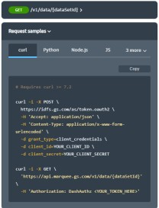
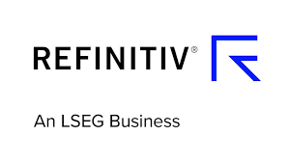





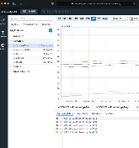
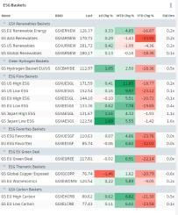
Cloud-native event-driven pipeline
REST APIs
ESG data
ESG scores
GS Financial Cloud
GS Quant
Carbon performance
Curated data
Data management
Data
analytics
Pricing data
PlotTool Pro
Set up
Elektron Real-Time
DataScope Plus

Slide 15
Cloud-native event-driven pipeline
REST APIs
ESG data
ESG scores
GS Financial Cloud
GS Quant
Carbon performance
Curated data
Data management
Data
analytics
Pricing data
PlotTool Pro
Set up
Elektron Real-Time
DataScope Plus

Slide 16
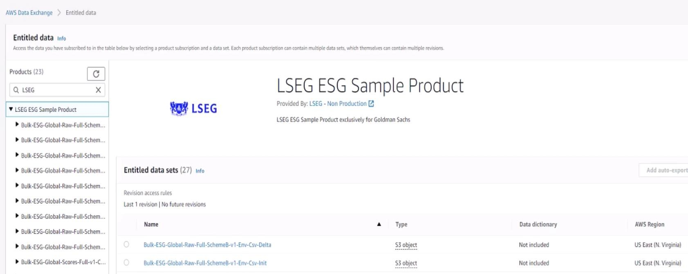
ESG reference data

Slide 17
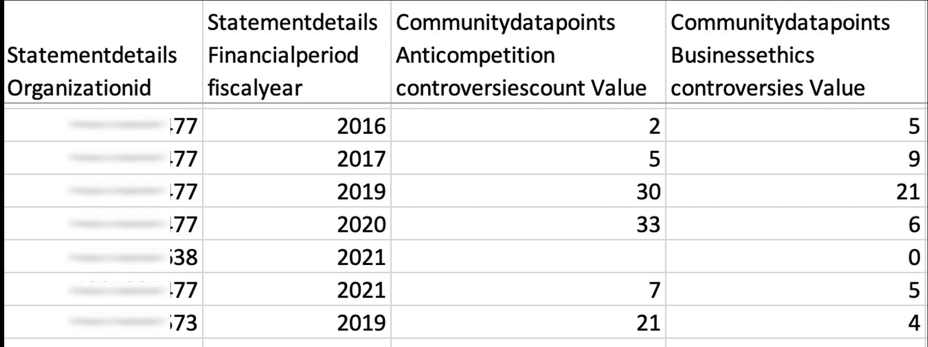
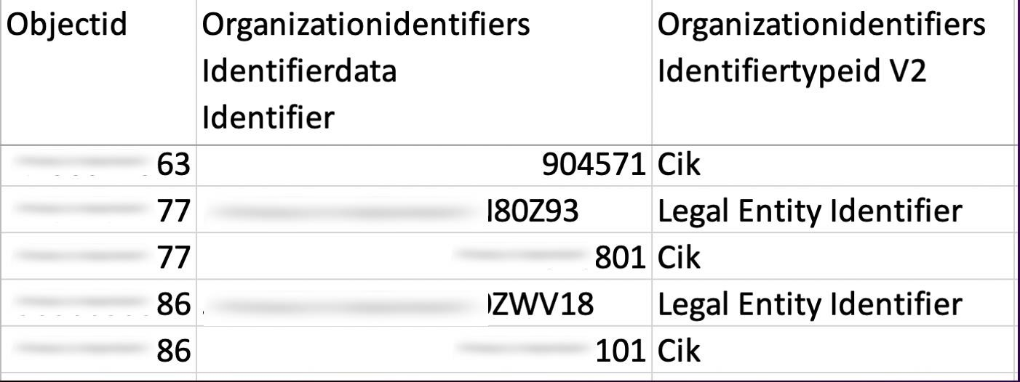
ESG raw data

Slide 18
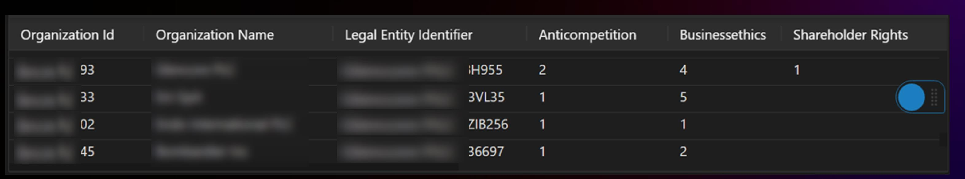
ESG raw data … and preferred form

Slide 19




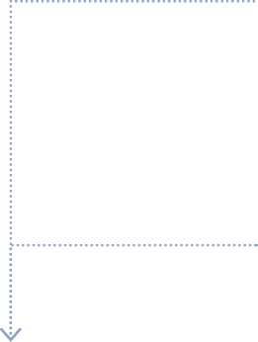




Reference data integration
Vendor data AWS Data Exchange VPC
Amazon Redshift
Amazon S3
Data streaming VPC
(Legend) connector
AWS Secrets Manager
AWS Lambda
AWS Glue
GS FCD
connector
Federated identity provider
GS Financial Cloud
Amazon CloudWatch
Amazon S3
(AWS Glue assets)

Slide 20
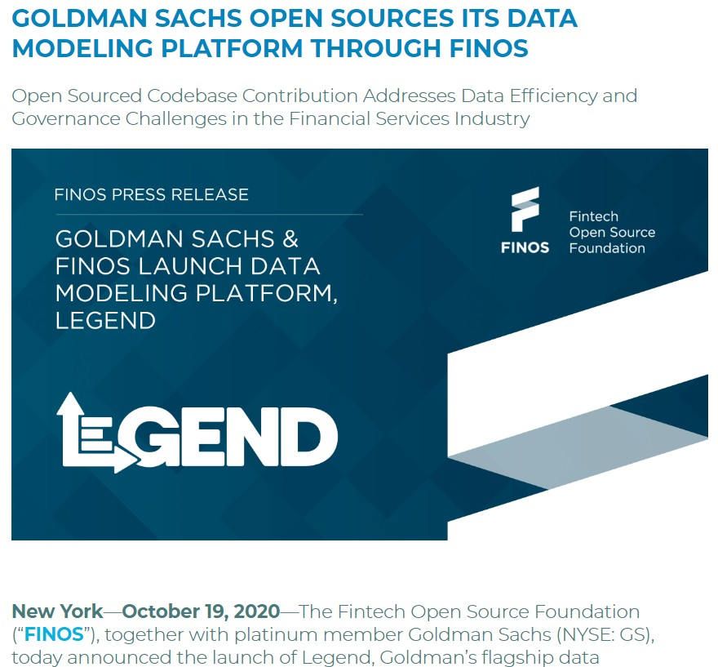

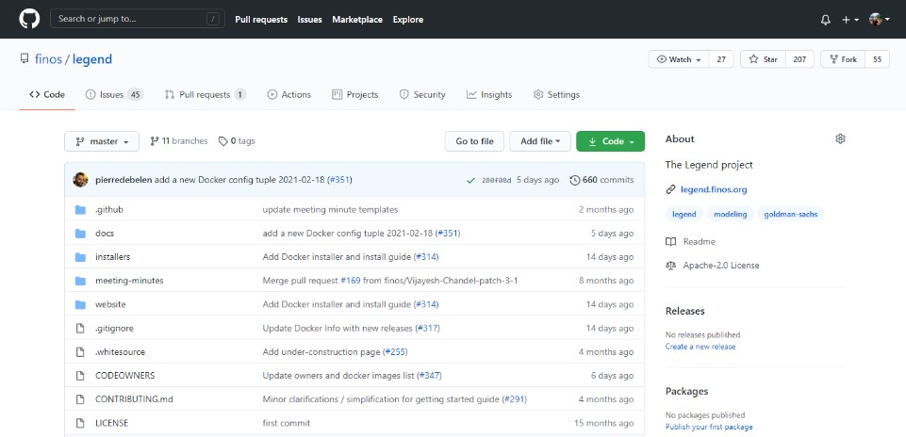
Legend: Open-source data management
Learn more at https://github.com/finos/legend and https://legend.finos.org

Slide 21

What is Legend?
DATA DISCOVERY
Discover important metadata and begin tackling business needs
DATA EXPLORATION
Explore and manipulate data, subject to entitlements, to understand and evaluate further investment
GOVERNANCE
Ensure data contracts and ownership are in place for shared governance with in-line constraints for safety and quality
End-to-end data modeling and management platform
BUSINESS UNDERSTANDING
Create data models to enhance business understanding and codify imprecise concepts
SOURCING & PUBLICATION
Publish data to other sources using APIs or conduct further processing for real-time sharing, all appropriately entitled

Slide 22
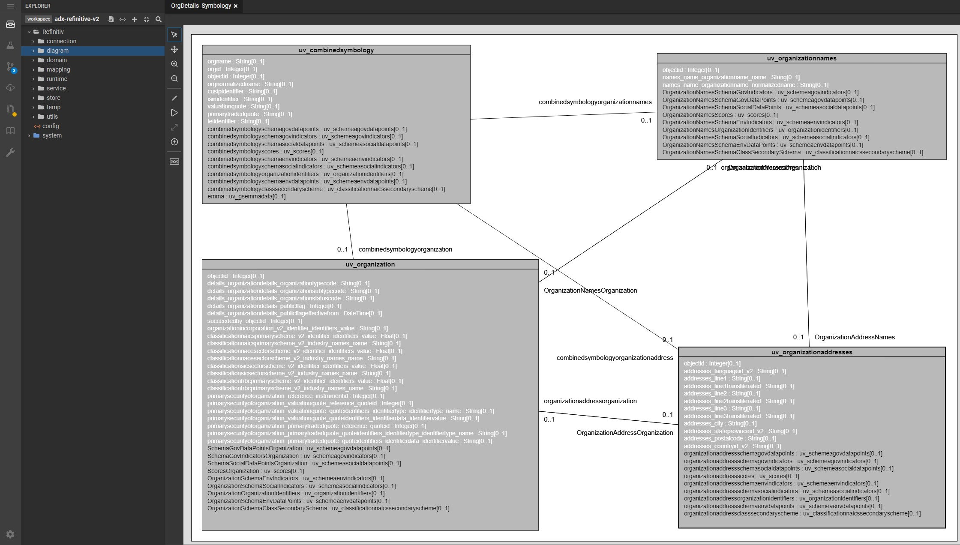
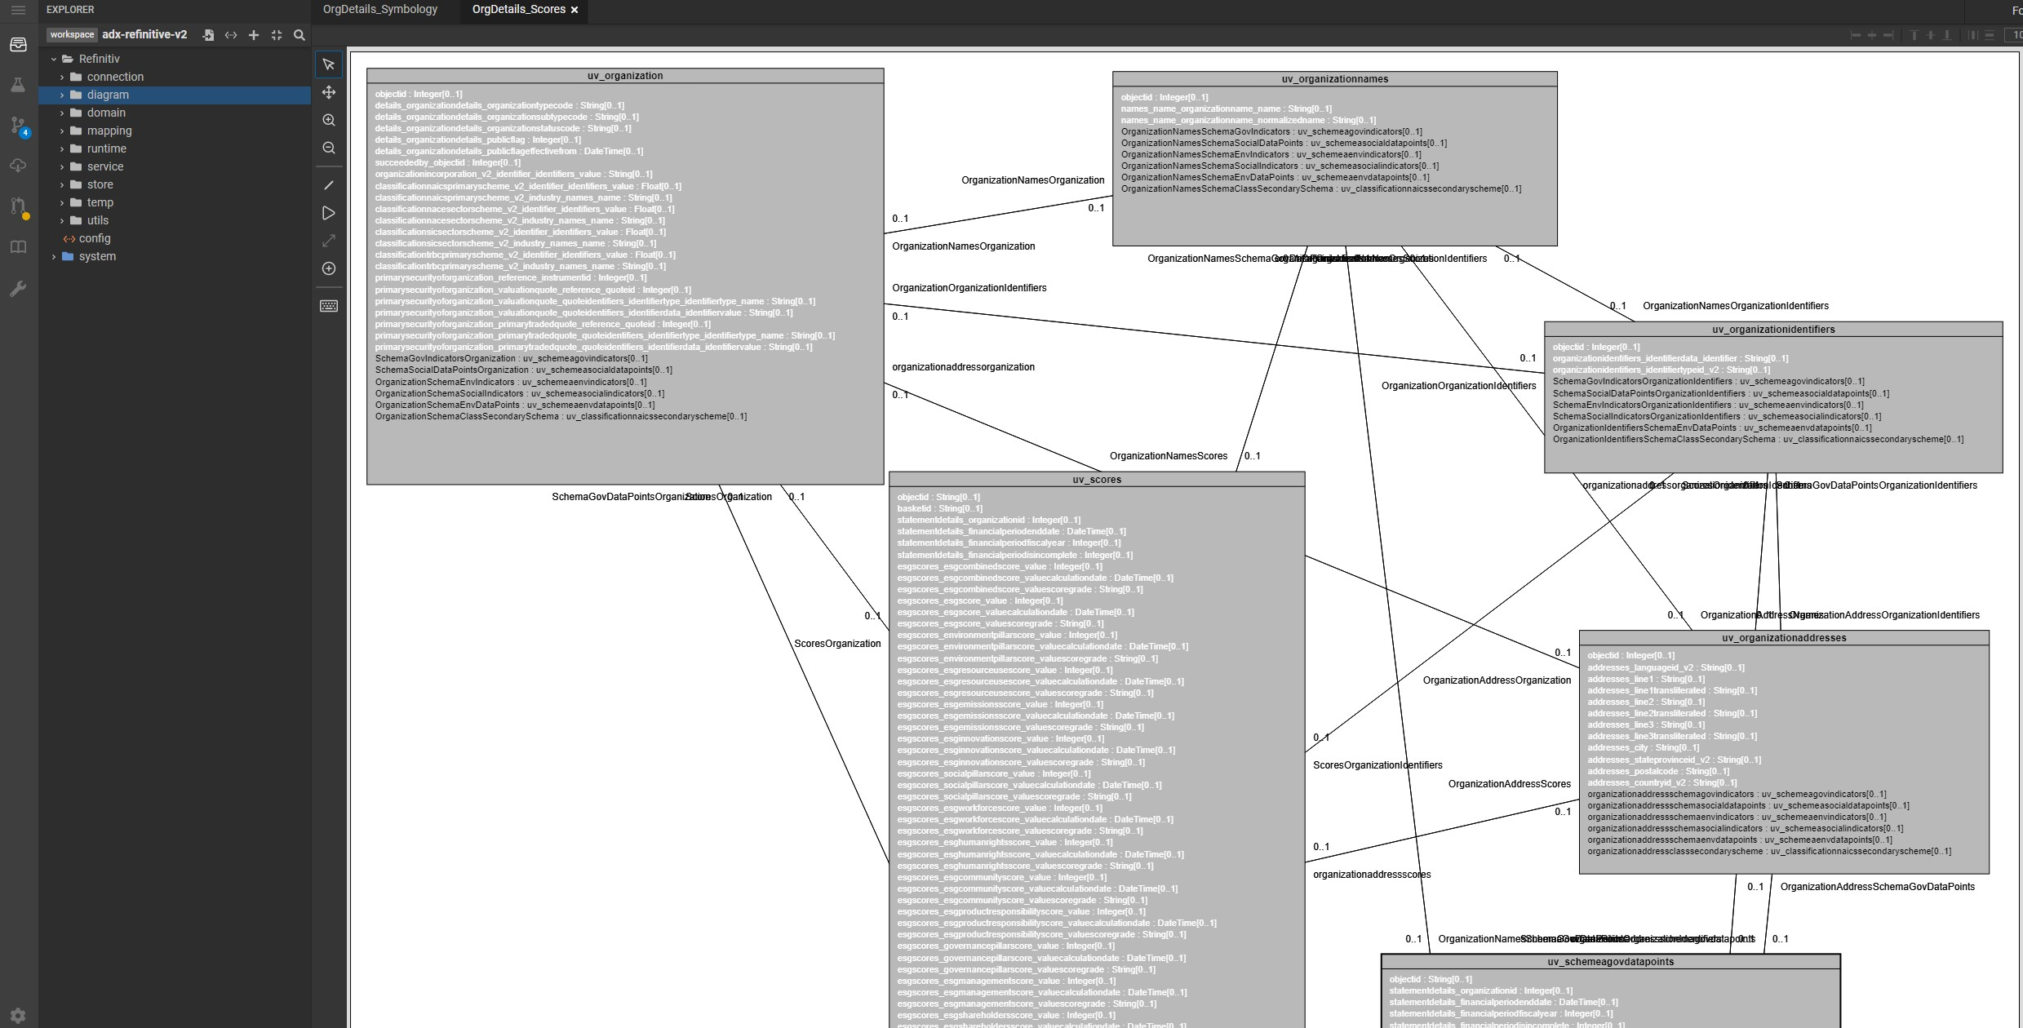
Modeling reference data

Slide 23
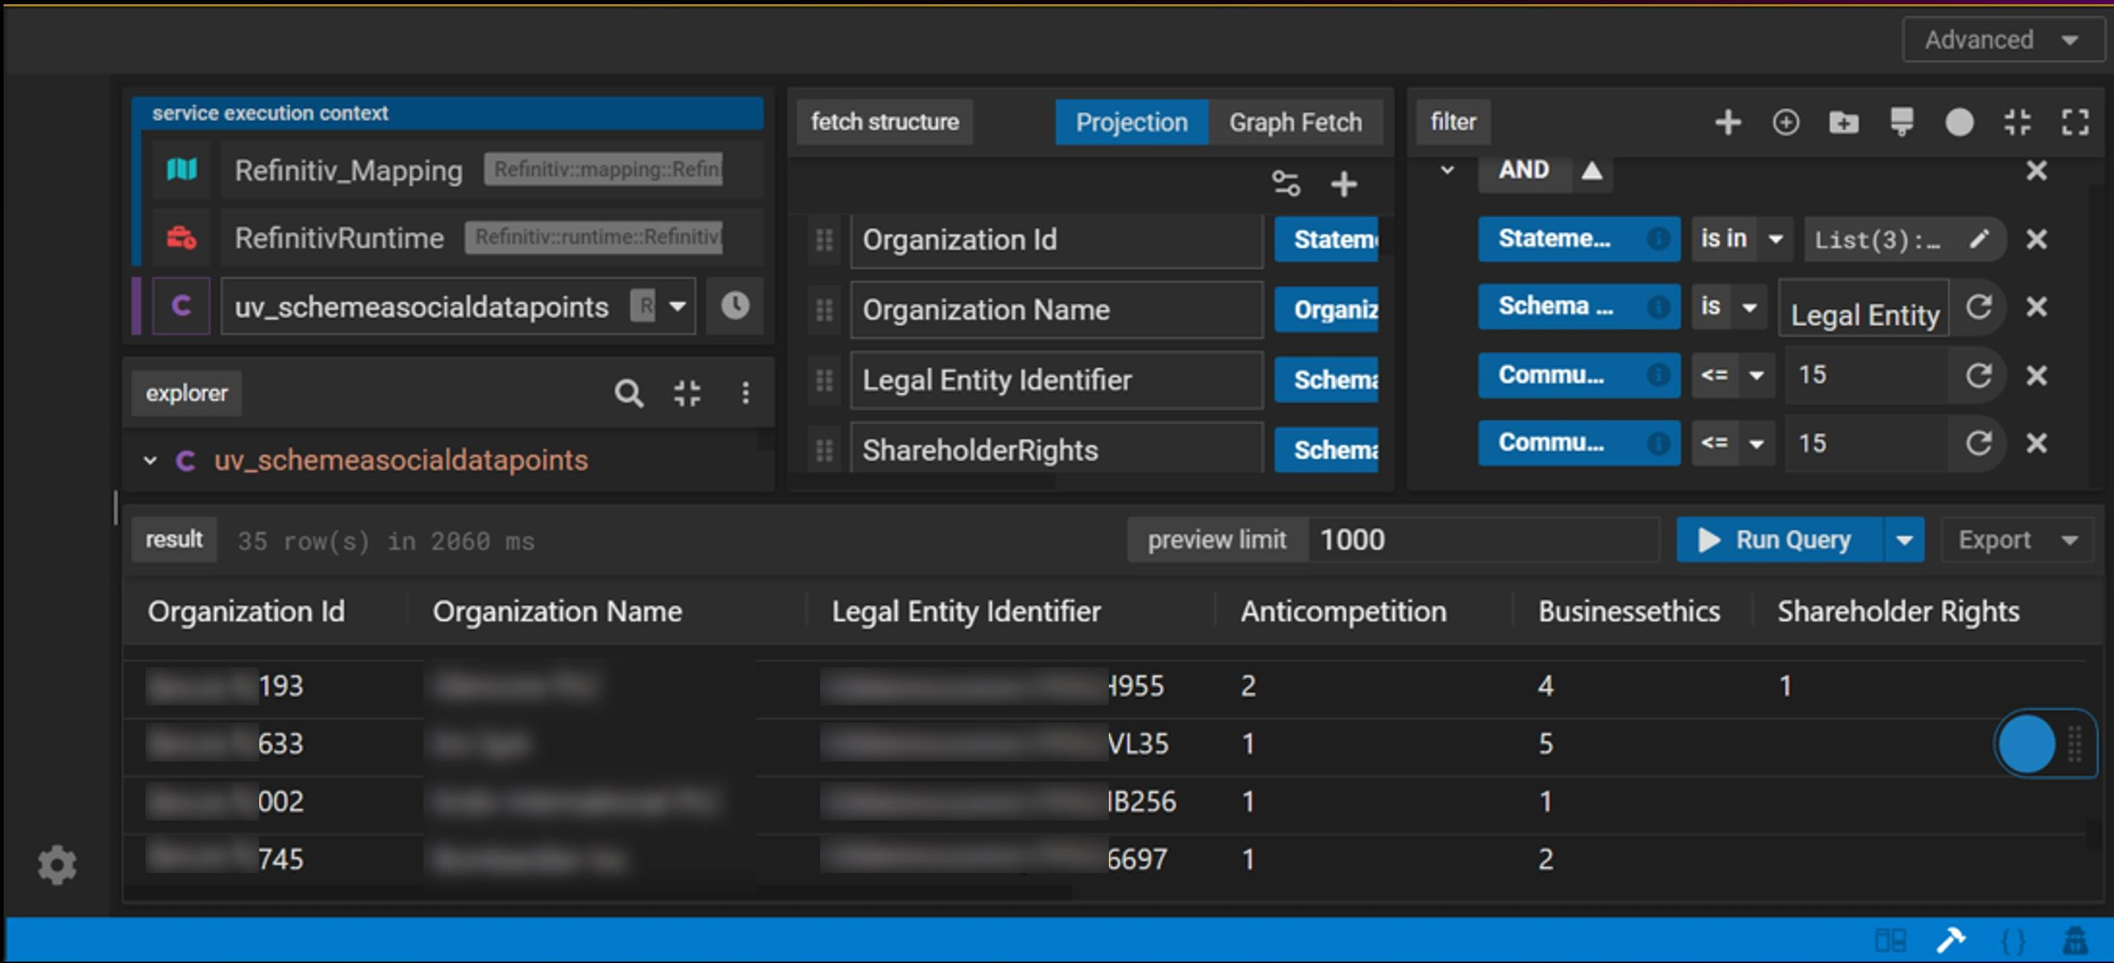
Legend Query – Self-service for all!

Slide 24


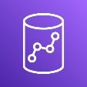



Walk-through
1
Queries AWS Data Exchange to find relevant reference data
AWS Data Exchange
2
Uses Legend Query to explore data,
identifying relevant attributes of interest
3
Models reference data and creates Legend Services to read data
Amazon S3
Amazon Redshift
4
Uses Persistence grammar construct in Legend to express pipelines that will move data
Data engineer
AWS Glue
5
Instructs the modeled reference data to flow into FinCloud
6
Verifies datasets are visible in FinCloud
Real-time market data from on-prem
7
Interrogates FinCloud via PlotTool Pro to visualize curated time-series data and gain some amazing insight
GS PlotTool Pro
GS FinCloud
GS Curated Data

Slide 25
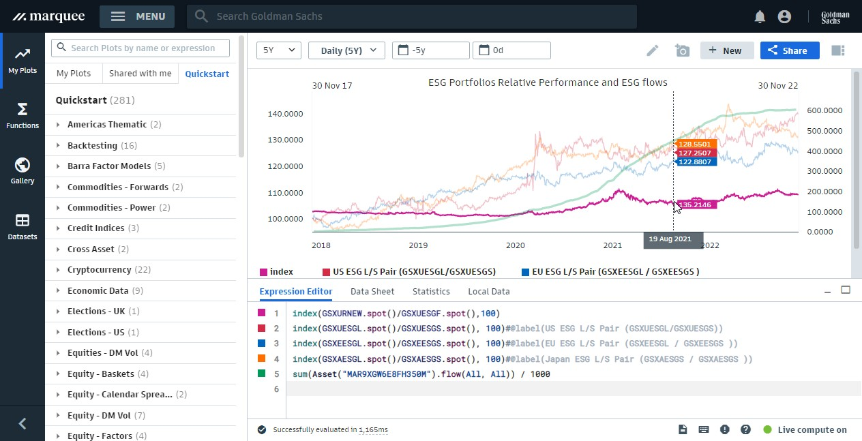
Accelerate research with instant feedback

Slide 26
Cloud-native event-driven pipeline
REST APIs
ESG data
ESG scores
GS Financial Cloud
GS Quant
Carbon performance
Curated data
Data management
Data
analytics
Pricing data
PlotTool Pro
Set up
Elektron Real-Time
DataScope Plus

Slide 27


Real-time market data ticker plant
GS
AWS Cloud
Transit VPC
 | GS t | ime-series DB | – | daily
VPC endpoint |  | DB instances | AWS KMS
GS time-series DB – intraday
Ticker plant
Collector and loader
AWS Direct Connect
Transit VPC
Elektron Real-Time
VPC
endpoint
DB instances
AWS KMS
Mutual TLS

Slide 28
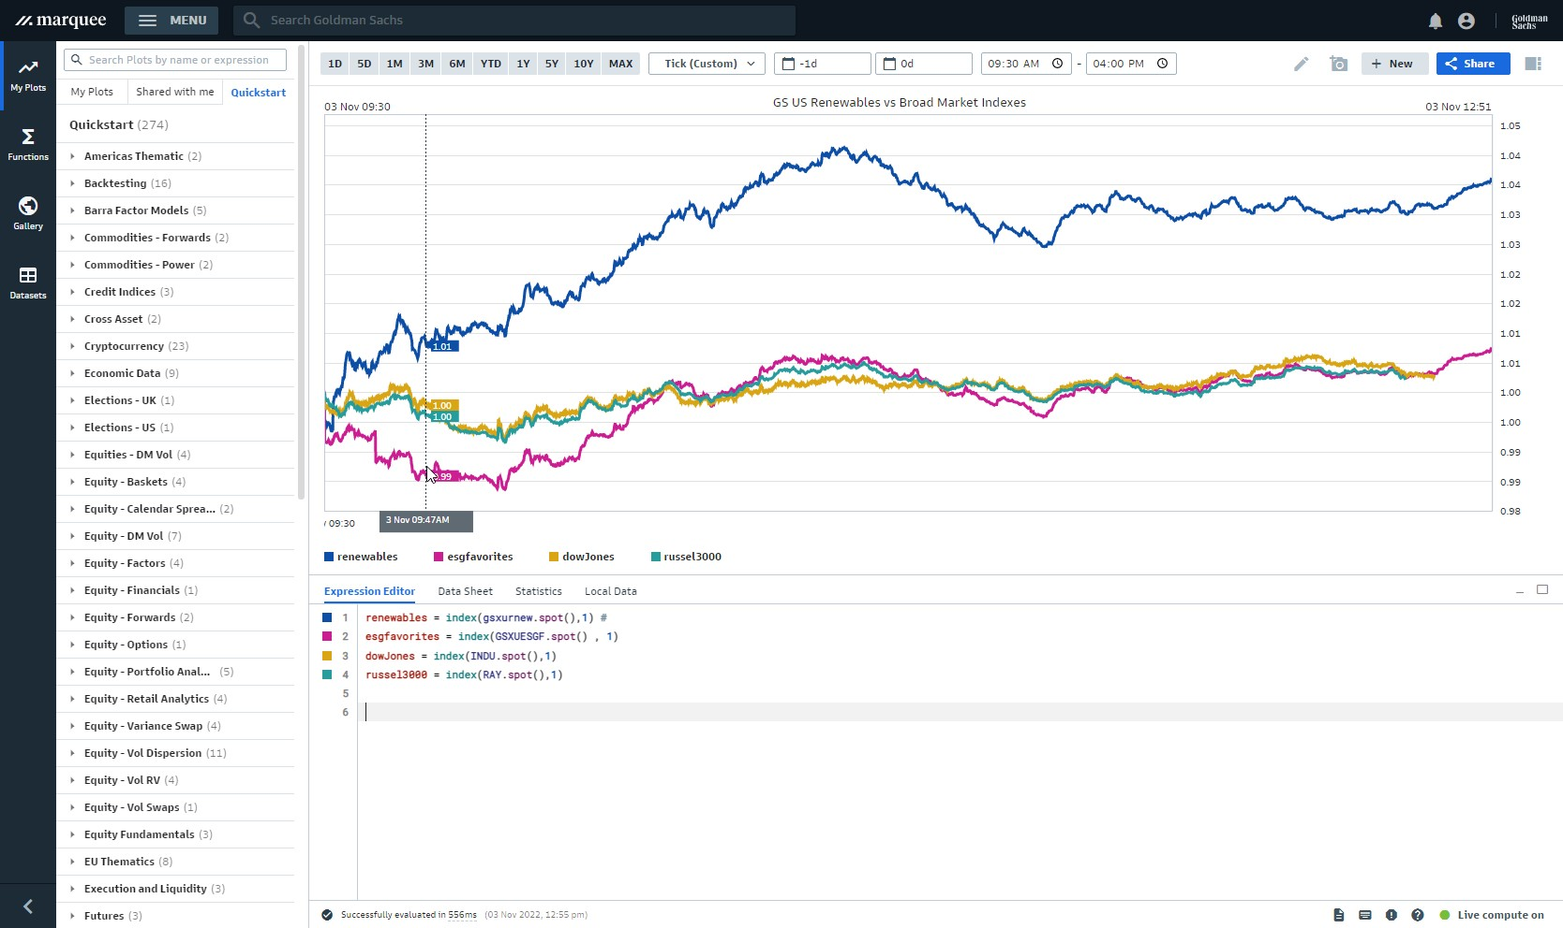
Intraday monitoring

Slide 29
Lessons learned
AWS
Petabyte-scale relational analytics
Live third-party data sharing
Serverless extract, transform, load
Goldman Sachs Financial Cloud for Data
Extensive curated financial data
Optimized time-series analytics
Scalable compute and storage
Plan and prepare
Serverless and managed for the win
Data lineage and ontology from Day 1
Engage early with security team
Demand for new, broad, deep data
Digital assets
ESG
Unstructured data
Highly complex relational data
Real-time analytics enabled by streaming data
On-premise and cloud systems must work together

Slide 30
Visit the Goldman Sachs booth
#3446
Visit the Financial Services Lounge
Caesars Forum Main Hall @ 2:30 - 4:00pm
developer.gs.com

Slide 31

Thank you!
Gerrard Cowburn
linkedin.com/in/gerrardcowburn
Ram Rajamony
linkedin.com/in/rajamony
Francesco Pontrandolfo
linkedin.com/in/francesco-pontrandolfo
Please complete the session survey in the mobile app

Slide 32
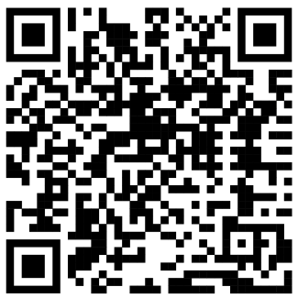



Further reading
https://developer.gs.com/discover/data/
https://aws.amazon.com/redshift/
https://aws.amazon.com/data-exchange/
https://legend.finos.org/

