Slide 1



Slide 2
Use AWS no-code services to build a credit default risk model
F S I 3 0 5
Xavier Loup
Principal Solutions Architect
AWS
Antoine Boucherie
Senior Solutions Architect
AWS
© 2022, Amazon Web Services, Inc. or its affiliates. All rights reserved.

Slide 3


What to expect?
Guided workshop
End to end business scenario
Hands on experience
No coding required
© 2022, Amazon Web Services, Inc. or its affiliates. All rights reserved.

Slide 4

Why no-code?
No-code is the best way to write secure and reliable applications
Write nothing; deploy nowhere
😉
© 2022, Amazon Web Services, Inc. or its affiliates. All rights reserved.

Slide 5


No-code – Getting started
Start by not writing any code.
Here is an example of a simple application:
You can also add more features:
😉
© 2022, Amazon Web Services, Inc. or its affiliates. All rights reserved.

Slide 6

Why no-code?
Democratize Innovation
Empower business users
Enable rapid prototyping
Improve Productivity
Harness the power of AWS without writing a single line of code
Remove communication barriers between business and IT
Extend Team
Grow your technical teams without relying on developer talent pools that are in high demand

Slide 7
No-code trend
In a June 2021 report, Gartner found that by 2024, 80% of tech products and services will be built by people who are not technology professionals
https://gtnr.it/3wOglym

Slide 8
Use cases in the financial services industry
Credit risk scoring
Fraud detection
Delayed payments prediction
Portfolio optimization
Account payables automation and many others!
© 2022, Amazon Web Services, Inc. or its affiliates. All rights reserved.

Slide 9


Today’s scenario
Loan system
Credit Bureau
Credit default risk ?

Slide 10
Data schema
Loan system
Credit Bureau
Column name | Description
national_id | National ID of the customer
loan_amount | The listed amount of the loan applied for by the borrower. If at some point in time, the credit department reduces the loan amount, then it will be reflected in this value.
loan_term | The number of payments on the loan. Values are in months and can be either 36 or 60.
interest_rate | Interest Rate on the loan.
installment | The monthly payment owed by the borrower if the loan originates.
verification_status | Indicates if income was verified, not verified, or if the income source was verified
issued_on | Date of issuance of the loan
purpose | A category provided by the borrower for the loan request.
dti | A ratio calculated using the borrower’s total monthly debt payments on the total debt obligations, excluding mortgage and the requested loan, divided by the borrower’s self-reported monthly income.
employment_length | Employment length in years. Possible values are between 0 and 10 where 0 means less than one year and 10 means ten or more years.
employer_title | Title of customer's current employment
home_ownership | The home ownership status provided by the borrower during registration. Our values are: RENT, OWN, MORTGAGE, OTHER.
annual_income | The self-reported annual income provided by the borrower during registration.
Column name | Description
national_id | National ID of the customer
earliest_credit_line | The month the borrower's earliest reported credit line was opened.
inquiries_last_6_months | The number of inquiries in past 6 months (excluding auto and mortgage inquiries).
open_credit_lines | The number of open credit lines in the borrower's credit file.
derogatory_public_records | Number of derogatory public records.
revolving_line_utilization_rate | Revolving line utilization rate, or the amount of credit the borrower is using relative to all available revolving credit.
total_credit_lines | The total number of credit lines currently in the borrower's credit file.
Lending Club Dataset available on Kaggle with a CCO Public Domain license
Column name | Description
loan_outcome | Outcome of the loan (target variable for our AI model)

Slide 11

Today’s Scenario
1
Credit Bureau data
retrieves
Prepared Data
3
2
AI Model Training & Testing
Credit Bureau
API
Join & prepare data
Training
Production
5
Loan data
historic
current
Model Inference
Batch transform job
Loan System
4
6
Visualization
of Data

Slide 12



Architecture Diagram
1
2
3
retrieves
5
Credit Bureau API
National Credit Bureau
Amazon AppFlow
Custom connector
Amazon S3 Bucket
AWS Glue DataBrew
Amazon S3 Bucket
SageMaker Canvas
Credit Bureau
data
Data
Preparation
Prepared data
Model Training & Testing
Customers
Loan System
Amazon S3 Bucket
6
4
Amazon QuickSight
Batch transform job
Loans data
Loans data
Visualization
Model Inference
Business Users

Slide 13
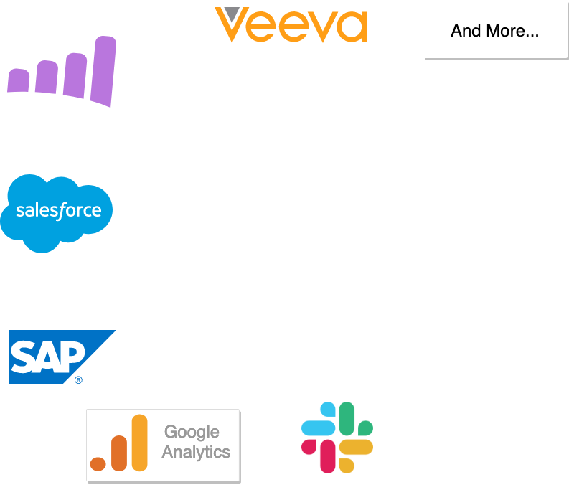
AWS AppFlow
No-code integration service
Main features
No-code bi-directional integration between SaaS solutions and AWS Services
50+ existing connectors for SaaS solutions including SAP, SalesForce, and Google Analytics
Possibility to create custom connectors
and much
more …
Amazon AppFlow
SaaS
Usage during the workshop
Retrieval of the Credit Bureau API data using a custom connector
Export to S3
Google Analytics

Slide 14
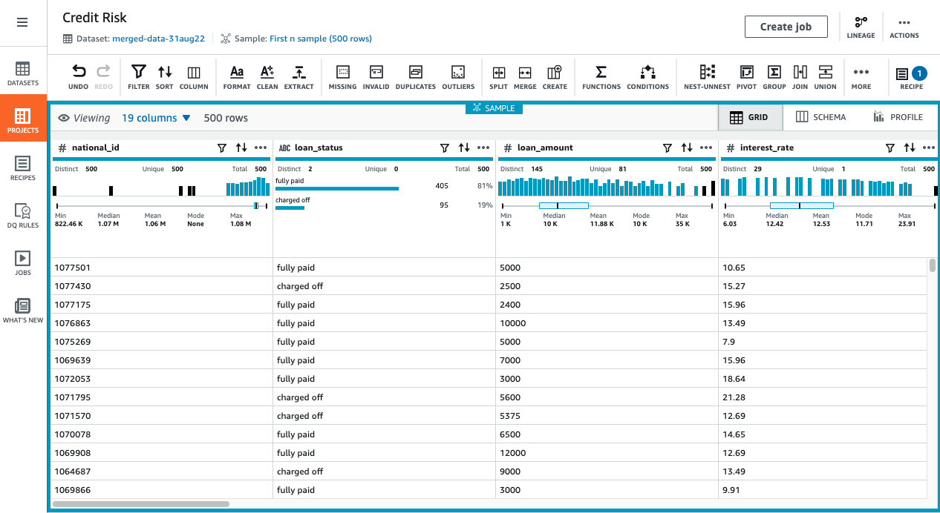
AWS Glue DataBrew
No-code data preparation service
Main features
Explore data with statistics
Clean and normalize data using over 250 built-in transformations
Build recipes using transformation steps
Run jobs to apply the recipe on incoming data
Usage during the workshop
Merging of loans data with Credit
Bureau data
Removal of unnecessary columns
Data cleaning / masking

Slide 15
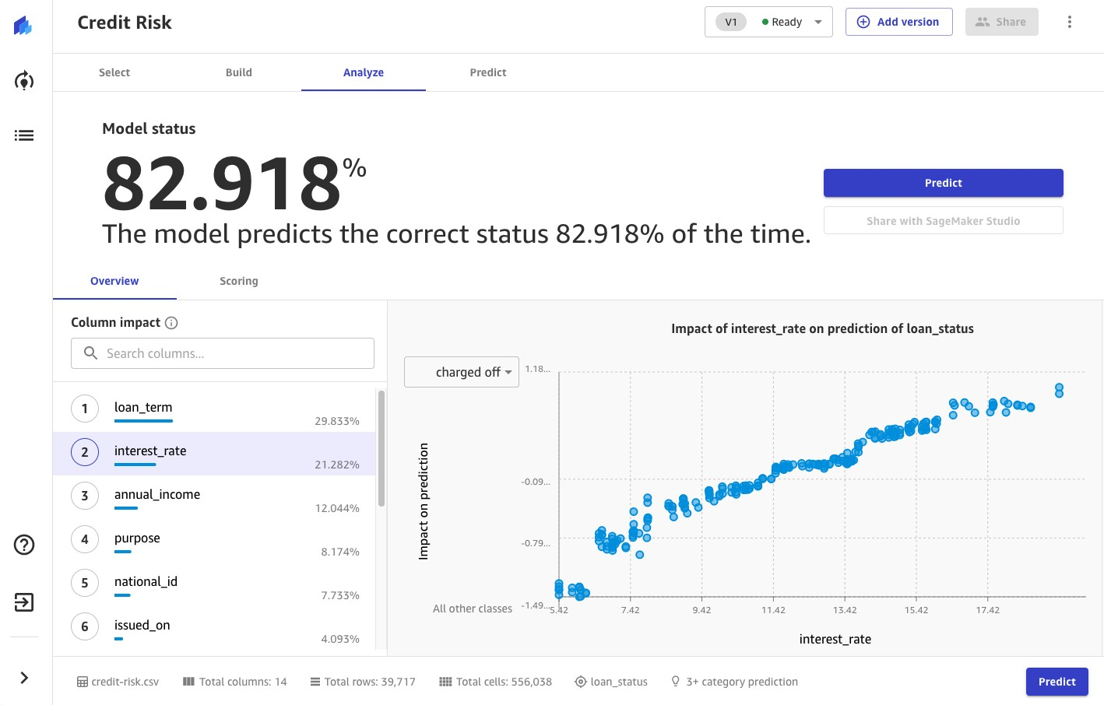
Amazon SageMaker Canvas
No-code Machine Learning
Main features
No-code creation of ML models for business users / analysts
Data cleansing and adjustment
Detailed statistics to understand predictions
Built-in sharing with SageMaker Studio for Data Science teams
Usage during the workshop
Build of the credit risk ML model
Batch prediction of credit default risk for current loans

Slide 16
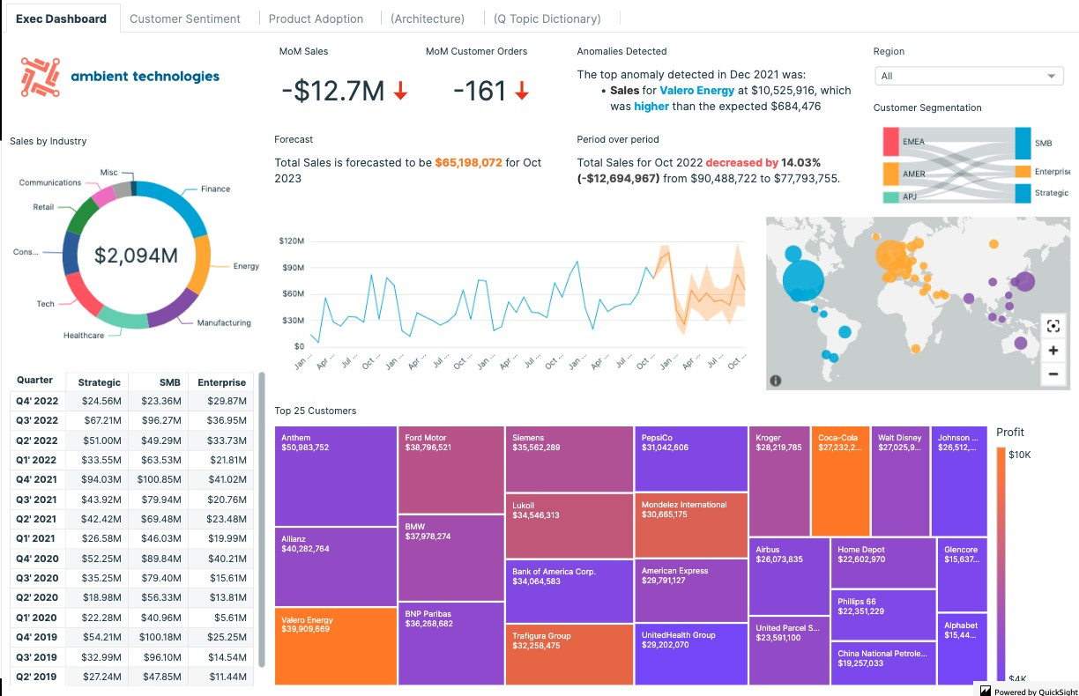
Amazon QuickSight
Business Intelligence
Main features
Customizable dashboards to analyze your data
No-code, simple UI
ML integration for smart insights
No servers to manage, pay by usage
Usage during the workshop
Visualization of the historic and
current data
Integration with SageMaker to predict credit default risk for current loans

Slide 17
Keep in mind
Some small laptop screens may have problems with image sizes; you may need to resize your browser window
Avoid doing the “Optional steps” unless you are really ahead
If you get lost, ask for help!

Slide 18
Links
Workshop Guide
https://catalog.workshops.aws/fsi-nocode
Event Portal
https://tinyurl.com/FSI305-workshop

Slide 19



Bonus - Let’s automate!
Event Bus
notifies
triggers
Amazon EventBridge
AWS Step Functions workflow
retrieves
Model Training & Testing
Credit Bureau API
National Credit Bureau
Amazon AppFlow
Custom connector
S3 Bucket
Credit Bureau data
AWS Glue DataBrew
Data
Preparation
S3 Bucket
Prepared data
SageMaker Canvas
Customers
S3 Bucket
Loans data
Loan S_{L}ys_{o}t_{a}e_{n}m
Application
infer
Amazon QuickSight
Visualization
Batch transform job
Model Inference
© 2022, Amazon Web Services, Inc. or its affiliates. All rights reserved.
Business Users

Slide 20
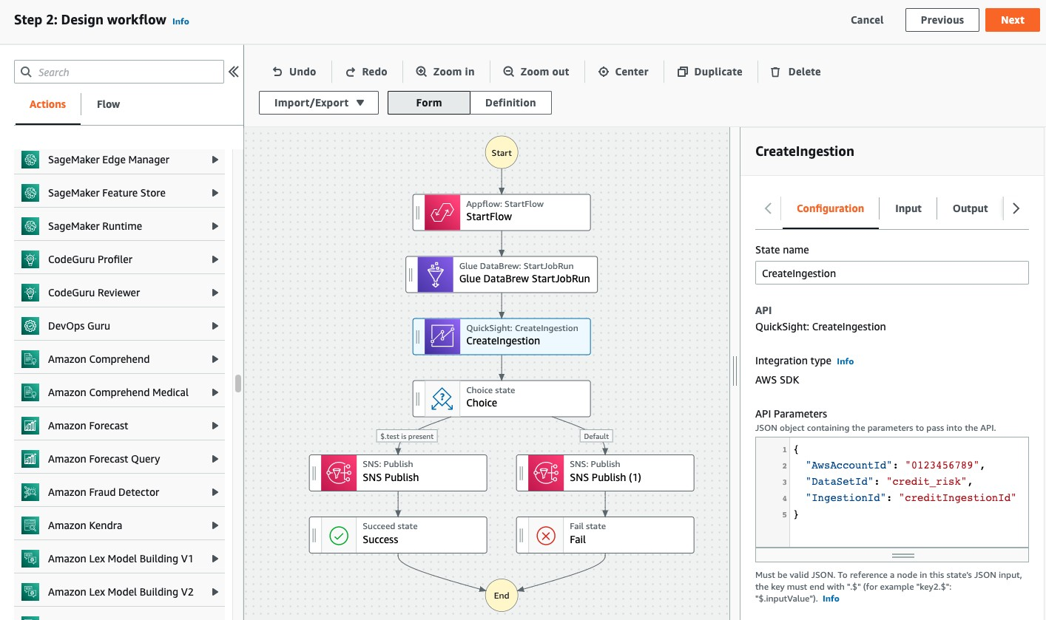
Visual workflow with AWS Step Functions

Slide 21

Conclusion
© 2022, Amazon Web Services, Inc. or its affiliates. All rights reserved.

Slide 22
What have we learned
Use cases for no-code / ML in FSI
How to import and synchronize data from a 3rd party with Amazon AppFlow
How to do data preparation with AWS Glue DataBrew
How to train a new AI model in a few clicks with Amazon SageMaker Canvas
How to visualize data with Amazon QuickSight
How to test your model in Batch mode within Amazon SageMaker Canvas
How to call a SageMaker model from QuickSight with the "Augment with SageMaker" feature
In less than 2 hours without a single line of code

Slide 23
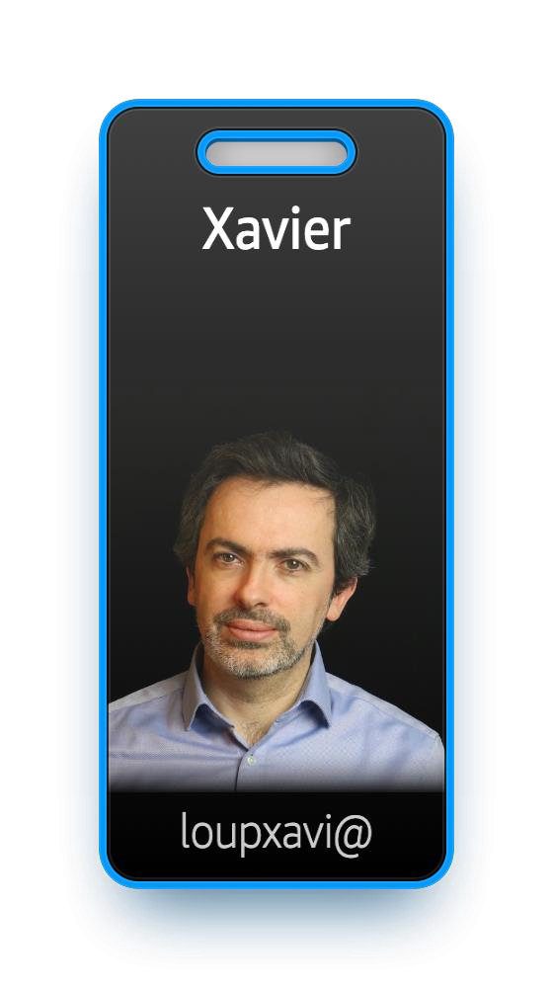
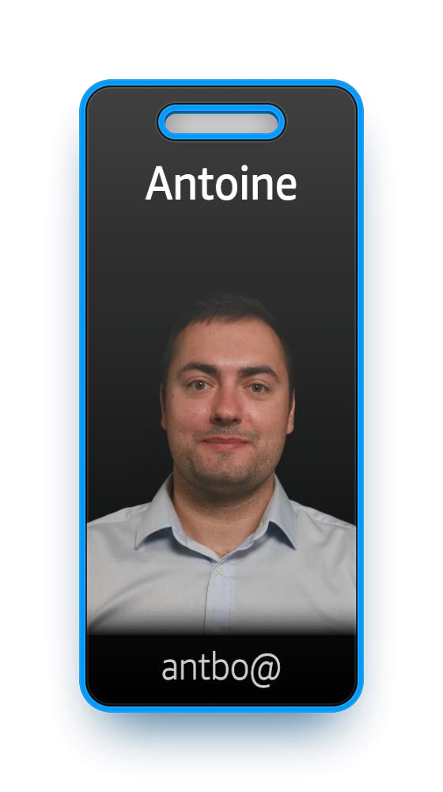
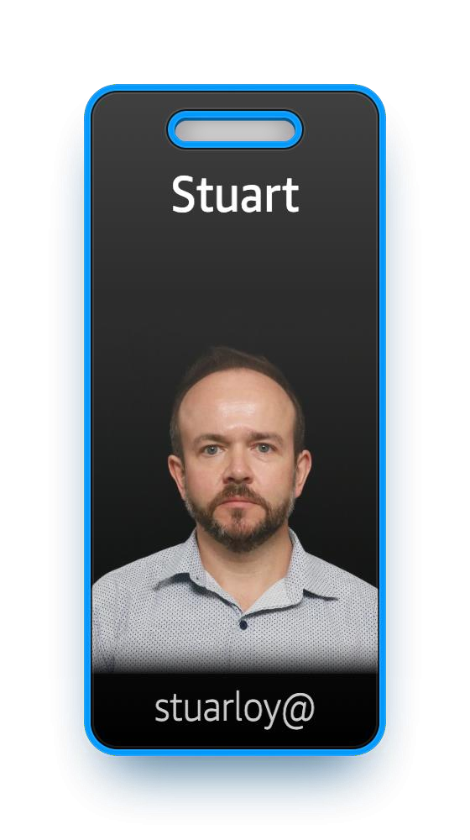
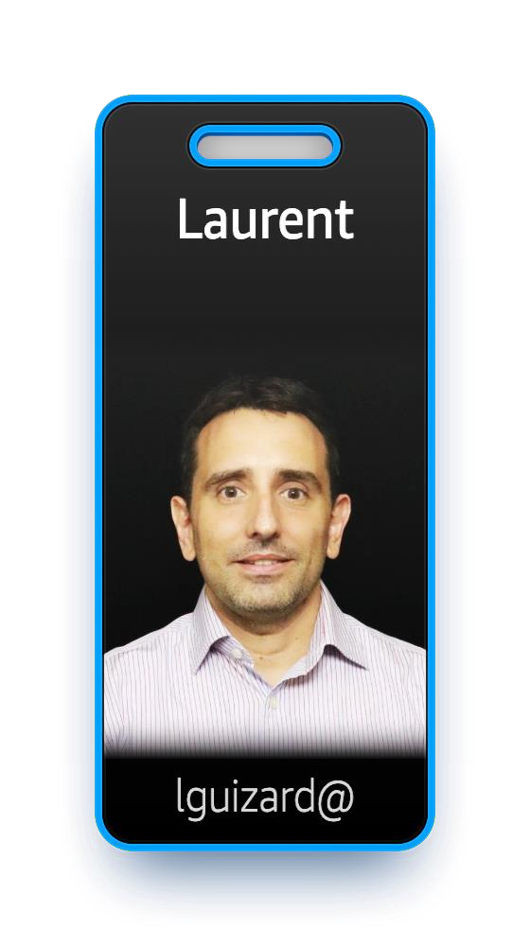

Credits
And also
Support team
Specialists
Reviewers
© 2022, Amazon Web Services, Inc. or its affiliates. All rights reserved.

Slide 24

Thank you!
Xavier Loup
loupxavi@amazon.com
Antoine Boucherie
antbo@amazon.com
Please complete the session survey in the mobile app

