Slide 1


C H I C A G O | A U G U S T 2 5 , 2 0 2 2

Slide 2


Modernize your applications with purpose-built AWS databases
D A T 2 0 1
Bill Baldwin
Tech Leader, Databases
AWS

Slide 3
Agenda
Key attributes of modern database applications
Modern database architecture Modernization at Amazon
The pursuit of the “ideal” database
Database modernization playbooks
Typical modernization journey with purpose-built databases

Slide 4
Key attributes of modern applications
Designed for
Without limits on
Is
Innovation and
agility
Performance and scalability
Highly available, easily managed, and
cost-effective

Slide 5

Modern data architecture
From traditional . . . . . . to microservices, decoupled architectures
Web servers
Presentation layers
Presentation
Application servers
Business logic
Events
Events
Business
logic
Database servers
Data layer
Queues + Caches + Messages
Data

Slide 6









Modernization at Amazon
L E S S O N L E A R N E D : D E C O M P O S E F O R I N N O V A T I O N A N D A G I L I T Y
Monolithic application
Microservices
Central database and dependent teams
Independent databases and two-pizza teams

Slide 7








Two-pizza teams are fast and agile!
Full ownership and autonomy
You build it, you run it DevOps – small, nimble teams Rapid innovation
Clean interfaces

Slide 8
The modernization virtuous cycle
Organizational alignment on business priorities
Technology transformation
Data sharing interfaces and data contracts
Governance
Business
transformation
framework to
empower teams
Decoupled technology decisions

Slide 9
The pursuit of the “ideal” database
T H E I D E A L D A T A B A S E S H O U L D D O E V E R Y T H I N G W E L L
Innovation
and agility
Performance
and scalability
Cost-effective and
easy to manage
Supports all storage
(data types) and
all access patterns
Provides limitless scalability and tolerates load variability
Is continuously available (no downtime)
Is simple and easy to use, tune, and maintain
Implements ACID transactions and strong consistency
Is highly performant regardless of query complexity
Is cost-effective
and predictable
. . . and more!

Slide 10

The pursuit of the “ideal” database
T H E I D E A L D A T A B A S E S H O U L D D O E V E R Y T H I N G W E L L
Innovation
and agility
Performance
and scalability
Cost-effective and
easy to manage
Supports all storage
(data types) and
all access patterns
Provides limitless scalability and tolerates load variability
Is continuously available (no downtime)
Is simple and easy to use, tune, and maintain
Implements ACID transactions and strong consistency
Is highly performant regardless of query complexity
Is cost-effective
and predictable
. . . and more!

Slide 11




















Explosion of database solutions
ORACLE
Microsoft SQL Server
Amazon DynamoDB
Amazon RDS
Amazon Aurora
Apache Cassandra
Apache HBase
Amazon DocumentDB (with MongoDB compatibility)
Amazon Keyspaces
(for Apache Cassandra)
TiDB
Memcached
Amazon ElastiCache
Amazon MemoryDB
for Redis
. . . and more!
Neo4j
Amazon Timestream
Amazon Neptune
Amazon QLDB

Slide 12
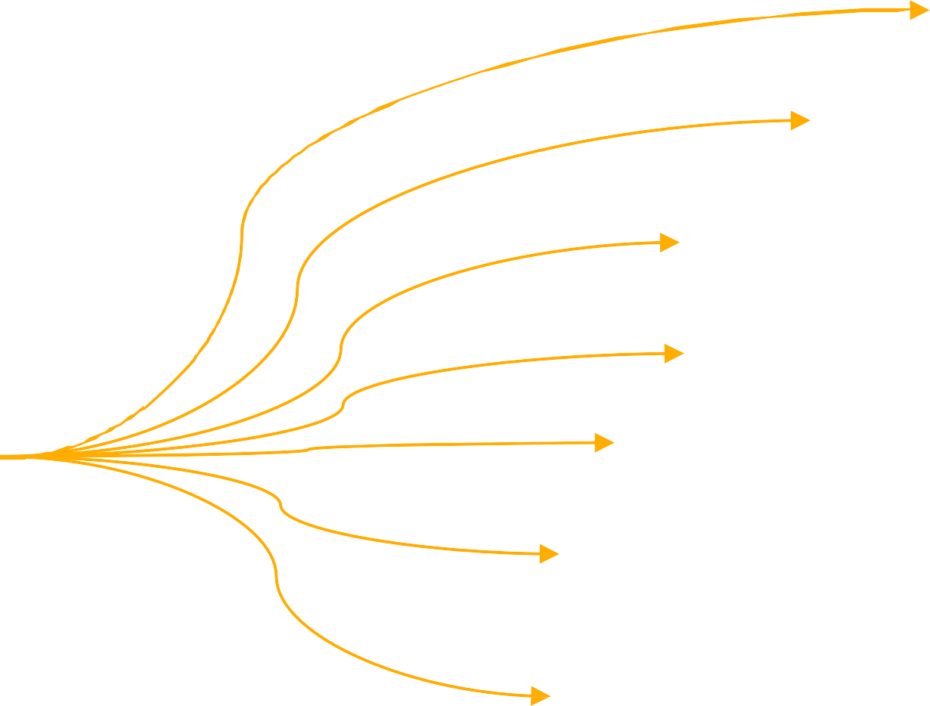
Purpose-built databases
U S E T H E R I G H T T O O L F O R T H E J O B
Relational databases
Key-value databases Document databases
Wide-column databases
The “ideal”
database
Graph databases
Time-series databases
Ledger databases
. . . and more!

Slide 13
Modernization using purpose-built databases
So, where do we start?

Slide 14
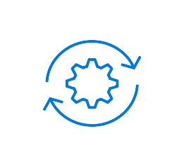


Database modernization playbooks
Move to managed databases
Break free from legacy databases
Modernize with purpose-built databases
Self-managed
AWS-managed
Commercial
Open source
Monolithic
Microservices
Oracle SQL Server MongoDB Redis
…
Aurora Amazon RDS
Amazon DocumentDB
ElastiCache MemoryDB
Oracle SQL Server IBM DB2
Sybase
…
Oracle SQL Server MySQL
PostgreSQL
…
DynamoDB
Aurora Neptune
Amazon DocumentDB
Timestream
…
Aurora Amazon RDS

Slide 15

Both migration and modernization are important
Innovation velocity
Total
cost of ownership (TCO)
On premises
Lift and shift
Move to managed databases
Break free from legacy databases
Modernize with purpose-built databases

Slide 16
Modernization using purpose-built databases
It’s a journey!

Slide 17



Typical database modernization journeys start here
Existing business-critical applications
Modernization of existing applications
Typically monolithic
Made to fit relational databases
But also
Start up new applications
Rapid prototyping, developed locally
ORM/ODM heavy for agility

Slide 18


Step 1: Move to a managed database
Adopt cloud-native relational databases
Amazon RDS, Amazon Aurora
Adopt a managed database
Agile, easily managed, cost-effective
Reduce operational burden
Take advantage of platform features

Slide 19





Amazon RDS
M A N A G E D R E L A T I O N A L D A T A B A S E S E R V I C E W I T H A C H O I C E O F P O P U L A R D A T A B A S E E N G I N E S
Microsoft SQL Server
ORACLE
Easy to administer
Easily deploy and maintain hardware, OS, and DB software; built-in monitoring
Performant and scalable
Scale compute and storage with a few
clicks; minimal downtime
for your application
Available and durable
Automatic Multi-AZ data replication; automated backup, snapshots,
and failover
Secure and compliant
Data encryption at rest and in transit; helps customers achieve their compliance goals through tooling

Slide 20
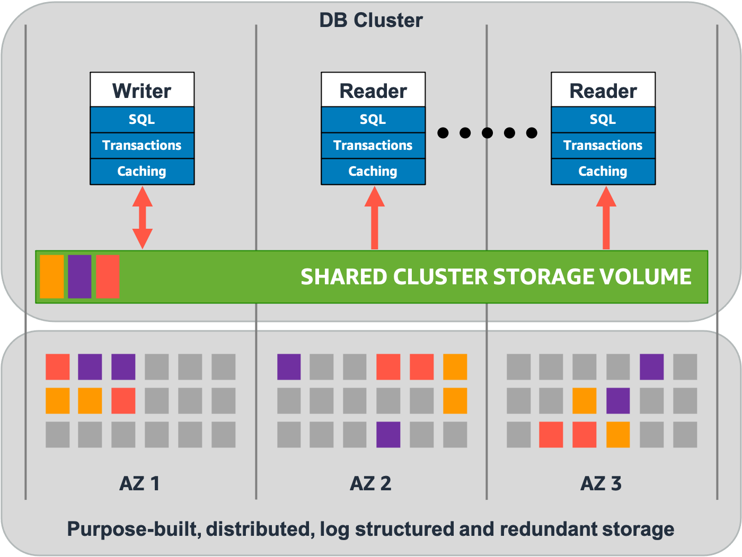
Amazon Aurora
E N T E R P R I S E D A T A B A S E A T O P E N - S O U R C E P R I C E , D E L I V E R E D A S A M A N A G E D S E R V I C E
Drop-in compatibility with MySQL and PostgreSQL
Compatible with T-SQL (Microsoft SQL Server) using Babelfish for Aurora PostgreSQL
Simplicity and cost-effectiveness of open-source databases
Throughput and availability of
commercial databases
Simple pay-as-you-go pricing
Global database with deployment in
multiple Regions
Serverless DB clusters that are instantly scalable

Slide 21











Evolution of AWS-managed relational databases
Router fleet
Compute
Compute fleet
Automatically grows and shrinks
Compute
Storage fleet
Automatically grows and shrinks
Storage fleet
Automatically grows and shrinks

Slide 22

Reddit was founded in 2005 and ranks as the 17th most visited website in the world. The social media company was experiencing hyperscale growth, with its monthly active users surging 30% year over year.
Challenge
A substantial operational burden associated with self-managing its relational database was constraining Reddit’s team and putting quality service delivery to its users at risk.
“
Using Aurora, we could build a longer- term strategy for how we were dealing with data and do more strategic thinking for long-term projects.
Solution
Migrating from self-managed PostgreSQL on Amazon EC2 to Aurora was a key component of Reddit’s success. It has resulted in not only higher database reliability, faster backup restoration and point-in-time recovery, and fast automated failovers but also improved productivity for engineers.
“
Jason Harvey
Principal Engineer
Reddit

Slide 23

Step 2: Cache and persistent in-memory data
Adopt cloud-native relational databases
Amazon RDS, Amazon Aurora
Address scaling pain
Low-hanging fruit, easy to adopt
Offload repetitive read operations
Offload session state
Caching
Cache frequently accessed data
Amazon ElastiCache
Persistent/durable
in-memory data structures
MemoryDB
Increase performance
Frequent counters
Fast-changing rankings
Submillisecond data access

Slide 24

AWS in-memory managed solutions
Durability spectrum
Semi-durable
Ephemeral
Durable
ElastiCache for Memcached
ElastiCache for Redis
Amazon MemoryDB for Redis
 | ElastiCache for Memcached | ElastiCache for Redis | MemoryDB for Redis
Maximum size | 20 nodes/13 TiB | 500 nodes/340 TiB | 500 nodes/128 TiB
Replication | No | Yes | Yes
Failover | Not available | Automatic | Automatic
Data types | 1 | Many | Many
Commands | 9 | 100+ | 100+

Slide 25

PayPay Corporation is one of Japan’s leading mobile payment applications, with more than 30 million users completing millions of cashless transactions every day. PayPay has been using ElastiCache for Redis both as a distributed cache and a low-latency persistent data store.
“
We chose ElastiCache because we needed a fully managed and highly scalable distributed Redis cluster for numerous microservices. For example, our authentication service is based on access tokens stored in ElastiCache for Redis. Because every API call requires authentication, this service handles a huge amount of traffic per second and requires submillisecond performance. ElastiCache for Redis makes this possible.
Challenge
The team was asked to build the QR Code Payment Service in a
short period: 3 months.
Solution
PayPay adopted a microservices architecture on AWS designed to support the growth of the business. Each microservice team can choose the right database solution according to the application requirements.
“
Shilei Long Senior Software Architect PayPay Corporation

Slide 26




Amazon MemoryDB for Redis
R E D I S C O M P A T I B I L I T Y W I T H M U L T I - A Z D U R A B I L I T Y
MemoryDB cluster
Ultra-fast
performance
Lowest-latency database offered by AWS
Redis
compatibility
Flexible and friendly Redis APIs and data structures
Availability Zone A
Availability Zone B
Availability Zone C
Primary
Replica
Replica
Fully managed
AWS-managed hardware and software setup, configuration, monitoring, and snapshots
SET A 100
High scalability
Up to 500 nodes and 128 TiB of in-memory storage per cluster
(with 1 replica per shard)
Redis
client
ACK
SET A 100
SET A 100
SET A 100
ACK
Durability and high availability
Multi-AZ transactional log for durability and replicas for high availability
Security
Amazon VPC, encryption at rest and in transit, access control lists (ACLs)
Multi-AZ transaction log
Synchronous
Asynchronous

Slide 27

Step 3: Nonrelational query patterns
Adopt cloud-native relational databases
Amazon RDS, Amazon Aurora
Breaking down the monolith
Right tool for the job
Microservice access pattern drives data store decision
Cache frequently accessed data
Amazon ElastiCache
Persistent/durable
in-memory data structures
MemoryDB
Benefits
Agility
Scalability
Performance
Key-value, globally accessible datasets Amazon DynamoDB
Document type datasets
Amazon DocumentDB
Wide-column datasets
Amazon Keyspaces

Slide 28



Amazon DynamoDB
F A S T A N D F L E X I B L E N O S Q L D A T A B A S E A T A N Y S C A L E
Performance at scale
No servers to manage
Enterprise-ready
Global tables
Delivers consistent, single-digit millisecond latency
Handles millions of requests per second
Maintenance-free
Auto scaling
On-demand capacity mode
Up to 99.999% SLA
ACID transactions
Encryption at rest
Continuous backups, on-demand backup and restore
Integration with
other AWS services
Build global applications
Get fast access to local data
Automated global replication
DynamoDB is ideal for
Serverless and event-driven architectures • Globally resilient services • High-throughput workloads

Slide 29

Zoom Video Communications, Inc. provides videotelephony and online chat services through a cloud-based peer-to-peer software platform and is used for teleconferencing, telecommuting, distance education, and social relations.
Challenge
Beginning in early 2020, Zoom’s software usage saw a significant global increase after quarantine measures were adopted in response to the COVID-19 pandemic.
“
On the backend, we were able to manage this surge with Amazon DynamoDB for Zoom Meetings. Using DynamoDB global tables in conjunction with on-demand mode enabled us to scale nearly infinitely with no performance issues, even with our sudden spike in usage.
Solution
DynamoDB global tables using on-demand capacity allowed Zoom to scale and meet that global increase in demand for their services.
“
Yasin Mohammed Engineering Manager, Cloud Operations Zoom Video Communications, Inc.

Slide 30



Amazon DocumentDB
F A S T , S C A L A B L E , A N D F U L L Y M A N A G E D M O N G O D B - C O M P A T I B L E D A T A B A S E S E R V I C E
Fast and scalable
Scale compute in minutes
Storage and I/O auto scaling
Storage scales to 64 TB without sharding
Scale out to 15 replicas for millions of reads
Globally distributed
Enterprise-ready
Built-in high availability
Backups enabled by default
Durable by default
Security best practices by default
Automatic patching
Monitoring and alerting
MongoDB-compatible
Applications, drivers, and tools can be used with little or
no change
Supports hundreds of APIs, operators, and stages
Continually working backward from customers to deliver the capabilities they need
Amazon DocumentDB is ideal for
Content management • Real-time big data • User or product profiles

Slide 31

Amazon Keyspaces
F U L L Y M A N A G E D A P A C H E C A S S A N D R A – C O M P A T I B L E D A T A B A S E S E R V I C E
Compatible with Apache Cassandra
Existing applications
New applications
Developer skill sets
Performance at any scale
Handles millions of requests per second
Delivers single-digit millisecond latency
Serverless
Enterprise-ready
No compaction
Fully managed
Auto scaling
Point-in-time recovery backups
Encryption at rest
IAM integration
Amazon Keyspaces is ideal for workloads with
Multiple independent sorts • Rows up to 1 MiB in size
Schema validation

Slide 32
Step 4: Specialized data interactions
Adopt cloud-native relational databases
Amazon RDS, Amazon Aurora
Specialized datasets
Social graphs
Recommendation
engines
Measurements
Systems of record
Digital records
Systems of record
and ledgers
Amazon QLDB
Cache frequently accessed data
Amazon ElastiCache
Time-series datasets
Amazon Timestream
Persistent/durable
in-memory data structures
MemoryDB
Benefits
Agility
Scalability
Performance
Graphs and highly connected data Amazon Neptune
Key-value, globally accessible datasets Amazon DynamoDB
Document type datasets
Amazon DocumentDB
Wide-column datasets
Amazon Keyspaces
© 2022, Amazon Web Services, Inc. or its affiliates. All rights reserved.

Slide 33




Amazon Neptune
F A S T , R E L I A B L E G R A P H D A T A B A S E B U I L T F O R
T H E C L O U D
Open Fast
Reliable
Easy
Supports property graphs and W3C RDF graph models
Query billions of relationships with millisecond latency
6 replicas of your data across
3 AZs with full backup and restore
Build powerful queries easily with Gremlin and SPARQL
Useful when
Relationships matter as much as the data
Results depend on the strength, weight, or quality of relationships
Neptune is ideal for
Social networking • Recommendations • Fraud detection • Life sciences

Slide 34
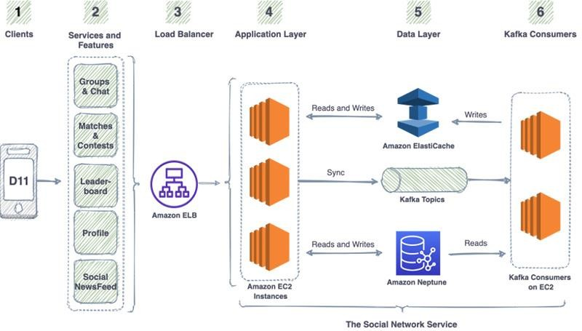

Dream11 Fantasy Sports Social Network Service
Dream11, the flagship brand of Dream Sports, is the world’s largest fantasy sports platform, with more than 100 million users. Their Social Network Service helped them evolve as a social sports platform.
Challenges
As the Social Network Service gained popularity, it needed to scale from thousands to millions of followers per user and withstand spiky behavior around popular match times.
Solution
Neptune provides persistent graph storage with proven high availability, scalability, and performance supporting social graph traversals such as friends in common and clusters of friends.
ElastiCache for Redis enables extremely high throughput API calls such as counts and sorted lists of followers.

Slide 35






Amazon Timestream
S E R V E R L E S S , F U L L Y M A N A G E D T I M E - S E R I E S D A T A B A S E
Collect, store, and process data sequenced by time at any scale
Serverless auto scaling for ingesting, storing, and querying
Data lifecycle management
No predefined schema
Access data across storage tiers with adaptive query engine
Built-in time-series
analytics in SQL
Integrates with ML, analytics, data collectors
Timestream is ideal for
Real-time performance tracking • Forecasting • Trend analysis • Event tracking

Slide 36


Amazon QLDB
F U L L Y M A N A G E D L E D G E R D A T A B A S E S E R V I C E
Immutable
Verifiable
Serverless
Easy to use
Append-only, immutable journal tracks history of all changes
All changes are cryptographically chained and verifiable
Scalable and highly available, no need to provision storage and I/O in advance
PartiQL offers familiar SQL operators, ION data model is rich and expressive
Amazon QLDB is ideal for
Audit databases • State change modeling • Systems of record • Blockchain alternatives

Slide 37
Next steps: Unify and innovate

Slide 38
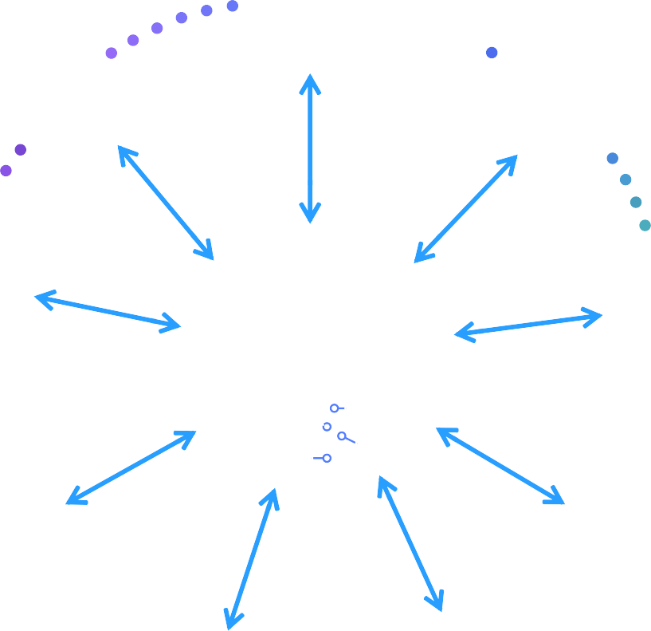

Unify using data lakes and innovate using ML
Adopt cloud-native relational databases
Amazon RDS, Amazon Aurora
Systems of record
and ledgers
Amazon QLDB
Cache frequently accessed data
Amazon ElastiCache
Graphs and highly connected data Amazon Neptune
Persistent/durable
in-memory data structures
MemoryDB
Time-series datasets
Amazon Timestream
Key-value, globally accessible datasets Amazon DynamoDB
Document type datasets
Amazon DocumentDB
Wide-column datasets
Amazon Keyspaces

Slide 39
To sum it all up

Slide 40
Purpose-built modernization is a journey
B O T H O R G A N I Z A T I O N A L L Y A N D T E C H N O L O G I C A L L Y
Move relational workloads to managed DB services
Aurora, Amazon RDS
Improve: agility, ease of management, cost-efficiency
1
Implement caching and offload in-memory workloads
ElastiCache, MemoryDB
Improve: scalability and performance
2
Move nonrelational query patterns to NoSQL
DynamoDB, Amazon DocumentDB, Amazon Keyspaces
Improve: agility, innovation, scalability, performance, ease of management, cost-efficiency
3
Move specialized datasets and query patterns to specialized databases
4 Neptune, Timestream, Amazon QLDB
Improve: agility, innovation, scalability, performance, ease of management, cost-efficiency

Slide 41





Learn in-demand AWS Cloud skills
AWS Skill Builder
Access 500+ free digital courses and Learning Plans
Explore resources with a variety of skill levels and 16+ languages to meet your learning needs
Deepen your skills with digital learning on demand
AWS Certifications
Earn an industry-recognized credential
Receive Foundational, Associate, Professional, and Specialty certifications
Join the AWS Certified community
and get exclusive benefits
Access new
exam guides
Train now
© 2022, Amazon Web Services, Inc. or its affiliates. All rights reserved.

Slide 42

Thank you!
Bill Baldwin
bbaldwin@amazon.com

