Slide 1


W A S H I N G T O N , D C | J U N E 7 ‒ 8 , 2 0 2 3
© 2023, Amazon Web Services, Inc. or its affiliates. All rights reserved.

Slide 2


Extracting meaningful insights from raw data
N P R 1 0 4 - I N D
John Hill
Sr. Manager, Solutions Architecture,
Nonprofit Business
AWS
© 2023, Amazon Web Services, Inc. or its affiliates. All rights reserved.

Slide 3
Agenda
We’re here to talk about getting value from your data
We’ll focus on overcoming challenges you’ll encounter on your data
journey (acquisition, preparation, analysis, visualization)
Along the way, we’ll architect a modern serverless data architecture

Slide 4
You want better business outcomes . . .
Value expected from data
Most respondents want to use data to make better decisions; they also hope to better know their customers and deliver improved products
Smarter decision-making
A better understanding of customers Better products and services
More efficient operations Reduced costs
New business
Source: MIT Technology Review Insights survey of 357 business leaders and decision-makers, July 2021

Slide 5
. . . but you have some challenges with data
Growing exponentially
From new sources
Increasingly diverse
Used by many people
Analyzed by many applications

Slide 6

Data acquisition
© 2023, Amazon Web Services, Inc. or its affiliates. All rights reserved.

Slide 7
Data acquisition: Challenges
Volume of data
Where do you put it?
Multiple sources of data
How do you ingest it?
Growing exponentially
From new sources

Slide 8





Amazon S3: Data lakes on AWS
Store virtually unlimited data in open file formats
Unmatched durability, availability, and scalability
Decouple storage from compute
Choice of analytical
and ML engines
Pay as you go
Amazon S3
On premises, batch
Real-time, streaming

Slide 9




Data sources: Databases
We provide AWS Database Migration Service (AWS DMS) and AWS Lake Formation blueprints by generating AWS Glue crawlers, jobs, and triggers that discover and ingest database data into the storage layer
Amazon S3
Databases
AWS DMS
Databases
AWS Lake Formation blueprints
Amazon S3
Amazon Redshift
https://docs.aws.amazon.com/dms/latest/userguide/CHAP_Source.html https://docs.aws.amazon.com/dms/latest/userguide/CHAP_Target.html
https://docs.aws.amazon.com/lake- formation/latest/dg/workflows-about.html

Slide 10





Data sources: File shares
AWS DataSync makes it simpler and faster to move large amounts of files from Network File System (NFS) shares, Server Message Block (SMB) shares, Hadoop Distributed File Systems (HDFS) into Amazon S3 data lake
On premises and edge AWS Region
1
Agents are deployed to connect to on- premises storage
1
4
NFS, SMB, HDFS, S3 API
AWS storage services
2
2
Locations control how DataSync connects to storage
Shared file system, object storage, or Hadoop cluster
DataSync agent(s)
Amazon S3
(any storage class)
3
DataSync managed service connects to AWS storage and coordinates the transfer
2
Amazon EFS
AWS Snowcone
AWS
DataSync managed service
Amazon FSx for
Windows File Server
4
For transfers between on premises and AWS, internet, AWS Direct Connect, and AWS VPN are supported
S3 API
3
Amazon S3 on AWS Outposts
DataSync agent(s)

Slide 11

Our architecture so far
Architect a workflow for ingesting your data
AWS Cloud
1
Data is collected as flat files
1
2
Data sources
Data ingestion
The data is uploaded into Amazon
S3 for data lake storage
2
Dataset
Amazon S3

Slide 12
Data preparation
© 2023, Amazon Web Services, Inc. or its affiliates. All rights reserved.

Slide 13




Challenges for data analysts and data scientists
Understand data quality
Outliers, anomalies, etc. – Identify issues with your data
Clean and normalize data
Handle missing data, enrich data, address format mismatch, etc.
Maintain your data lineage
Understand steps that the data has been through
Automate at scale
Save transformations and apply to new data as it comes in

Slide 14










As much as 80% of time is spent preparing data today*
Need the right tool for the right persona
© 2023, Amazon Web Services, Inc. or its affiliates. All rights reserved.
*“What Is Data Preparation?” https://aws.amazon.com/what-is/data-preparation/

Slide 15
Use AWS Glue DataBrew for intuitive, visual data preparation

Slide 16


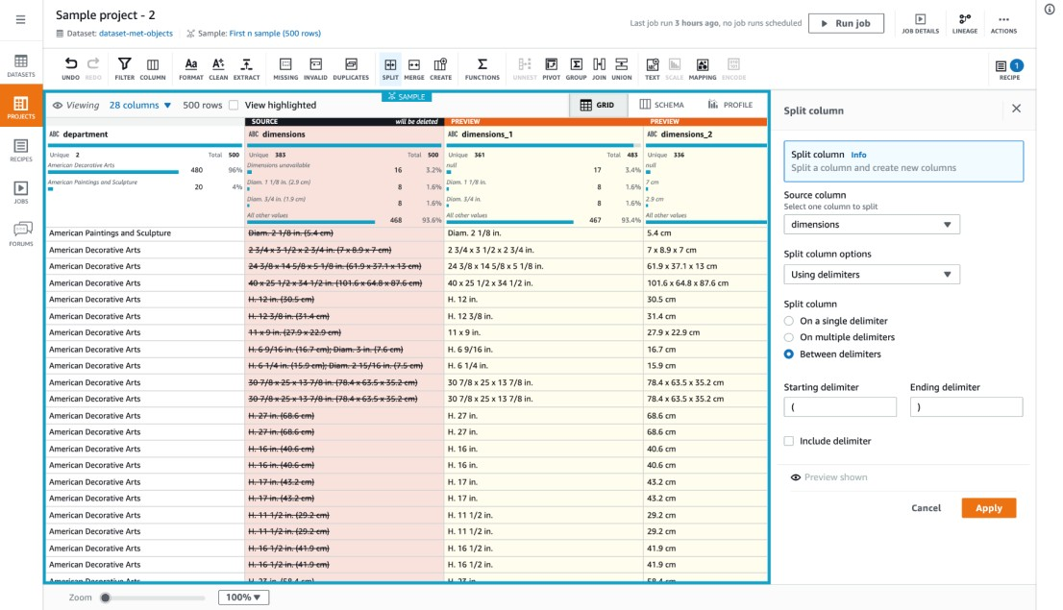



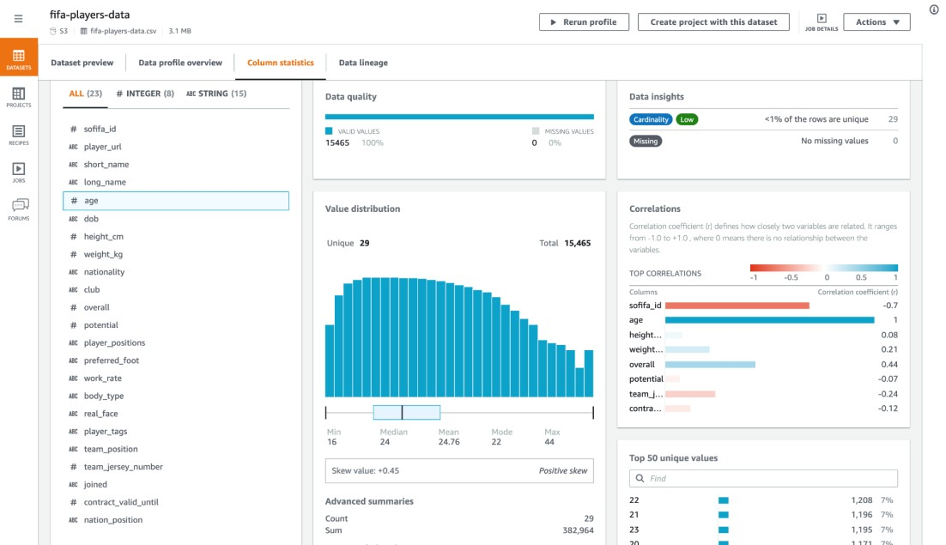

AWS Glue DataBrew
V I S U A L D A T A P R E P A R A T I O N & D A T A Q U A L I T Y
C H E C K S
Choose from 350+ transformations
to prepare data
Identify dataset quality with 50+ statistics
Share, reuse, schedule transforms across users and teams
Run data preparation serverlessly and at scale

Slide 17

Our architecture so far
Architect a workflow for ingesting and preparing your data
AWS Cloud
1
Data is collected as flat files
1
2
3
Data sources
Data ingestion
Data preparation
2
The data is uploaded into Amazon
S3 for data lake storage
3
AWS Glue DataBrew is used for visual data preparation, cleansing, and enrichment in preparation for visualization. The transformed data is written to an Amazon S3 bucket and again cataloged into the Data Catalog. AWS Glue crawlers take inventory of the data in your data stores and add the metadata to the Data Catalog. The Data Catalog collects representations of databases and tables from the crawled metadata.
Amazon S3
AWS Glue crawler
Dataset
Amazon S3
AWS Glue Data Catalog
AWS Glue DataBrew

Slide 18
Data analysis
© 2023, Amazon Web Services, Inc. or its affiliates. All rights reserved.

Slide 19
Building interactive analytics: Challenges
Lack of analytics tool interoperability across data sources and other tools and technologies
Difficult to manage analytics infrastructure
Increasingly diverse

Slide 20
Use Amazon Athena for seamless, interactive data analysis

Slide 21

Simple, instant start
Amazon Athena
Interactive analytics for all your data
Interactive analytics
Open and flexible
Cost effective

Slide 22
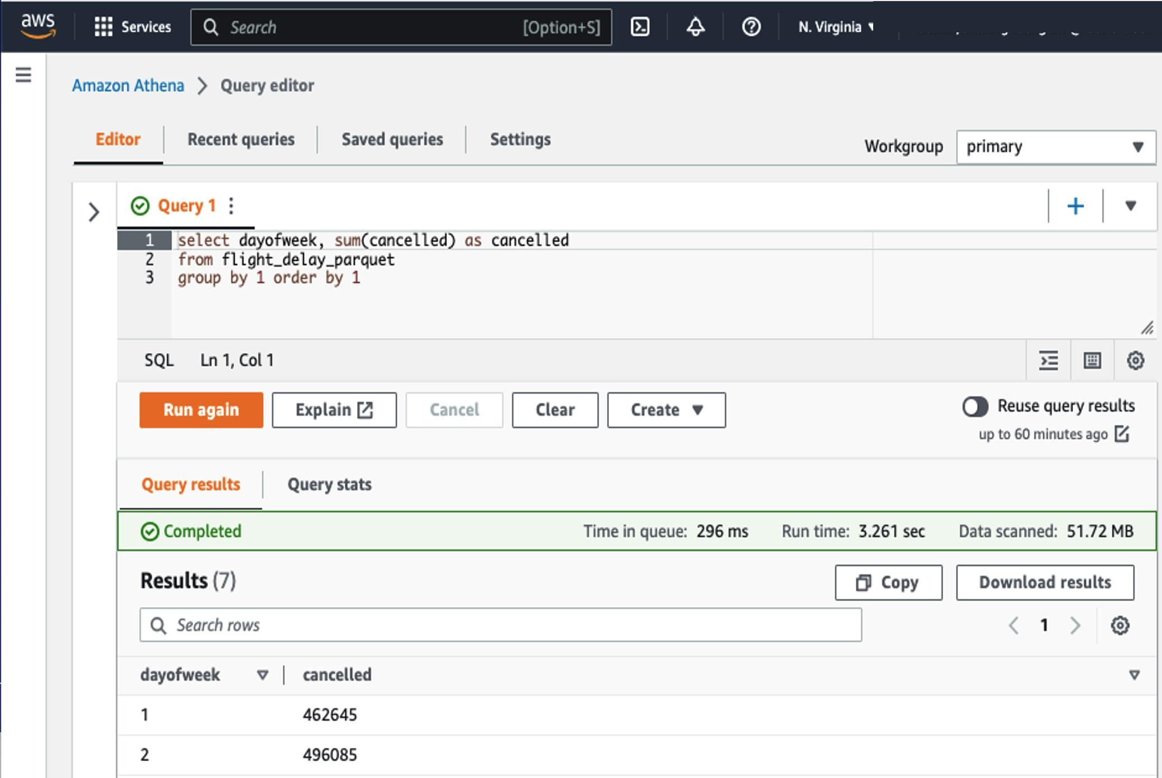
Interactive analysis
U S I N G F A M I L I A R S Q L

Slide 23

Our architecture so far
Architect a workflow for ingesting, preparing, and analyzing your data
AWS Cloud Data is collected as flat files
1
1
2 3
Data sources
Data ingestion
Data preparation
Purpose-built analytics & insights
The data is uploaded into Amazon
S3 for data lake storage
2
3
AWS Glue DataBrew is used for visual data preparation, cleansing, and enrichment in preparation for visualization. The transformed data is written to an S3 bucket and again cataloged into the Data Catalog.
AWS Glue crawlers take inventory of the data in your data stores and add the metadata to the Data Catalog.
The Data Catalog collects representations of databases and tables from the crawled metadata.
Amazon S3
4
Amazon Athena
Dataset
AWS Glue crawler
Amazon S3
AWS Glue Data Catalog
4
Amazon Athena enables interactive querying, analyzing, and processing capabilities
AWS Glue DataBrew

Slide 24
Data visualization
© 2023, Amazon Web Services, Inc. or its affiliates. All rights reserved.

Slide 25



















The unmet promise of BI
DATA CREATED IN 2022
AVERAGE NUMBER OF BI TOOLS
DECISION-MAKERS USE BI
Reporting
Dashboards
Embedding
Forecasting
© 2023, Amazon Web Services, Inc. or its affiliates. All rights reserved.
IDC & Forrester 2022

Slide 26
Discover powerful insights with Amazon QuickSight

Slide 27



Unified BI for all your analytics needs
Lower costs with consumption-based pricing
Consistent high performance with auto scaling
UNIFIED BI SERVICE AT HYPERSCAL E
Augmented analytics with ML-insights and NLQ

Slide 28
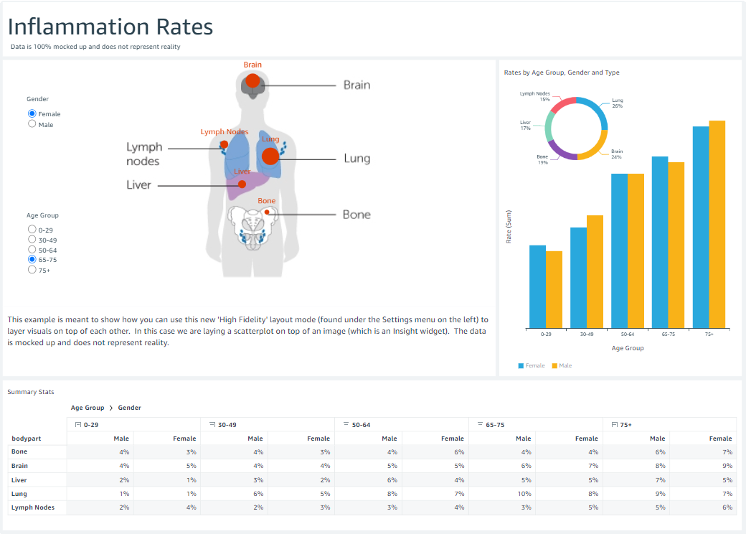
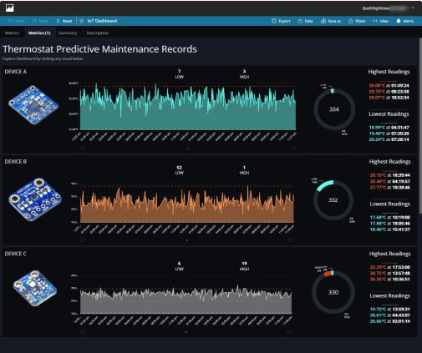
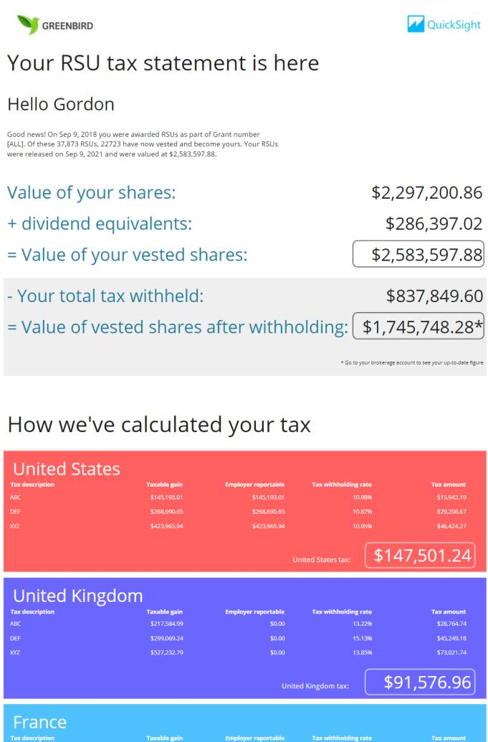
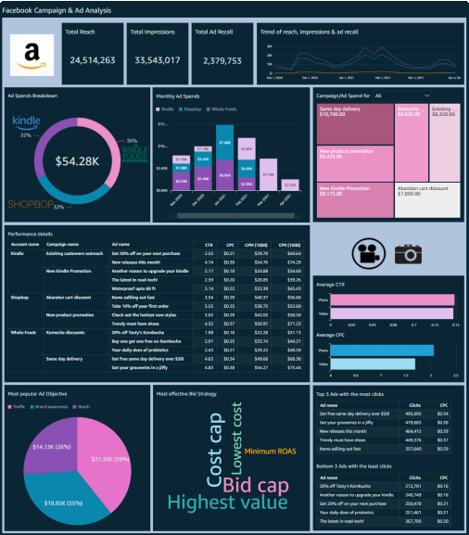
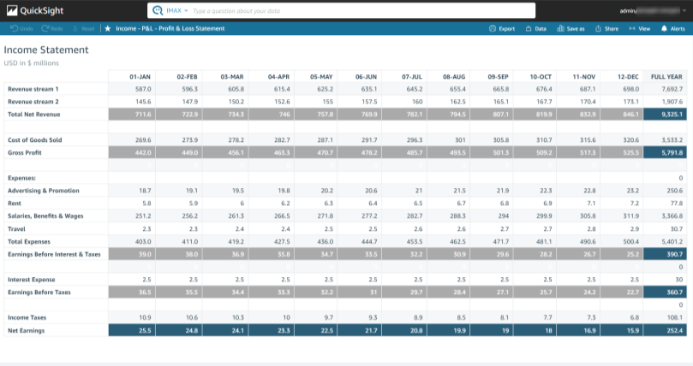
Build and deploy rich, interactive dashboards

Slide 29
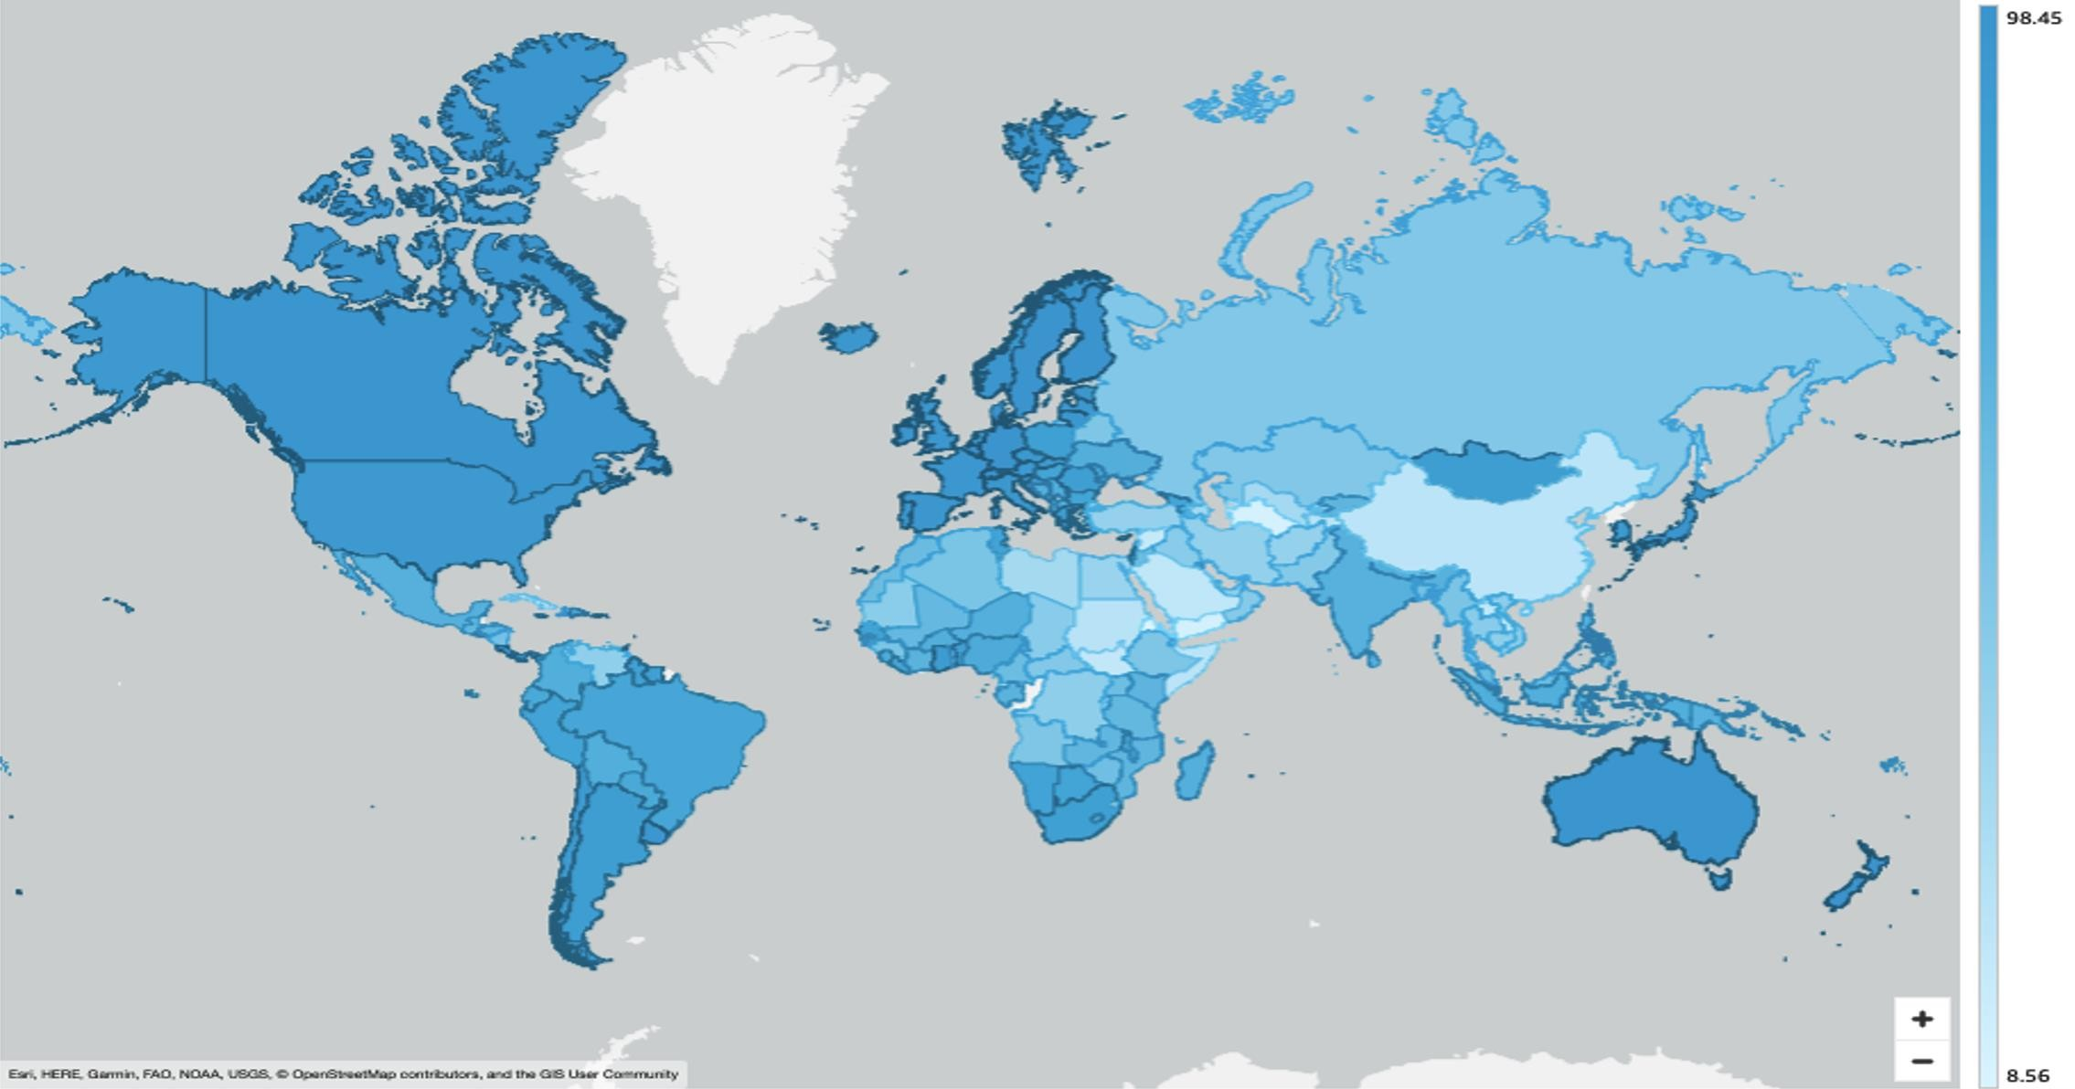
QuickSight: Visualize your meaningful insights

Slide 30
Our complete architecture
Architect a workflow for acquiring, preparing, analyzing, and visualizing your data
AWS Cloud Data is collected as flat files
1
1
2 3
Data sources
Data ingestion
Data preparation
Purpose-built analytics & insights
2
The data is uploaded into Amazon
S3 for data lake storage
3
AWS Glue DataBrew is used for visual data preparation, cleansing, and enrichment in preparation for visualization. The transformed data is written to an S3 bucket and again cataloged into the Data Catalog.
AWS Glue crawlers take inventory of the data in your data stores and add the metadata to the Data Catalog.
The Data Catalog collects representations of databases and tables from the crawled metadata.
AWS Glue DataBrew
4
Amazon Athena
Amazon S3
Dataset
Amazon S3
5
AWS Glue crawler
Amazon QuickSight
4
Amazon Athena enables interactive querying, analyzing, and processing capabilities
AWS Glue Data Catalog
5
Amazon QuickSight provides ML- powered business intelligence

Slide 31
Getting started on your data journey with AWS
© 2023, Amazon Web Services, Inc. or its affiliates. All rights reserved.

Slide 32


Get started
D E V E L O P Y O U R
S T R A T E G Y A N D T E A M
P R O T O T Y P E Y O U R S T R A T E G Y
S C A L E Y O U R P R O J E C T S
Data-Driven Everything AWS Training and Certification
ML Solutions Lab AWS Immersion Day
AWS Marketplace (ISVs) AWS Professional Services
AWS Migration Acceleration Program
AWS Partner Network – 100,000+ AWS Partners globally

Slide 33


Thank you!
Please complete the session survey in the mobile app
John Hill
hillmjoh@amazon.com
© 2023, Amazon Web Services, Inc. or its affiliates. All rights reserved.

