Slide 1



Slide 2


A N T 3 2 1
Set up capital markets analytics, integrated with your data, using FinSpace
Vincent Saulys (he/him)
Principal Solutions Architect, Amazon FinSpace
AWS
Steve Yalovitser (he/him)
Principal Engineer, Amazon FinSpace AWS
© 2021, Amazon Web Services, Inc. or its affiliates. All rights reserved.

Slide 3
Agenda
Introducing Amazon FinSpace
Architecture Installing Demo
Q&A

Slide 4








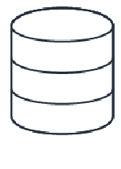
Significant time and resources are spent to collect, organize, distribute, and prepare data
before deriving value . . .
I need to . . .
I want to . . .
. . . control data
access
. . . track and
I want to . . .
. . . build a new factor using
alternative data . . .
. . . and analyze 10 years of historical time series data
I want to . . .
. . . keep track of data versions and corrections
. . . aggregate data from multiple third- party data providers
validate data used
. . . share results
with other teams
Market data Compliance Equity analyst
. . . which leads to fewer experiments, less innovation, and more operational risk

Slide 5

Amazon FinSpace
Data management and analytics service that reduces the time to organize, prepare, and access data needed for financial analysis
Instantly access data from a centralized data store
Easily find and share data
Prepare time series data at petabyte scale
Perform historical point-in-time analysis
Enforce your data access rules

Slide 6













































Architecture
Amazon FinSpace
Governance and audit
Data sources
Data consumers
Internal data sources
Interfaces
First- party data
Web UI
Notebooks
Python SDK
Enterprise data lake
Data analysts
Data
management
Data
organization
Prepare and analyze
Second- party data
Business line databases
Optimized views
Search and
browse
Machine
learning
Business analysts
External data sources
Data versioning
Business data catalog
Time series analytics
Third- party data
Data scientists
Third-party data feeds
Storage
Metadata
Managed Spark clusters
Alternative data
Applications, engines, and algorithms
Data access management
Resource access control
Audit reporting

Slide 7
Setup: Installing FinSpace
What does one need to create an environment?
Admin privileges for the account
AWS Key Management Service (KMS) key for data encryption
That’s it!

Slide 8


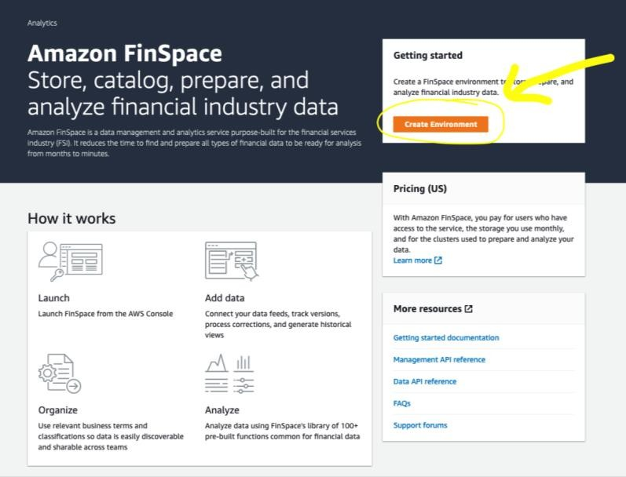
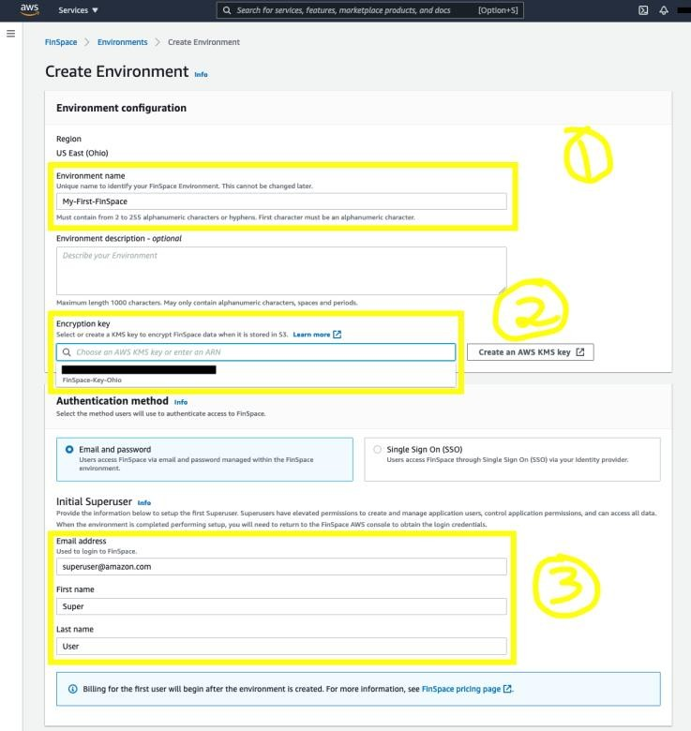
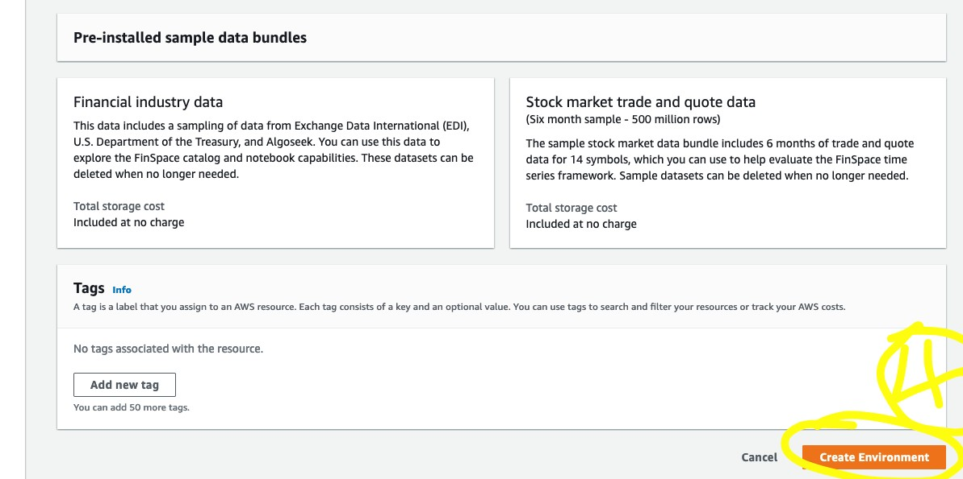
Simple creation from the AWS console
Name the environment
Select KMS key
Enter Super User name, email
Create!

Slide 9
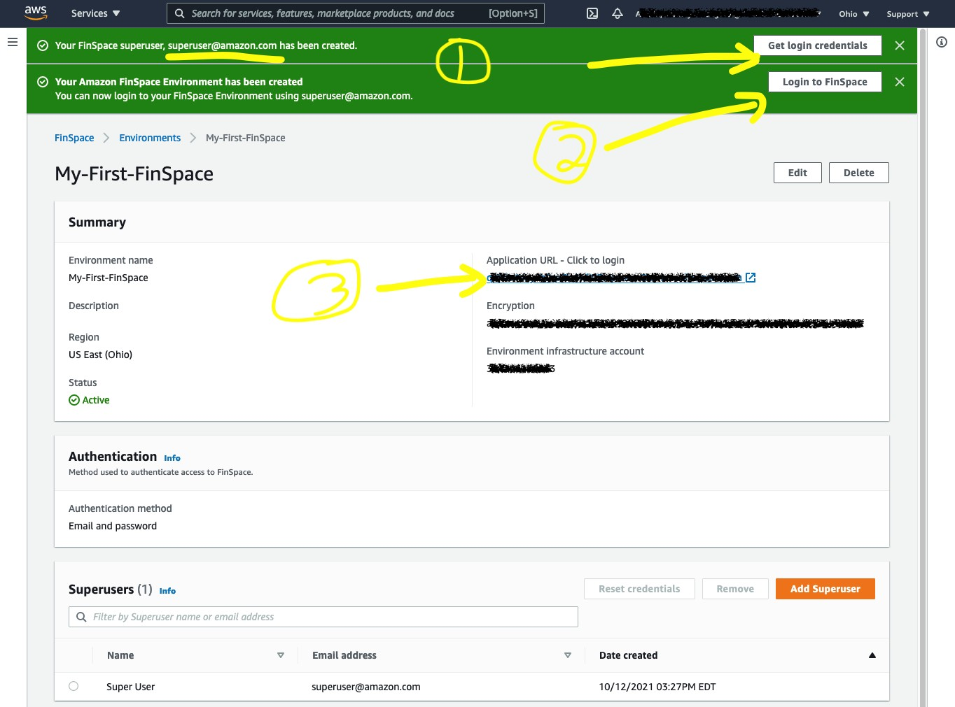
Creation of environment completed
Super User credentials
Login
Environment URL

Slide 10

Slide bank
© 2021, Amazon Web Services, Inc. or its affiliates. All rights reserved.

Slide 11
Users and groups
Adding users
Adding users to groups
Setting group permissions

Slide 12
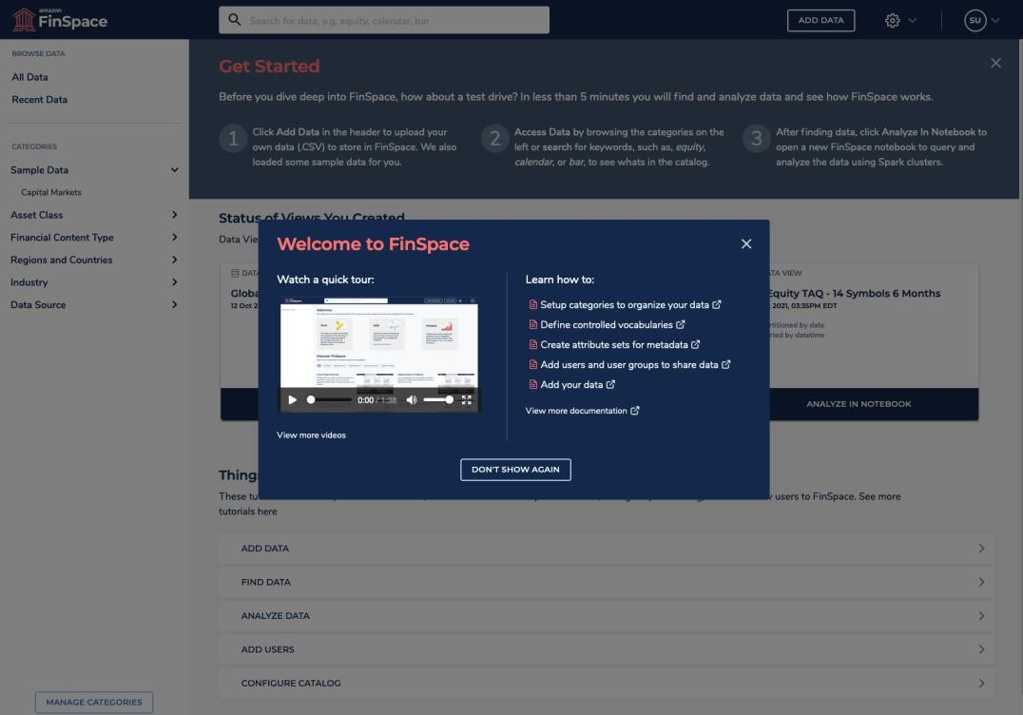
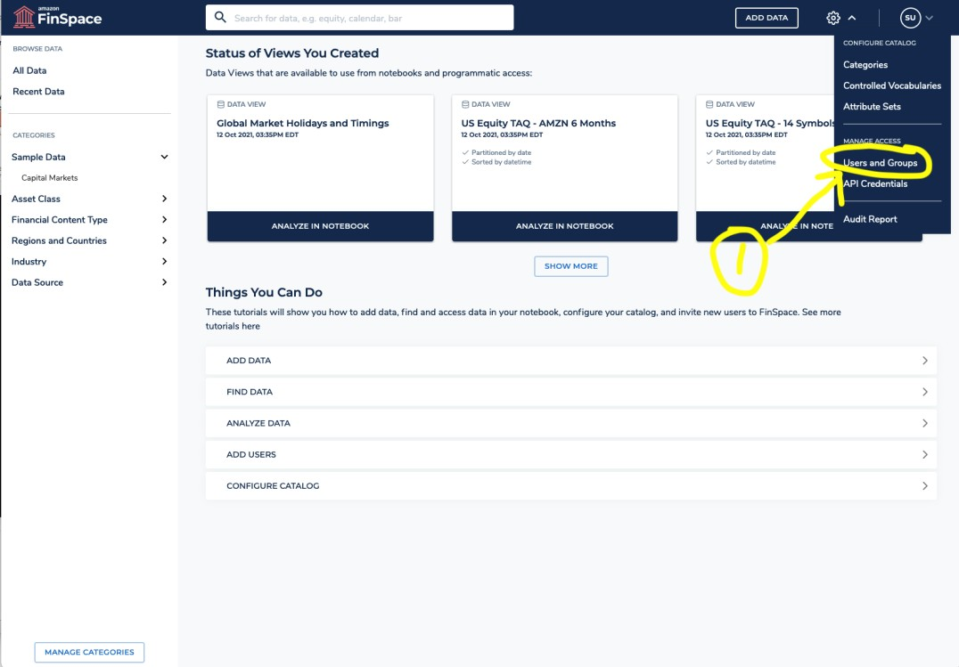
Adding first user
Log in as Super User
Gear menu → Users and Groups

Slide 13
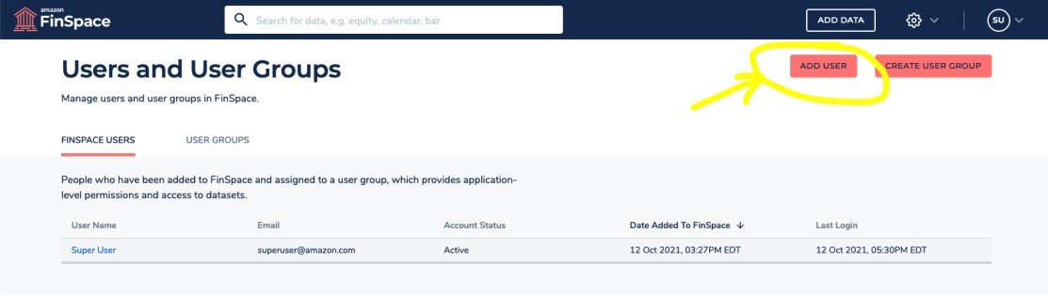
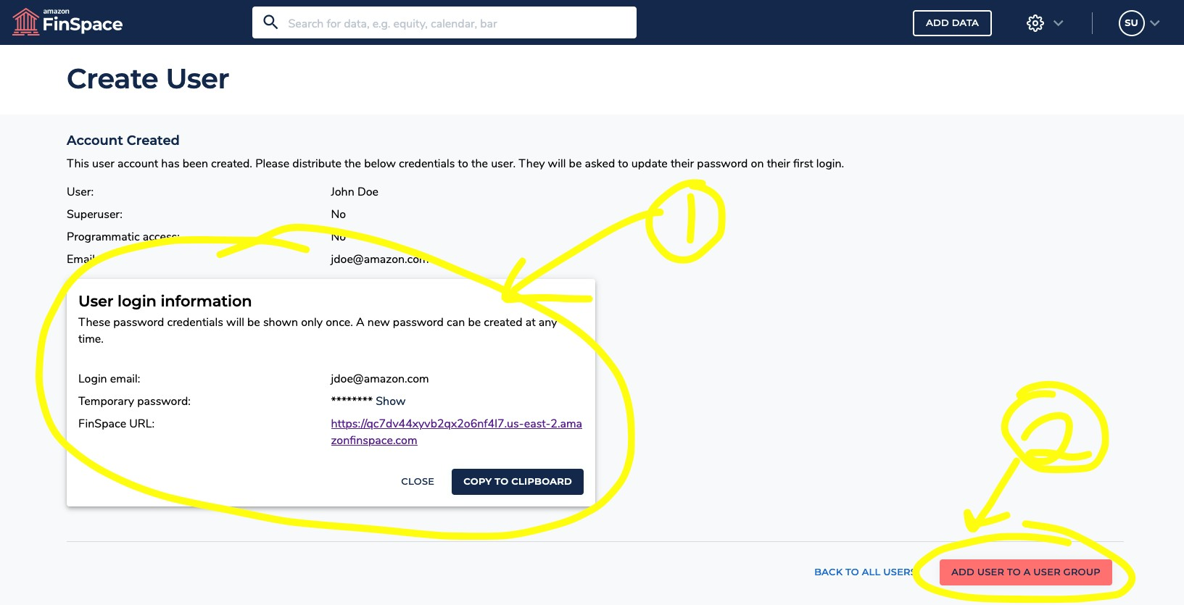
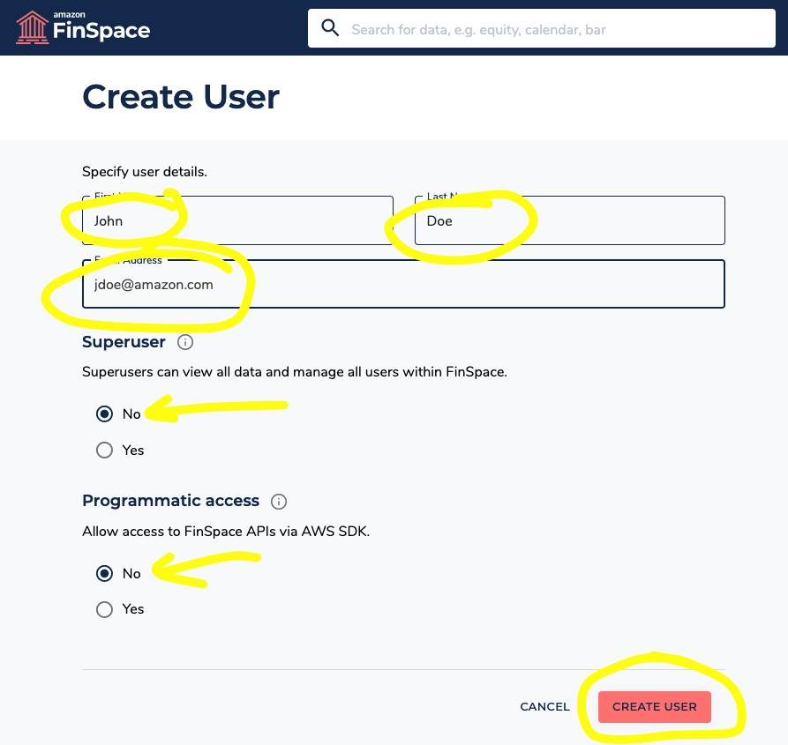
Adding a user
User credentials you can email
Go right to adding to a group

Slide 14
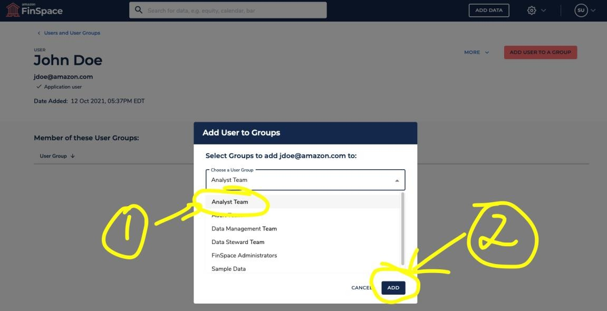
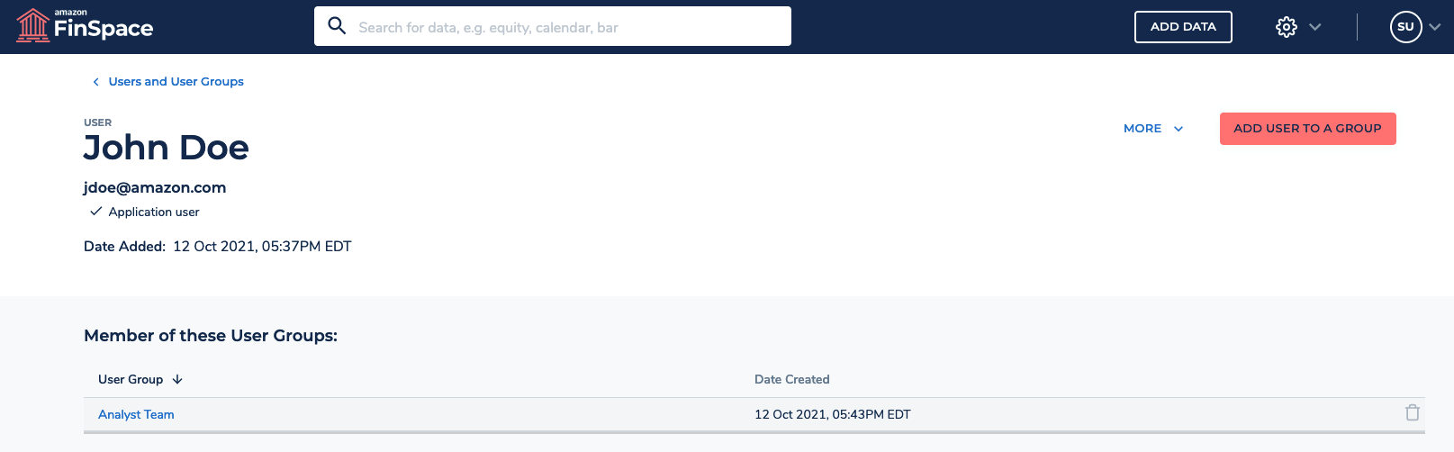
Adding users to groups
Select the group
Choose ADD

Slide 15
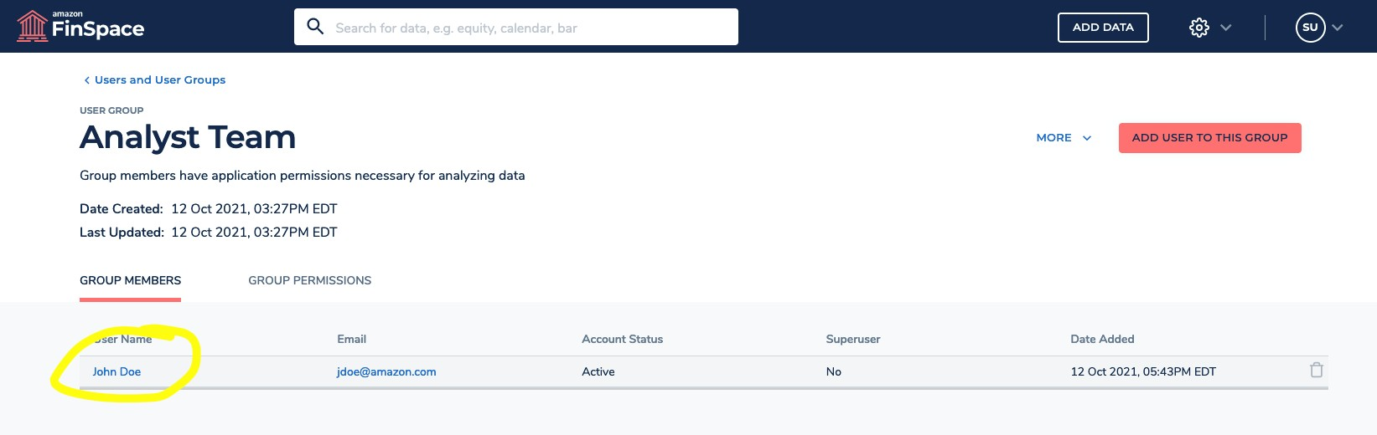
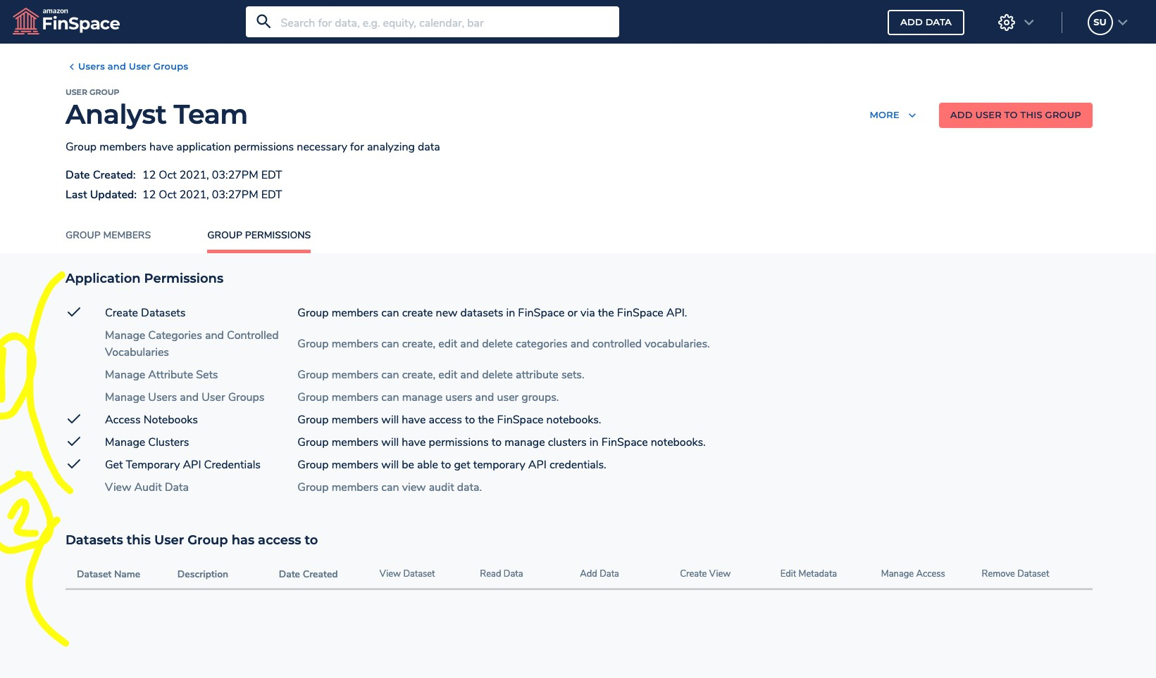
Setting group permissions
Groups have members Groups have permissions
Application-wide
Datasets

Slide 16
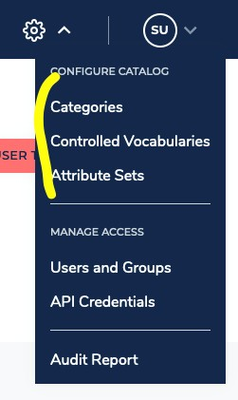
Business data catalog
Terminology
Managing categories
Managing controlled vocabularies
Managing attribute sets

Slide 17
Terminology
Categories: Hierarchal attributes
Controlled vocabularies: Enumerated lists of attributes
Attribute sets: Sets of categories, controlled vocabularies, strings, and numbers that can be applied to datasets in order to describe them

Slide 18
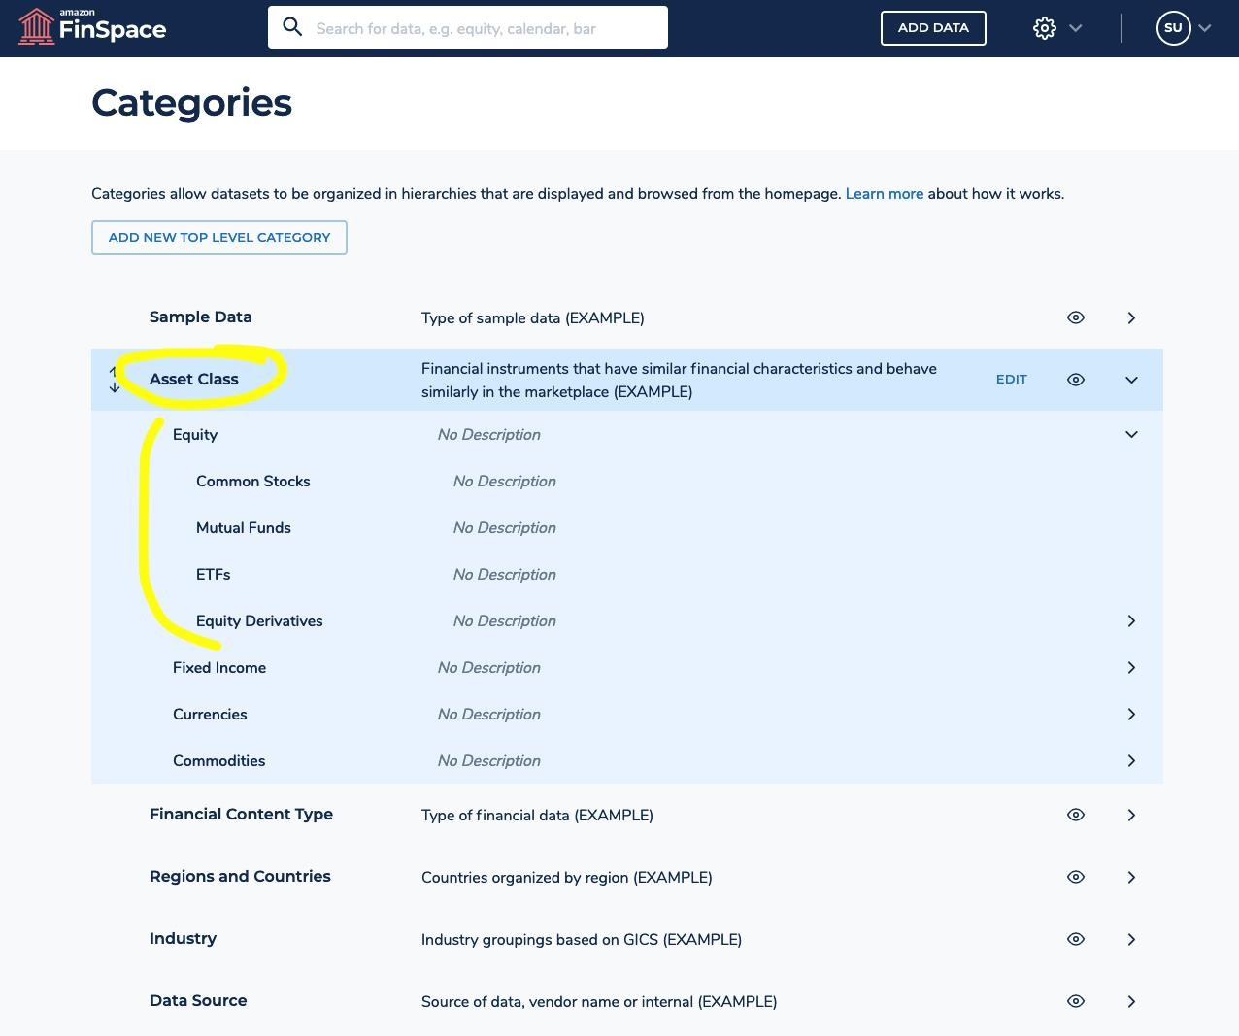
Categories
Category: Asset Class
Top level: Equity, Fixed Income, Currencies . . . Equity children: Common Stocks, Mutual Funds,
ETFs…

Slide 19
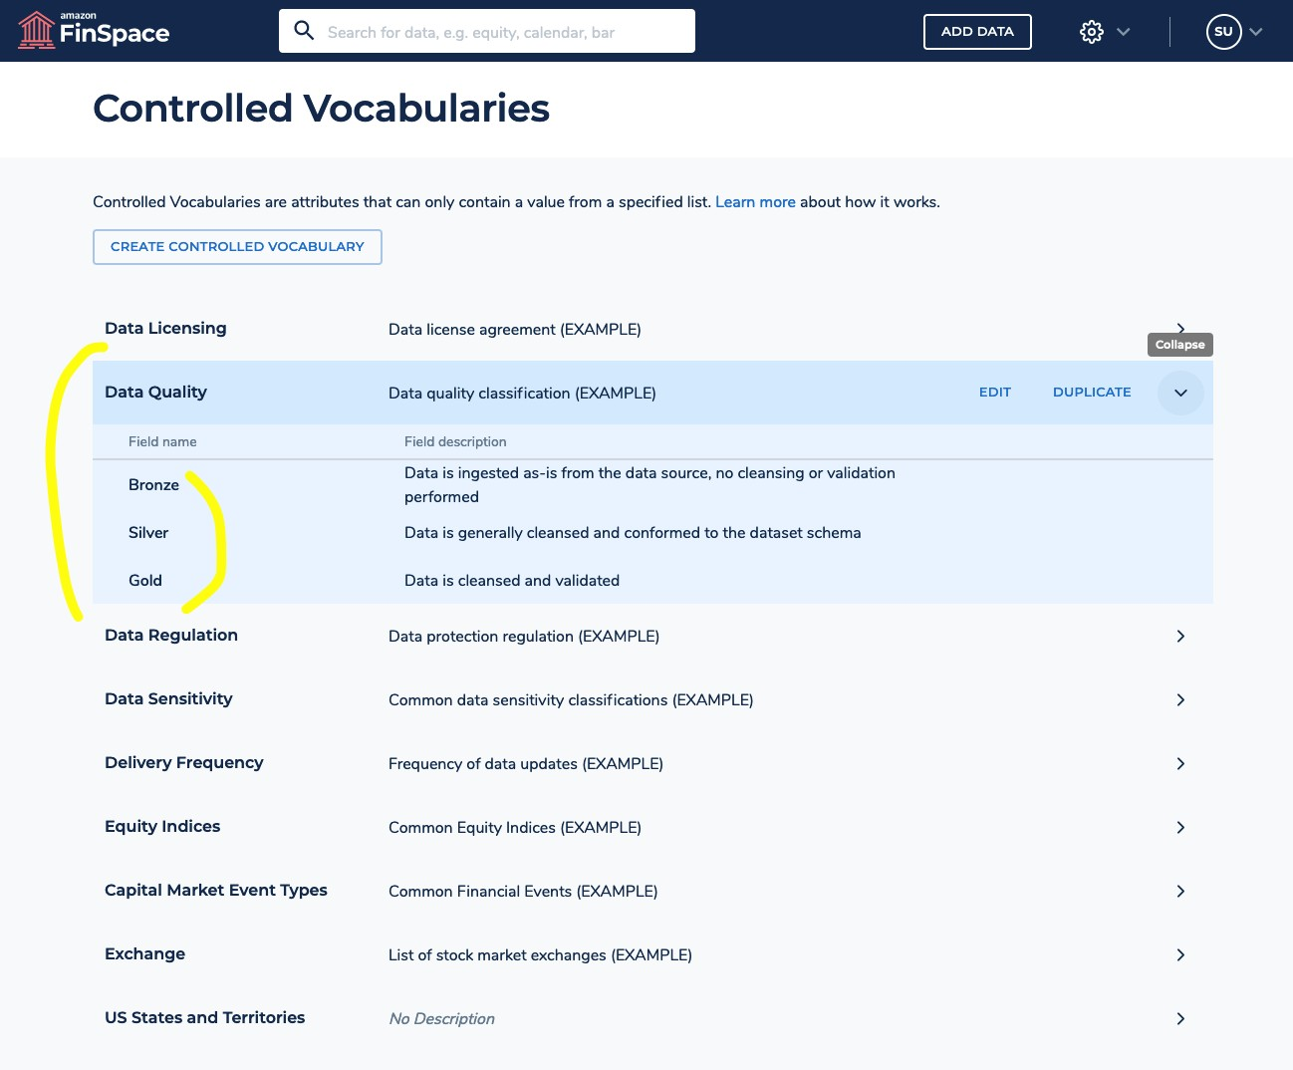
Controlled vocabularies
No hierarchy Simple set of values

Slide 20
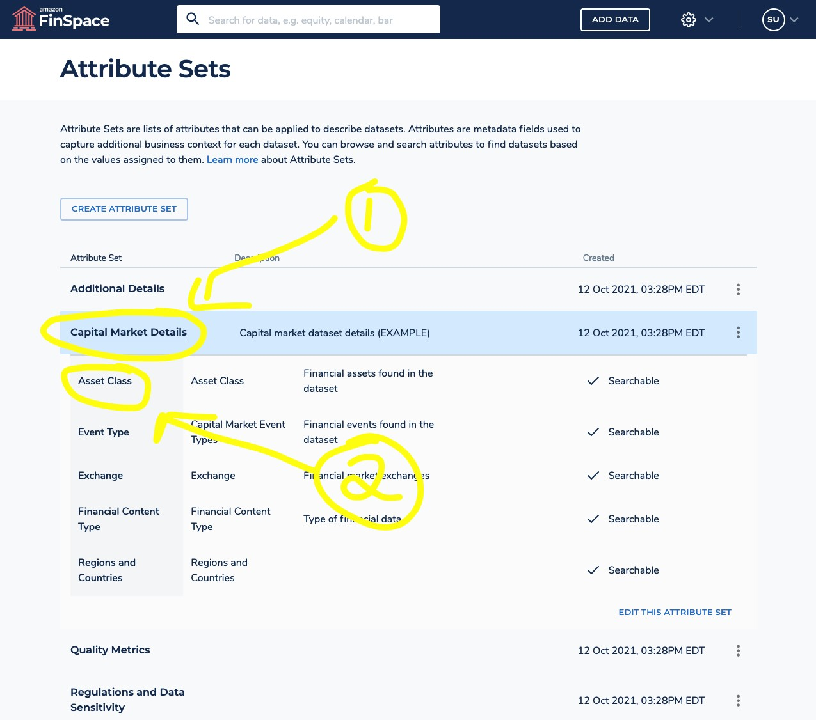
Controlled vocabularies
Attribute set: Capital Market Details
Category: Asset Class

Slide 21
Data in FinSpace
Terminology
Adding data (UI, API)
Relating attribute sets (UI, API)

Slide 22
Terminology
Dataset
Has name, description, and attribute sets associated to it Contains changesets and views
Changeset
How data is associated to a dataset Can be append, replace, or correction
View
Created from changesets
Can be static (versioned) or auto-updating (current state)

Slide 23
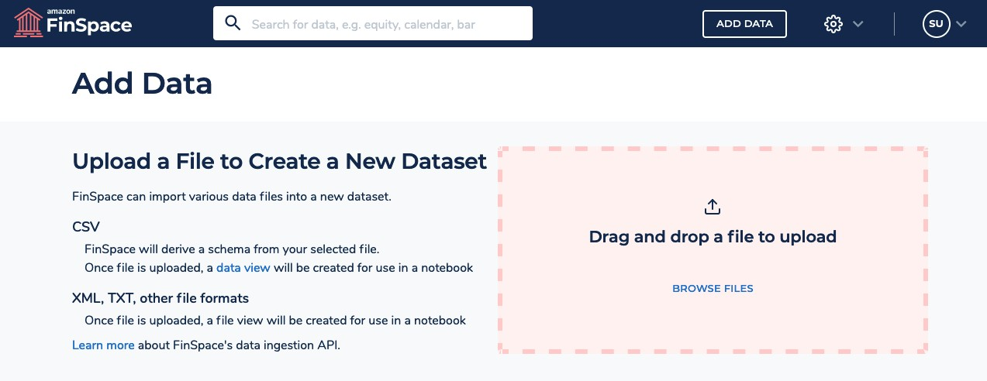
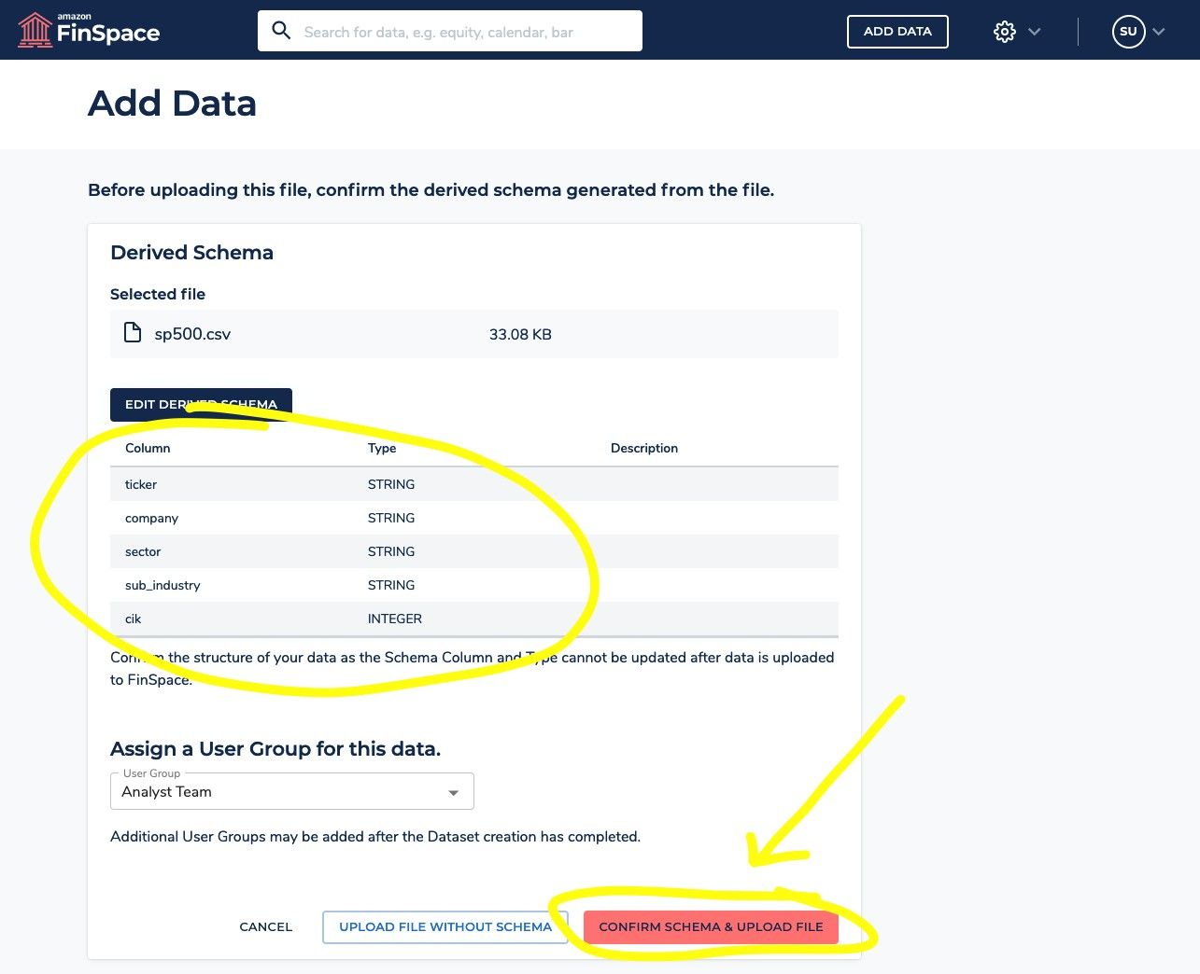
Add data with the web interface

Slide 24
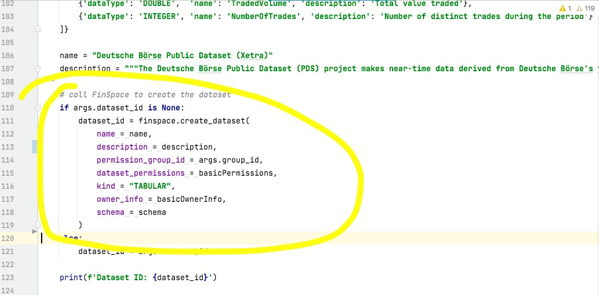
Add data with the boto API

Slide 25
Notebooks
Buttons: “Analyze in notebook” and “Go to notebook”
GitHub examples Time series library

Slide 26
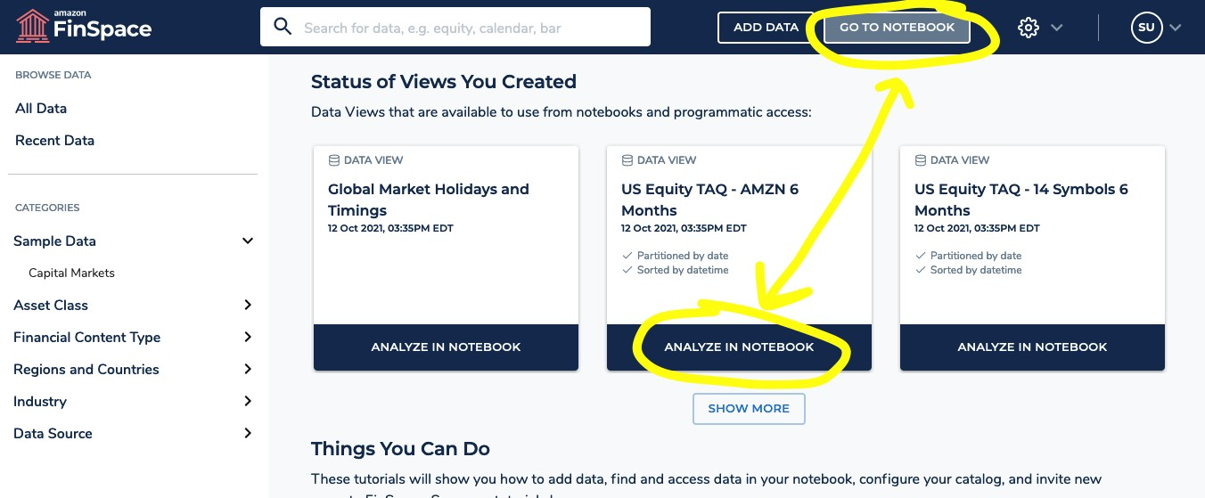
Notebooks

Slide 27
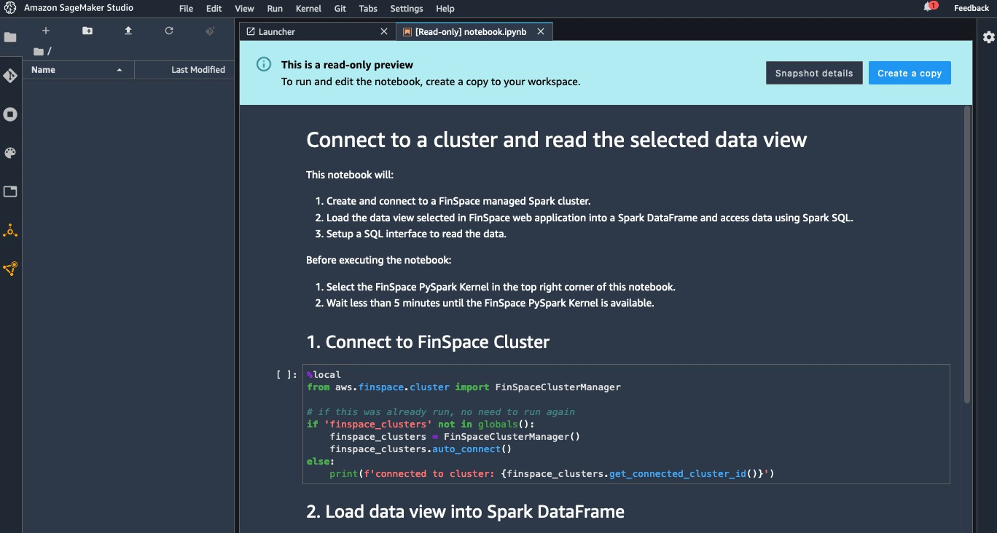
Analyze in notebook

Slide 28
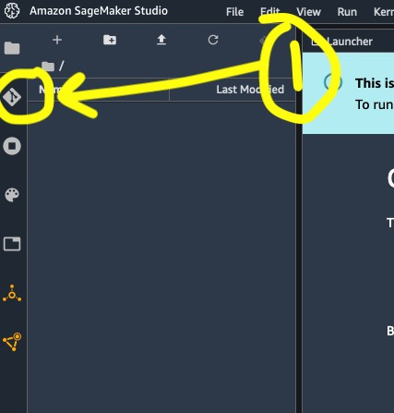
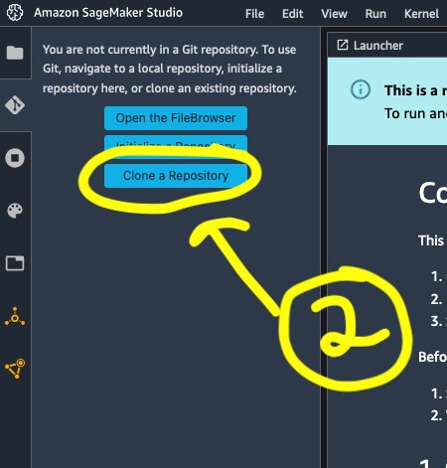
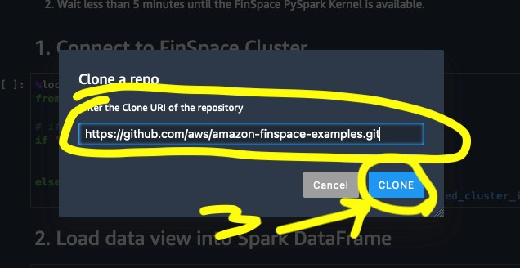
Clone the GitHub example notebooks
Choose Git tool in sidebar
Choose ”Clone a Repository”
Enter https://github.com/aws/amazon-finspace-examples.git and choose Clone

Slide 29
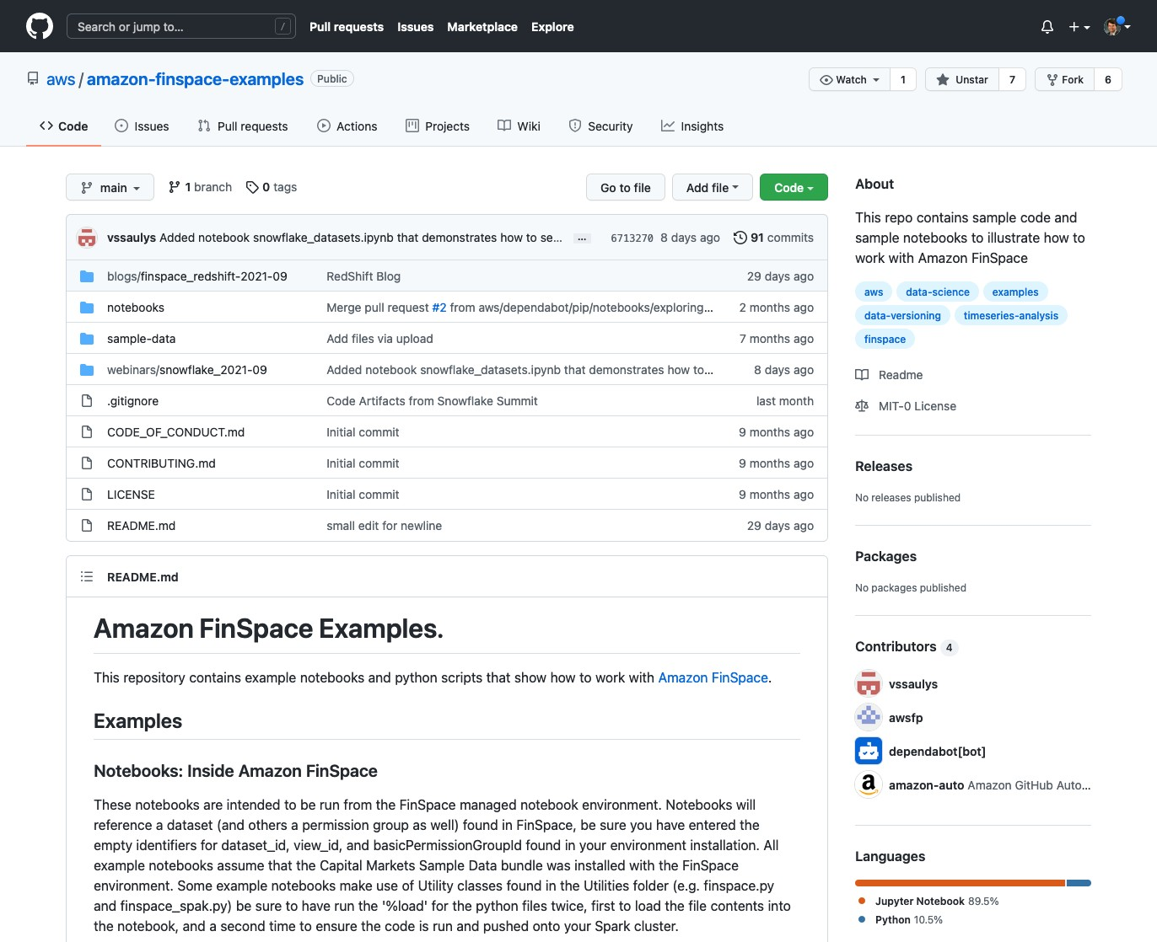
GitHub examples
Example notebooks include
Cluster management
Using time series libraries
Importing changesets from Amazon S3
Working with third-party APIs
Working with Snowflake-sourced tables
Working with Amazon Redshift Java database connectivity (JDBC) sourced tables
Always more being added . . .

Slide 30
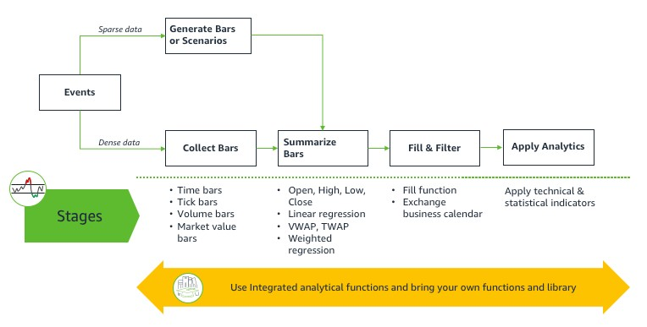
Time series library
Full data pipeline Extensible by customers Backed by Spark

Slide 31
Q: How do I set up programmatic access?
In AWS console: Create user in
AWS Identity and Access Management (IAM)
Associate user Amazon Resource Name (ARN) to FinSpace user

Slide 32
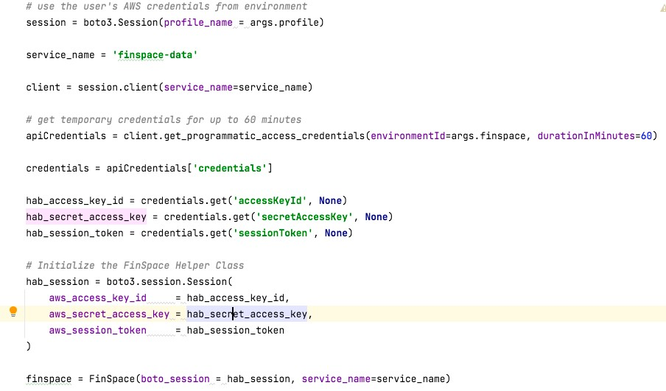
How do I use API credentials?

Slide 33
How do I grant access to an S3 bucket?
Give the FinSpace service role access to the S3 bucket
{
"Version": "2012-10-17",
"Id": "CrossAccountAccess", "Statement": [
{
"Effect": "Allow",
"Principal": { "AWS": [ "arn:aws:iam::INFRASTRUCTURE_ACCOUNT_ID:role/FinSpaceServiceRole" ] },
"Action": "s3:GetObject",
"Resource": "arn:aws:s3:::S3_BUCKET/*"
},
{
"Effect": "Allow",
"Principal": { "AWS": [ "arn:aws:iam::INFRASTRUCTURE_ACCOUNT_ID:role/FinSpaceServiceRole" ] },
"Action": "s3:ListBucket",
"Resource": "arn:aws:s3:::S3_BUCKET/*"
}
] }

Slide 34
How do I put data into FinSpace?
Examples in GitHub https://github.com/aws/amazon-finspace-examples
Notebooks/s3_import
Notebooks/third_party_apis

Slide 35
How do I get data out of FinSpace?
Create an external view
Use API credentials to copy data from external view’s S3 location to
another S3 bucket
Show code: UsingFinSpace/access_external_view.py

Slide 36
How do I create an attribute set?
Easiest, in the UI

Slide 37
How do I tag (describe) my datasets?
UI-based
Code-based

Slide 38
How do I use attribute sets programmatically?
Navigating the globally unique identifiers (GUIDs) and names of attribute sets programmatically
Code: Equifax/associate_attributeset.py

Slide 39
Resources
FinSpace product page: https://aws.amazon.com/finspace GitHub:
https://github.com/aws/amazon-finspace-examples Blogs:
https://aws.amazon.com/search/?searchQuery=finspace#facet_type=blogs
Workshop:
https://amazon-finspace-workshop-volatility.workshop.aws

Slide 40
Thank you!
Vincent Saulys
@vssaulys
Steve Yalovitser
@yalostev
© 2021, Amazon Web Services, Inc. or its affiliates. All rights reserved.

