Slide 1



Slide 2


Building data mesh architectures on AWS
A N T 3 3 6
Ian Meyers
Director, Product Management
AWS Analytics Service
Nivas Shankar
Principal Product Manager
AWS Lake Formation
Travis Muhlestein
Chief Data & Analytics Officer
GoDaddy
© 2022, Amazon Web Services, Inc. or its affiliates. All rights reserved.

Slide 3
Agenda
Modern data strategy on AWS Customer challenges
Why build a data mesh?
Data mesh – Design goals and four core principles Data mesh architecture on AWS
Why GoDaddy chose a data mesh pattern
How GoDaddy built a data mesh using AWS modern data architecture
Conclusion

Slide 4
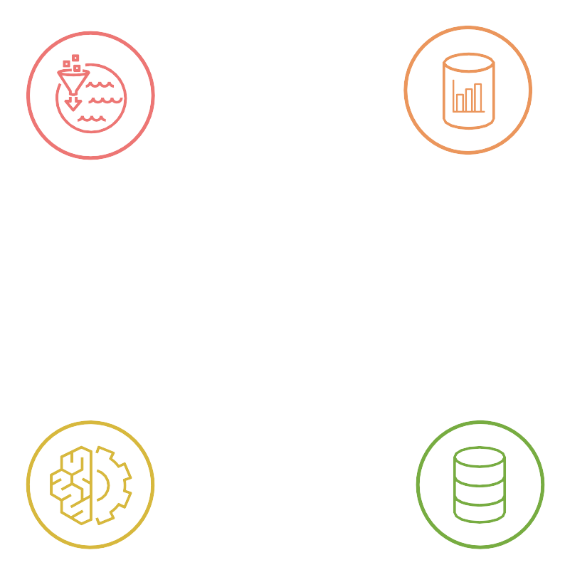


Modern data strategy
Data lakes
Analytics
Catalog
People, apps, and devices
Data sources
Governance
Machine
learning
Databases

Slide 5




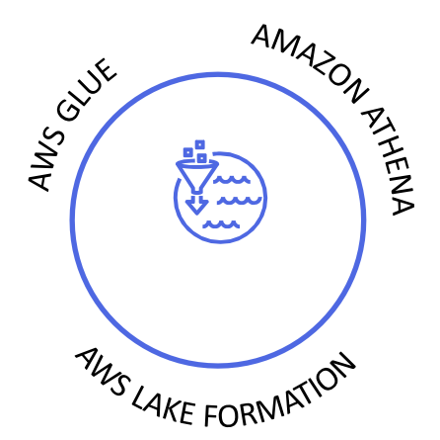





Amazon DynamoDB
Amazon EMR
Amazon OpenSearch
Amazon Aurora
Service
Amazon S3
on AWS
Amazon Redshift
Amazon SageMaker

Slide 6




Security, durability, availability
Simplicity and ease of use and operations Price/performance
Data connectivity and integration
Data governance

Slide 7
Customer challenges
MORE
SOURCES
Data sources increasing with the pace of the business
MORE
BUSINESS UNITS
Data and analytics is table stakes for innovation
All business units are all-in
STRONGER
GOVERNANCE
Enterprises need stronger governance to protect their data so that it can be used safely

Slide 8




















Sharing data in an enterprise can be challenging
Data lake
Data lake
Data lake
Data lake
Data lake
Data lake
Lines of business have made investments in cloud-based data lakes and analytics that are purpose-built to solve their specific business problem
These systems are often unique to the type of data and the algorithms being applied, and don’t always translate to other problems
Data lake
Data lake
Data lake
Data lake
Data lake
Data lake
© 2022, Amazon Web Services, Inc. or its affiliates. All rights reserved.
Data lake

Slide 9
Common data lake challenges we hear from our customers
“Finding the data I need is too difficult”
“It’s difficult to meet all requirements across differing business units”
“I just want to get access to the data I need”
“I wish to focus on innovating with
data, not on maintaining and
administering a data lake”
“My data science team should easily find the datasets they seek and have the ability to share them with others”
“My team needs to own datasets, pipelines, and repositories that are isolated from other teams”
“Why doesn’t our organization treat data as a product?”
“Current data architecture
is complex and monolithic and
slow to change”
“If I share data, I’ve lost control”
“There is a mismatch between executive leadership goals & business line deliverables, and incentives”
“Our internal policies on what can be shared is unclear & there is lack of incentive to share”
“I need to create a model to support
sharing from both producers and
consumers of data”

Slide 10












Sharing data in an enterprise can be challenging
Data lake
It may seem that the only way to effectively govern data is through
a single, centralized architecture and technology
This can increase friction to adopt and reduce velocity of delivering business outcomes
Time
Delivery velocity

Slide 11












Centralized data lakes are complex to scale across business units
ANALYTICS BUSINESS INTELLIGENCE AND MACHINE LEARNING
Amazon Redshift
Data warehousing
Amazon EMR
Hadoop + Spark
Amazon Athena
Interactive analytics
AWS Data Exchange
QuickSight
Visualizations
Amazon SageMaker ML
Amazon Kinesis Data Analytics
Real time
Amazon OpenSearch Service
Operational analytics
Third-party BI tools
Lake Formation
Access control
Data Catalog
DATA LAKE
Amazon S3
data lake storage
DATA MOVEMENT
AWS Database Migration Service | AWS Snowball | AWS Snowmobile | Amazon Kinesis Data Firehose | Amazon Kinesis Data Streams M anaged Streaming for Kafka

Slide 12

Sharing data in an enterprise can be challenging
Often data is being shared (and maybe reshared), but in an ad hoc, ungoverned
way based on team connections
This can increase risk associated with protecting sensitive data

Slide 13


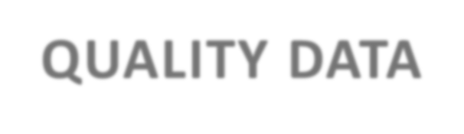




Sharing data in an enterprise can be challenging
O R G A N I Z A T I O N A L I N C E N T I V E S A R O U N D D A T A S H A R I N G C A N B E M I S A L I G N E D
FOR SALE
“Everyone wants to be a consumer, no one wants to be a producer”
FRESH QUALITY DATA
BUY!
BUY!
BUY!
BUY!
BUY!
BUY!

Slide 14
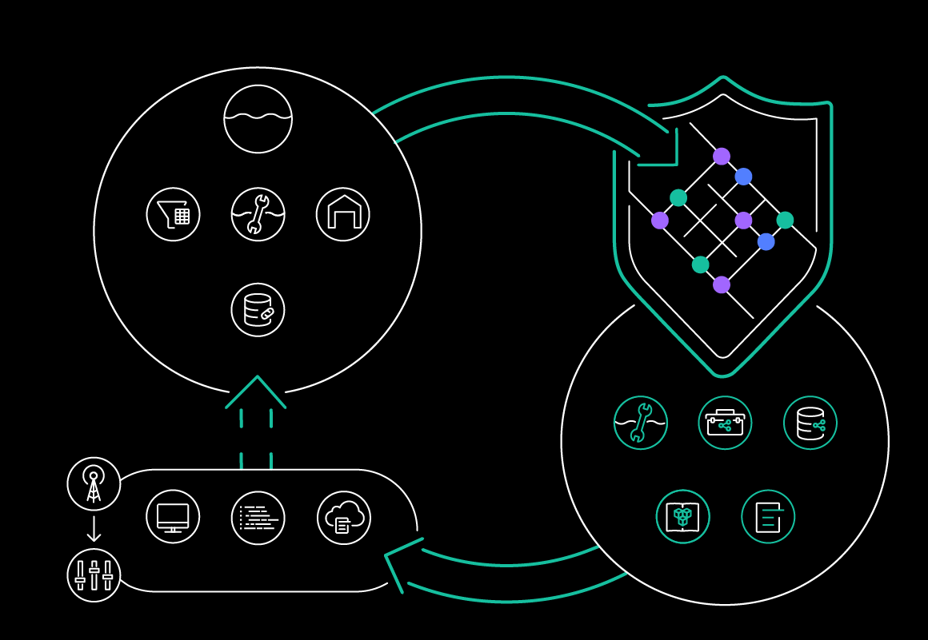
Why data mesh?
Data domain
Data mesh
Use existing investments in data platforms
and treat them as independent “domains”
Amazon S3
Improve data governance by pushing policy down into data domains
AWS Glue Data Catalog
Lake Formation
Amazon Redshift
Provides a clear mechanism for centralized
data discovery
Resource link
Provides self-service data sharing features to allow domain owners to grant access to consumers
Control tower
Self-service provisioning
Lake
Formation
Data governance policies
Resource
sharing
Measure and invest in data products based
on usage and business value
AWS
Console
AWS SDK
CloudFormation
Service catalog
CloudFormation template library
Organizations service control policies

Slide 15
Data mesh: Design goals and four key principles
© 2022, Amazon Web Services, Inc. or its affiliates. All rights reserved.

Slide 16


Data mesh: Four core principles
Data steward
Federated computational governance
Federated data governance is how data products are shared – delivering discoverable metadata auditability based on federated decision-making and accountability structures
Data owner
Data domain ownership
A data mesh features data domains as nodes, which exist in data lake accounts; it is founded in decentralization and distribution of data responsibility to people closest to the data
Data engineer
Data as a product
A data producer contributes one or more
data products to a central catalog in a data mesh account; DaaP must be autonomous, discoverable, secure, and correct, and useable
Data consumer
Self-serve sharing
The platform streamlines the experience of data users to discover, access, and use data products; it streamlines the experience of
data providers to build, deploy, and maintain data products

Slide 17
Data mesh design goals
Enable organizations to get value from data at scale
Create a business-oriented data products that
can support the top strategic goals
Allow business domains federated governance through lightweight
centralized policy by removing bottlenecks
Encourage data-driven agility
Support the sharing of data products, with the goal of delighting the experience of data users

Slide 18











Modern data architecture consists of five parts
Scalable data lake and warehouses
Non-relational
databases
Big data processing
Purpose-built data services
Data sharing
Log
analytics
Relational databases
Data domain
Unified governance
Data
warehousing
Machine
learning
Data discovery

Slide 19





Data mesh architecture
D E C E N T R A L I Z E D , L I G H T W E I G H T F E D E R A T E D G O V E R N A N C E A C R O S S D O M A I N - O R I E N T E D D A T A S Y S T E M S T O D R I V E G O V E R N E D S H A R I N G
CONSUMER 1 CONSUMER 2
….
CONSUMER N
Domain
Amazon Amazon Amazon Redshift EMR Athena
Domain
Amazon Amazon
QuickSight Athena
Domain
Notebook
Amazon Redshift
Amazon EMR
Amazon SageMaker
Unified policy management
Federated governance
Centralized governance & audit
Federated access control Organization-wide sharing
Resource
share
Data projects
Data Products
DataZone
Amazon Simple
Storage Service (S3)
Amazon
Redshift
Amazon Simple Storage Service (S3)
Amazon Redshift
Domain
Domain
Data Share
Data Share
PRODUCER 1
….
PRODUCER N

Slide 20




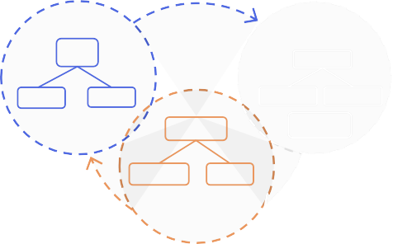

Data mesh principle #1: Data domain ownership
D A T A O W N E R S A R E A C C O U N T A B L E F O R T H E I R D A T A P R O D U C T S T O B E R E L I A B L E , A V A I L A B L E , A N D A C C U R A T E
Data owner
Accountability for data domain and consumption of data products
Create
Owns data created or transformed in
my organization
Store
Owns data stored in
my organization
Share
Owns how my organization
uses the data
Data lake Data marketplace Data warehouse
Register and catalog data assets
AWS
Organizations
Organizational unit (lines of business)
Protect and secure organization data
Bounded context Bounded context
Manage data quality
LOB 1
General Reference Data
Domain
Bounded Context
Country
Product 1
Product 2
LOB 2
Currency
Geography
Domain
Products and services
Producer account
Analytical account
Operational account
Maintain ease of use and atomic integrity
Business unit
Customer

Slide 21










Data mesh principle #2: Data as a product
D O M A I N - D R I V E N D E S I G N T E C H N I Q U E S T O F O R M U L A T E A N D E S T A B L I S H B O U N D E D C O N T E X T S F O R D A T A P R O D U C T S
Federated data governance
Data Catalog Data attributes
Natively accessible
Discoverable & addressable
Data engineer
› Each team manages their data and organizes it as data products
› Each product provides an interface(s) to allow others to interact (e.g., APIs, SQL, reports)
› Remove usability frictions, meet the user where they are
› Provide all supporting metadata, lineage
› Data products are valuable on their own
AWS Lake Formation
Policy control Data permissions
Trustworthy & truthful
Data domain
Data registry
Interoperable
AWS Glue
Data
lake
Data Data
warehouse marketplace
Data lifecycle
Operationalize data quality
Amazon EMR
Devices
Web
Sensors
Social

Slide 22






Data mesh principle #3: Self-serve sharing
E C O S Y S T E M O F S E L F - S E R V E D A T A I N F R A S T R U C T U R E W I T H O P E N P R O T O C O L S
Data consumer
Data consumer
Amazon Athena
AI/ML
Amazon Redshift
Amazon QuickSight
› Design for generalist majority
(i.e., make it easy to use and adopt with no specialist skills needed)
Authorize principal
Query from client services
Federated data governance
Data Catalog Data attributes
› Enable personas to discover, learn, understand, consume, and maintain data products
› Collection of interoperable data products, which enable cross-functional domains to produce and consume data easily and with autonomy and will allow it to scale
› Data products must include data, metadata,
code, and policy all as single
unit of value
› Abstract complexity through automation
AWS Lake Formation
Policy control Data permissions
Data domain
Data lake
Data Data
warehouse marketplace

Slide 23




Data mesh principle #4: Federated data governance
G O V E R N A N C E M O D E L T H A T E M B R A C E S D E C E N T R A L I Z A T I O N A N D D O M A I N M A K I N G M O D E L L E D B Y F E D E R A T I O N O F D A T A P R O D U C T O W N E R S
S E L F - S O V E R E I G N T Y T H R O U G H D E C I S I O N -
Federated access control to data owners
Data domain
owner A
Data domain A
Data consumer
Data engineer
Data domain B
DataZone
Data domain owner B
Consumer Y
Data domain N
Security credentials
Access auditing
Entitlements
 | Data stewards (organization) |  | PCI/SOX auditors
› | Decentralization implementation of governance team and standard authorization | › | They create global policies and standardization to achieve interoperability
› | Governance team = a guild consisting of representatives of all teams taking part in the data mesh | › | Automated execution of policies by the data domains (e.g., data classification and privacy, compliance, security, documentation, and interoperability)

Slide 24
















Data mesh architecture pattern: Data lake data products sharing
Data domain organization N Data domain organization 1
Data domain organization N Data domain organization 1
Central organization –
federated governance account
1 Register data location
AWS Data Exchange
Amazon Athena
Amazon Redshift
9 Share assets collections
Data lake
AWS Data Exchange
8 Subscribe and query shared data products
AWS Lake Formation
Data projects
Data Products
5 Transform & enrich
DataZone
Populate metadata
AWS Lake Formation
AWS Lake
Formation
Data Catalog
Table column tags
Data Catalog
Data Catalog
Table column tags
AWS Glue
Amazon EMR
2
Grant share tables
Table column
6 Grant share tables
tags
3 Create local database
Central catalog updated regularly from each data domain
7 Grant consumer permission
4 Create table resource link

Slide 25




Data mesh architecture pattern: Data lake and data warehouse data product sharing
Data domain organization N Data domain organization N
Data domain organization 1
Central organization –
federated governance account
Data domain organization 1
Data lake
Data Catalog
1 Register data location
Amazon Data Redshift share
6 | Query shared datase A F
Data Catalog Table column tags
2 Regist
er data share tables
Data share
4 Transform & enrich
DataZone
Data projects
Data Products
AWS Lake Formation
t
AWS Lake Formation
WS Lake
ormation
Data Catalog
Table column tags
Data Catalog
3
Grant data share tables
Table column
5
Grant dat
a share tables
tags
Populate metadata

Slide 26
GoDaddy’s journey with AWS
© 2022, Amazon Web Services, Inc. or its affiliates. All rights reserved.

Slide 27


Our vision
is to radically shift the global economy toward life-fulfilling entrepreneurial ventures
Our mission
is to empower entrepreneurs everywhere, making opportunity more inclusive for all
© 2022, Amazon Web Services, Inc. or its affiliates. All rights reserved.

Slide 28
Our strategy
We champion everyday entrepreneurs by empowering them with sage guidance set in seamlessly intuitive experiences
to securely name, create, and grow their ventures in select markets; leveraging the exponential power of our community at global scale to deliver profitable revenue growth
© 2022, Amazon Web Services, Inc. or its affiliates. All rights reserved.

Slide 29
At GoDaddy our goal is to partner with our customers at every point on this wheel
Marketplaces and social media
Messaging commerce
Digital identity
Payments
Domain
Logo
Email Bio site
Website
Hosting and security
Connected commerce
Create posts
Online store
Physical store
Offline point of sale
Ubiquitous presence
Customer relationship management

Slide 30

21M+ customers | 84M+ domains | 15M+ human-guided moments*
85% customer retention | 12% website share | 65+ Care net promoter score (NPS)
55 global sites | 10M+ mailboxes | $26B gross merchandise volume (GMV)
The largest domain registrar
in the world
One of the world’s top WordPress hosting brands
One of the top-branded email providers
in the world

Slide 31
GoDaddy & AWS – 5 years of strategic collaboration
2018
2019
2020
2021
2022
2023
GoDaddy selects AWS for its scale, performance,
and acceleration
Public cloud portal launches
GoDaddy on-premises Hadoop migration begins
Neustar migration to AWS
Websites & marketing migration begins
Amazon registrar plans to migrate 1 million domains to GoDaddy
130+ teams and 800 developers migrate to AWS
Amazon registrar migrates 113K domains to GD
Migrated from Hadoop to AWS
150 teams & 97 prod workloads on AWS
App services established & first TLZs
Migration of 100K customer website builder sites into AWS
300+ teams, 165 prod
workloads, and 651 projects on AWS
100% new product development on AWS (7/2019)
MAIT Team established
Amazon Prime collaboration with websites and marketing
27 teams onboarded
to AWS (on goal of 7)
Security scans, golden AMIs, node rotation

Slide 32
Why GoDaddy chose a data mesh pattern
© 2022, Amazon Web Services, Inc. or its affiliates. All rights reserved.

Slide 33


Data mesh:
Can a data mesh create customer clarity?
Multi-domain – insights & sharing
Data
Preparation
+
Augmentation
Discovery
=
Interaction + governance
Exploration
Data consumer
Data discovery
Unified data experience
Data sharing

Slide 34
















Multi-domain federated customer actions
First-time user
Learn
Cohort
Care
A
First milestone use: 10,480
First
milestone use
Churn risk
Customer
Manage products: 11,202
Active users
Entitlements: GoDaddy Payments,
W+M, 0ffice365 Upcoming renewal: Web+Marketing Upcoming renewal date: 10/2/2023 Autopay: On
B
Manage products
High
use
Product engagement
User conversion
Low
use
Bot
C
SERP
Repeat visitor
Shop
Purchased
Upsell/
cross-sell
Product engagement:
20,042
Product engagement Top prod name: WAM
Total active time: 14hrs 22mins Websites published: 23
Websites updated: 204
D
Setup

Slide 35






Multi-domain federated customer actions
First-time user
Cart
Cohort
Care
A
Learn
Chat
First milestone use
Churn risk
B
Customer
Manage products
High
use
User conversion
Low
use
Other 1
C
Bot
SERP
Other 2
Repeat visitor
Purchased
Upsell/
cross-sell
D
Shop
Setup

Slide 36


GoDaddy data mesh – Customer layers
Data owner
Data domain ownership
CUSTOMER TIERS
Multi-domain products
Visiting user (tier 0) Prospective customer (tier 1) Highly or lowly engaged (tier 2) Conversion (tier 3)
Account (tier 4)
High-value account (tier 5)
Data engineer
Data as a product
Data steward
Data governance council
Data consumer
Self-serve sharing

Slide 37
How GoDaddy built a data mesh using AWS modern data architecture
© 2022, Amazon Web Services, Inc. or its affiliates. All rights reserved.

Slide 38


Data mesh
Data owner
Data domain ownership
Producer domains
Systems of record
Utility domains
1st party 3rd party Services Products
Data ingress
S3
Self- service*
AWS native and third-party services

Slide 39
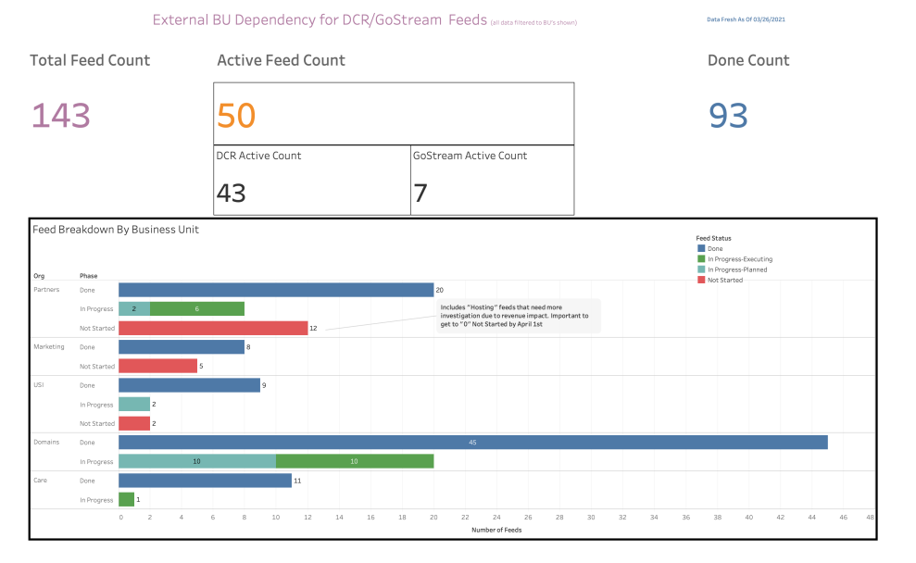

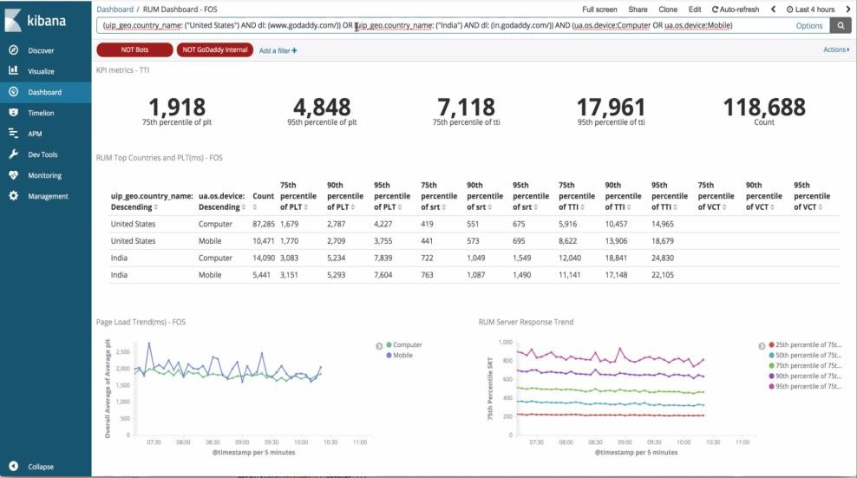
Data mesh
Data consumer
Self-serve sharing
Producer domains
Consumer domains
Systems of record
Utility domains
1st party 3rd party Services Products
Data products
Data ingress
Data egress
Business insights
S3
Self- service*
Self- service*
AWS native and third-party services

Slide 40





Data mesh
Data engineer
Data as a product
Producer domains
Consumer domains
Data processing
(streaming & batch)
Systems of record
Utility domains
1st party 3rd party Services Products
Data ingress
Data egress
Data products
S3
Data lake
(storage & metadata)
Business insights
Self- service*
Self- service*
AWS native and third-party services
Spark, Tecton, Tableau Cloud,
Alation Searchability (Catalog)
Amazon Redshift
Amazon EMR
Amazon Athena
SageMaker
AWS Glue
AWS Lake Formation

Slide 41

Data mesh
Data steward
Data governance council
Producer domains
Consumer domains
Data processing
(streaming & batch)
Systems of record
Utility domains
1st party 3rd party Services Products
Data ingress
Data egress
Data products
S3
Data lake
(storage & metadata)
Business insights
Self- service*
Enhanced governance
Data governance* and the data interfaces
Self- service*
AWS native and third-party services
Spark, Tecton, Tableau Cloud,
Alation Searchability (Catalog)
Amazon Redshift
Amazon EMR
Amazon Athena
SageMaker
AWS Glue
AWS Lake Formation

Slide 42

Data mesh
Utility
domains
Self-service, modern cloud data platform –
delivers reliable, secure, near real-time customer 360 data
Producer domains
Machine learning, data tooling, and experimentation
Consumer domains
Notebook
Data processing
(streaming & batch)
Utility domains
Data Processing
(Streaming & Batch)
Systems of record
1st party 3rd party Services Products
Data ingress
Data egress
Data products
S3
Data lake
(storage & metadata)
Business insights
Self- service*
Enhanced governance
Data governance* and the data interfaces
Self- service*
AWS native and third-party services
Spark, Tecton, Tableau Cloud,
Alation Searchability (Catalog)
Amazon Redshift
Amazon EMR
Amazon Athena
SageMaker
AWS Glue
AWS Lake Formation

Slide 43
Data mesh
Utility
domains
Self-service, modern cloud data platform –
delivers reliable, secure, near real-time customer 360 data
Producer domains
Machine learning, data tooling, and experimentation
Consumer domains
Notebook
3
Data processing
(streaming & batch)
1
Utility domains
Data Processing
(Streaming & Batch)
Systems of Record
1st party 3rd party Services Products
Data ingress
Data egress
5
Data products
S3
Business insights
2
Data lake
(storage & metadata)
4
Self- service*
Enhanced governance
Data governance* and the data interfaces
Self- service*
AWS native and third-party services
Spark, Tecton, Tableau Cloud,
Alation Searchability (Catalog)
Amazon Redshift
Amazon EMR
Amazon Athena
SageMaker
AWS Glue
AWS Lake Formation

Slide 44
Data mesh
Producer domains
Producers instrument DOMAIN* telemetry,
share data via data platform
1
Systems of record
Utility
domains
1st party 3rd party Services Products
Data ingress
2
Producers register
DOMAIN* data in catalog
Self- service*

Slide 45
Data mesh
Utility
domains
Self-service, modern cloud data platform –
delivers reliable, secure, near real-time customer 360 data
Machine learning, data tooling, and experimentation
Notebook
Data processing
(streaming & batch)
3
Inferencing* request access table (DB-API)

Slide 46
Data mesh
Data governance council enforces policies
4
Enhanced governance
Data governance* and the data interfaces

Slide 47

Data mesh
Consumers use shared DOMAIN* data
Data egress
Data products
5
Business insights
Self
Service*

Slide 48

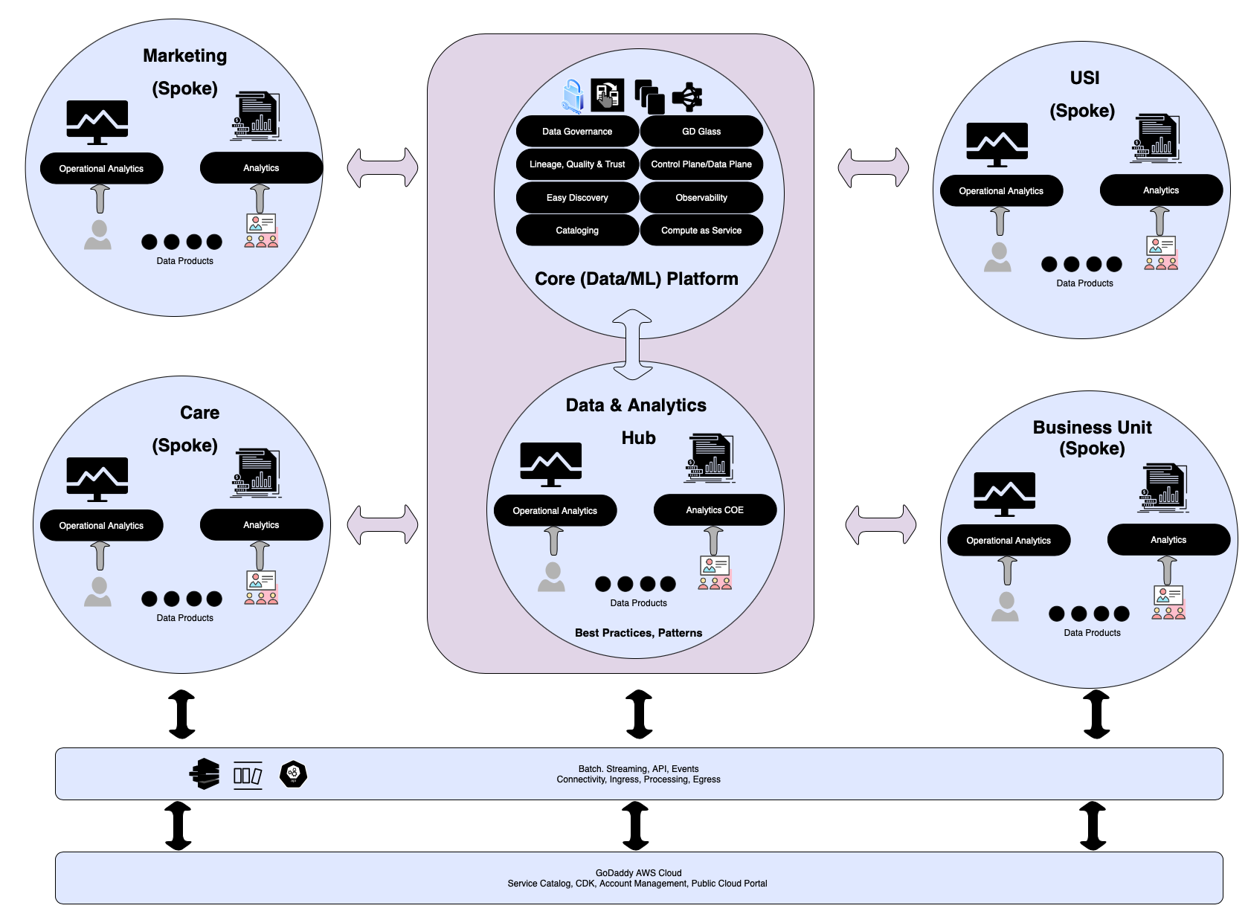
GoDaddy conceptual/ domain architecture

Slide 49
Business outcomes
Created hierarchical views of data products at different levels so that business users can analyze information to make quicker business decisions
Automated access management framework to enable self-served access to data within and across lines of business
Accelerated the data platform adoption to 10+ LOBs and 300+ teams globally, with more to come in the future
Enabled data scientists to find and access data needed to generate ML models across LOBs
Achieved 10s of millions of dollars in cost savings from data reuse and better management of purchased datasets

Slide 50


Thank you!
Please complete the session survey in the mobile app

