Slide 1



Slide 2


Creating a modern CPG data architecture with a data mesh
er Packages Goods
C P G 201
Michael Connor
Global Head of Solutions for Consumer Packages, Consumer Packaged Goods AWS
Krithika Ganesamoorthi
Global Retail Partner Technical Lead AWS
© 2021, Amazon Web Services, Inc. or its affiliates. All rights reserved.

Slide 3
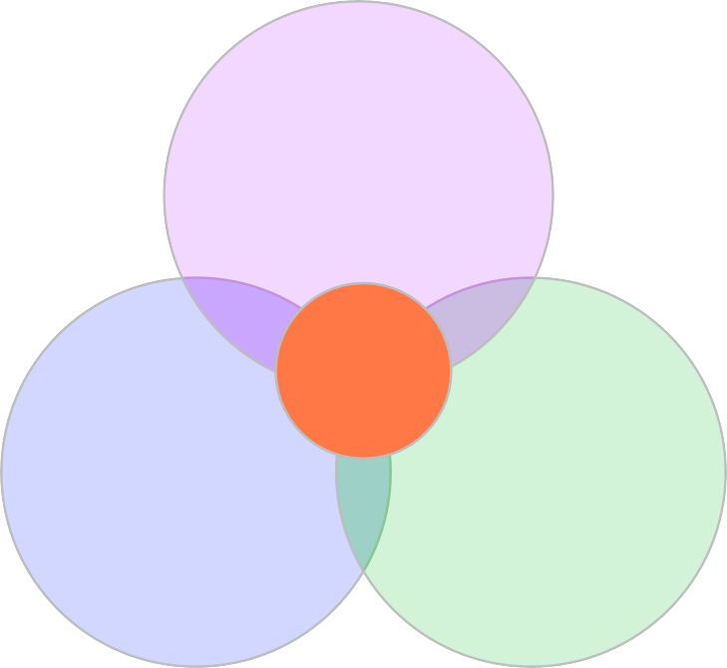
Data Mesh
Data mesh (as defined by Zhamak Dehghani of ThoughtWorks) is an architectural and organizational paradigm shift in how we manage big analytical data. The paradigm is founded on four principles
Domain-oriented decentralization of data ownership and
architecture
Domain-oriented data served as a product
Self-serve data infrastructure as a platform to enable autonomous, domain-oriented data teams
Federated governance to enable ecosystems and interoperability.
Culture
Data Driven
Systems
Processes
Data should be served and usable at the source

Slide 4
Top 10 business issues around data/analytics
Despite advances in cloud infrastructure and technology, many CPGs still face the same data failure modes
they’ve suffered from for decades
Meetings devolve into whose spreadsheet is right
It’s like pulling teeth trying to find datasets and get access to them
Once we get access to data, it’s hard to make sense of what it means
We only realize we have a profit/loss problem when we go to close the books
We have a lot of data, but it doesn’t translate into meaningful actions
It takes months to align with IT and get a new report
We only find out we’ve had data loss when we run month/quarter end reports
When we have a problem, it takes us a long time to find root cause and take action
We don’t get value from the investments we’ve made in data & analytics
We don’t have well-defined processes for giving people access to specific datasets and revoking access when they no longer need them

Slide 5
Key tenants of a successful data science practice
Business Value
Agility
Access & Governance
Data Quality

Slide 6
The data monolith
The data monolith starts with the assumption that data must flow elsewhere to be usable. The hadoop monolith started out great, one vendor, no tech debt, but attempts to scale brought familiar failure modes.
Producers Data monolith Consumers
Ingest
Change
Process e.g., AI/ML experts
Serve

Slide 7
Data mesh
Organizing teams around domains, rather than functions (ingest, process, and serve) removes bottlenecks, and creates business value from data this is more accurate, accessible, and responsive to the business.
Producers Domain Data Lake Consumers
Domain: Digital Advertising
Ingest
Process
Serve
Domain: Direct to Consumer Commerce
Ingest
Process
Serve
Domain: Manufacturing
Ingest
Process
Serve
Change

Slide 8











Customers are moving from…
…
Business
Intelligence
Reporting
Business
Intelligence
Reporting
Realtime
monitoring
Personalized
experiences
Integrated
AI / ML
Amazon Aurora
Amazon EMR
…
Amazon OpenSearch
Service
Amazon DynamoDB
DW Silo
Hadoop Silo
Amazon S3
OLTP ERP CRM LOB
Devices Web Sensors Social
Amazon Redshift
Amazon SageMaker
Siloed data
Modern Data Lake

Slide 9



Data mesh: Ownership and governed sharing
Data lake
Data lake
A decentralized, domain-oriented data architecture to drive governed sharing of data products.
Data lake
Data lake
Data products

Slide 10






Data mesh
Organizing teams around ingest, process, and serve, instead of domains creates bottlenecks, and these teams don’t understand the domain data
Producers Data monolith
Domain: Digital Advertising
Data catalog
Discoverable
Addressable
Domain: Direct to Consumer Commerce
Trustworthy
Domain: Manufacturing
Self-describing
Interoperable
Data infrastructure engineers
Data infrastructure as a platform
Secure
The data infrastructure designs are self-service and domain agnostic

Slide 11
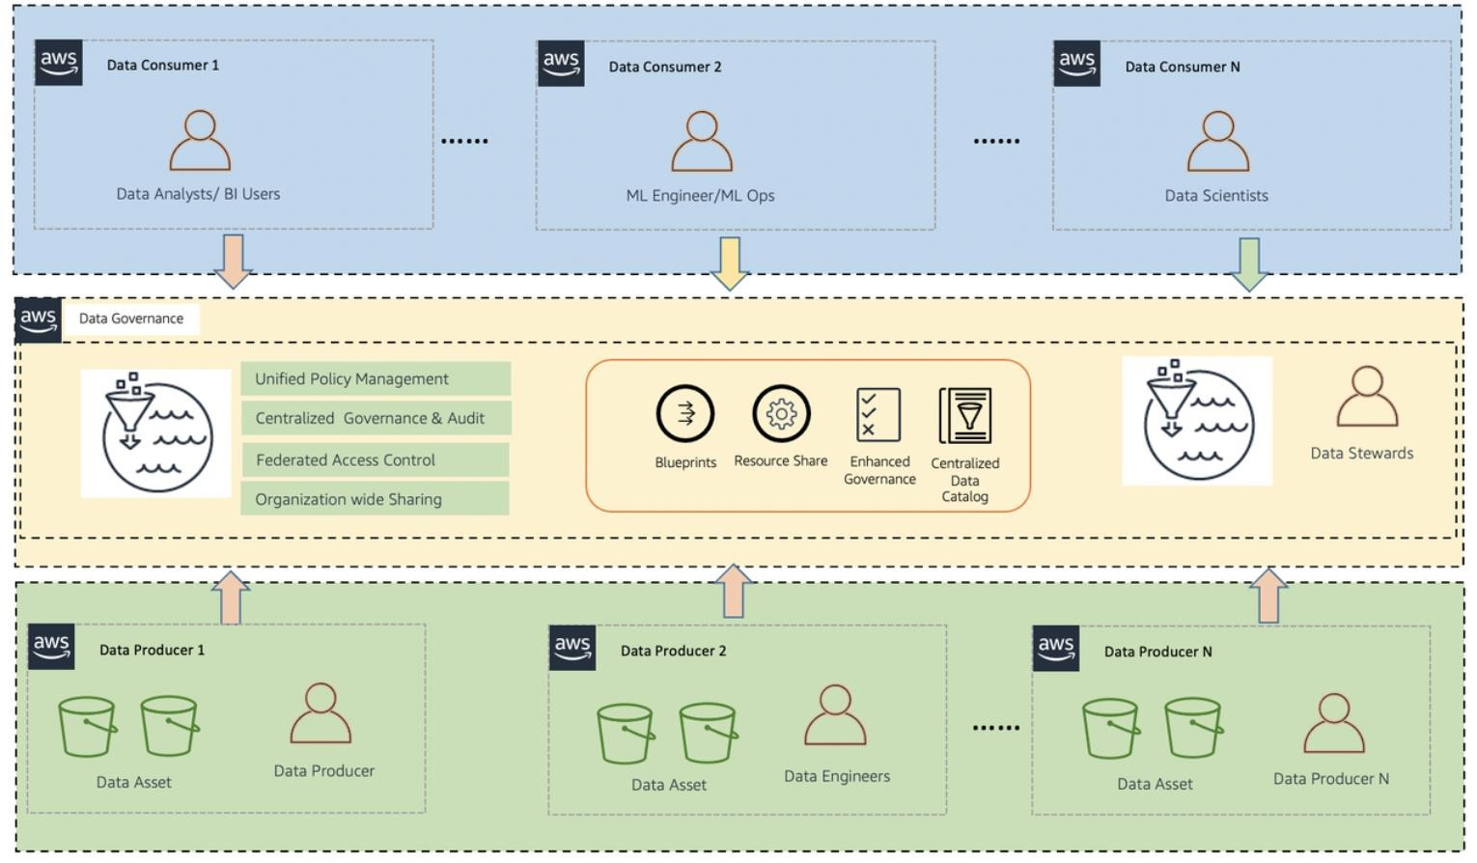
High-Level Architecture

Slide 12
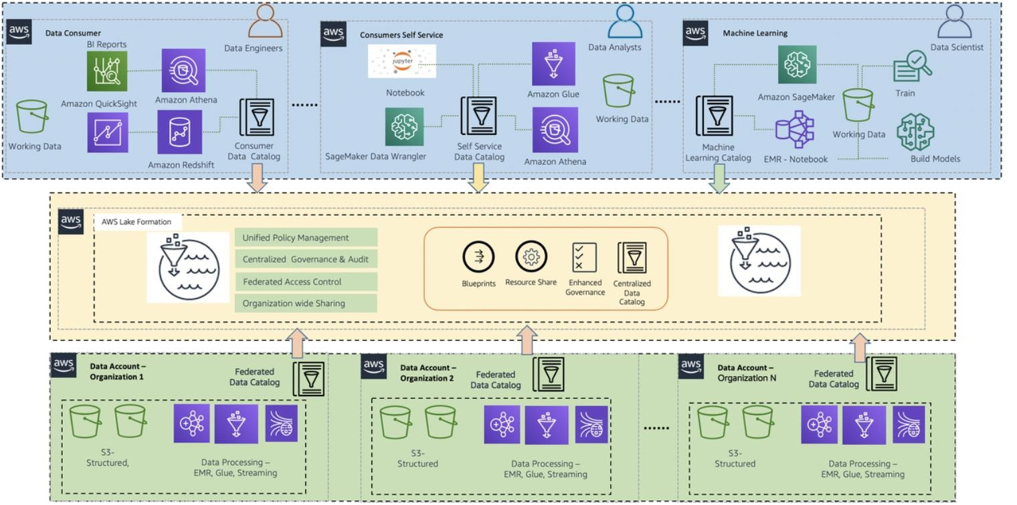
AWS Data Mesh Architecture

Slide 13
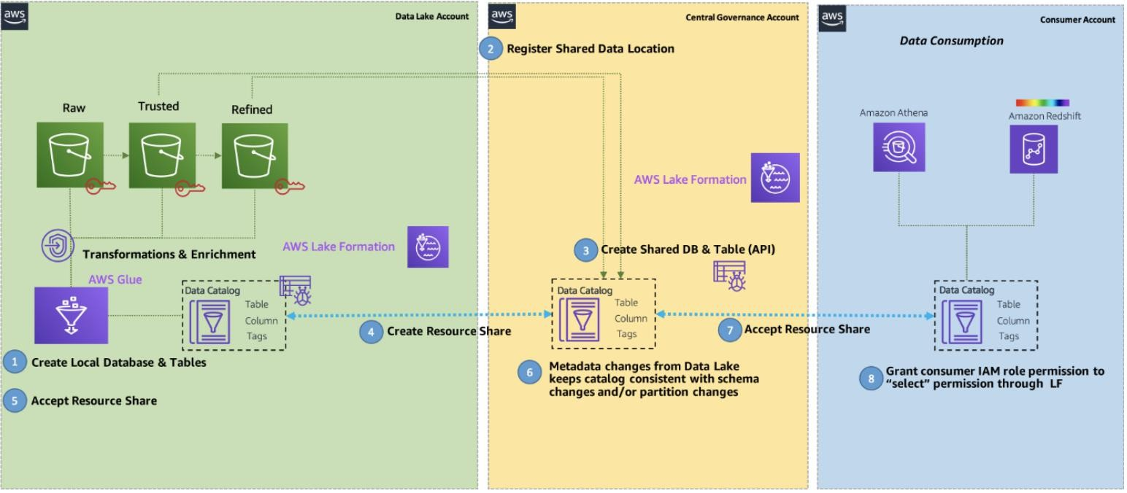
End-to-End Workflow

Slide 14
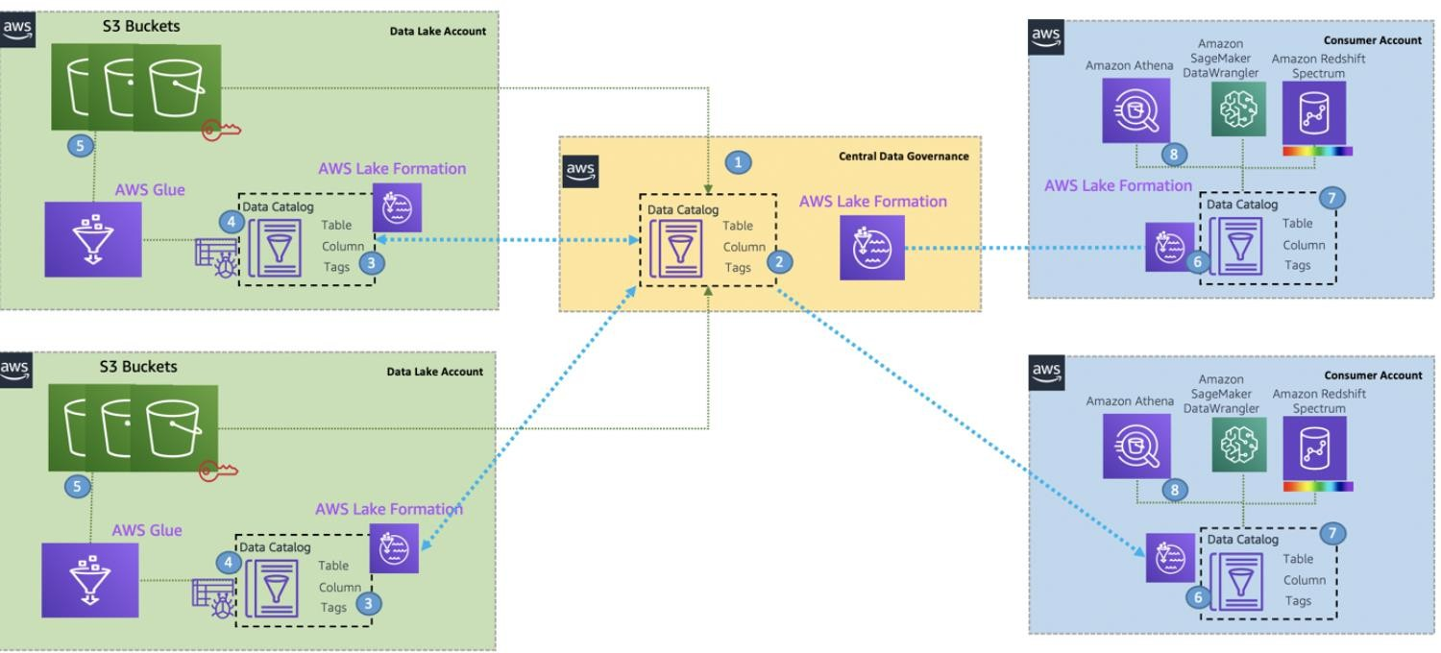
Cross-Account Data Mesh

Slide 15
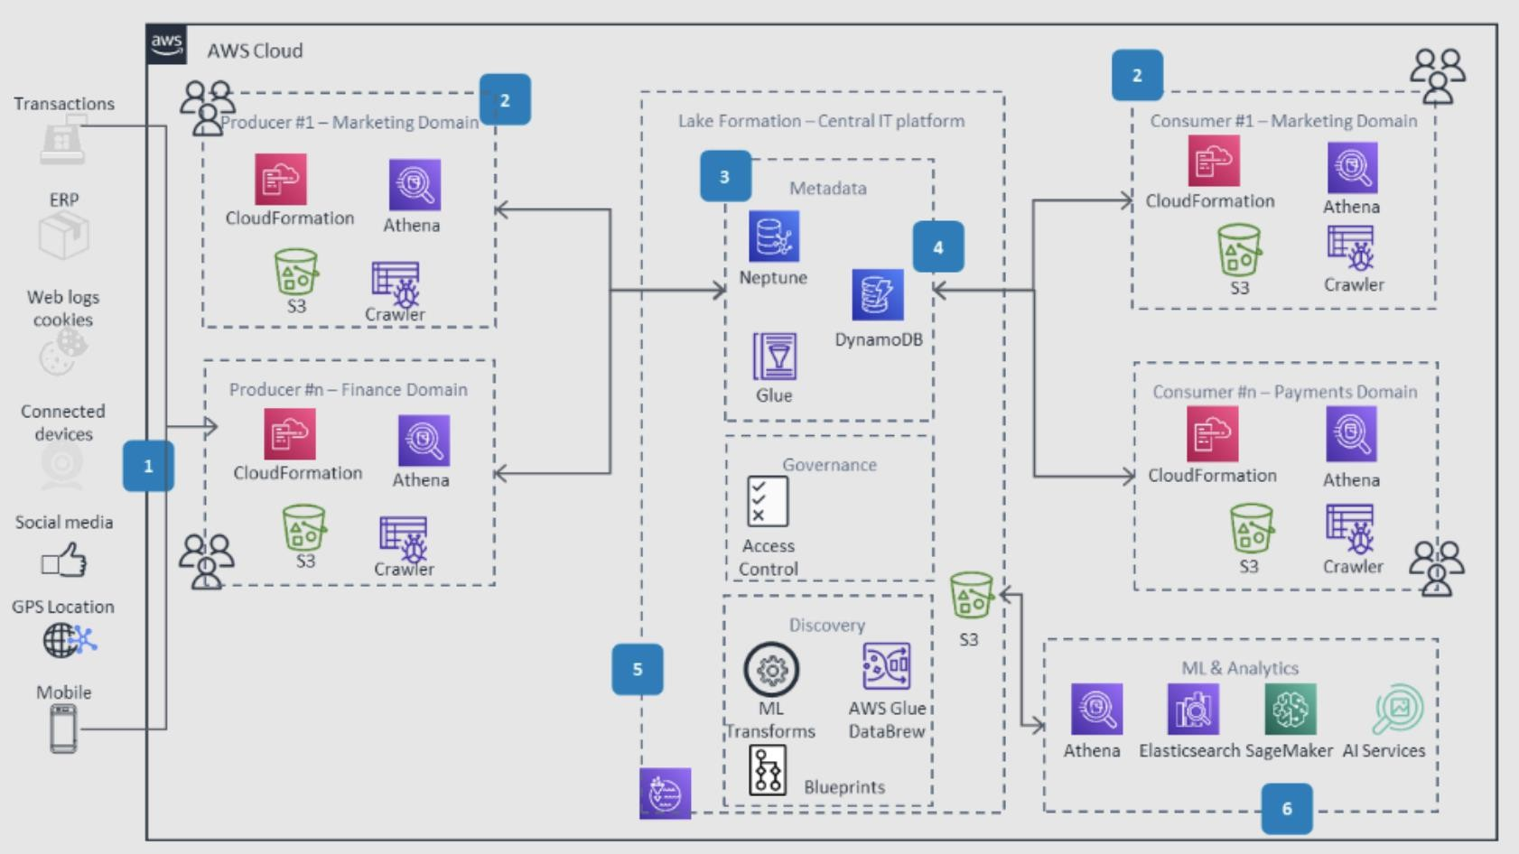
CPG Data Mesh

Slide 16

Thank you!
Krithika Ganesamoorthi
kganesam@amazon.com
Michael Connor
mlconnor@amazon.com
© 2021, Amazon Web Services, Inc. or its affiliates. All rights reserved.

