Slide 1



Slide 2


Best practices and architecture patterns for risk calculations on AWS
FSI306
Shivani Sharma
(she/her)
Solutions Architect
Amazon Web Services
Alseny Diallo
(he/him)
Solutions Architect
Amazon Web Services
© 2023, Amazon Web Services, Inc. or its affiliates. All rights reserved.
© 2023, Amazon Web Services, Inc. or its affiliates. All rights reserved.© 2023, Amazon Web Services, Inc. or its affiliates. All rights reserved.

Slide 3





Why run risk calculations in AWS?
BUSINESS PERSPECTIVE
Cost optimization
Regulatory requirements
Increasing market volatility
On-demand analytics
Faster time to market

Slide 4



Why run risk calculations in AWS?
TECHNICAL PERSPECTIVE
Capacity problems
Growing data set
System bottlenecks
Modernize

Slide 5


Why run risk calculations in AWS?
BENEFITS OF THE CLOUD
Cost
Speed
Scale
Agility

Slide 6
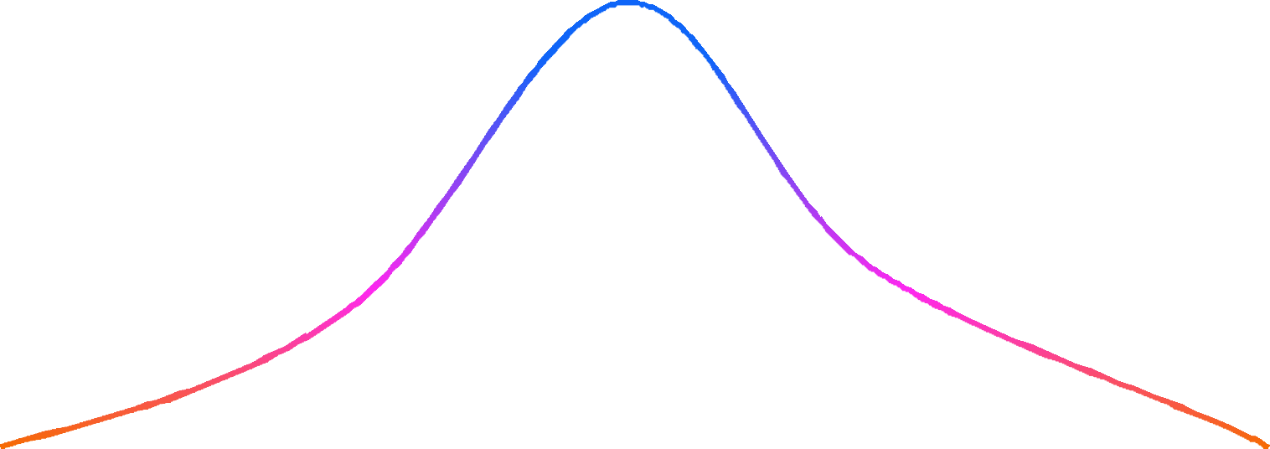
Value at risk (VaR)
Measures the potential loss in value of a financial asset or entity given a time period and a confidence level
Time horizon = 1 day
Confidence level = 95%

Slide 7
On premises
Data processing
Calculation engine
Results
Data storing
Data retrieval
Risk engine
Data loading Data storing
Database
Orchestration

Slide 8






Long-term data strategy
VaR calculation
In-memory datastore
Database
Data lake
Data warehouse
Risk engines
Data

Slide 9
Architecture discussion

Slide 10

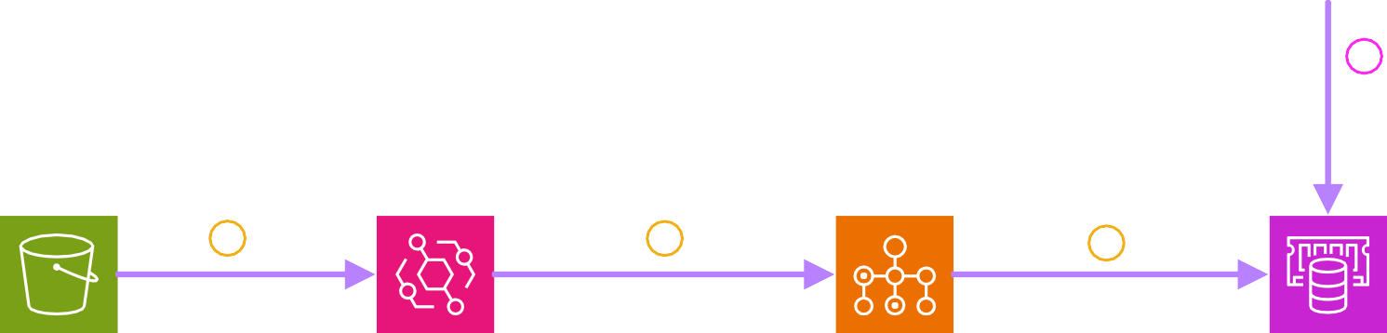

Prototype architecture
User
5
Initiate calculation
AWS Cloud
AWS Batch
₆ Calculate
and
store results
Risk engine data
Event trigger
2
Initialize load job
3
Load data
4
Risk engine
1
Amazon Simple Storage Service (Amazon S3)
Amazon EventBridge
AWS Batch
Amazon ElastiCache

Slide 11
Long-term data strategy
VaR calculation
AWS Batch
In-memory datastore
Database
Amazon ElastiCache
Amazon MemoryDB for Redis
Amazon Aurora
Data lake
Data warehouse
Risk engines
Data
Amazon Simple Storage Service (Amazon S3)
Amazon Redshift

Slide 12


Thank you!
_{Thank you!} Please complete the session survey in the mobile app
© 2023, Amazon Web Services, Inc. or its affiliates. All rights reserved.
Please complete the session survey in the mobile app
Shivani Sharma
awsshivs@amazon.com
Alseny Diallo
dialseny@amazon.com
© 2023, Amazon Web Services, Inc. or its affiliates. All rights reserved.© 2023, Amazon Web Services, Inc. or its affiliates. All rights reserved.

