Slide 1



Slide 2


Finding data in a life science data mesh
L F S 3 0 3
Somdeb Bhattacharjee
Senior Solutions Architect, Data Lake and
Analytics HCLS
AWS
Navneet Srivastava
Principal Solutions Architect, Data Lake and
Analytics HCLS
AWS
© 2022, Amazon Web Services, Inc. or its affiliates. All rights reserved.

Slide 3
Agenda
AWS for Health
How to find the right data product?
What is data mesh?
End-to-end data discovery implementation
Why use a graph database?
Workshop walkthrough
AWS services used in the workshop

Slide 4



AWS for Health
Omics
Healthcare
Life sciences
Accelerating innovations from benchtop to bedside

Slide 5
How to find the right data product
Without a knowledge graph
Search (terms)
Publishers’ data descriptions
Request access
Download files
Query
Useful?
Yes
Analyze
No
With a knowledge graph
Data catalog (Semantic graph, ontologies, data profile)
Search
(concepts)
Download
files
Analyze

Slide 6











What is data mesh?
A decentralized, domain-oriented data system to drive governed sharing using a
modern data architecture design pattern
Consumer 1
Consumer 2
. . . Consumer N
Consumers
Amazon
Amazon
Amazon
Amazon
Amazon
Amazon Amazon
Redshift EMR _{Athena}
BI reports
EMR
Notebook
Redshift EMR SageMaker
Federated governance
Unified policy management
Centralized governance and audit Federated access control
Data
governance/mesh
Blueprints
Resource Enhanced share governance
Centralized
data catalog
Organization-wide sharing
Data producers
Amazon S3
Amazon S3
data lake storage
Amazon S3
. . .
data lake storage
LOB 1
data lake storage
LOB N
LOB 2

Slide 7
Data discovery from end to end: Catalog
Business catalog: Search based on business glossaries
Data and technical catalog: Search based on the schema and location
Knowledge graph: Semantic search based on the related entities, maps, and ontologies

Slide 8
Why use a graph database?
© 2022, Amazon Web Services, Inc. or its affiliates. All rights reserved.
8

Slide 9



Graph query languages are designed to move through data
Friend
Friend
Jack
Annie
Sam

Slide 10
Graph query languages are designed to move through data
Person
Person ID | Name
P1 | Jack
P2 | Annie
P3 | Sam
Friends
Friend ID | Person ID1 | Person Name1 | Person ID2 | Person Name2
E1 | P1 | Jack | P2 | Annie
E2 | P2 | Annie | P3 | Sam
Friends of a Friend
Friend ID | Person ID1 | Person Name1 | Person ID2 | Person Name2 | Person ID3 | Person Name3
E4 | P1 | Jack | P2 | Annie | P3 | Sam
X
=
Relational queries work by combining sets of data via joins or recursive CTE

Slide 11

Workshop use case
Patient discovery using patient demographics, disease concepts, and disease ontologies (ICD10, SNOMED CT)

Slide 12


Workshop architecture
Knowledge Graph
Data Product1
Ontology xref file
S3
Input to knowledge graph
S3
Data Product2
Amazon Neptune
Generate
S3
S3
Aggregate file
Data Product3
S3
Data Product4
S3
Data Product5
S3

Slide 13

Workshop architecture
Knowledge Graph
Data Product1
Ontology xref file
S3
Input to knowledge graph
S3
Data Product2
Amazon Neptune
Generate
S3
S3
Aggregate file
Data Product3
S3
Data Product4
Catalog and permissions management
S3
Catalog data products
AWS Glue
Data Product5
S3

Slide 14


Workshop architecture
Front end UI Query Translator
Data Product1
Knowledge Graph
Ontology xref file
S3
Input to knowledge graph
S3
Semantic search
Invokes
Queries
Data Product2
AWS Amplify
AWS Lambda
Amazon Neptune
Users
Generate
S3
Sends query results back
Receives query output
S3
Aggregate file
Data Product3
S3
Data Product4
Catalog and permissions management
S3
Catalog data products
AWS Glue
Data Product5
S3

Slide 15

Workshop architecture
Front end UI Query Translator
Data Product1
Knowledge Graph
Ontology xref file
S3
Input to knowledge graph
S3
Semantic search
Invokes
Queries
Data Product2
AWS Amplify
AWS Lambda
Amazon Neptune
Users
Generate
S3
Sends query results back
Receives query output
S3
Aggregate file
Data Product3
S3
Request access to data product
Provision access to data product
Data Product4
Catalog and permissions management
S3
Catalog data products
AWS Lake Formation
AWS Glue
Data Product5
S3

Slide 16

Workshop architecture
Front end UI Query Translator
Data Product1
Knowledge Graph
Ontology xref file
S3
Input to knowledge graph
S3
Semantic search
Invokes
Queries
Data Product2
AWS Amplify
AWS Lambda
Amazon Neptune
Users
Generate
S3
Sends query results back
Receives query output
S3
Aggregate file
Data Product3
S3
Request access to data product
Provision access to data product
Data Product4
Catalog and permissions management
S3
SQL Client
Catalog data products
Validate access
AWS Lake Formation
AWS Glue
Data Product5
Query data product
Amazon Athena
Query dataset
S3
Show query results

Slide 17




Amazon Neptune
Open
Fast
Reliable
Flexible
Supports Apache TinkerPop and W3C RDF graph models
Query billions of relationships with millisecond latency
6 replicas of your data across
3 AZs with full backup and restore
Build powerful queries easily with Gremlin, openCypher, and SPARQL

Slide 18


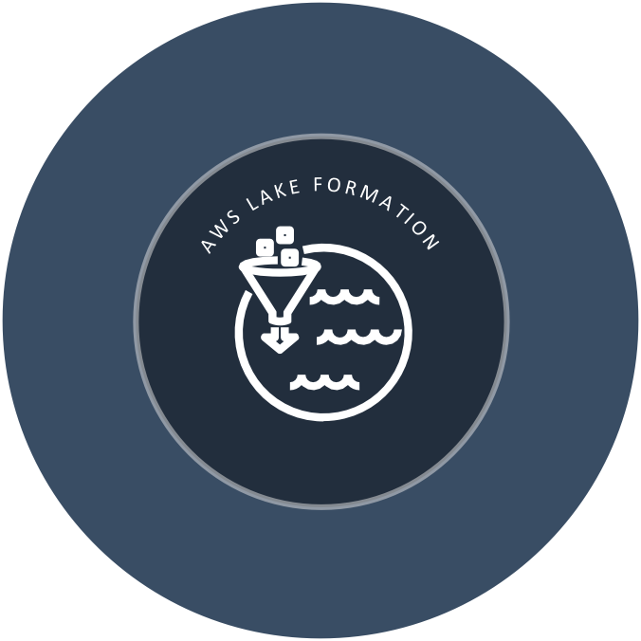


AWS Lake Formation
Ingestion and identification
Blueprints simplify ingest, store, and catalog faster ML transforms for data cleaning
AWS Lake Formation is a fully managed serverless service that allows you to build clean and secure data lakes in days
Simplified security
Centralized permissions table and column
Self-service access to data
Comprehensive portfolio of integrated tools
Real-time monitoring and integrated auditing

Slide 19



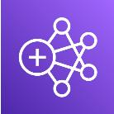
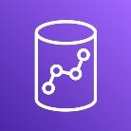





AWS Lake Formation: The foundation for data lakes
Single place to manage access
Open file formats
Efficient sharing
AWS
Lake Formation
AWS
Blueprints
ML Data
transforms catalog
Access
Glue
control
System of integrated tools
Amazon S3
data lake storage
Cost-effective

Slide 20


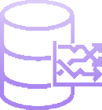

Amazon
Athena
Serverless
Open and flexible
Fast and interactive
Q U E R Y A L L Y O U R D A T A U S I N G S Q L
Cost-effective

Slide 21




SQL
AA YY PP EE RR
UU EE RR YY
O P E N A N D F L E X I B L E
SS EE RR VV EE RR LL EE SS SS
E A S Y
setup cost
Point to Amazon S3 and start querying
Pay only for queries run
ANSI SQL
JDBC/ODBC drivers
Multiple formats, compression types, and complex joins and data types
Serverless: zero infrastructure, zero administration
Integrated with QuickSight and other BI tools
Save on
per-query costs
through compression

Slide 22

AWS Health Lounge
Connect with AWS Health experts and other attendees in our dedicated lounge space for informal discussions and networking
Explore AWS Healthcare & Life Sciences demos and new additions to the AWS for Health portfolio!
Location: AWS Industries Networking Lounges, Caesars Forum Main Hall

Slide 23
Workshop Instruction guide
https://tinyurl.com/47r5fws6
Event URL
https://tinyurl.com/yyyxhfhj

Slide 24

Thank you!
Please complete the session survey in the mobile app

