Slide 1



Slide 2


Integrate third-party data into your data architecture and data mesh
M K T 3 0 7 - R
Chris Casey
General Manager for Industry ISVs & AWS Data Exchange Business Development
AWS
Nghi Ho
Director, Head of Data & AI Platform and Enterprise Data Governance Gilead Sciences, Inc
Anna Whitehouse
Senior PM, AWS Data Exchange AWS
© 2022, Amazon Web Services, Inc. or its affiliates. All rights reserved.

Slide 3





Agenda
Overview: Data mesh architecture New launch announcements Gilead’s data mesh
Whiteboarding: Architect it together
Call to action

Slide 4

Tell us about you
© 2022, Amazon Web Services, Inc. or its affiliates. All rights reserved.

Slide 5


Data architecture – Decentralized/Siloed
L I M I T S B U S I N E S S A G I L I T Y A N D H A M P E R S I N N O V A T I O N
Web
logs
Device data
App
data
ERP
CRM
LoB
SFTP
One size fits all approach
Slow ETL before analysis
Data silos & proprietary formats
Data
Data
warehouse
warehouse
Can’t scale easily
or on-demand
Varying analytic and business needs
Wasted capacity
Business Intelligence
Business intelligence

Slide 6




Data architecture – Centralized
L I M I T S B U S I N E S S A G I L I T Y A N D H A M P E R S I N N O V A T I O N
Central data platform
Web Device App
_{data} SFTP
_{Web} Device
App data
SFTP
ERP CRM LoB
logs data
ERP CRM LoB
logs
data
Data
warehouse
Data
warehouse
Data warehouse
Data warehouse
Business
intelligence
Business intelligence
Business intelligence
Business intelligence
Sales and marketing
Supply chain

Slide 7
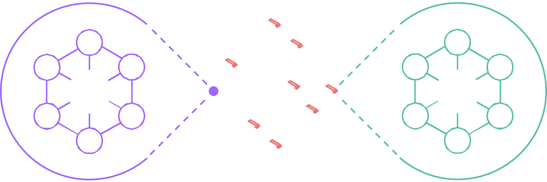
Data mesh
W H A T I S I T ?
Distributed data architecture that enables the governed sharing of data products from data producers to data consumers
Data science
Supply chain
BI/analytics
Sales
Finance
Sales
User
interaction
Supply chain Data consumers
Data producers
Data mesh

Slide 8
What about third-party data?
© 2022, Amazon Web Services, Inc. or its affiliates. All rights reserved.

Slide 9
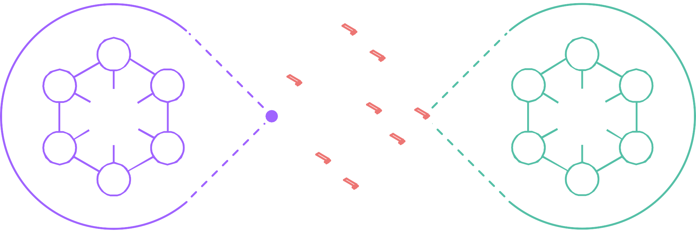
Data mesh
W H A T I S I T ?
Distributed data architecture that enables the governed sharing of data products from data producers to data consumers
Data science
Weather
data
Claims
data
BI/analytics
Foot
traffic
Sales
Market intelligence
Supply chain Data consumers
Data producers
Data mesh

Slide 10
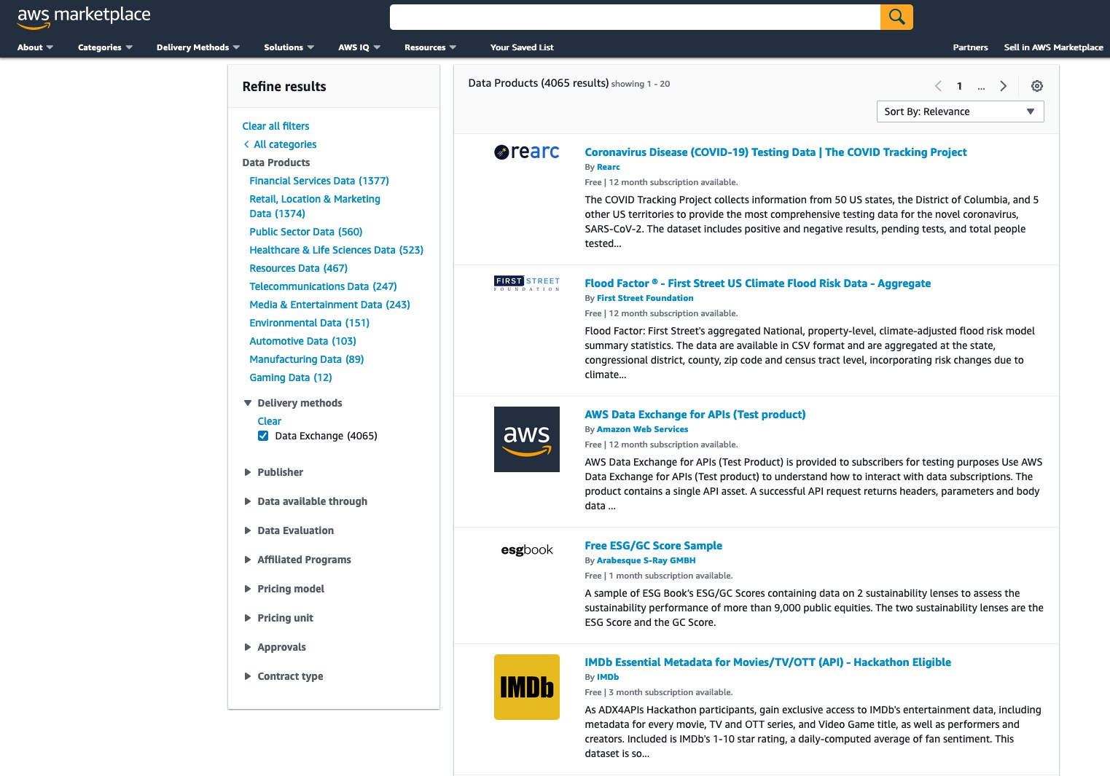
AWS Data Exchange enables customers to easily find, subscribe to, and use third-party data in the cloud
300+ data providers and 3,500+ data products
Over 1,500 free public data products to easily evaluate the data you need
Support for private products and
private data trials
Data delivery via files, tables, and APIs

Slide 11














Organizations innovating with AWS Data Exchange
neuravest
The University of Texas at Austin
Cockrell School of Engineering
DUKE UNIVERSITY
FLIXED
Investics

Slide 12






Third-party data via files, tables, or APIs, all in one service
Ingest or access files directly
Query tables
Call APIs
NEW
NEW
AWS Data
AWS Data Exchange for Data Files
AWS Data Exchange for Amazon S3
AWS Data Exchange for Amazon Redshift
Exchange for AWS Lake Formation
AWS Data Exchange for APIs

Slide 13
How does Gilead incorporate third-party data procured via AWS Data Exchange into their data mesh?
© 2022, Amazon Web Services, Inc. or its affiliates. All rights reserved.

Slide 14

Guiding principles
Data as Products – Improve trust and quality of data
Minimize data movement
Unified data strategy for all data and analytics applications with common governance principles
Seamless integration of data science tool sets
Lower cost of ownership

Slide 15








































High-level architecture
D A T A
M E S H S Y S T E M
Mesh experience plane
Services that operate on a mesh of interconnected data products
C O N T E X T
Gilead-DNA platform – Tier 1 enterprise platform
Data product catalog
Data product observability
Data product: registration API, Grant Access API, Quality API
Data product discovery
Understand data product
Request access
Access approval
Enterprise Catalog
Schema
Shape/profile
Classification
Quality
Operational metrics
Find data products and get access
AWS Lake Formation
AWS
Lambda
AWS
Lambda
AWS
Glue
AWS Glue DataBrew
AWS
Lambda
AWS Step Functions
Data scientist | Business analyst | Data steward | Data engineer | End users
Data product experience plane
Services that operates directly with data products
Data acquisition
Data transformation
Business rules processing
Data pipeline orchestration
Connectors
Global data access control
Distributed query engine
Data pipeline
Others
Augmented analytics
Others
AWS
Glue
Amazon AppFlow
Amazon EMR
AWS
Glue
AWS
Lambda
Amazon EMR
AWS
Glue
AWS
Lambda
Amazon EMR
Amazon MWAA
Amazon EventBridge
AWS
AppSync
Amazon AppFlow
AWS
Lambda
Data products
Source aligned
Consumption aligned
MDM
External data products (Data Marketplace)
LOB
Data Product
LOB
Data Product
LOB
Data Product
LOB
Data Product
Enterprise MDM
Purchased data
AWS KMS
IAM
Public domain data
SQL query
AWS Secrets Manager
Segment
MDM
Island account
Academic collaborators
As per IT security standards
Amazon Redshift
Amazon S3
Amazon RDS
Amazon S3
Amazon S3
AWS Data AWS
Exchange Glue
AWS
Glue
AWS Lake Formation
BI tools
Data lakes
Commercial data lake
PDM
data lake
Medical affairs data lake
Business conduct compliance data lake
HR
data lake
Finance data lake
Other data lakes
Self Serve Infrastructure Plane
DNA Platform Infrastructure: AWS Service Catalog | Terraform | Automation | Databricks
Bring your own Infra: build data products using infrastructure of choice
Data science tools
Other self-serve infra. tools
Amazon VPC
IAM
AWS Service Catalog AWS CloudTrail Amazon CloudWatch

Slide 16






AWS Data Exchange accelerates bringing
third-party data into the data mesh
AWS account
R&D & Commercial
Gilead’s Central Management Account
Data lineage Data governance
Business Data Catalog
Use auto-export to automate the delivery of new data updates
Global Data Access Control
AWS account
Business Analysts
AWS Data Exchange for Data Files
Distributed Query Engine
AWS Glue
AWS Lake Formation
AWS account
Data Scientists

Slide 17
How it’s going
Benefits of using ADX in the mesh context
Faster onboarding of new datasets
Data Sharing instead of data movement
Security compliance
Less operational overhead
Top challenges encountered during the implementation/migration
Vendor selection
Data sharing needs are complex

Slide 18

Whiteboarding: Architect it together
© 2022, Amazon Web Services, Inc. or its affiliates. All rights reserved.

Slide 19
Third-party data via files, tables, or APIs, all in one service
Ingest or access files directly
Query tables
Call APIs
NEW
NEW
AWS Data
AWS Data Exchange for Data Files
AWS Data Exchange for Amazon S3
AWS Data Exchange for Amazon Redshift
Exchange for AWS Lake Formation
AWS Data Exchange for APIs

Slide 20

Call to action/wrap-up
Scan this QR code for more information on:
Subscribing to data products
Becoming an AWS Data Exchange data provider
AWS Data Exchange for Amazon S3
AWS Data Exchange for AWS Lake Formation
Watch the recording of LFS202 – Gilead Sciences’ journey from migration to innovation on AWS – for an in-depth look at how Gilead Sciences implemented their data mesh
Visit AWS Data Exchange in the exhibition hall at AWS Marketplace pavilion (Booth #3525)

Slide 21

Thank you!
Chris Casey
linkedin.com/in/chris-casey- 39359628/
Nghi Ho
https://www.linkedin.com/in/nghiho/
?locale=pl_PL
Anna Whitehouse
linkedin.com/in/whitehouseanna/
Please complete the session survey in the mobile app

