Slide 1



Slide 2


S T G 3 3 4 - R
Build data mesh architectures using AWS Transfer Family & AWS Lake Formation
Blayze Stefaniak (he/him)
Senior Solutions Architect
AWS
Ken Howard (he/him)
Senior Solutions Architect
AWS
Shoeb Bustani (he/him)
Senior Solutions Architect
AWS
Kapil Shardha (he/him)
Principal Solutions Architect
AWS
Basiruddin Seikh (he/him)
Senior Storage Solutions Architect AWS
© 2022, Amazon Web Services, Inc. or its affiliates. All rights reserved.

Slide 3
Agenda
Why choose a modern data architecture?
Unified governance of data products by using AWS Lake Formation
Third-party data products with AWS Transfer Family managed workflows Introduction to the session use case
Let’s start building!
Conclusion

Slide 4
Why choose a modern data architecture?
© 2022, Amazon Web Services, Inc. or its affiliates. All rights reserved.

Slide 5
Customers want more value from their data
Growing exponentially
From new sources
Increasingly diverse
Used by many people
Analyzed by many applications

Slide 6









Key pillars of the modern data architecture
Non-relational
databases
Big data processing
Scalable data lake
Purpose-built data services Seamless data movement
Log analytics
Relational databases
Performant and cost effective
Data lake
Unified governance
Data warehousing
Machine learning

Slide 7
Unified governance of data products by using AWS Lake Formation
© 2022, Amazon Web Services, Inc. or its affiliates. All rights reserved.

Slide 8
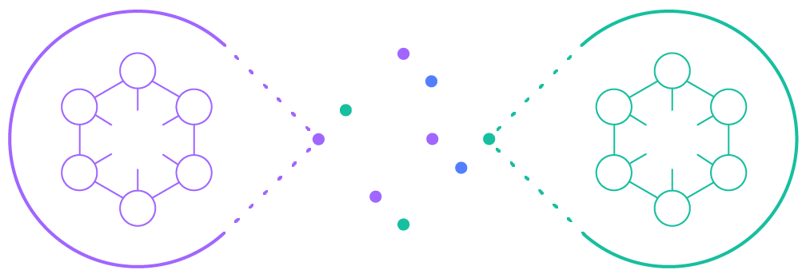
Data mesh: Governed sharing of data products
Architecture that enables the governed sharing of
data products across one or more data lakes
Data producers
Data mesh
Data consumers

Slide 9
Third-party data products with AWS Transfer Family managed workflows
© 2022, Amazon Web Services, Inc. or its affiliates. All rights reserved.

Slide 10







AWS Transfer Family
F R I C T I O N L E S S F I L E T R A N S F E R S E N A B L I N G B U S I N E S S - TO - B U S I N E S S
( B 2 B )
C O N N E C T I V I T Y
Seamless migration of file transfers using SFTP, FTPS, and FTP
Fully managed, highly available across the globe
Secure and compliant
Native integration with AWS services
Cost effective
Simple to use

Slide 11

FINRA uses AWS Transfer Family to provide secure access to their data lake on Amazon S3
Challenge
FINRA manages SFTP infrastructure for over 1,000 external users doing 6 million file transfers per month. This put a significant strain on their operations teams to manage and monitor.
Solution
FINRA has embraced using Amazon S3 as their data lake. As part of building their new FileX platform on AWS, FINRA used the AWS Transfer Family to provide their external users secure access to data stored in Amazon S3.
Benefits
By using AWS Transfer Family, FINRA was able to reduce operational burden, continue to use Amazon S3 as their data lake, and maintain connections to their existing authentication systems.
“
AWS Transfer for SFTP is helping us reduce our operational burden, keeping S3 as our data lake, while maintaining critical connection to our existing authentication systems for external users –
”
so they don’t experience any disruption as we complete our migration of SFTP services to AWS.
- Ranga Rajagopal, Senior Director, Enterprise Data Platforms, FINRA

Slide 12


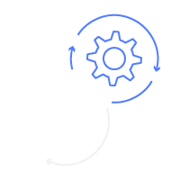






Managed workflows for secure file transfers
AWS Transfer Family managed workflows for post-upload processing
SFTP, FTPS, FTP
users & clients
Filezilla Tech and Me Cyberduck
AWS Transfer Family
Amazon S3
File transfer
server
Sequence of preconfigured processing steps
Amazon CloudWatch
Amazon Elastic File System (Amazon EFS)
Supported features
Console/API/Amazon CloudFormation for defining steps
Copy/tag/delete
Custom option for Lambda invocation
Triggered only on completed uploads for data quality
Exception handler mode to catch erroneous data
Metrics/logs consolidated in CloudWatch for auditing

Slide 13
Builders’ session use case
© 2022, Amazon Web Services, Inc. or its affiliates. All rights reserved.

Slide 14









AWS Transfer Family data product personas
Y O U V A L I D A T E F O R M S Y O U R E C E I V E F R O M T H I R D P A R T I E S A N D M A K E T H E M A V A I L A B L E T O Y O U R C O N S U M E R S
User/persona
Ana – tax accountant
(third-party business partner)
Mateo – IT operations (data product owner)
Zhang – data engineer (data product owner)
Saanvi – data scientist (data consumer)
Provides tax services to the population
Validates the integrity of files processed by managed file transfer (MFT) ingestion service
Builds and manages extract, transform, load (ETL) jobs to write raw data into a consumable format
Studies income trends across the population to influence data-driven public policy proposals
Job duties
AWS service usage

Slide 15












AWS Transfer Family data product use case
Y O U V A L I D A T E F O R M S Y O U R E C E I V E F R O M T H I R D P A R T I E S A N D M A K E T H E M A V A I L A B L E T O Y O U R C O N S U M E R S
AWS Cloud
AWS Transfer Family
A
Uploads file
C
Stores file to S3 bucket
Your business partners
AWS SFTP
Ingest bucket
AWS Glue
D
Invokes Post-upload file-processing
B
Extract, transform, and load data into processed S3 bucket
Workflow steps:
Archive bucket
E
Authenticates sender
COPY - Archive bucket with versioning
CUSTOM - File decryption
CUSTOM - Security scan
CUSTOM - Extract form data
CUSTOM - Data quality validation
DELETE - Encrypted form
Decrypt prefix
F
Submit queries
Extract prefix
Custom Identity Provider
6
Exception handler:
Amazon Athena
Data scientists
COPY - ‘Failed’ prefix of intake bucket
TAG - ‘Failed’
DELETE - Incoming file
Extract bucket
Amazon API Gateway
Failed prefix
AWS Lambda
Processed bucket
AWS Lake Formation

Slide 16
Let’s start building!
Workshop dependencies have been deployed with infrastructure as code
Run lab prerequisite steps from an AWS Cloud9 environment
View your AWS Transfer Family managed workflow data pipeline
Set up AWS Lake Formation
Create an extract, transform, load (ETL) job with AWS Glue Studio
Register your data product with AWS Lake Formation, and grant permissions
Query your data product with Amazon Athena
Upload forms to your data pipeline Transfer Family server, and run Glue job
Retrieve processed form data from Athena

Slide 17

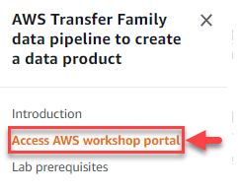
Getting started
Go to https://tinyurl.com/yw64fnxr
Choose Access AWS workshop portal
Choose the Workshop Studio join page link
Register with your email Enter the event hash (below) Review Terms and Conditions
Choose Open AWS Console (bottom left)
Event hash: 8fab-0e26a1-da
© 2022, Amazon Web Services, Inc. or its affiliates. All rights reserved.

Slide 18
Conclusion
© 2022, Amazon Web Services, Inc. or its affiliates. All rights reserved.

Slide 19



Continue your AWS Storage learning
Build a
learning plan
Increase your knowledge
Earn AWS
Storage badges
Set your AWS Storage Learning Plans via AWS Skill Builder
Use our Ramp-Up Guides to build your storage knowledge
Demonstrate your knowledge by earning digital badges
aws.training/storage

Slide 20

Thank you!
Blayze Stefaniak
Ken Howard
Shoeb Bustani
Kapil Shardha
Basiruddin Seikh
Please complete the session survey in the mobile app

