Slide 1
ENERGY INDEPENDENCE
Homeowner Education Program

Slide 2
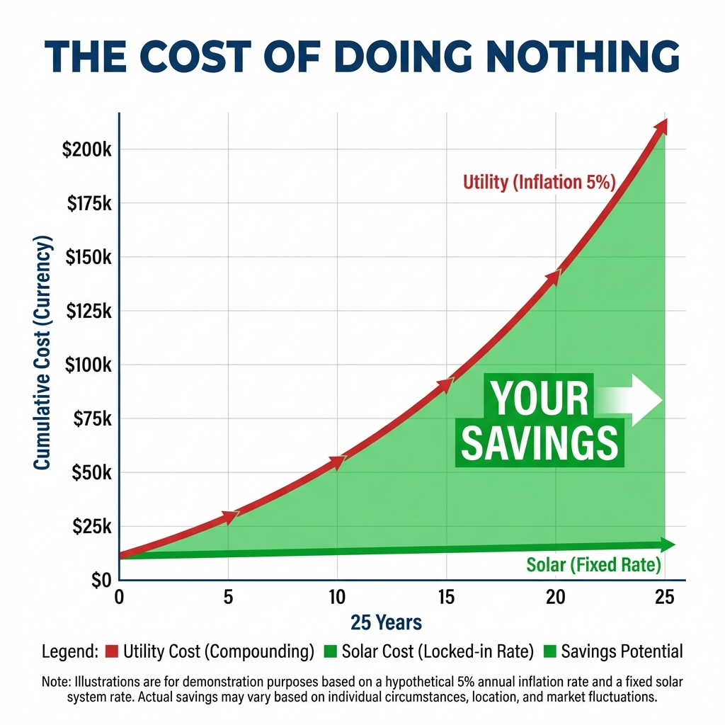
The Cost of Doing Nothing
Utility rates are historically rising at 4-6% per year.
Doing nothing isn't free. It's the most expensive option.

Slide 3
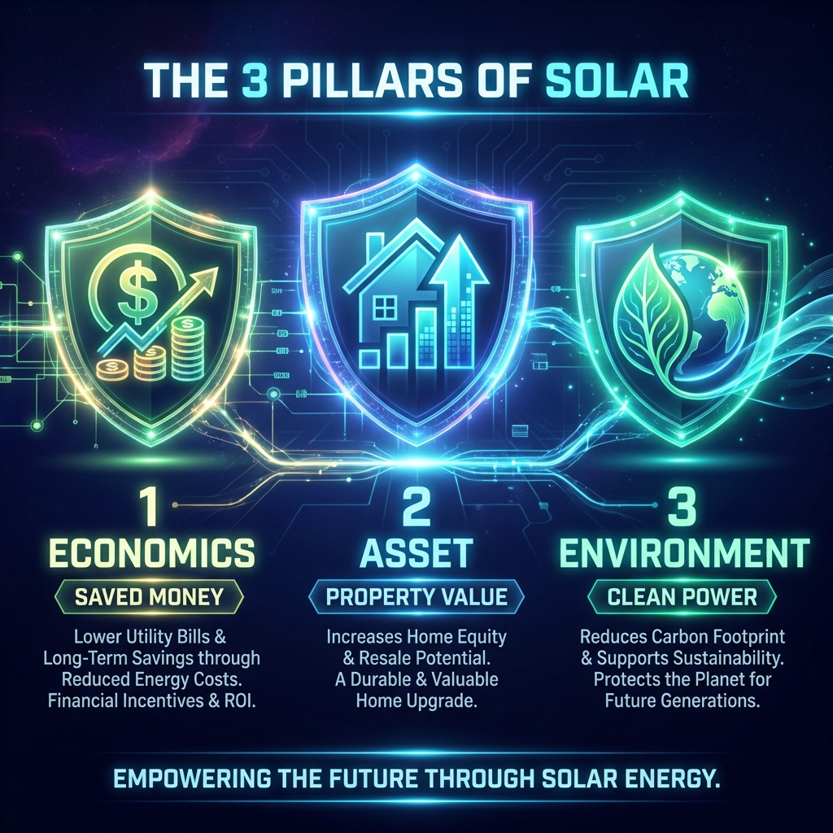
The 3 Pillars of Ownership

Slide 4
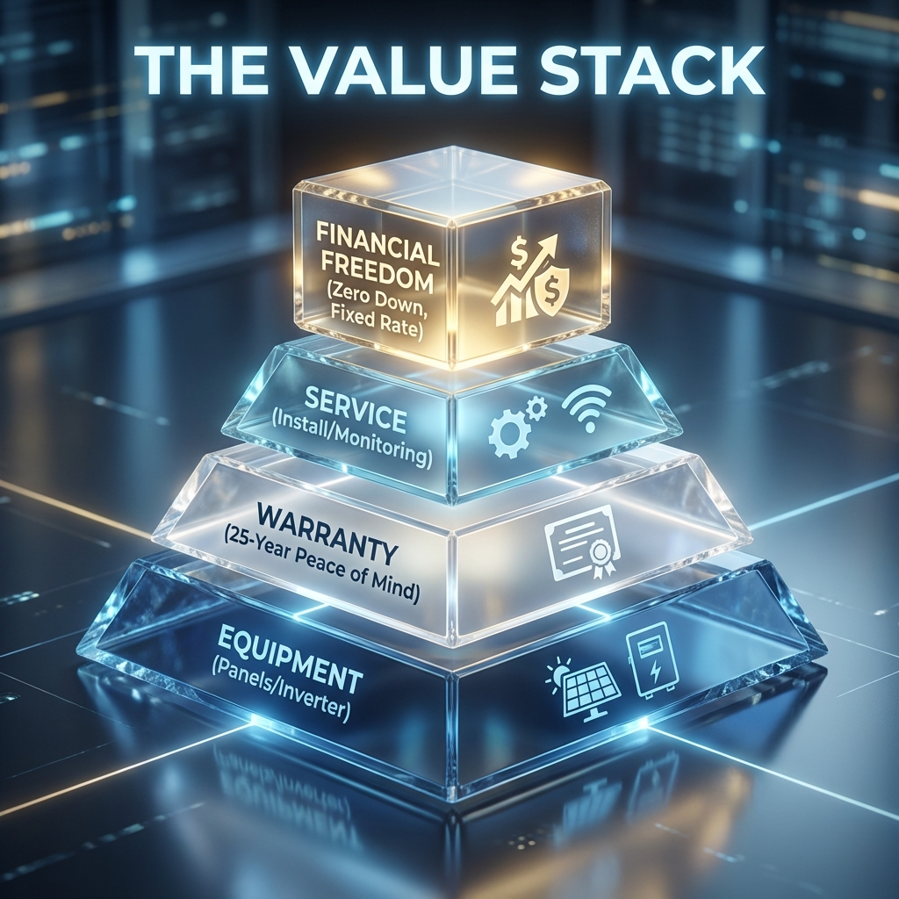
The Value Stack
Fixed Cost: Inflation Proof
Equity: ~4% Home Value Increase
Incentives: 30% Federal ITC
Control: Own vs Rent

Slide 5
Ready to own your power?
Step 1: Prequalification
Step 2: Custom Design
Step 3: Site Survey
Let's see if you qualify

