Slide 1
ENERGY INDEPENDENCE
PROGRAM
Take Back Your Power

Slide 2
Why We Are Here
Our mission is simple: To help homeowners transition from renting their power to owning it.
☀️
Every eco-friendly decision starts with a financially smart one.

Slide 3
Discovery: Understanding Your Goals
Have you looked into going solar before?
Which matters most to you right now?
💰 Saving Money 🛡️ Rate Protection 🌱 Going Green
Do you anticipate your energy usage going up? (EV, Pool, AC)

Slide 4
The Problem: Traditional Energy
You are in an infinite lease.
+6%
Utility rates have risen an average of 6% per year.
Annual Rate Increase
You pay for Generation, Transmission, and Distribution.

Slide 5
The Solution: Solar Energy
So Simple. So Local.
🏡☀️
Avoid the inefficiencies of the grid.
Produce power right on your roof.
Convert liability into an asset.

Slide 6
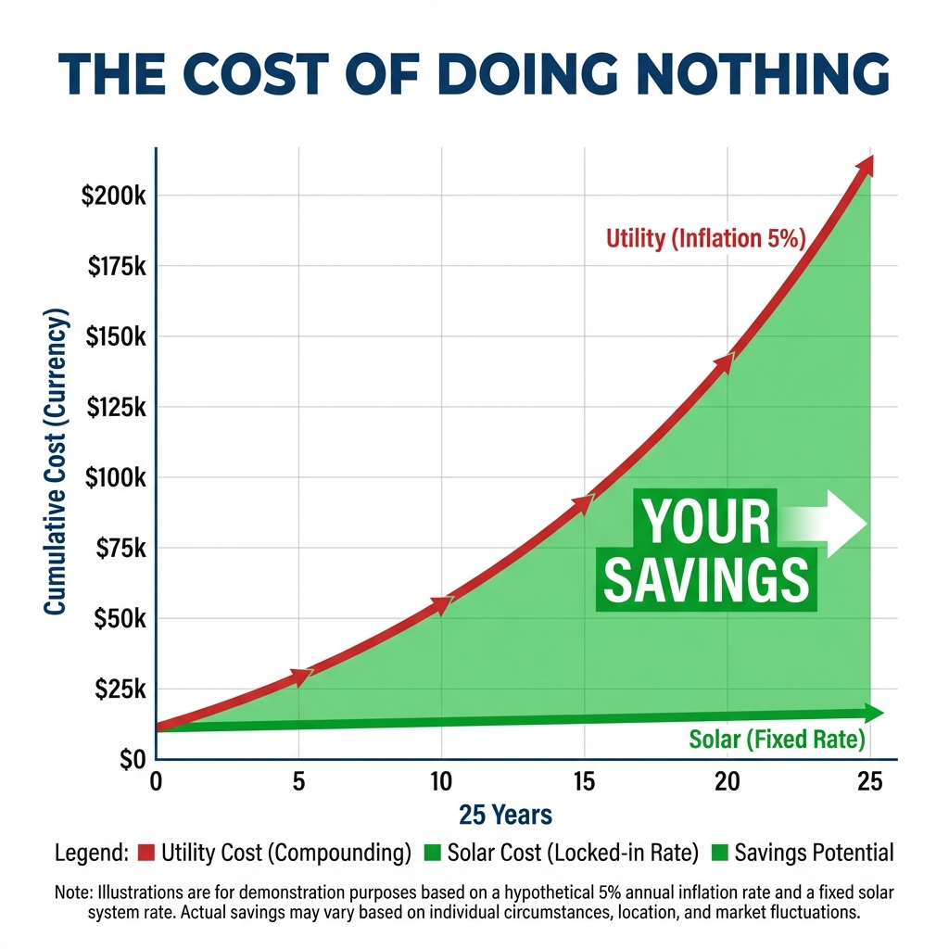
The Cost of Doing Nothing
Utility rates are historically rising at 4-6% per year.
Doing nothing isn't free. It's the most expensive option.

Slide 7
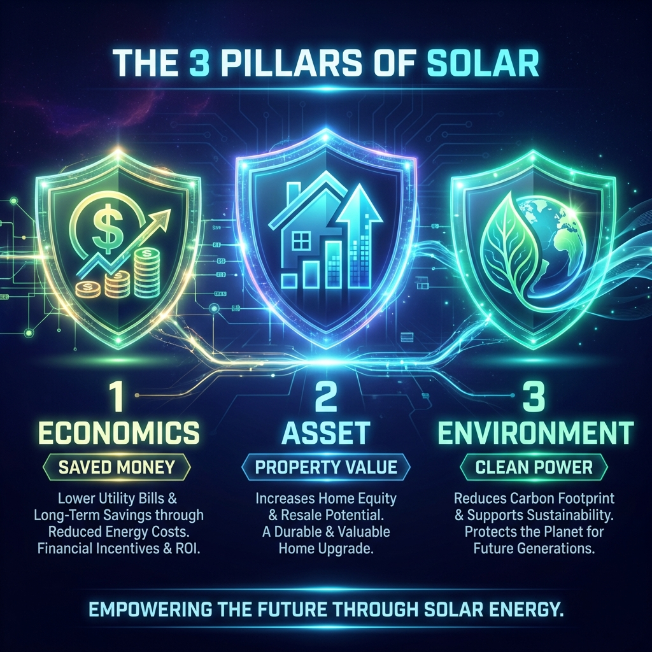
The 3 Pillars of Ownership

Slide 8
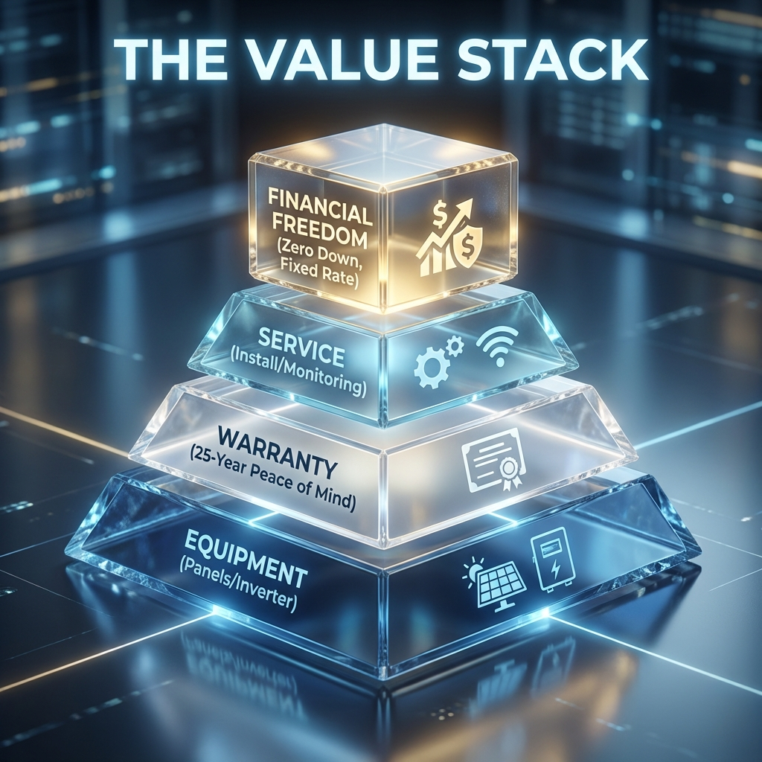
The Value Stack
Fixed Cost: Inflation Proof
Equity: ~4% Home Value Increase
Incentives: 30% Federal ITC
Control: Own vs Rent

Slide 9
Common Questions
❔
Q: What are the upfront costs?
A: $0 Down. You only pay when the system is producing power.
Q: What if I sell my home?
A: Transfer the agreement OR pay it off to increase home equity.
Q: What about warranties?
A: 25-Year Production, Workmanship, and Roof Penetration Warranty.

Slide 10
Your Roadmap to Freedom
1
2
3
4
5
Qualify
Site Survey
Permitting
Install
Activation
Credit & Usage Check
Roof Measurements
City Approval
System Build
PTO & Savings

Slide 11
Ready to own your power?
Stop Renting. Start Owning.
See if you qualify

