Slide 1


DSIR Capstone: Energy Forecasting
Ricardo Daniel Alatorre Cantú

Slide 2

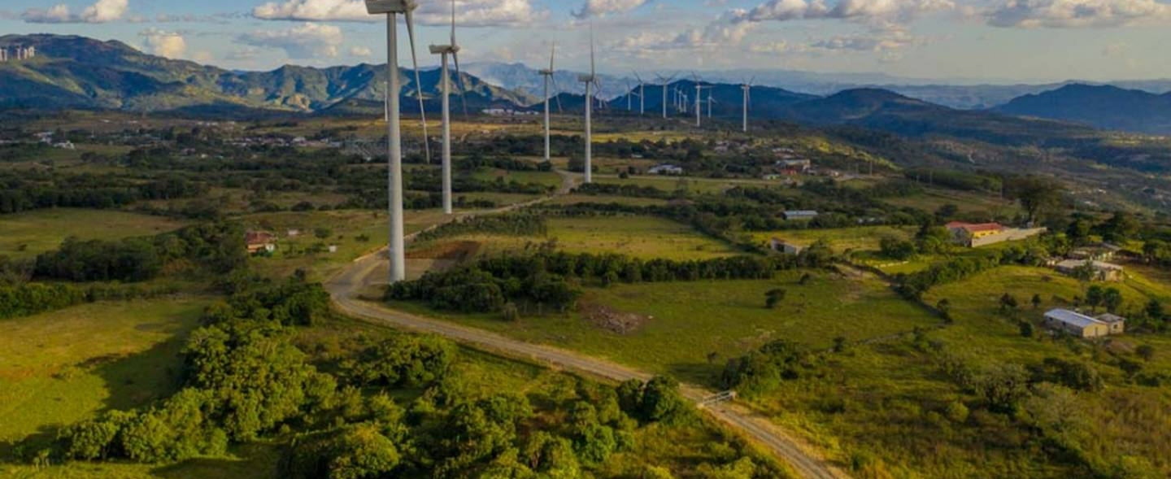
The Mexican Wholesale Energy Market - Background
In 2013 the Mexican Senate passed reforms that opened up the energy industry to private investment.
Said investment flowed in, doubling the country’s renewable energy capacity as early as 2017 and setting world-record low prices for solar and wind energy.

Slide 3


PROBLEM STATEMENT
A private energy trading firm in Mexico wants you to make a model that predicts the price of energy.
The Mexican wholesale energy market is so new that the managing directors of the firm are convinced there are arbitrage opportunities to take advantage of.
But in order to fully take advantage of them, they need better estimates than those of their competitors.

Slide 4

DATA SOURCES
National Center for Energy Control (CENACE) maintains locational marginal price information for every single node in the Mexican Wholesale Energy market on an hourly basis, for both the real-time and day-ahead markets. [Link] It also maintains data on national generation and demand by region.
Limitation – Records only reach as far back as 2016.
Benefit – It’s squeaky clean.
OpenWeatherAPI was leveraged to garner weather data corresponding to Monterrey, Mexico
Limitation – Some columns feature plenty of NaNs
Benefit – the Temperature series is comprehensive

Slide 5

Methodology
We leveraged a government API in order to extract locational marginal price data from nodes in the Monterrey metropolitan area.
API only accepted calls covering a period of 7 days at a time.
Data covering the period from 2019-2022 inclusive was collected for roughly 29 nodes
Generation and Demand data was collected manually

Slide 6
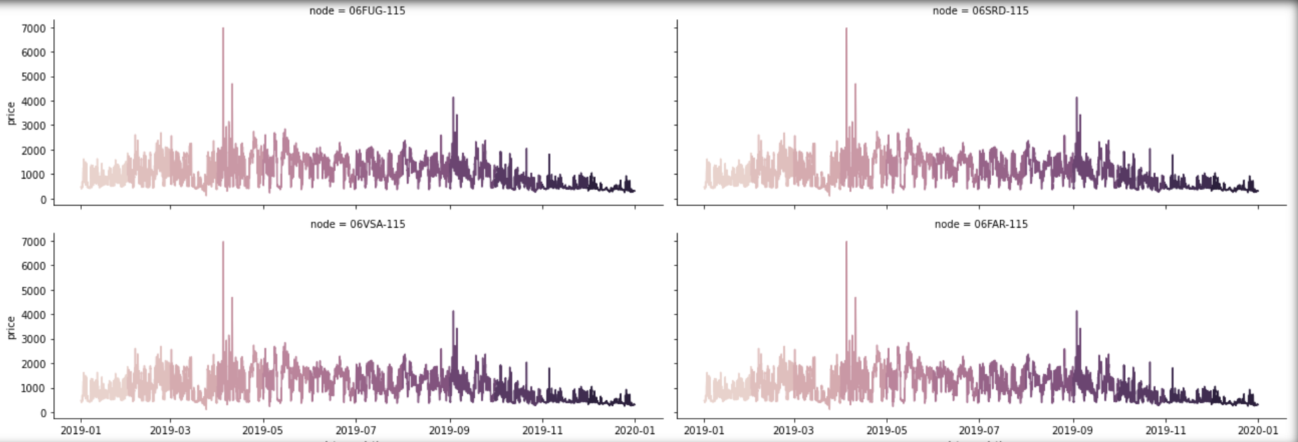
Individual nodes in the same area have practically the same profile
Locational Marginal Price (MXN/MWh)

Slide 7
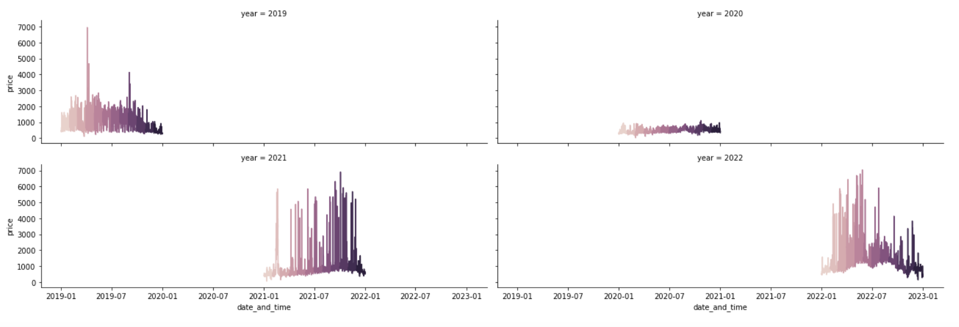
The Pandemic’s sudden slowdown of economic activity seems to be reflected in 2020’S energy prices
Locational Marginal Price (MXN/MWh) 2019-2022

Slide 8
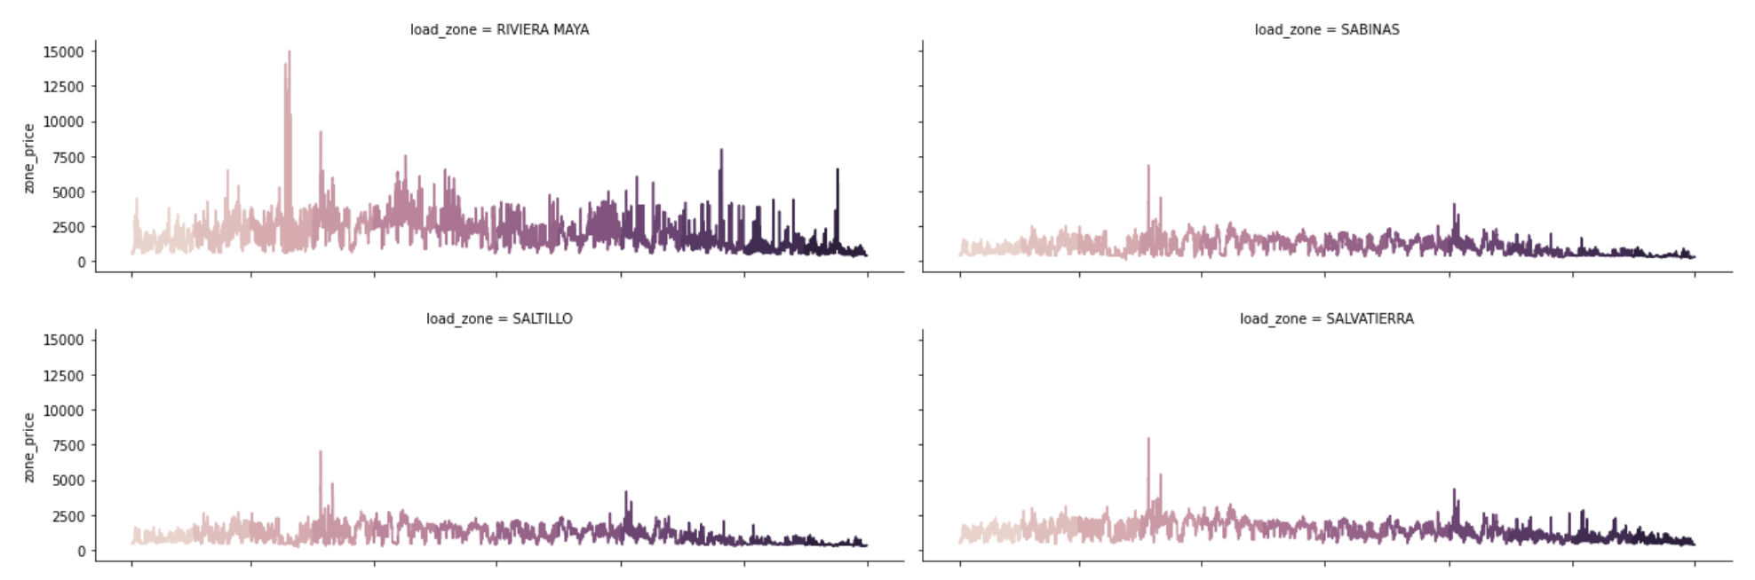
Although yearly price profiles are often similar, regions with high economic activity (e.g. tourism) see higher energy prices more often
Locational Marginal Price (MXN/MWh) 2019

Slide 9
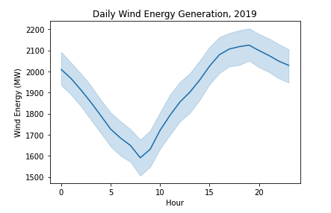
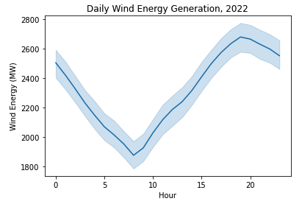
Daily energy generation data reveals when the sun shines and when the wind blows

Slide 10
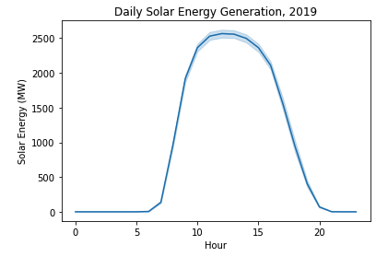
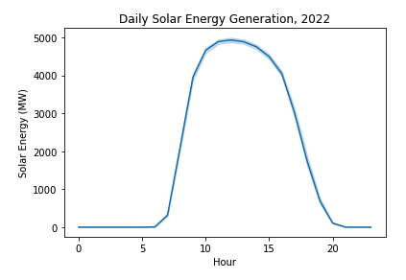
Daily energy generation data reveals when the sun shines and when the wind blows
2x the capacity over 4 years!

Slide 11
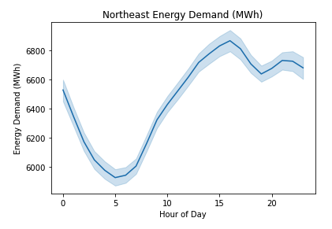
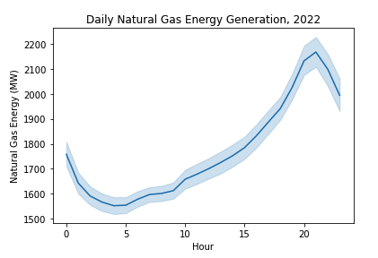
Energy generation data also reveals which generation sources track demand and which serve as a baseline

Slide 12
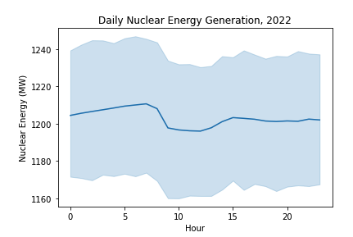
Energy generation data also reveals which generation sources track demand and which serve as a baseline

Slide 13
a) Energy Price Modeling - ARIMAX
Construction
Our first attempt at modeling involved an ARIMA model with exogenous variables (ARIMAX) which regressed energy prices to themselves as well as a set of exogenous variables.
Y – Hourly Distributed Node Price: Monterrey (MXN)
X – [Northeast Energy Demand (MW), Temperature (Celsius)]
SARIMAX GridSearch
Best Order: (1, 1, 1)
Best Seasonal Order (2, 1, 1, 7)

Slide 14
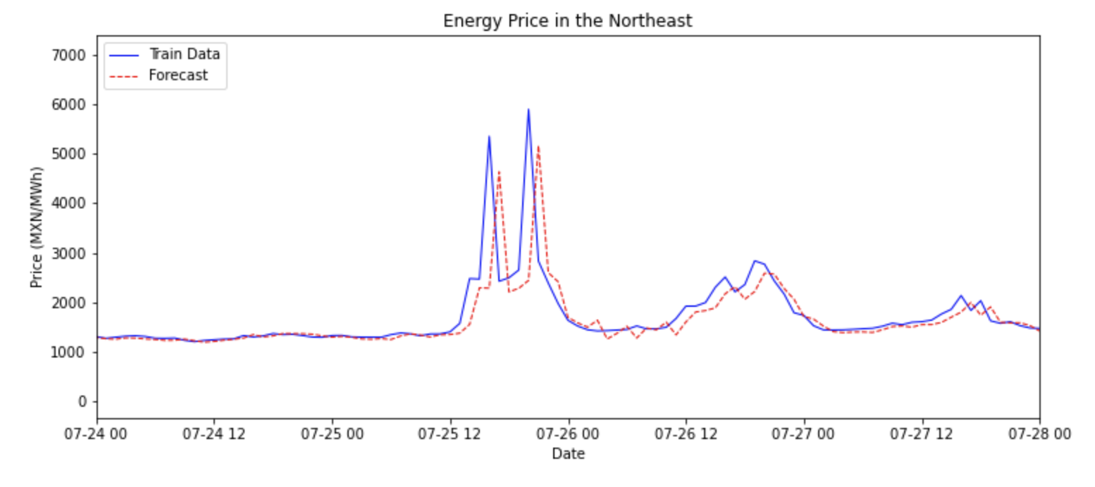
ARIMAX Model Results
Model predicted the price of energy reasonably well
R² Score: 64%
When forecasting the price of energy, our model is off by about $367 MXN/MWh, give or take.
Our model seems to lag by an hour compared to realized energy prices, however.

Slide 15
B) Energy Price Modeling – Random forest
Construction
Our second attempt at modeling involved an Random Forest Regressor model which regressed energy prices against energy demand in the Northeast and national aggregate energy generation by technology
Y – Hourly Distributed Node Price: Monterrey (MXN)
X – [Northeast Energy Demand (MW), Generation by Tech ]
Tech: [Natural Gas, Nuclear, Hydro, Solar, Wind, Geothermal, etc]
Random Forest Regressor RandomSearch

Slide 16
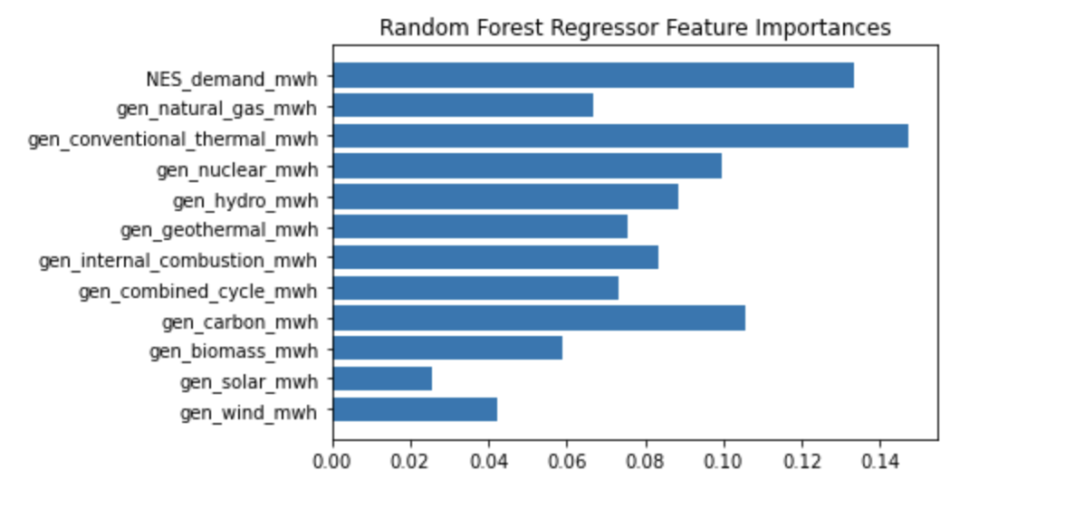
Random Forest Regressor results
Model predicted the price of energy reasonably well.
R² Score: 77%
When forecasting the price of energy, our model is off by about $257 MXN/MWh, give or take.
Most important features driving the price of energy were Thermal Generation, Northeastern Demand, and Carbon Generation.
Solar and Wind generation were negatively correlated with energy prices – reflection of their inexpensiveness

Slide 17
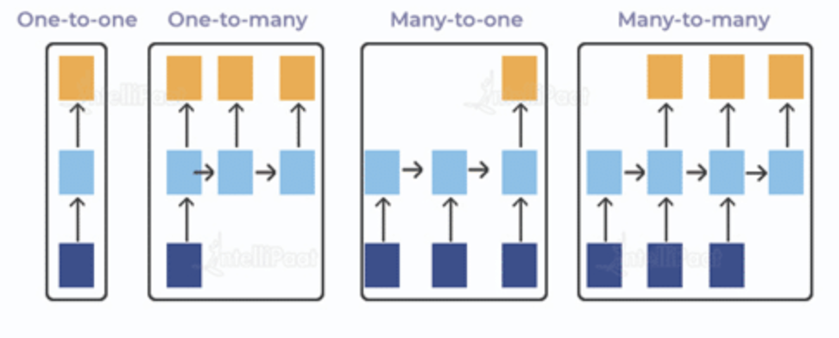
C) Energy Demand Modeling – LTSM RNN
Construction
Our third and final attempt at modeling involved a univariate Long Short-Term Memory network model using Keras.
LTSMs are a variety of recurring neural network (RNN) that are capable of learning long-term dependencies
Model predicts the next 24 hours of demand using the last 24 hours of demand as inputs.

Slide 18
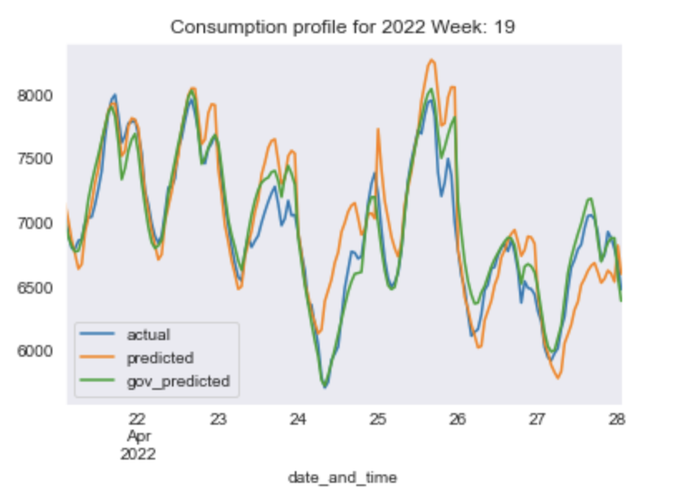
LTSM Results
This model gave us mixed results in terms of predicting energy demand over 24 hour periods.
Average Model Prediction MAPE: 13.7%
Average Government Forecast MAPE: 7.6%
Although the model clearly did not beat the government’s own forecast, it got pretty close considering it’s a univariate model.
Further refinement will likely yield a more competitive result.

Slide 19
Conclusions & Next Steps
Hard to beat the house without a sharper methodology, more comprehensive dataset.
ARIMAX and Random Forest Regressor models can give us a reasonable ballpark estimate of where the price of energy is going to be by simply looking at basic fundamentals
Historical Demand, Prices, and Generation Totals
Univariate LTSM RNN model gets within spitting distance of government’s own demand estimates
Both models are too course to use in say, day trading.
Next Steps
Work with all available data [2016 to Present]
Regional Generation vs National Generation
More comprehensive use of weather data

Slide 20

Questions?

