Slide 1
Project III: Did a Hockey Fan Write This?
An NLP Model for Classifying Sports League Subreddits
Ricardo Daniel Alatorre Cantú

Slide 2



Problem Statement
Your friends have decided to get into an argument at the cookout about which fandom is more predictably annoying on Reddit – hockey fans or basketball fans.
You bet them $20 that you can get your computer to correctly guess which sports league subreddit a post came from.

Slide 3

Background
Reddit is an American social news aggregation, content rating, and discussion website.
Forums called subreddits exist for practically any topic under the sun, including sports!

Slide 4
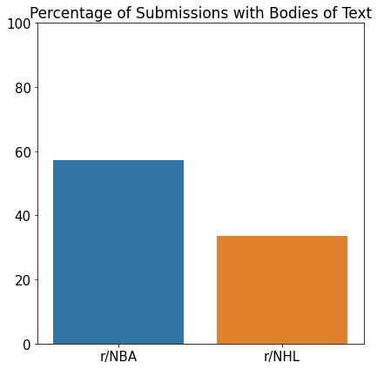
Only About Half of All Submissions Actually Have Bodies of Text

Slide 5
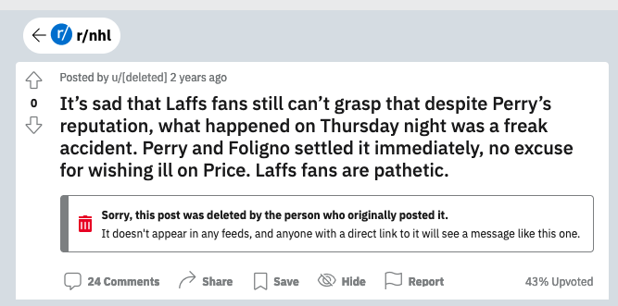
When the Title Is the Post Itself

Slide 6
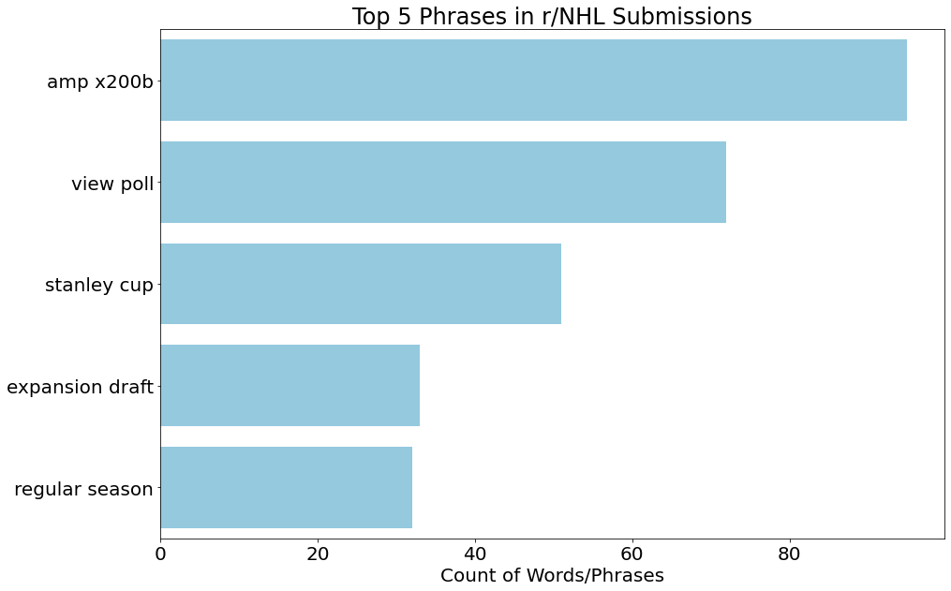
CountVectorizer Helps Us Clean the Data

Slide 7
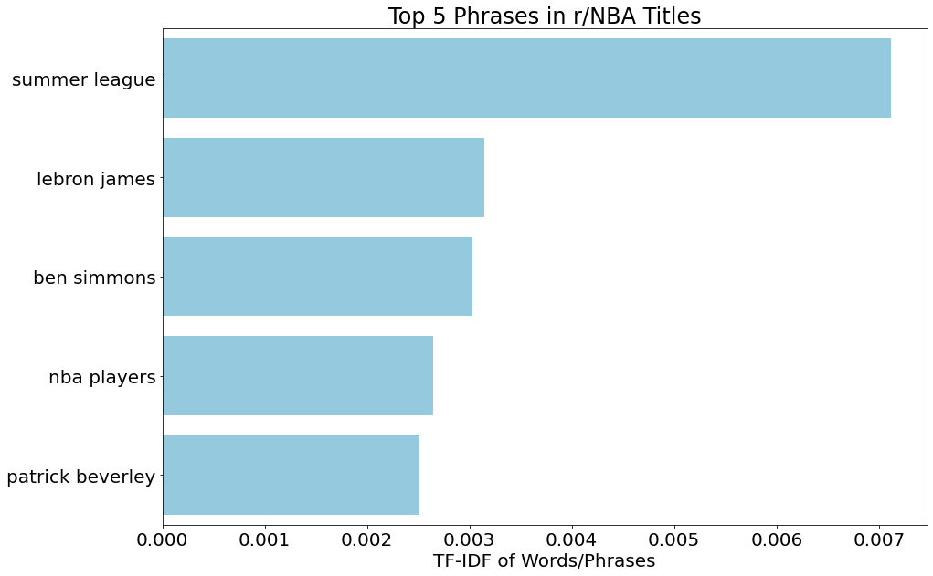
TfidVectorizer Zeroes In on Signals: Cups, Teams & Players

Slide 8
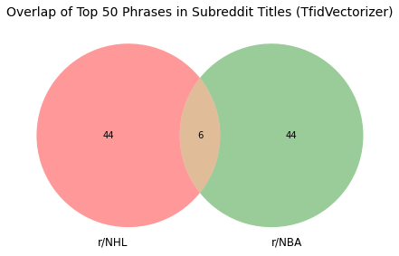
Not a Lot of Overlap Between Subreddits

Slide 9
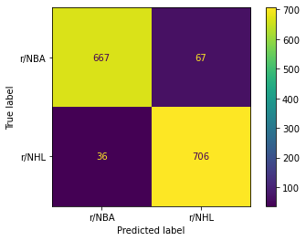
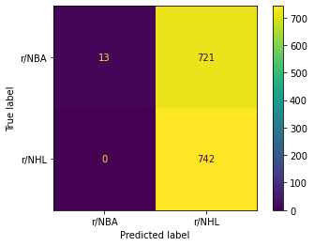
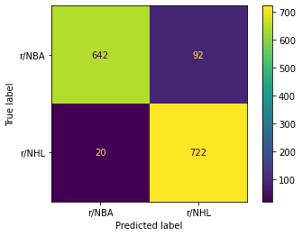
A Tale of Three Confusion Matrices
Logistic Regression
k-Nearest Neighbors
Random Forest

Slide 10
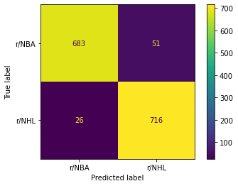
Top Model: Logistic Regression under GridSearch

Slide 11

Conclusions
Logistic Regression was likely helped along by a preponderance of bigrams specific to each sports league
Teams
Players
Tournaments
k-Nearest Neighbors not suited to the task at hand given the high dimensionality of features

Slide 12

Next Steps
Keep refining GridSearch parameters
1
Drop kNN classifier – too many dimensions!
2

