Slide 1
Stream Processing of Space Fence Data
Raymond A. LeClair
June 10, 2020
WORKING PRESENTATION

Slide 2
Objective
Process order 100 tracks per second produced by the Space Fence to perform orbit determination and correlate to order 100,000 orbits in real time

Slide 3
Apache Flink
A framework and distributed processing engine for stateful computations over unbounded data streams
Applications are parallelized into tasks that are distributed and concurrently executed in a cluster
Tasks perform all computations by accessing local, often in-memory, state yielding low processing latencies
Can maintain large application state and guarantee state consistency in case of failures by checkpointing local state to persistent storage
Applications written using Flink have demonstrated:
Processing of trillions of events per day
Maintaining terabytes of state
Running on thousands of cores

Slide 4
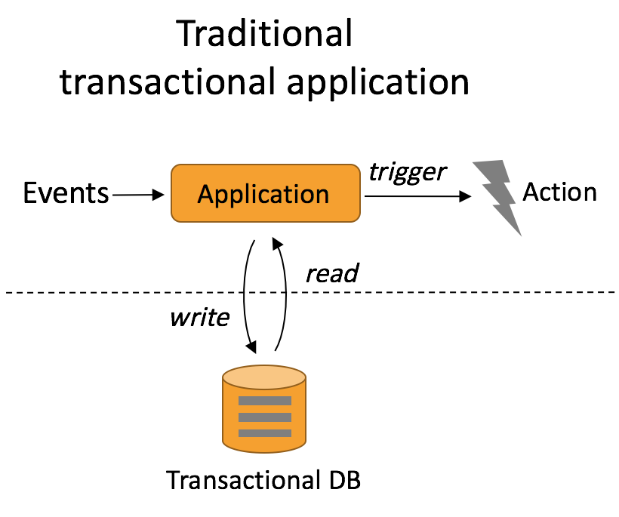
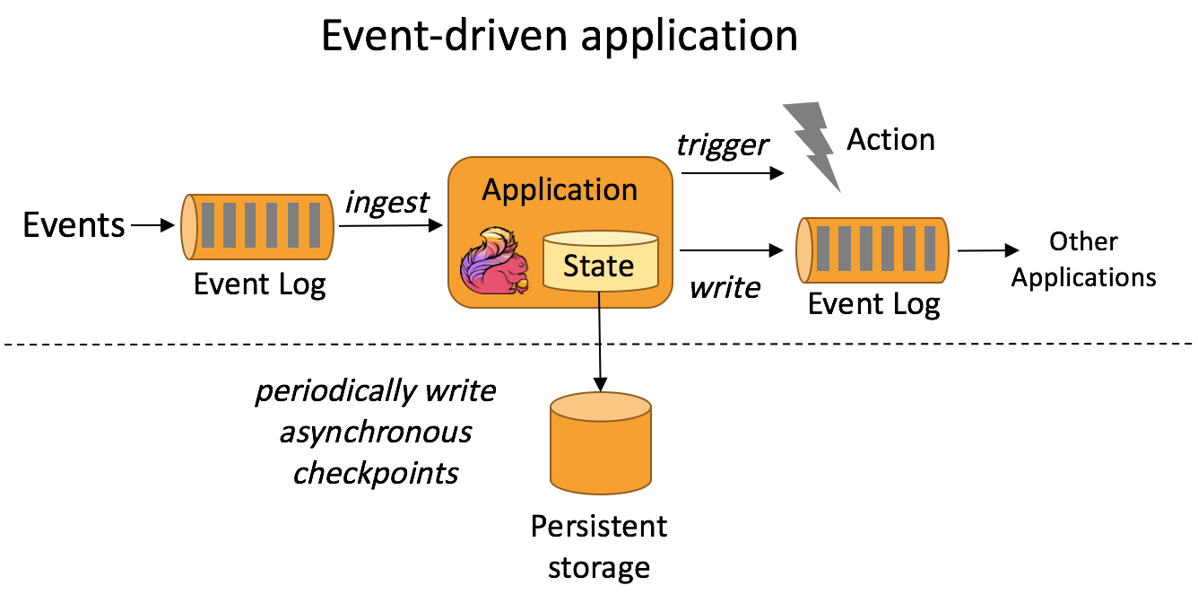
Transactional vs Event Driven¹
Requires declaring and maintaining state decoupled from computational logic
Operational challenges arise when scaling in or out, dealing with partial failures, or changing application logic
Transactions with external storage can become a bottleneck
Closely integrates state management with computation yielding higher throughput and lower latency
Manages operations on state, failure recovery, and reconfiguration (scale-out/in) whenever necessary
Performs checkpoints to remote persistent storage enabling restart
¹ Carbone, Paris, Stephan Ewen, Gyula Fóra, Seif Haridi, Stefan Richter, and Kostas Tzoumas. “State Management in Apache Flink®: Consistent Stateful Distributed Stream Processing.” Proceedings of the VLDB Endowment 10, no. 12 (August 1, 2017): 1718–29.

Slide 5
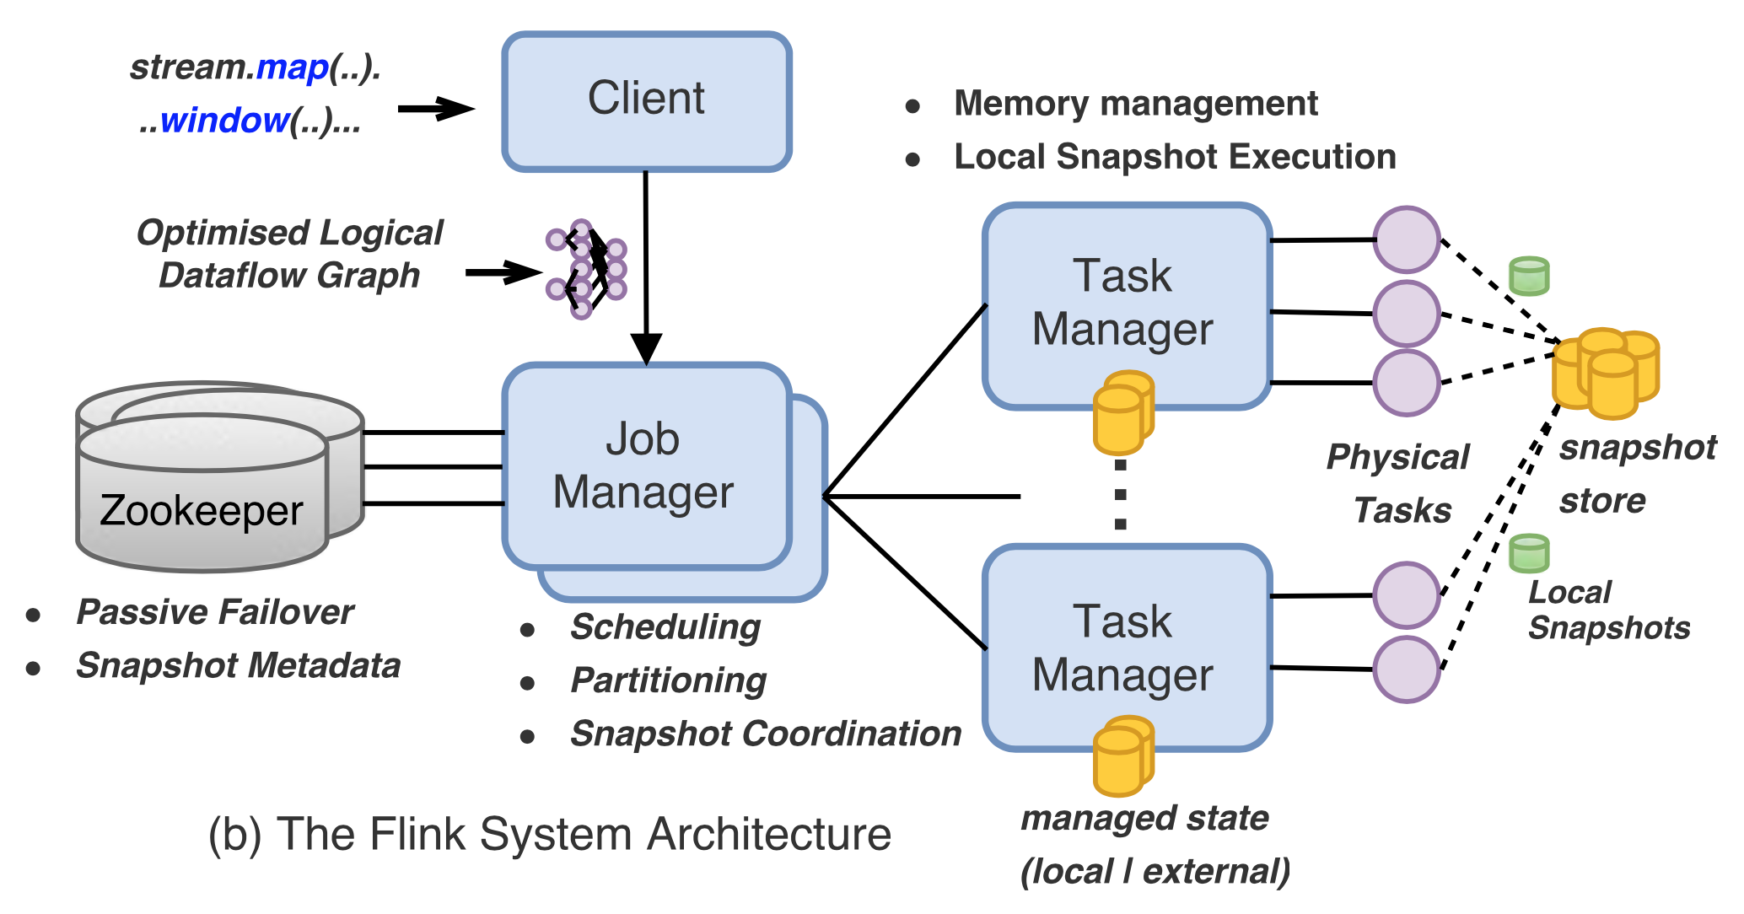
The Flink System Architecture

Slide 6
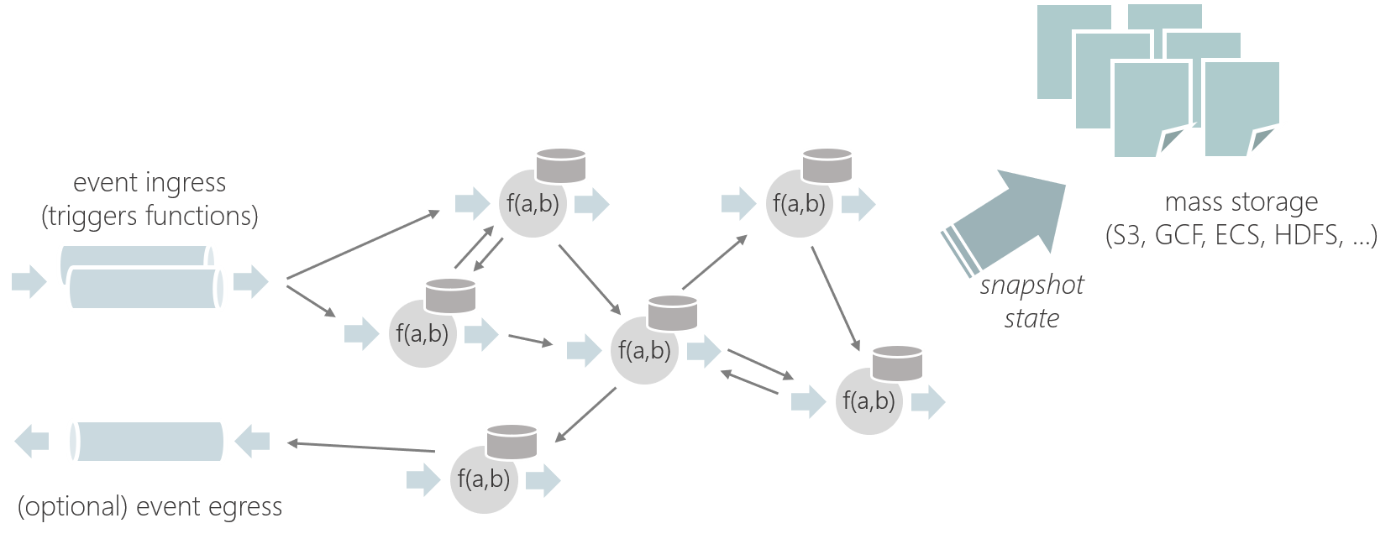
Flink Stateful Functions API
Logic/code existing in multiple instances that represent entities, similar to actors¹
Functions are invoked through messages and:
Have embedded, fault-tolerant state, accessed locally like a variable
Don't reserve resources, so inactive functions don't consume CPU/Memory
Messaging patterns don't need to be pre-defined as dataflows (dynamic) and are also not restricted to DAGs (cyclic)
¹A mathematical model of concurrent computation that treats actor as the universal primitive. In response to a message, an actor can: make local decisions, create more actors, and send more messages. (Wikipedia)

Slide 7
Stream Processing Architecture
TrackSource
PrintSink
Sensor
Entire implementation requires about 1000 sloc
MessageBroker
Sensor
SystemRouter
Sensor
TrackStatefulFunction
- trackState
- OrbitBuilder
- orbitIds
OrbitStatefulFunction
- orbitState
- trackIds
- OrbitCorrelator
- OrbitBuilder
TrackStatefulFunction
OrbitStatefulFunction
TrackStatefulFunction
OrbitIdStatefulFunction
- orbitIds
OrbitStatefulFunction
TrackStatefulFunction
OrbitStatefulFunction

Slide 8
cloc Output for Dependencies
Project files blank comment code
orekit
--------------------------------------------------
Java 1308 48882 110007 209381
flink-statefun
--------------------------------------------------
Java 481 8468 16830 66488
hipparchus
--------------------------------------------------
Java 1412 38599 112711 196516
flink
--------------------------------------------------
Java 9964 255678 388517 999682
Scala 1935 54654 68129 282944

