Slide 1
Stream Processing
Raymond A. LeClair
June ?, 2020
WORKING PRESENTATION

Slide 2
Apache Flink
A framework and distributed processing engine for stateful computations over unbounded data streams
Applications are parallelized into tasks that are distributed and concurrently executed in a cluster
Tasks perform all computations by accessing local, often in-memory, state yielding low processing latencies
Can maintain large application state and guarantee state consistency in case of failures by checkpointing local state to durable storage
Applications have demonstrated:
Processing of trillions of events per day
Maintaining terabytes of state
Running on thousands of cores

Slide 3
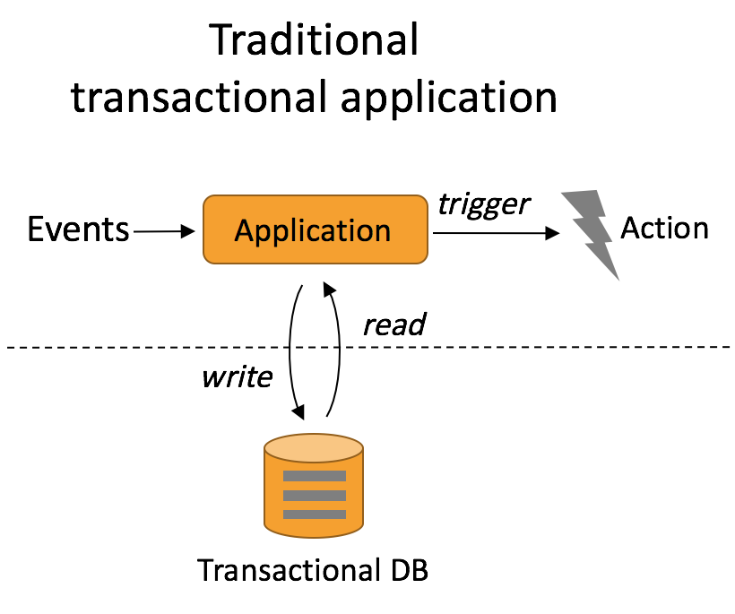
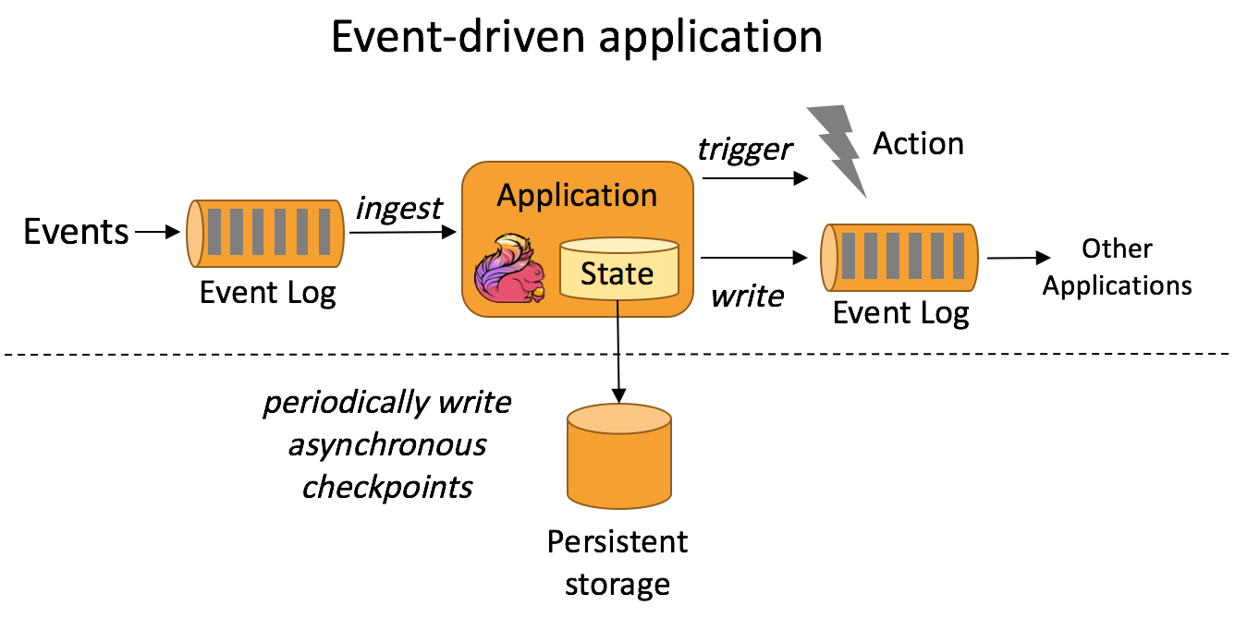
Transactional vs Event Driven
Requires declaring and maintaining state decoupled from computational logic
Operational challenges arise when scaling in or out, dealing with partial failures, or changing application logic
Transactions with external storage can become a bottleneck
Closely integrates state management with computation yielding higher throughput and lower latency
Manages operations on state, failure recovery, and reconfiguration (scale-out/in) whenever necessary
Performs checkpoints to remote persistent storage enabling restart

Slide 4
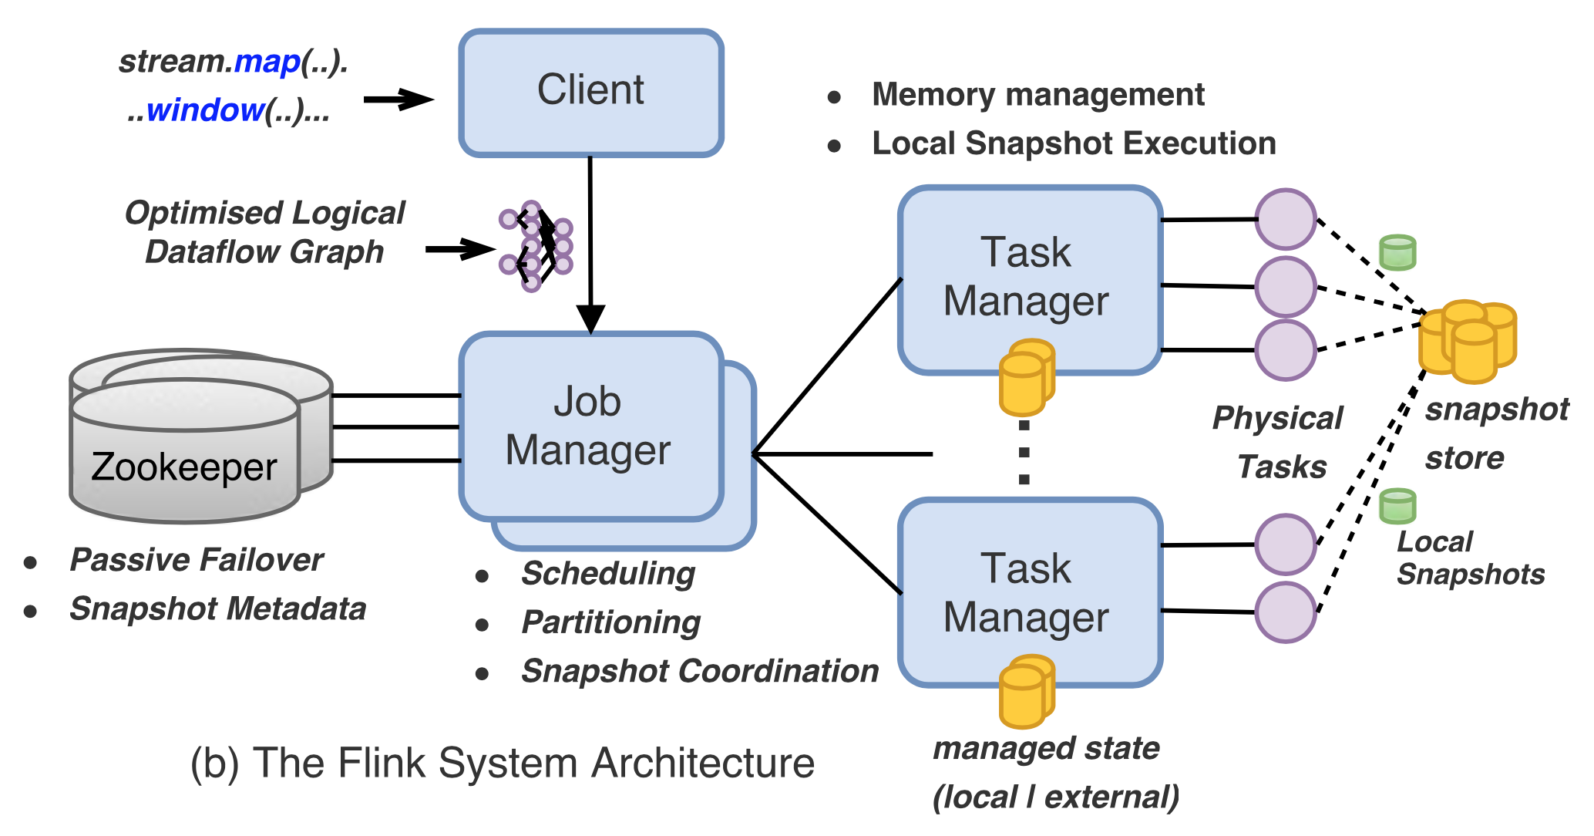
The Flink System Architecture

Slide 5
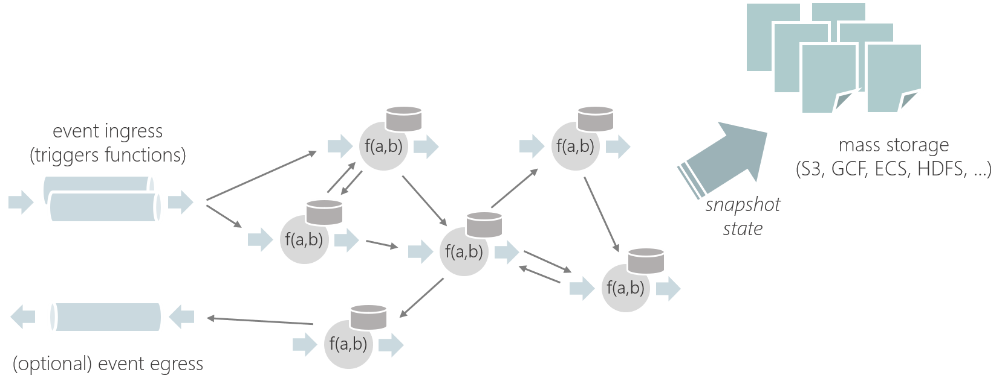
Stateful Functions
Logic/code existing in multiple instances that represent entities, similar to actors
Functions are invoked through messages and:
Have embedded, fault-tolerant state, accessed locally like a variable
Don't reserve resources, so inactive functions don't consume CPU/Memory
Messaging patterns don't need to be pre-defined as dataflows (dynamic) and are also not restricted to DAGs (cyclic)

Slide 6
Stream Processing Architecture
TrackletSource
PrintSink
Sensor
MessageBroker
Sensor
SystemRouter
Sensor
TrackletStatefulFunction
- trackletState
- orbitIds
- OrbitBuilder
OrbitStatefulFunction
- orbitState
- trackletIds
- OrbitCorrelator
- OrbitBuilder
TrackletStatefulFunction
OrbitStatefulFunction
TrackletStatefulFunction
OrbitIdStatefulFunction
- orbitIds
OrbitStatefulFunction
TrackletStatefulFunction
OrbitStatefulFunction

