Slide 1
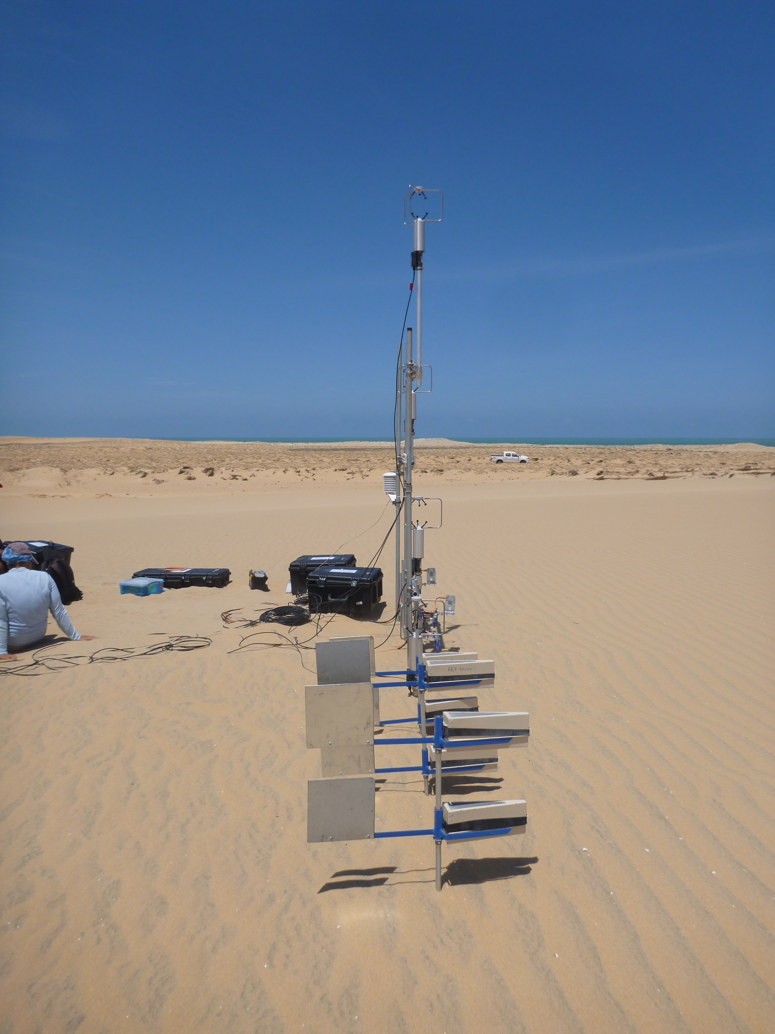




BSNE trap geometry
$$W$$
BSNE
$$H$$
$$z_{B,i}$$
$$z_{bot,B,i}$$

