Slide 1
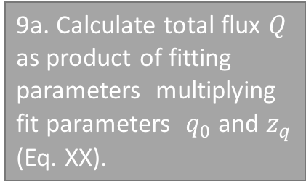
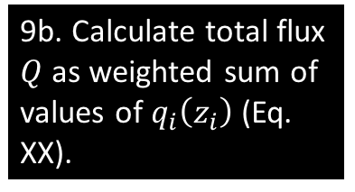
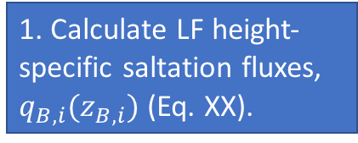
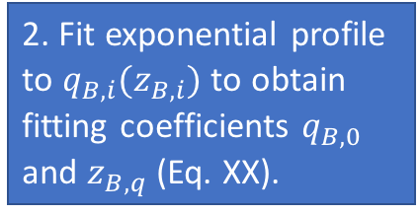
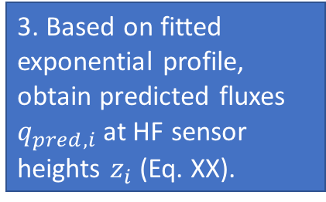
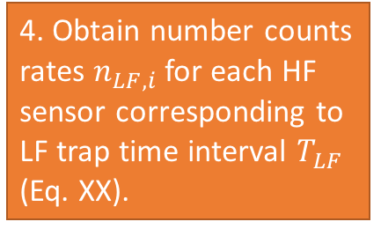
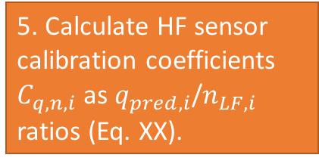
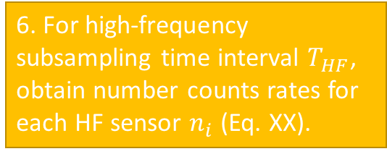
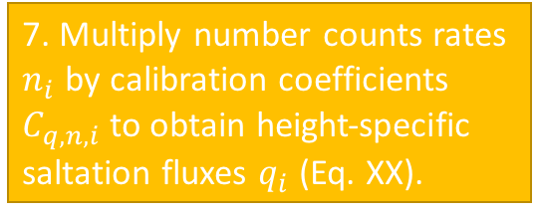
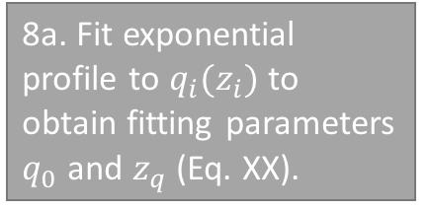
1. Calculate LF height-specific saltation fluxes, $q_{B,i}(z_{B,i})$ (Eq. XX).
6. For high-frequency subsampling time interval $T_{HF}$, obtain number counts rates for each HF sensor $n_{i}$ (Eq. XX).
2. Fit exponential profile to $q_{B,i}(z_{B,i})$ to obtain fitting coefficients $q_{B,0}$ and $z_{B,q}$ (Eq. XX).
Calculate HF subsampled fluxes
7. Multiply number counts rates $n_{i}$ by calibration coefficients $C_{q,n,i}$ to obtain height-specific saltation fluxes $q_{i}$ (Eq. XX).
Fit LF flux profile
3. Based on fitted exponential profile, obtain predicted fluxes $q_{pred,i}$ at HF sensor heights $z_{i}$ (Eq. XX).
Calculate total saltation fluxes
8a. Fit exponential profile to $q_{i}(z_{i})$ to obtain fitting parameters $q_{0}$ and $z_{q}$ (Eq. XX).
8b. Estimate relative importance of each HF sensor height for determining total saltation flux (Eq. XX).
4. Obtain number counts rates $n_{LF,i}$ for each HF sensor corresponding to LF trap time interval $T_{LF}$ (Eq. XX).
Obtain calibration coefficients
9a. Calculate total flux $Q$ as product of fitting parameters multiplying fit parameters $q_{0}$ and $z_{q}$ (Eq. XX).
5. Calculate HF sensor calibration coefficients $C_{q,n,i}$ as $q_{pred,i}$/$n_{LF,i}$ ratios (Eq. XX).
9b. Calculate total flux $Q$ as weighted sum of values of $q_{i}\left(z_{i}\right)$ (Eq. XX).

