Slide 1
Date with Data
Foundations of Data and Introduction to Tableau

Slide 2
Agenda
What does data look like? (10 minutes)
Where is data available? What do I do with it? (10 minutes)
How can I visualize data to help others understand it? (20 minutes)
Walk-through of Tableau (20 minutes)
Free play in Tableau (30 minutes)

Slide 3
What does data look like?
Tidy
Clean

Slide 4
What does data look like?
Tidy Data
ID | Variable 1 | Variable 2 | Variable 3
Observation 1 | data | data | data
Observation 2 | data | data | data
Observation 3 | data | data | data
Clean Data
ID | First Name | Last Name | Birth Month | Birth Day | Address
1 | Rachel | Lesniak | 01 | 15 | 2000 Connecticut Ave NW
2 | Mary Ellen | Koontz | 03 | 28 | 800 Burke St SE
3 | Catalina | Calachan | 10 | 20 | 1400 Irving St NW
ID | Name | Birthday | Address
1 | Rachel Lesniak | 01-15 | 2000 Connecticut Ave NW
2 | Mary Ellen Koontz | 03-28 | 800 Burke St SE
3 | Catalina Calachan | 10-20 | 1400 Irving St NW

Slide 5
Where is data available?
Lots of it is public!
Population Data
American Fact Finder (Census and American Community Survey)
Transportation Data (Rachel’s specialty)
National Transit Database – annual operating statistics reported to FTA
GTFS Feeds – standardized schedules, can create GIS layers from this data and other analyses
Bikeshare Data – many operators provide it (although not dockless)
Housing Data
FRED (St. Louis Federal Reserve)
International Cities
UN-Habitat Urban Data

Slide 6
What do I do with this data?
Keep it in a universal format
.csv – data is as compact as possible, separated by commas
.xlsx – keeps Microsoft formatting, not as compact
Remember some simple math norms:
Unsummarized data is your friend
Do not average an average!
Ask your data questions
“Data exploration” – we’ll get into that later

Slide 7
How can I visualize data?
Math
Graphic Design

Slide 8
How can I visualize data?
Think of it like any other communication:
Who is my audience? What do they already know?
What is my content?
Is my presentation giving all the facts? Is it misleading?
How have others done this before and succeeded?
Think of it like any other math form:
Is my approach efficient?
What is the correct answer?

Slide 9
Some visualization thoughts
Pie charts are bad. Do not use them.
Sub-idea: your chart doesn’t have to be fancy to be effective.
Colors can make or break your visualization.
Emphasize one message instead of all the messages.
Remember your audience.

Slide 10
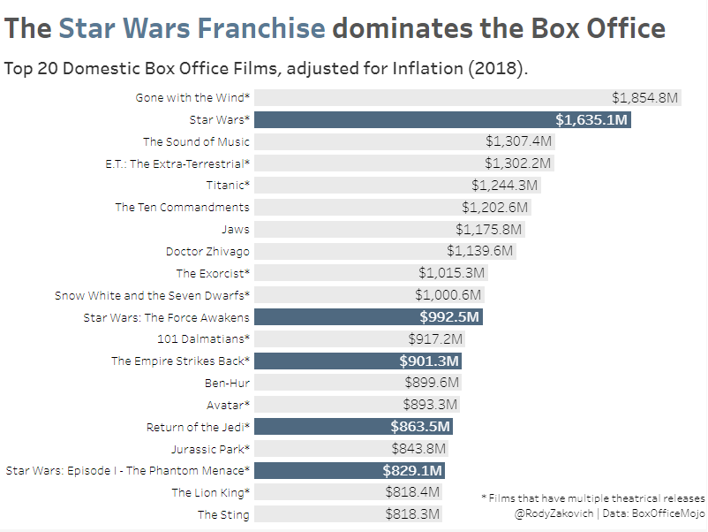
Non-fancy charts
Bar Chart here: http://www.storytellingwithdata.com/blog/2018/3/9/bring-on-the-bar-charts
Design tips here: https://visage.co/12-design-tips-bar-charts/

Slide 11
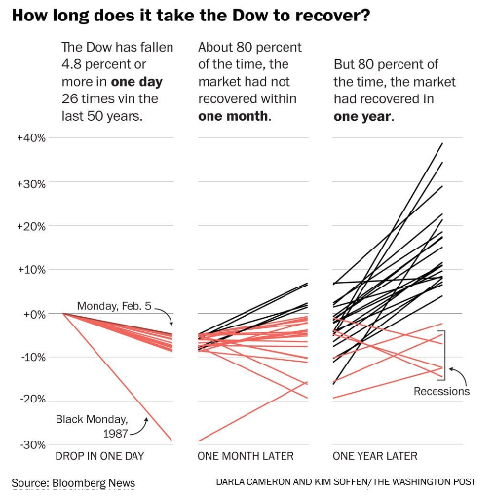
Non-fancy charts
Line Chart here: http://www.visualisingdata.com/2018/05/little-visualisation-design-part-52/
Design tips here: https://visage.co/data-visualization-101-line-charts/

Slide 12
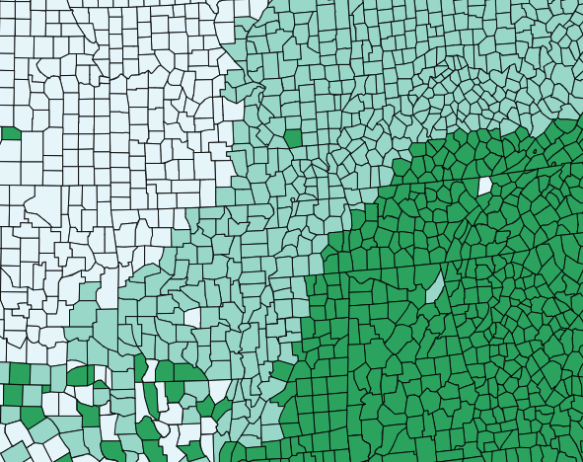
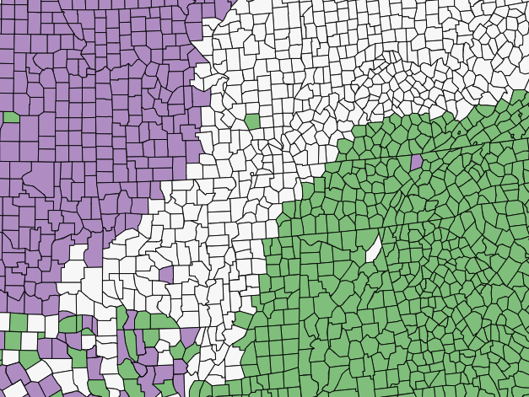
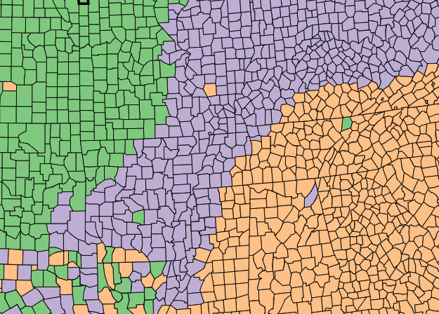
Colors should match your data
Sequential
Diverging
Qualitative
Color Brewer (basically canon): http://colorbrewer2.org/

Slide 13
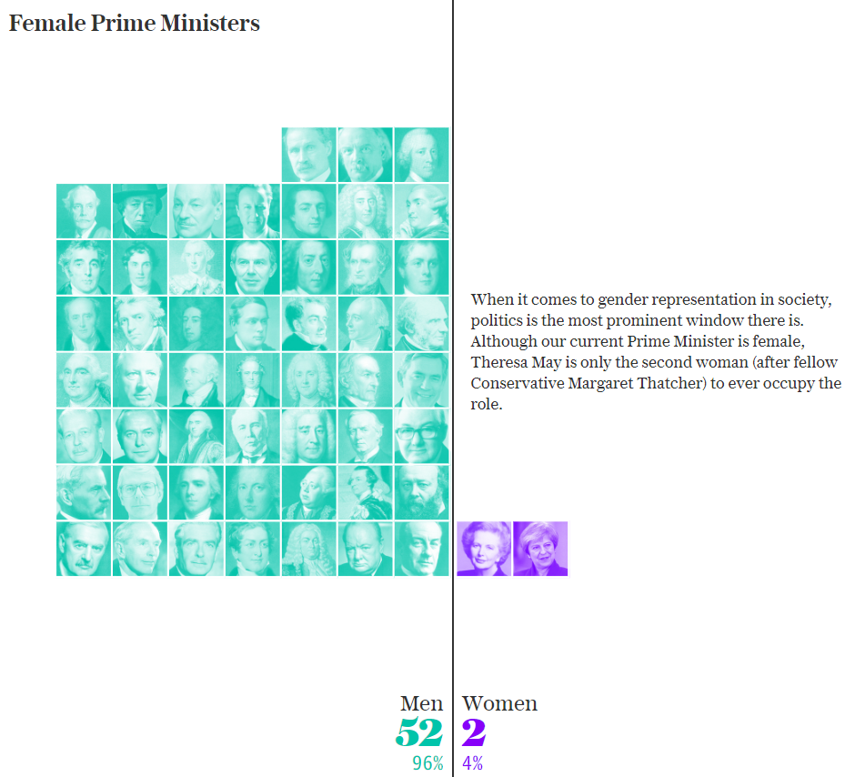
Colors should match your data
Colors in Data Viz: https://blog.graphiq.com/finding-the-right-color-palettes-for-data-visualizations-fcd4e707a283
Color Guide: https://blog.datawrapper.de/colorguide/
Gender Color: https://blog.datawrapper.de/gendercolor/

Slide 14
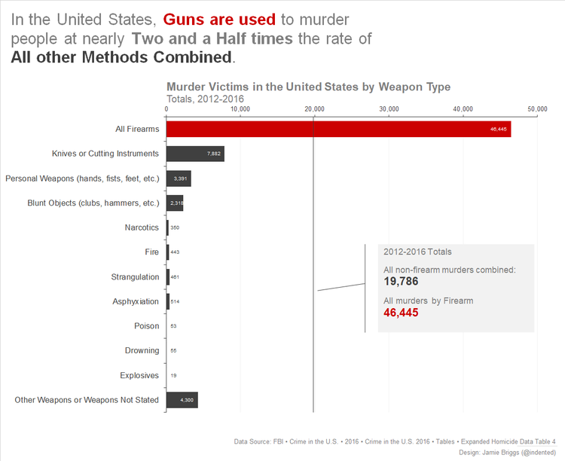
Emphasize one message
Source: http://www.storytellingwithdata.com/blog/2018/3/9/bring-on-the-bar-charts

Slide 15
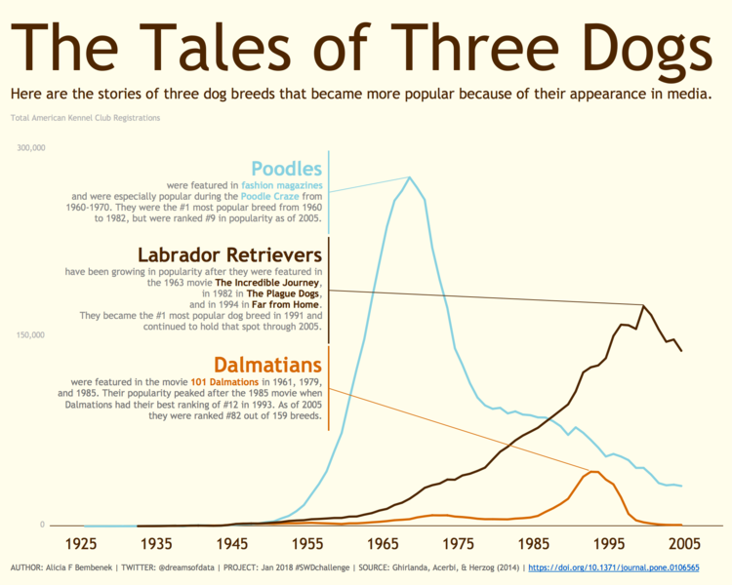
Remember your audience
Source: http://www.storytellingwithdata.com/blog/2018/1/22/88-annotated-line-graphs

Slide 16
Additional Resources + Fun
Tableau Public Gallery
Data viz + culture: https://pudding.cool/
Chart types with examples: http://visualizationuniverse.com/charts/
Making accessible viz: http://www.storytellingwithdata.com/blog/2018/6/26/accessible-data-viz-is-better-data-viz & http://www.storytellingwithdata.com/blog/2018/4/23/accessibility-considerations-for-visuals
Data viz as part of a Better Presentation: https://policyviz.com/better-presentations/
Book is available as GU eBook
Storytelling with Data blog & book: http://www.storytellingwithdata.com/
Learn from others’ mistakes: http://junkcharts.typepad.com/junk_charts/
Why is this blog so consistently good? https://blog.datawrapper.de/
Fundamentals of Data Viz book: https://serialmentor.com/dataviz/

Slide 17
Example Questions for Tableau
Which station is the most popular?
Which station pair is the most popular?
Which time of day has the most amount of trips?
What is the average trip length by month? By weekday?
Which bike did the most work?
You can always add in or filter by dates, time, or member type to get a finer-grained analysis.

