Slide 1

Benchmarking Program-Aided vs. Natural Language Mathematical Reasoning in LLMs
Mathematics and Machine Learning
Mohamed El Maghari, Ralf König, Fritz Körner, Khalid Sabih
Leipzig, 18.02.2026

Slide 2
Motivation
The Paradox of Modern LLMs in Mathematics
AlphaProof (DeepMind, 2025) — silver medal at IMO 2024
  Solved P6, the hardest problem, solved by only 5 of 609 humans
  Uses Lean 4 formal verification → zero hallucination possible
Yet top models fail at this:
  "Alice has N brothers and M sisters. How many sisters does Alice's brother have?"
  State-of-the-art models answer this incorrectly
So which is it — can LLMs do math or not?
→ Research Goal: Compare Pure LLM vs. Python vs. Lean 4 on the same problems, same model, same conditions

Slide 3
Hypotheses
H1: Easy problems solvable across all three modalities
H2: Hard problems benefit from Python code generation
H3: Lean 4 zero-shot accuracy will be very low
H4: Code-specialized LLMs outperform general-purpose LLMs as program-aided models

Slide 4
Methodology / Dataset
Dataset: MATH-500 benchmark — 100 problems sampled
7 categories × 5 difficulty levels (L1–L5)
Model tested: GPT-OSS-120b via Blablador (Helmholtz)
Zero-shot prompting — no examples, no feedback loop
Python sandbox with SymPy, NumPy, Math libraries
Lean 4 via Kimina-LEAN-Server for remote proof verification
Evaluation: LLM-as-Judge

Slide 5
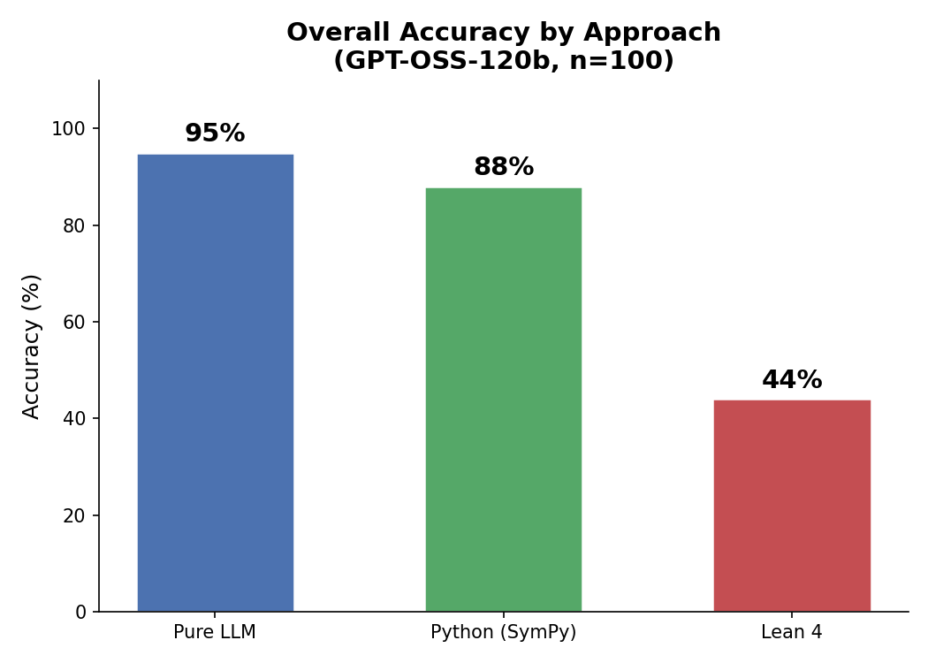
RESults
Overall Accuracy:
Pure LLM 95%
Python (SymPy) 88%
Lean 4 44%

Slide 6
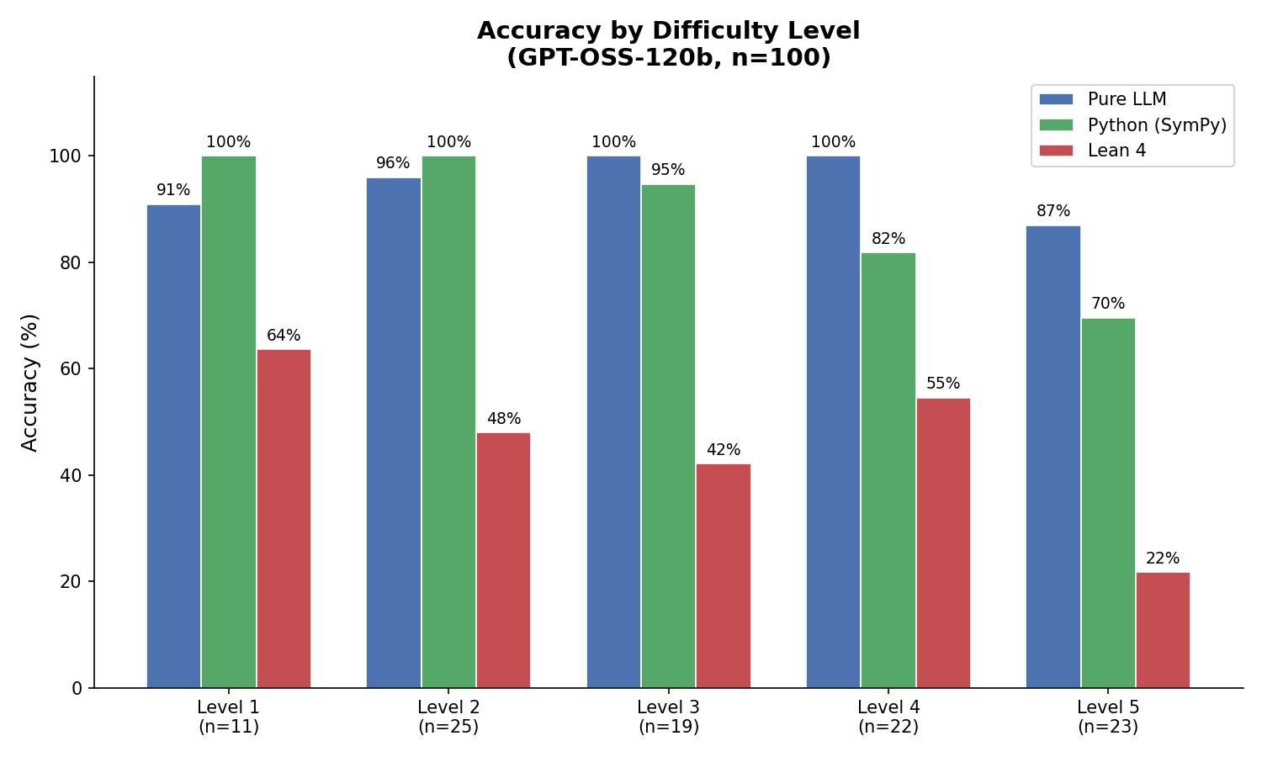
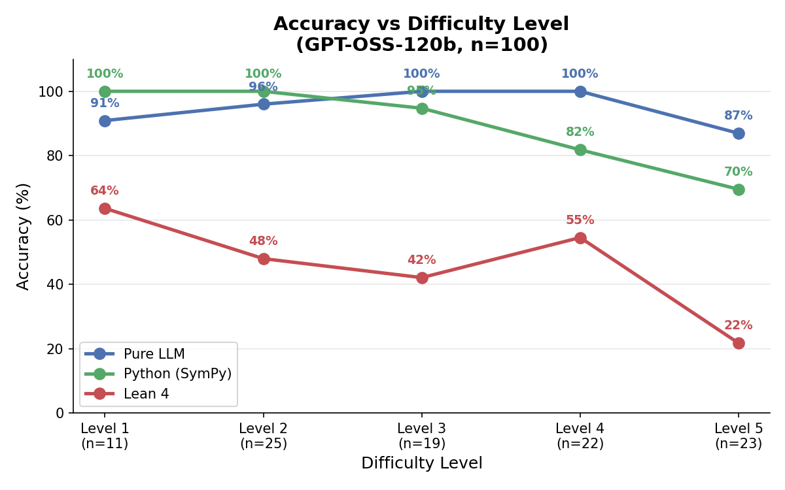
Results : Accuracy by Difficulty Level

Slide 7
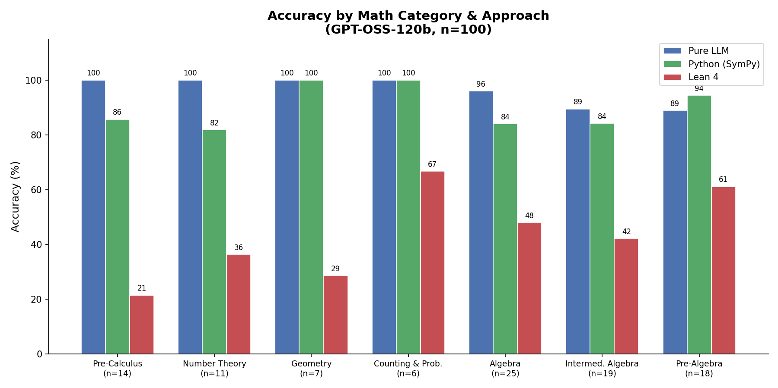
RESults: Accuracy by Math Category & Approach
Category Breakdown:
Pure LLM dominates
Lean 4 struggles especially in Pre-Calculus (21%) and Geometry (29%)

Slide 8
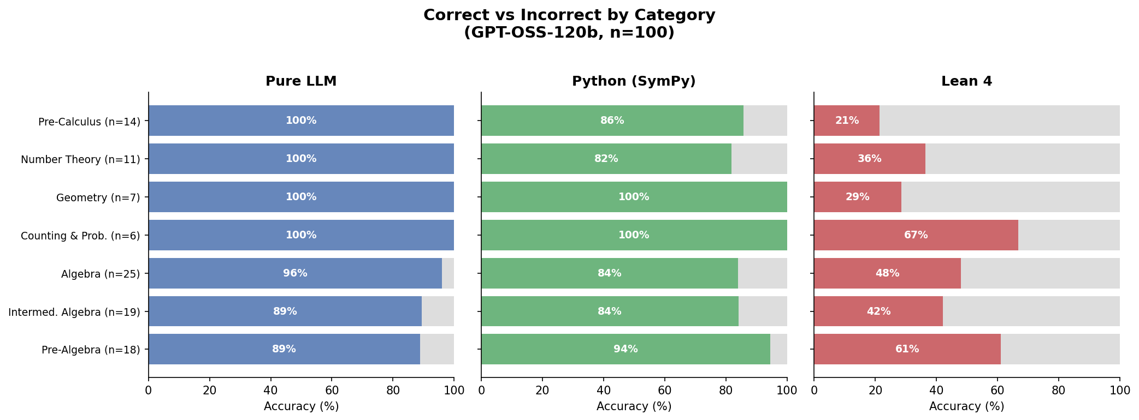
RESULTS : Correct vs Incorrect by Category

Slide 9
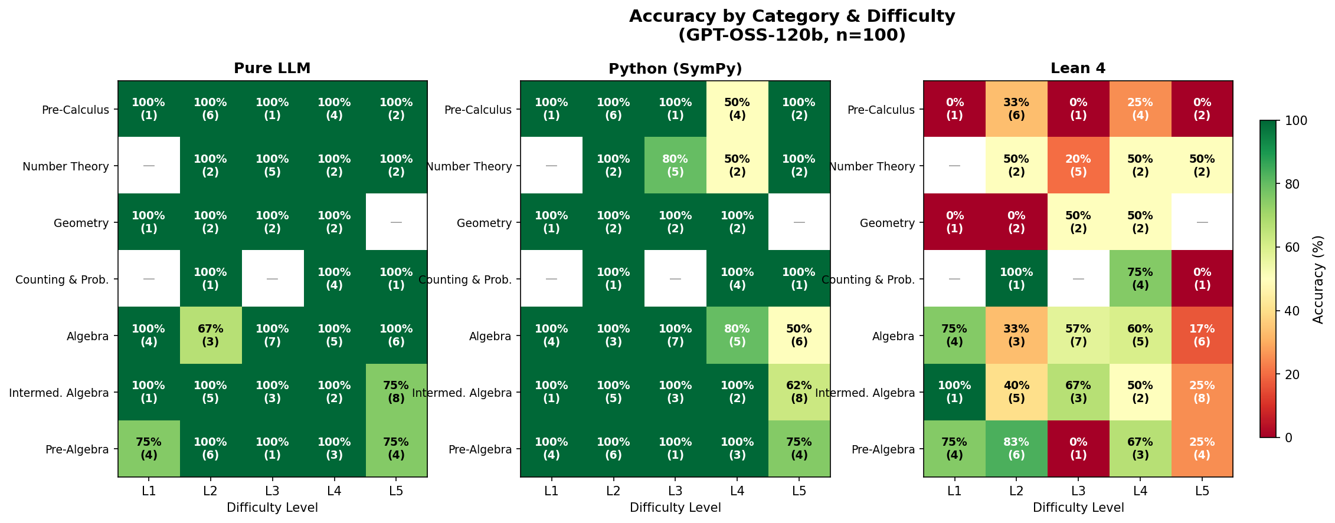
RESULTS : Accuracy by Category & Difficulty

Slide 10
conclusion
Pure LLM: best overall accuracy (95%)
Python (SymPy): competitive but drops at higher difficulty (88%)
Lean 4: significant underperformance across all dimensions (44%)
Difficulty scaling disproportionately hurts Lean 4 (64% → 22%)
Proof generation — not mathematics — is the core bottleneck
Zero-shot Pure LLM remains the most practical approach today

Slide 11
Future Work
Benchmark additional models: GPT-4o, Claude, Gemini
Test few-shot and chain-of-thought prompting strategies
Fine-tune models specifically on Lean 4 proof corpora
Explore hybrid pipelines: Python solving + Lean 4 verification
Scale dataset beyond 100 problems and more categories
Analyze Lean 4 failure modes systematically

Slide 12
Thank You!
Ralf König
Fritz Körner
Khalid Sabih
Mohamed El Maghari

