Slide 1
Analytics Server Setup
January 17, 2018
Yuchen Li & Yanglin Li

Slide 2
Objectives
Step 1: Determined the building blocks
Capacity: CPU, memory, storage
Connectivity: bridges to existing server/data/service
Compatibility: legacy models, version control
Compliance: HIPAA
Step 2: Collected feedback and opinion from ACE staff
Step 3: Constructed a list of comprehensive requirements for development and sandbox server
Step 4: Server delivery

Slide 3
In-house Development & Sandbox server
New development & sandbox server are extensions to existing server, with more recent tools/languages installed
It will maintain general access to existing data (MarketScan, NIKE)
Legacy models will keep running on existing server until they are ready to be transitioned into new servers
Models will be tested and archived on sandbox server, final version will be compiled and stored on development server

Slide 4
General HIPAA
The Security Rule requires covered entities to maintain reasonable and appropriate administrative, technical, and physical safeguards for protecting e-PHI. Specifically, covered entities must:
Ensure the confidentiality, integrity, and availability of all e-PHI they create, receive, maintain or transmit
Identify and protect against reasonably anticipated threats to the security or integrity of the information
Protect against reasonably anticipated, impermissible uses or disclosures; and
Ensure compliance by their workforce

Slide 5
Development vs. Sandbox server: specs
 | Development | Sandbox
Timing | Early February | Upon finishing development server
Data restrictions | General HIPAA | General HIPAA
3rd party software | Docker(17.06.2-ee-6), Flexible Analytics (via API) | Docker(17.06.2-ee-6), Flexible Analytics (via API), Anaconda Python(>=3.6: pandas, numpy, sklearn), R and Rstudio, SQL, Git, Git LFS, Jupyter Notebook, Spark, Hadoop, SAS(?)
Access/users | Restricted access to and control by project/development lead | Restricted and unrestricted access to and control by ACE users

Slide 6
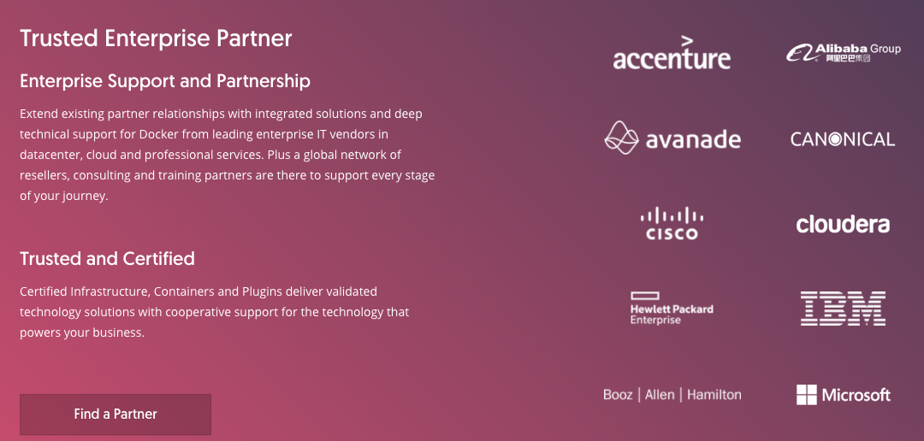
What is Docker?
Docker is an realization of container technology. A container image is a lightweight, stand-alone, executable package of a piece of software that includes everything needed to run it: code, runtime, system tools, system libraries, settings.

Slide 7
Benefit of Docker
Standardization
Rather than building a new environment for every analysis, you can put the tools and packages required for certain types of analyses (e.g., SAS, python, etc.) into a container, create an image of that container, and have every user boot up an isolated, standardized environment from that image
Reproducibility
Docker provides an easy way to share working environments including libraries and drivers. This allows reproducible data science workflows

Slide 8
Development vs. Sandbox server: specs
 | Development | Sandbox
CPU | 32 virtual cpu per virtual machine | 32 virtual cpu per virtual machine
Storage | 5TB | 1-2TB (must be scalable)
RAM | 128GB | 256GB per virtual machine
Operating system | Red Hat Enterprise Linux 7.3 | Red Hat Enterprise Linux 7.3
Path to existing server/model | SFTP tunnel | SFTP tunnel
Data access | Explorys, MarketScan, SAF, Huntmore(CED), PIDB, reference data | Explorys, MarketScan, SAF, Huntmore(CED), PIDB, reference data

Slide 9
Cloud server
Instead of in-house development and sandbox server, IBM cloud server has its potentials

Slide 10
Solution 2: cloud server
Pros | Cons
No need for onsite hardware or capital expenses. Well suited to rapidly growing companies that may outgrow their infrastructure too quickly. | The user experience is limited by the speed of the Internet connection.
Easily scalable; can be added to as needed. Solutions are often on-demand, so you only pay for the options you want. | Third party cloud services could have direct access to your data.
Workers can connect from anywhere, using any computer, tablet, or smartphone. Companies can implement BYOD (bring your own device) policies. | If the Internet goes down on your side or on your cloud provider’s side, you won’t have access to any of your information.
Data can be backed up in the cloud as regularly as 15-minute intervals, minimizing data losses in disaster situations. | The costs can outweigh the benefits for companies not as dependent on uptime.

Slide 11
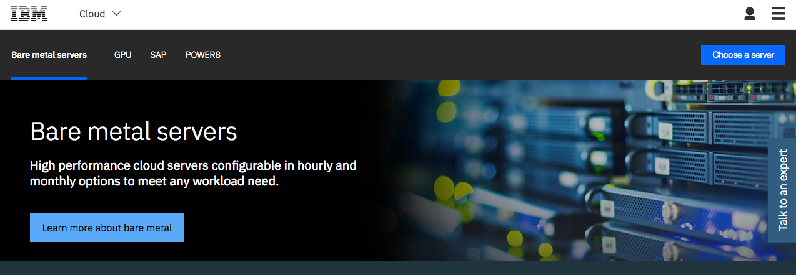
IBM cloud server

Slide 12
IBM cloud server
Intel Xeon E5-2690 v4: $1500/month (additional 30% IBM internal discount)
Configure to our demand
HIPAA compliant
28 cores, 2.60 GHz
256GB RAM, 10TB storage
Point of contact: wnichola@us.ibm.com

