Slide 1
New Analytics Server Setup
Phase 2
February 2, 2018
Yuchen Li & Yanglin Li

Slide 2
Current Situations
Analytics Server (0852)
MarketScan, data mentors, client data
Python, R , SAS enabled
Very crowded
NIKE Server (1465)
MarketScan data
SAS enabled
Python/R not available

Slide 3
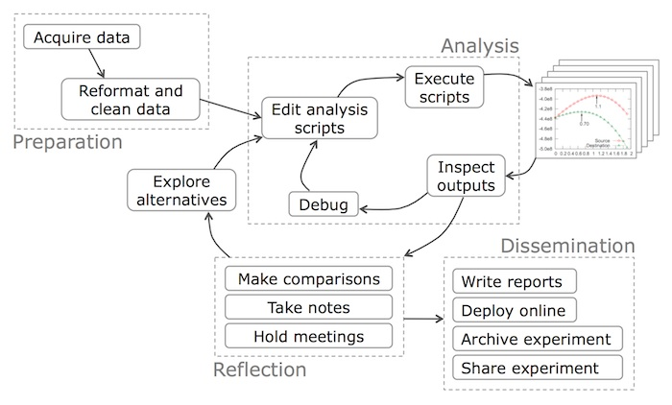
Data Science Workflow
Objective
Preparation
Import data
Data exploration and cleaning
Analysis and Reflection
Baseline model
Secondary model
Dissemination
Deployment/production

Slide 4
Objectives
Build a team (ACE) development server
Development server will:
Run final models only (i.e., for incorporation into products such as Flexible Analytics)
Archive final code, metadata, and relevant train/test/output datasets (HIPAA)
Interface with production/engineering teams (e.g., through use of Docker)
Build a team (ACE) sandbox server
Sandbox server will:
Provide space for model fitting and testing
Archive code, metadata, and relevant train/test/output datasets (HIPAA)
Interface with development server (e.g., through use of Docker)

Slide 5
The Building Blocks
Capacity: storage and computing power
To accommodate 20-30 users on ongoing basis
Connectivity: access to in-house data sources
Compatibility: version control, standardization
Compliance: HIPAA and general client data guidelines

Slide 6
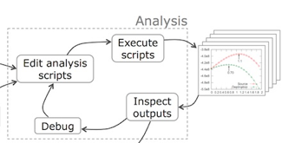
Solutions
Capacity: storage and computing power
In-house physical server with attached distributed computing capacity
Physical Server
Distributed computing environment
Storage

Slide 7
Solutions
Connectivity: access to MarketScan, data mentor and etc.
Attached storage with NFS/Sand mount to 0852 and 1465 server
1465: NIKE
Physical Server
Distributed computing environment
0852: Analytic
Storage

Slide 8
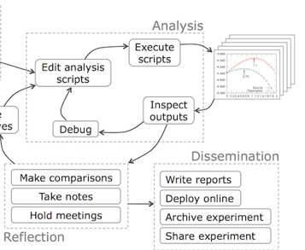
Solutions
Compatibility: version control, standardization
Version control: Git
Standardization: Docker

Slide 9
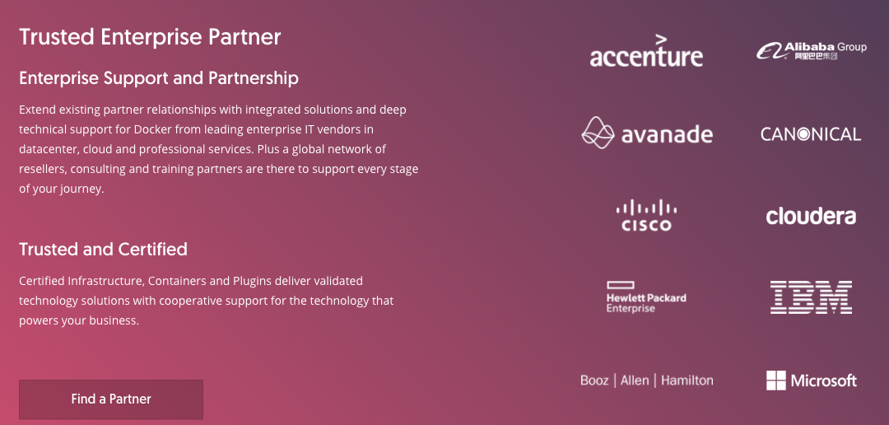
What is Docker?
Docker is an realization of container technology. A container image is a lightweight, stand-alone, executable package of a piece of software that includes everything needed to run it: code, runtime, system tools, system libraries, settings.

Slide 10
Benefit of Docker
Standardization
Rather than building a new environment for every analysis, you can put the tools and packages required for certain types of analyses (e.g., SAS, python, etc.) into a container, create an image of that container, and have every user boot up an isolated, standardized environment from that image
Resource control
By default, a Docker image has no resource constraints and can use as much of a given resource as the host’s kernel scheduler allows. Docker provides ways to control how much memory, CPU, or block IO an image can use

Slide 11
Solutions
Compliance: HIPAA and general client data guidelines
Ensure the confidentiality, integrity, and availability of all e-PHI they create, receive, maintain or transmit
Identify and protect against reasonably anticipated threats to the security or integrity of the information
Protect against reasonably anticipated, impermissible uses or disclosures; and
Ensure compliance by their workforce

Slide 12
Development vs. Sandbox Server
 | Development | Sandbox
Timing | Completed | Immediately
Data restrictions | General HIPAA, client data guidelines | General HIPAA, client data guidelines
CPU | 12 virtual cores per virtual machine | 24 physical cores
Storage | 5TB | 5TB
RAM | 128GB | 512GB
Operating system | Red Hat Enterprise Linux 7.3 | Red Hat Enterprise Linux 7.3
Data access | NA | NFTS mount to 0852 and 1465 server
3rd party software | Docker(17.06.2-ee-6), Flexible Analytics (via API) | Docker(17.06.2-ee-6), Flexible Analytics (via API), Anaconda Python(>=3.6: pandas, numpy, sklearn), R and Rstudio, SQL, Git, Git LFS, Jupyter Notebook
Access/users | Restricted access to and control by project/development lead | Restricted and unrestricted access to and control by ACE users

