Slide 1
Analytics Server Setup
January 12, 2018
Yuchen Li & Yanglin Li

Slide 2
Objectives
Step 1: Determined the building blocks
Capacity： CPU, memory, Storage
Connectivity: bridges to existing server/data/service
Compatibility: legacy models, version control
Compliance: HIPAA
Step 2: Collected feedback and opinion from ACE staff
Step 3: Constructed a list of comprehensive requirements for development and sandbox server

Slide 3
Development & Sandbox server
New development & sandbox server are extensions to existing server, with more recent tools/languages installed
It will maintain general access to existing data (MarketScan, NIKE)
It will maintain general access to existing server (0852, 1465) ??
Legacy models will keep running on existing server until they are ready to be transitioned into new servers
Future models will be tested, stored and produced on new development & sandbox server

Slide 4
Development vs. Sandbox server
 | Development | Sandbox
Timing | Early February | Upon finishing development server
Data restrictions | General HIPAA | General HIPAA
3rd party software | Docker*, Flexible Analytics(API?) | Docker*, Flexible Analytics, Anaconda Python(>=3.6: pandas, numpy, sklearn), R and Rstudio, SQL, Git, Git LFS, Jupyter Notebook, Spark, Hadoop, SAS(?)
Access/users | Restricted access to and control by project/development lead | Restricted and unrestricted access to and control by ACE users, (open port for pip and cran (Python and R package installation)??)

Slide 5
General HIPAA
The Security Rule requires covered entities to maintain reasonable and appropriate administrative, technical, and physical safeguards for protecting e-PHI. Specifically, covered entities must:
Ensure the confidentiality, integrity, and availability of all e-PHI they create, receive, maintain or transmit;
Identify and protect against reasonably anticipated threats to the security or integrity of the information;
Protect against reasonably anticipated, impermissible uses or disclosures; and
Ensure compliance by their workforce.

Slide 6
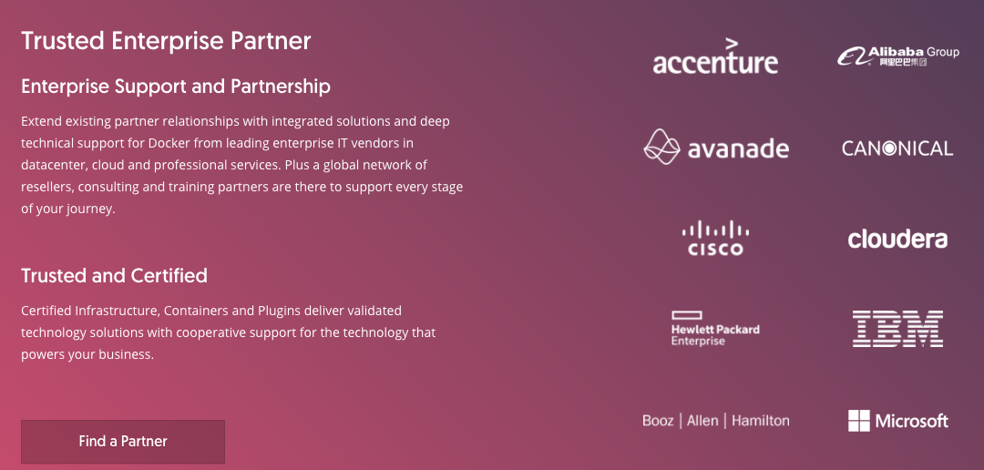
What is Docker?
Docker is an realization of container technology. A container image is a lightweight, stand-alone, executable package of a piece of software that includes everything needed to run it: code, runtime, system tools, system libraries, settings.

Slide 7
Benefit of Docker
Standardization
Rather than building a new environment for every analysis, you can put the tools and packages required for certain types of analyses (e.g., scikit-learn, TensorFlow, Jupyter, etc.) into a container, create an image of that container, and have every user boot up an isolated, standardized environment from that image.
Reproducibility
Docker provides an easy way to share working environments including libraries and drivers. This allows reproducible data science workflows.

Slide 8
Development vs. Sandbox server
 | Development | Sandbox
CPU | 24 cores | 56 cores
Storage | 4-8TB (must be scalable) | 1-2TB (must be scalable)
RAM | 64-128GB | 768GB-1.5TB
Operating system | Linux 64-bit (Redhat or minimal install CentOS 7) | Linux 64-bit (Redhat or minimal install CentOS 7)
Path to existing server/model | SFTP tunnel? | SFTP tunnel?
Data access | Explorys, MarketScan, SAF, Huntmore(CED), PIDB, reference data | Explorys, MarketScan, SAF, Huntmore(CED), PIDB, reference data

Slide 9
Solution 2: cloud servers
Pros | Cons
No need for onsite hardware or capital expenses. Well suited to rapidly growing companies that may outgrow their infrastructure too quickly. | The user experience is limited by the speed of the Internet connection.
Easily scalable; can be added to as needed. Solutions are often on-demand, so you only pay for the options you want. | Third party cloud services could have direct access to your data.
Workers can connect from anywhere, using any computer, tablet, or smartphone. Companies can implement BYOD (bring your own device) policies. | If the Internet goes down on your side or on your cloud provider’s side, you won’t have access to any of your information.
Data can be backed up in the cloud as regularly as 15-minute intervals, minimizing data losses in disaster situations. | The costs can outweigh the benefits for companies not as dependent on uptime.

Slide 10
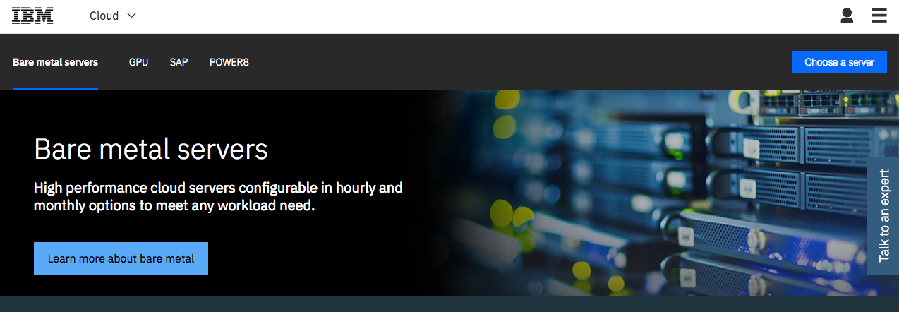
IBM cloud server

Slide 11
IBM cloud server
Intel Xeon E5-2690 v4: $1500/month (additional 30% IBM internal discount)
Configure to our demand
HIPAA compliant
28 cores, 2.60 GHz
256GB RAM, 10TB storage
Point of contact: wnichola@us.ibm.com

