Slide 1
New Analytics Server Setup
Phase 1
February 2, 2018
Yuchen Li & Yanglin Li

Slide 2
Current Situations
Analytics Server (0852)
MarketScan, data mentors, client data
Python, R , SAS enabled
Very crowded
NIKE Server (1465)
MarketScan data
SAS enabled
Python, R not available

Slide 3
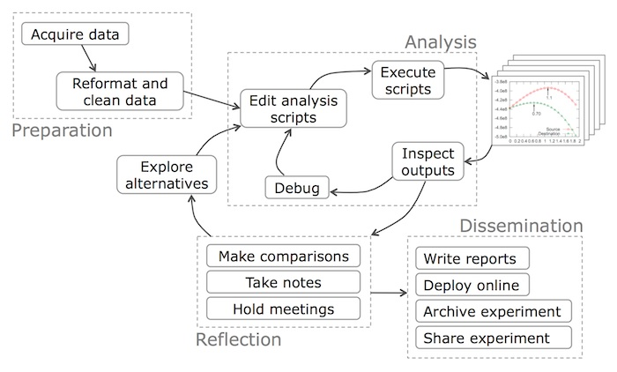
Data Science Workflow

Slide 4
Objectives
Build a team (ACE) development server
Development server will:
Run final models only (i.e., for incorporation into products such as Flexible Analytics)
Archive final code, metadata, and relevant train/test/output datasets (HIPAA)
Interface with production/engineering teams (e.g., through use of Docker)
Build a future-proof team (ACE) sandbox server
Sandbox server will:
Provide space for model fitting and testing
Archive code, metadata, and relevant train/test/output datasets (HIPAA)
Interface with development server (e.g., through use of Docker)

Slide 5
The building blocks
Capacity: storage and computing power
To accommodate 20-30 users on ongoing basis
Connectivity: access to in-house data sources
Compatibility: version control, standardization, reproducibility
Compliance: HIPAA and general client data guidelines

Slide 6
Solutions
Capacity: storage and computing power
In-house physical server with attached distributed computing capacity
Physical Server
Distributed computing environment
Storage

Slide 7
Solutions
Connectivity: access to MarketScan, data mentor and etc.
Attached storage with NFS/Sand mount to 0852 and 1465 server
1465: NIKE
Physical Server
Distributed computing environment
0852: Analytic
Storage

Slide 8
Solutions
Compatibility: version control, standardization, reproducibility
Git and Docker

Slide 9
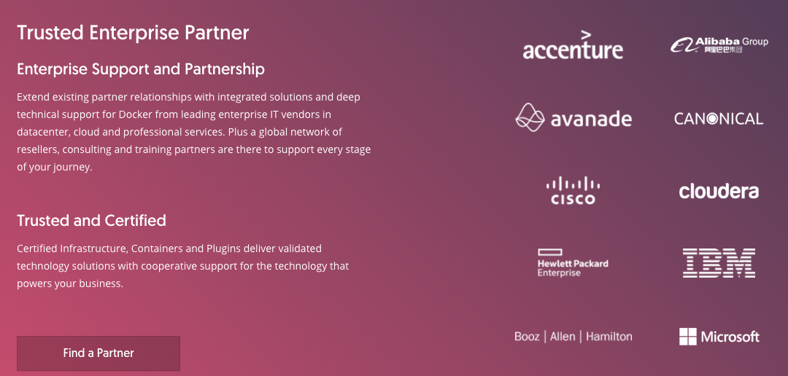
What is Docker?
Docker is an realization of container technology. A container image is a lightweight, stand-alone, executable package of a piece of software that includes everything needed to run it: code, runtime, system tools, system libraries, settings.

Slide 10
Solutions
Compliance: HIPAA and general client data guidelines
Ensure the confidentiality, integrity, and availability of all e-PHI they create, receive, maintain or transmit
Identify and protect against reasonably anticipated threats to the security or integrity of the information
Protect against reasonably anticipated, impermissible uses or disclosures; and
Ensure compliance by their workforce

Slide 11
Benefit of Docker
Standardization
Rather than building a new environment for every analysis, you can put the tools and packages required for certain types of analyses (e.g., SAS, python, etc.) into a container, create an image of that container, and have every user boot up an isolated, standardized environment from that image
Reproducibility
Docker provides an easy way to share working environments including libraries and drivers. This allows reproducible data science workflows

Slide 12
Development vs. Sandbox Server
 | Development | Sandbox
Timing | Completed | Mid-late February
Data restrictions | General HIPAA, client data guidelines | General HIPAA, client data guidelines
CPU | 32 virtual cpu per virtual machine | 32 virtual cpu per virtual machine
Storage | 5TB | 12TB
RAM | 128GB | 512GB
Operating system | Red Hat Enterprise Linux 7.3 | Red Hat Enterprise Linux 7.3
Data access | NA | NFTS mount to 0852 and 1465 server
3rd party software | Docker(17.06.2-ee-6), Flexible Analytics (via API) | Docker(17.06.2-ee-6), Flexible Analytics (via API), Anaconda Python(>=3.6: pandas, numpy, sklearn), R and Rstudio, SQL, Git, Git LFS, Jupyter Notebook
Access/users | Restricted access to and control by project/development lead | Restricted and unrestricted access to and control by ACE users

