Slide 1
New Analytics Server Setup
Phase 1
February 2, 2018
Yuchen Li & Yanglin Li

Slide 2
Current Situation
Analytics Server (0852)
MarketScan, data mentors, client data
Python, R , SAS enabled
Very crowded
NIKE Server (1465)
MarketScan data
SAS enabled
Python, R not available

Slide 3
Objectives
Build a team (ACE) development server
Development server will:
Run final models only (i.e., for incorporation into products such as Flexible Analytics)
Archive final code, metadata, and relevant train/test/output datasets (HIPAA)
Interface with production/engineering teams (e.g., through use of Docker)
Build a team (ACE) sandbox server
Sandbox server will:
Provide space for model fitting and testing
Archive code, metadata, and relevant train/test/output datasets (HIPAA)
Interface with development server (e.g., through use of Docker)

Slide 4
The building blocks
Capacity: storage and computing power
To accommodate 20-30 users on ongoing basis
Connectivity: access to in-house data sources
Compatibility: version control, standardization, reproducibility
Compliance: HIPAA

Slide 5
Solutions
Capacity: storage and computing power
In-house physical server with attached distributed computing capacity
Physical Server
Distributed computing environment
Storage

Slide 6
HIPAA
The Security Rule requires covered entities to maintain reasonable and appropriate administrative, technical, and physical safeguards for protecting e-PHI. Specifically, covered entities must:
Ensure the confidentiality, integrity, and availability of all e-PHI they create, receive, maintain or transmit
Identify and protect against reasonably anticipated threats to the security or integrity of the information
Protect against reasonably anticipated, impermissible uses or disclosures; and
Ensure compliance by their workforce

Slide 7
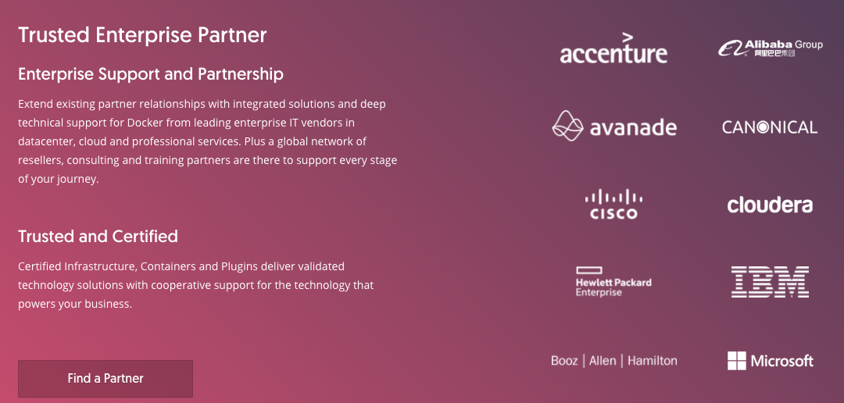
What is Docker?
Docker is an realization of container technology. A container image is a lightweight, stand-alone, executable package of a piece of software that includes everything needed to run it: code, runtime, system tools, system libraries, settings.

Slide 8
Benefit of Docker
Standardization
Rather than building a new environment for every analysis, you can put the tools and packages required for certain types of analyses (e.g., SAS, python, etc.) into a container, create an image of that container, and have every user boot up an isolated, standardized environment from that image
Reproducibility
Docker provides an easy way to share working environments including libraries and drivers. This allows reproducible data science workflows

Slide 9
Development vs. Sandbox server: specs
 | Development | Sandbox
Timing | Early February | Upon finishing development server
Data restrictions | General HIPAA | General HIPAA
3rd party software | Docker(17.06.2-ee-6), Flexible Analytics (via API) | Docker(17.06.2-ee-6), Flexible Analytics (via API), Anaconda Python(>=3.6: pandas, numpy, sklearn), R and Rstudio, SQL, Git, Git LFS, Jupyter Notebook, Spark, Hadoop
Access/users | Restricted access to and control by project/development lead | Restricted and unrestricted access to and control by ACE users

Slide 10
Development vs. Sandbox server: specs
 | Development | Sandbox
CPU | 32 virtual cpu per virtual machine | 32 virtual cpu per virtual machine
Storage | 5TB | 1-2TB (must be scalable)
RAM | 128GB | 256GB per virtual machine
Operating system | Red Hat Enterprise Linux 7.3 | Red Hat Enterprise Linux 7.3
Path to existing server/model | SFTP tunnel | SFTP tunnel
Data access | Explorys, MarketScan, SAF, Huntmore(CED), PIDB, reference data | Explorys, MarketScan, SAF, Huntmore(CED), PIDB, reference data

Slide 11
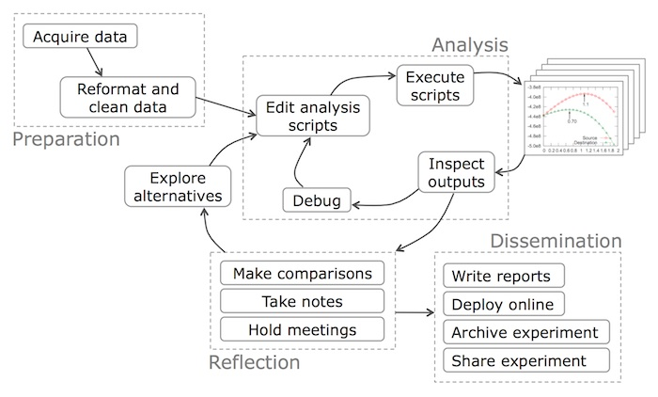
Data Science Workflow

