Slide 1
Analytics Server Setup
January 9, 2018
Yuchen Li & Yanglin Li

Slide 2
Objectives
Step 1: Determined the building blocks
Capacity： CPU, memory, Storage
Connectivity: bridges to existing server/data/service
Compatibility: legacy models, version control
Compliance: HIPAA
Step 2: Collected feedback and opinion from ACE staff
Step 3: Constructed a list of comprehensive requirements for development and sandbox server

Slide 3
Production & Sandbox server
New production & sandbox server are extensions to existing server, with more recent tools/languages installed
It will maintain general access to existing data (MarketScan, NIKE)
It will maintain general access to existing server (0852, 1465)
Legacy models will keep running on existing server until they are ready to be transitioned into new servers
Future models will be tested, stored and produced on new production & sandbox server

Slide 4
Production vs. Sandbox server
 | Production | Sandbox
Timing | Early February | Upon finishing Production server
Data restrictions | General HIPAA | General HIPAA
3rd party software | Docker*, Flexible Analytics | Docker*, Flexible Analytics, Anaconda Python(2.7 and 3.6: pandas, numpy, sklearn), R and Rstudio, SQL, Git, Git LFS, Jupyter Notebook, Spark, SAS(?)
Access/users | Restricted access to and control by project/production lead | Restricted and unrestricted access to and control by ACE users

Slide 5
Production vs. Sandbox server
 | Production | Sandbox
CPU | 24 | 8 per user
Storage | 4-8TB (must be scalable) | 1-2TB (must be scalable)
RAM | 64-128GB | 16-32GB per user (roughly 10 at a time)
Operating system | Linux 64-bit (Redhat or minimal install CentOS 7) | Linux 64-bit (Redhat or minimal install CentOS 7)
Path to existing server/model | SFTP tunnel | SFTP tunnel
Data access | Explorys, MarketScan, SAF, Huntmore(CED), PIDB, reference data | Explorys, MarketScan, SAF, Huntmore(CED), PIDB, reference data

Slide 6
Solution 2: cloud servers
Pros | Cons
No need for onsite hardware or capital expenses. Well suited to rapidly growing companies that may outgrow their infrastructure too quickly. | The user experience is limited by the speed of the Internet connection.
Easily scalable; can be added to as needed. Solutions are often on-demand, so you only pay for the options you want. | Third party cloud services could have direct access to your data.
Workers can connect from anywhere, using any computer, tablet, or smartphone. Companies can implement BYOD (bring your own device) policies. | If the Internet goes down on your side or on your cloud provider’s side, you won’t have access to any of your information.
Data can be backed up in the cloud as regularly as 15-minute intervals, minimizing data losses in disaster situations. | The costs can outweigh the benefits for companies not as dependent on uptime.

Slide 7
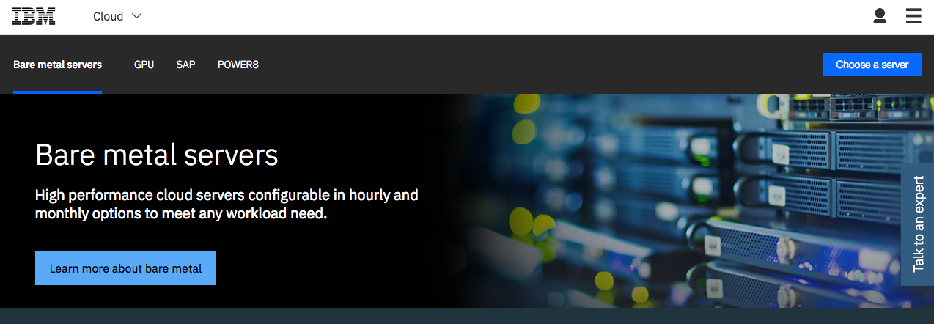
IBM cloud server

Slide 8
IBM cloud server
Intel Xeon E5-2690 v4: $1500/month (additional 30% IBM internal discount)
Configure to our demand
HIPAA compliant
28 cores, 2.60 GHz
256GB RAM, 10TB storage
Point of contact: wnichola@us.ibm.com

