Slide 1
Disease prevalence and Average cost
Yuchen Li, Prateek Agrawal
Dec 11, 2017

Slide 2
Objectives
How does disease prevalence/average cost for a given DS Diagnosis Category(DXCAT) and client change over time?
Propose a way to compare disease prevalence/average cost between clients

Slide 3
Data
MarketScan commercial claims and encounters
Outpatient:
2006-2015: ccaeo063-ccaeo153
Tracked a fixed group of 84 clients
Around 10 million enrollees
Disease prevalence(DXCAT): CVS09, END05, RES02 and RES05
Congestive Heart Failure
Diabetes Mellitus Type 2, Unsp Types & Hyperglycemic States
Asthma
Chronic Obstructive Pulmonary Disease

Slide 4
Methodology
Disease prevalence:
the number of cases of a disease that are present in a particular population
Number of cases:
unique (DS Diagnosis Category, Enrollee ID) tuple
Average cost:
Focusing on payment(PAY)
Gross payments to a provider for a service. Payment equals the amount eligible for payment under the medical plan terms after applying rules such as discounts, but before applying COB, Copayments, and Deductibles

Slide 5
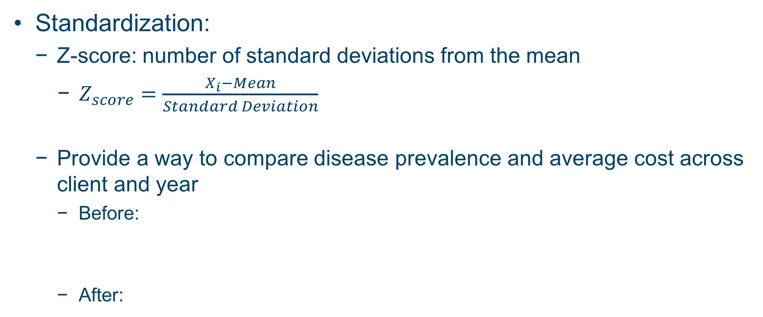
Methodology
Standardization:
Z-score: number of standard deviations from the mean
$Z_{score}=\frac{X_{i}−Mean}{Standard Deviation}$
Provide a way to compare disease prevalence and average cost across client and year
Before:
After:

Slide 6
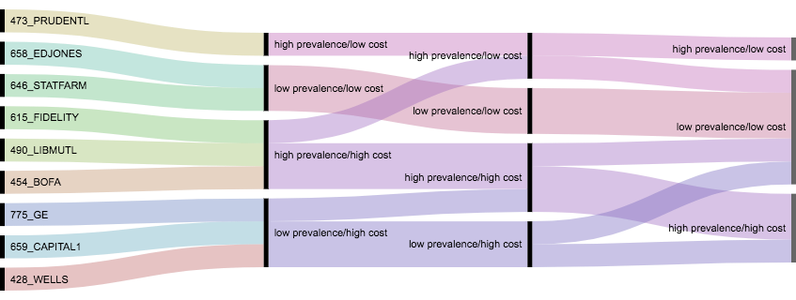
Visualization
Finance, Insurance and Real Estate sector, 2006-2008, Asthma
2006
2007
2008

Slide 7
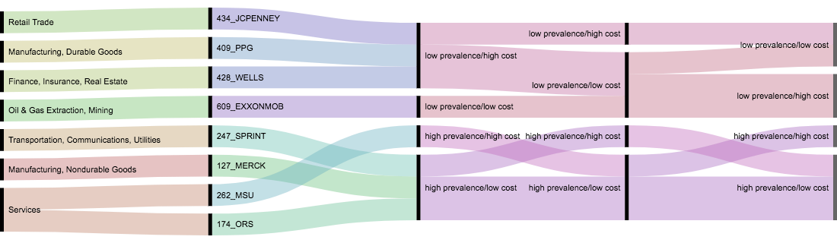
Visualization
(2006, 2009, 2012), Asthma
2006
2009
2012

