Slide 1
Population Classification EMR Based Model Final Considerations
Emerging Analytics
IBM WH VBC
January, 2018

Slide 2
Last ditch effort - New Model
Approach:
Use a CED sample and assign the categories based on claims model.
Use these as training data to create a new model based on new and old EMR features
Improvements:
The logic for CED sample was changed in order to obtain a higher consistency between the claims (MarketScan) and clinical (Explorys) data and eliminate filters based on high activity.
We considered new features based on clinical information, otherwise not available in the claims. For example we considered counts and results (normal/abnormal) from various lab tests (hbA1C, Hemoglobin, etc.)
Expectations:
We expect to see improvements in the accuracy of the decision tree model, the open question was by how much and if there is any compromise on the interpretability.

Slide 3
New Model contnd. – Higher Concordance Sample
Started from an existing concordance table (Emerging Analytics - Huntmore project) selecting patients who had TRatio = 1 but no filtering on minimum months of claims activity.
Counted MarketScan events in both inpatient and outpatient services tables(count_MScan)
Counted up the number of events in the EMR encounter table (count_EMR)
Select patients where min(count_Mscan,count_EMR)/max(count_Mscan,count_EMR) >= 0.5
Because very few patients ended in Crisis Management and Recovery Guidance we increased the sample by removing the above filter and reverting to the initial filter of Tratio=1.
Final sample resulted in 27,833 patients

Slide 4
New Model contnd. – Results
Model | Tree Depth | Accuracy
 |  | Current Sample (28K) | New Sample (higher concordance, 27.8K)
Current (same as claims) | 7 | 59.5% | 79.2%
New model trained with current sample data | 36 | 77%
New model trained with new sample data | 20 |  | 85.3%
New model trained with new sample data and pruned for interpretability | 6 |  | 82.9%

Slide 5
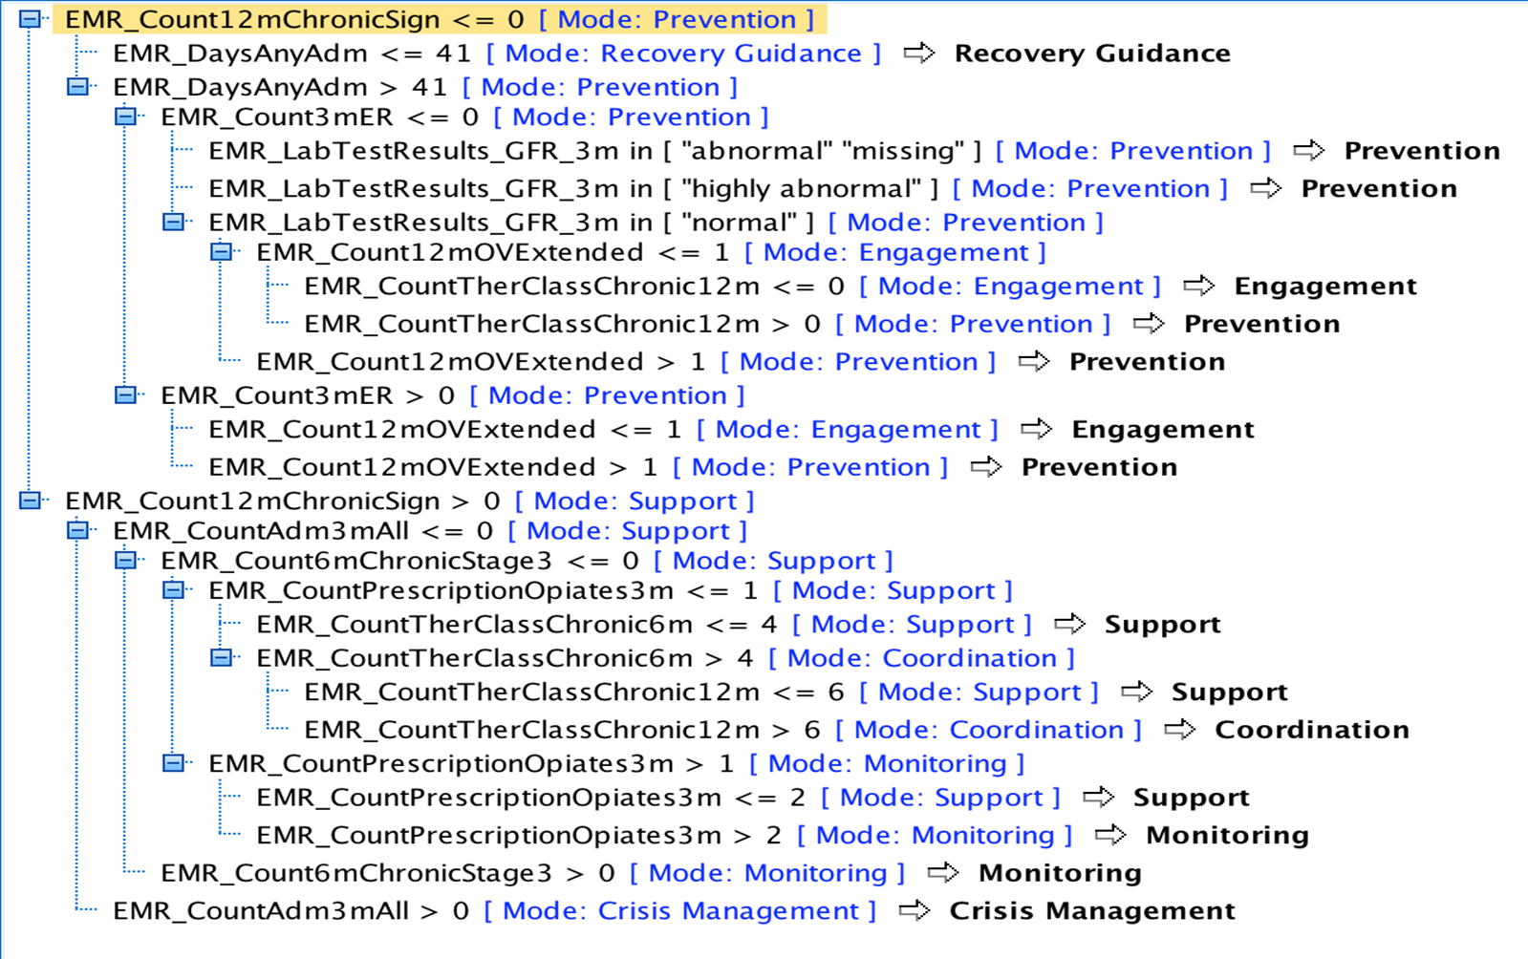
New Decision Tree Model

Slide 6
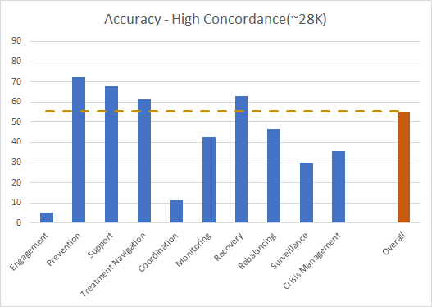
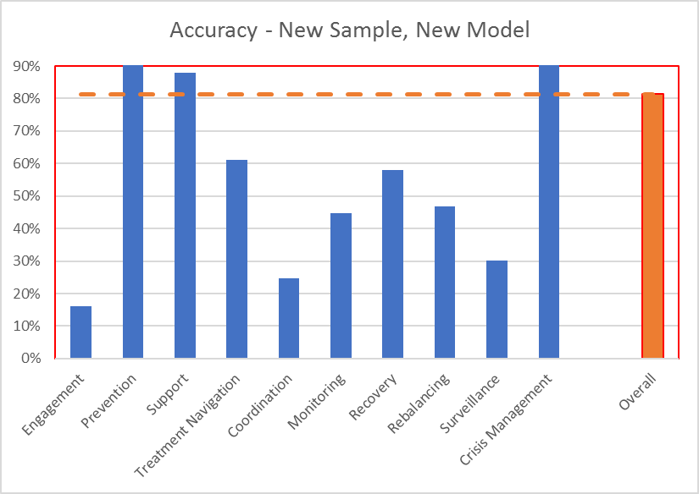
New Model contnd. – Overall Accuracy Comparison

Slide 7
New Model contnd. – Conclusions
When the data gaps are closed between claims and EMR (higher concordance sample) the baseline model accuracy is significantly higher too. So the accuracy gain, even though it looks large, it is mostly due to better data. The model itself, taking advantage of new EMR features, is only adding 3.7%.
It is possible to create new model with higher accuracy even in the old sample but it is mostly due to overfitting the data. Also the depth of the model makes it very hard to interpret it. We consider a better compromise the simpler model but easy to interpret.
The higher accuracy is mainly driven by “Prevention” category, but otherwise the model accuracy is lagging in the higher ranked categories. The accuracy in the rules based categories did not change, as they were not affected by the new model, and the “Crisis Management” is still below 50% accuracy.

Slide 8
Issues Affecting Accuracy that were diminished in the new sample
CONDITION RELATED
Missing diagnoses
Disease Staging Issues
DRG assignment
ENCOUNTER RELATED
Encounter missing
Encounter classified differently (e.g. ER visit in MarketScan, outpatient visit in Explorys)
DRUG RELATED
Missing Drugs
Issues related to differences in prescription date and claims date
Metadata Issues – Conversion of RX_CUI to ‘maintenance’ drugs

Slide 9
Project repository Population Classification on the Box

Slide 10
What have we learned about …

Slide 11
… about the data and the model?
EMR data is very different from claims in terms of the information it contains. The assumptions that same kind of basic information (diagnosis, encounters with providers and the type of encounters, drugs taken) is available in either system (claims vs. EMR) is generally not true.
On the positive note, there are pockets of data where high concordance between the two systems is possible but the subpopulations are diminishing a lot in these cases.
Processing the EMR data is multiple folds more challenging due to the lack of standardized values in EMR. Even simple events like office visits can be challenging to identify.
It is not always the case that claims have the most complete history of encounters, so caution must be taken when claims are considered the base for golden standard.
Training the model is cheap and fast, features computation is expansive and slow.

Slide 12
… about managing our own projects? – Part 1
Sprints work! But we need to manage better the expectations for the work we can do in the 2 weeks timeframe. Or change the timeframe.
Trello works! Everybody liked to use it as it was easy to adopt it. But we need to do better job at keeping the boards cleaner and set up the right amount of work so that they don’t become cluttered (see point above).
Offering Management needs to get more involved! We could use more interaction and guidance to take the right decisions for shaping the product.

Slide 13
… about managing our own projects? – Part 2
Not enough time allowed for the Sprint meetings as 30 minutes are barely enough to start the meeting and review where the project was 2 weeks ago. We need longer Sprint reviews.
Weekly working sessions are the best way to communicate with each others and make progress as a group. The project may benefit from having more than one session per week.
A lot of time is spent to prepare for the Sprint reviews. Either longer time intervals between the sprints or better ways to communicate the work done may help making us more efficient.
We generally lacked any communication with Stakeholders between the Sprint reviews. Improving this can help improve the point above too.

Slide 14
… about managing our own projects? – Part 3
Documentation … documentation … more documentation. This is especially true for this type of project where new data and many features are involved. Having one source of truth for all the specs is key for an efficient work within the group.
Assess the risk areas in the beginning of the project and allocate more resources there. Better to take things out if not needed than scramble to add time or people to emergency tasks.
Too many communication channels is sometimes bad. Having Trello, Slack, Box, Emails and SameTime as ways to communicate and store information can lead to confusion. Team must decide early on what tools are used for what purpose and stay consistent.

Slide 15
… about managing our own projects? – Part 4
More collaboration between teams on different projects. This is especially true for methodologists who can learn and leverage information from other projects (in our case it was the Huntmore project).
More data miners on the team! This relates to a previous point we made that training the model is usually less intensive than creating the features.
Streamline the way we interact with Explorys VDI, especially downloading and uploading files.

