Slide 1
wireframes
PART 1

Slide 2

5. WIREFRAMES (FOR DESKTOP)
HOME
Character 1
Character 2
Information
Image
Information
Image
1 Char
2 Char
Home
4 Char
5 Char
4 Char
5 Char
2 Char
1 Char
Home
4 Char
R
Home
5 Char
R
Character 4
Report
Character 5
Home
Information
Image
Information
Image
Appendices
1 Char
5 Char
1 Char
Home
2 Char
Home
2 Char
4 Char
R
R

Slide 3
Sitemaps
PART 1

Slide 4
Layout
PART 1

Slide 5

Home Page

Slide 6
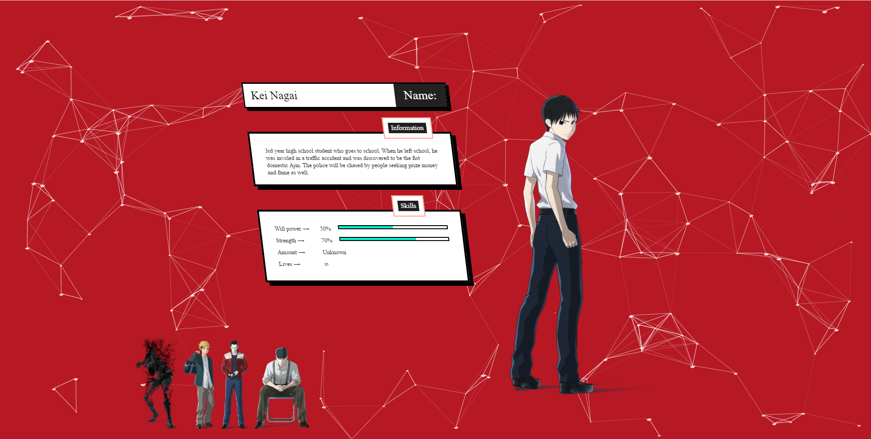
Character 1

Slide 7

Character 2

Slide 8
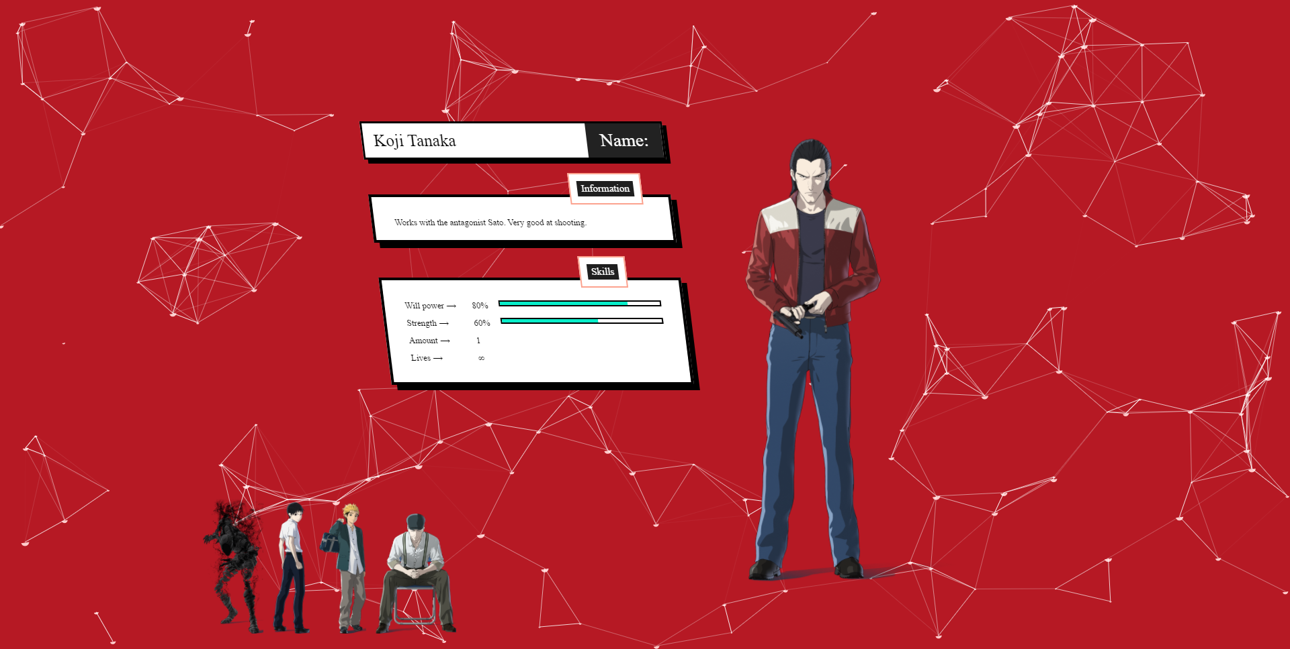
Character 4

Slide 9

Character 5

