Slide 1
Semi-Structured Text Document Search using VSM
Intelligent Data Processing and Applications, Project 2
By Ralph Aouad (201904846)
Karen Estephan (201900860)
Sara Karam (201900868)

Slide 2
Table of Content
Preprocessing Documents
Cleaning text for both text docs & XML files
02. Document Differencing Tool
TED & VSM
03. Indexing Techniques
04. Querying Interface
For keyword & XML queries
05. Optimization and Observations

Slide 3
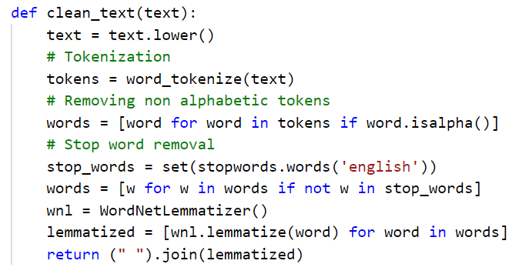
1. Preprocessing files – Cleaning text for .txt documents
Textual values will first be:
Converted to lowercase
Tokenized (based on punctuation and case)
Non alphabetical tokens will be removed
As well as stop words
Lemmatized using the WordNet Lemmatizer

Slide 4
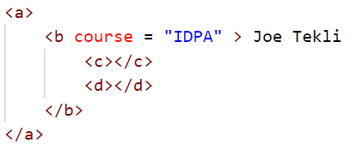
1. Preprocessing files – Cleaning XML files
a
0.&a
b
0.0.&b
Tags and attributes will only be converted to lowercase
Textual content will be tokenized and cleaned following the process seen earlier
=> The XML tree representation will adopt the one used in Project 1
course
c
d
joe
tekli
0.0.0.@course
0.0.1.&c
0.0.4.#tekli
0.0.3.#joe
0.0.2.&d
idpa
0.0.0.0.#idpa

Slide 5


2. Document Differencing Tool
.txt files
WF ED
Sim1(WF)*,
Sim2(WF)*, t1
VSM for text
TF / IDF / TF-IDF
Cosine, PCC, Euclidian, Manhattan, Jaccard, Dice
Doc 1
Sim(VSM), t2
Doc 2
.xml files
Tree 1, Tree 2
TED
Sim(TED)*,
Sim2(TED)*,
t1
ROLT Preprocessing
VSM for trees
Term-Context Representation
TF / IDF / TF-IDF
Extended-Cosine
Sim(TED), t2
* Formula 1:
* Formula 2:

Slide 6
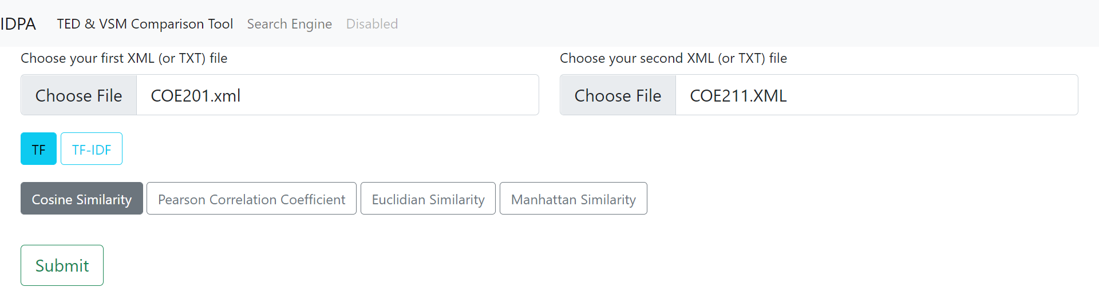

2. Document Differencing Tool
VSM Similarity serves as an upper bound for the TED similarity

Slide 7
2. Document Differencing Tool - VSM
Steps of our VSM:
Vectorize our input texts/trees
Vectors should have the same dimension
Fill the weights (using TF or TF-IDF)
Use a similarity measure to compute the similarity between both vectors

Slide 8
2. Dimensions of each vector - text
String of terms (1)
TF
Dict of terms1 with occurrences
Dimensions of both vectors
=
[ terms 1 U terms 2]
String of terms (2)
TF
Dict of terms2 with occurrences
Dimensions | Term1 | term2 | term3 | term4
V1
V2

Slide 9
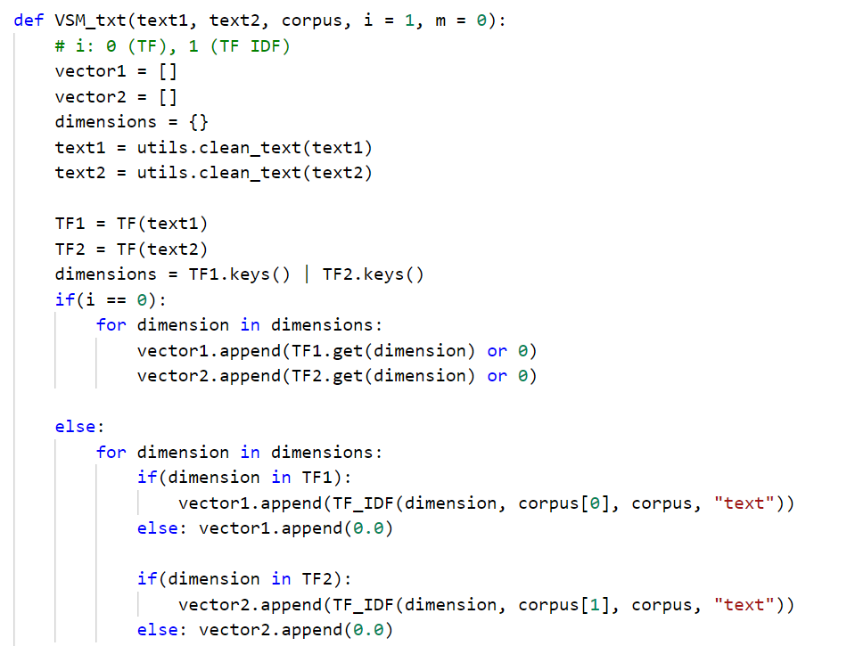
Filling in the weights using TF or TF-IDF (text)

Slide 10
2. Dimensions of each vector - xml
Term Context (TC)
TF
Dict of term/contexts1 with occurrences
Tree A
Dimensions of both vectors
=
[ term,contexts1 U term,contexts2 ]
Term Context (TC)
TF
Dict of term/contexts2 with occurrences
Tree B
Dimensions | Term, context | Term, context | Term, context | Term, context
V1
V2

Slide 11
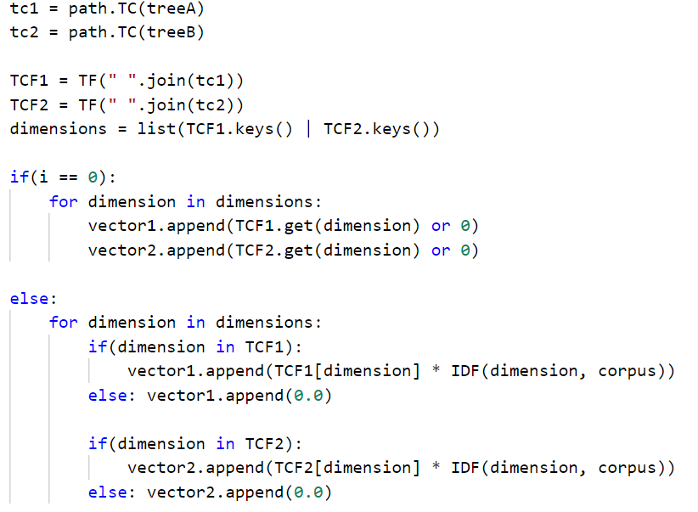
Filling in the weights using TCF or TCF-IDF (XML)

Slide 12
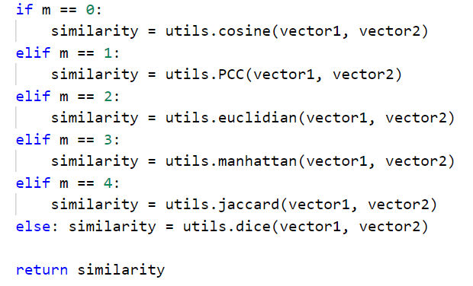
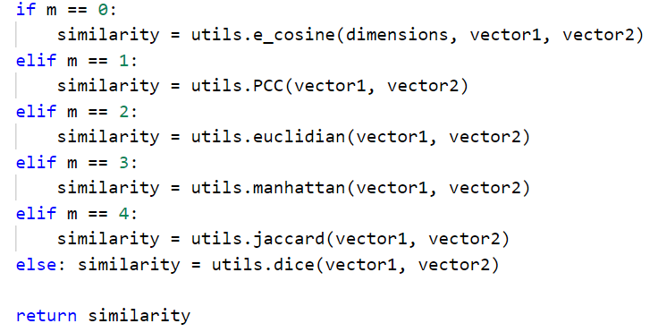
Choosing a similarity measure
For text vectors:
For tree vectors:

Slide 13
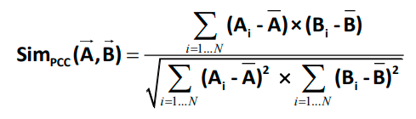
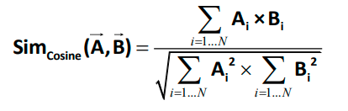
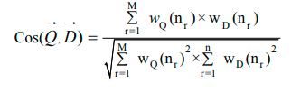






Correlation Measures
Pearson Correlation Coefficient
Cosine Measure
Extended Cosine Measure
Jaccard Distance
Manhattan Distance
Euclidian Distance
Dice Distance

Slide 14
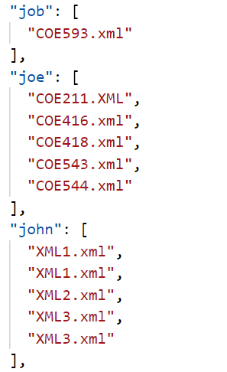

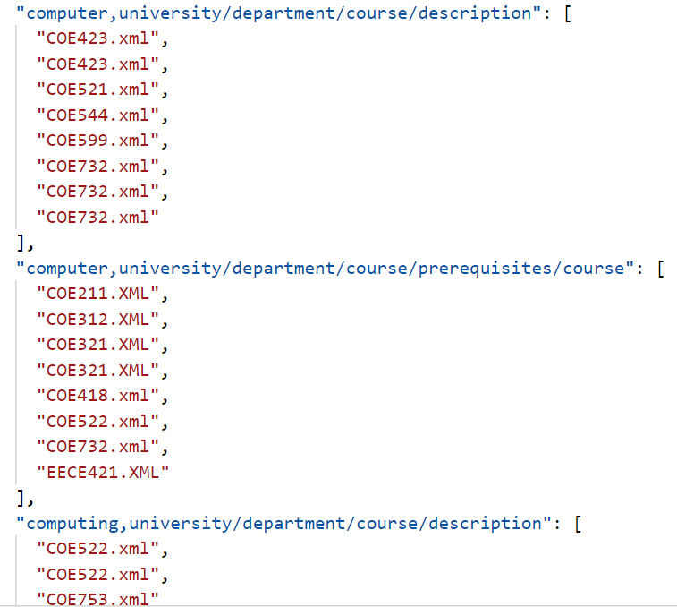
3. Indexing Techniques
Since our querying interface will have two types of inputs, we will need 2 indexing Tables:
Key Word queries: in which we will use the tag-based approach to represent our XML files
XML input files: in which we will use the term-context approach to represent our XML files
Both Indexing Tables will be stored offline as JSON files

Slide 15
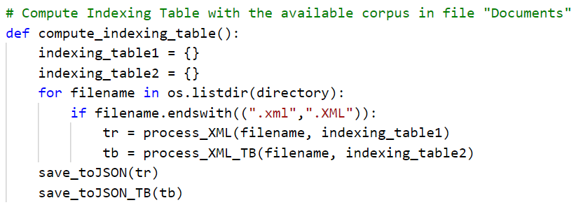
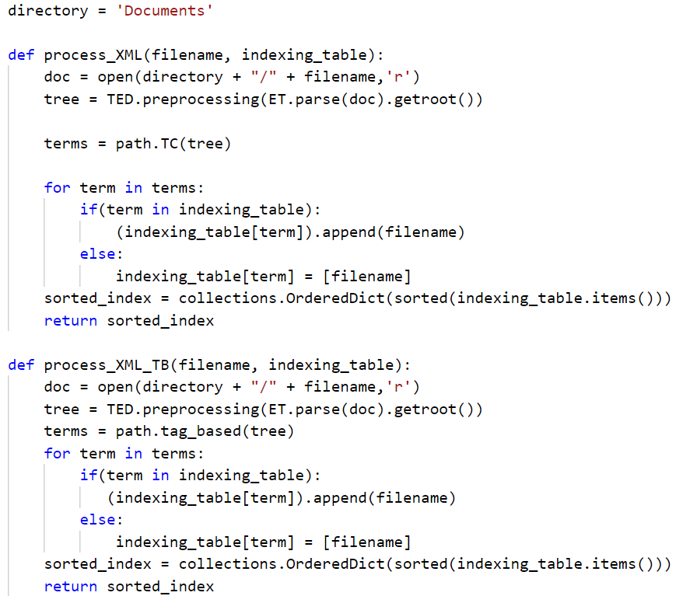
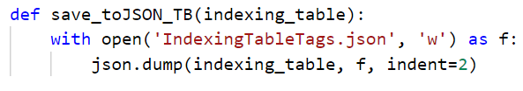
3. Computing the indexing tables
Processing an XML file in its term/context (1) and tag-based (2) rep.
Then save the tables as JSON

Slide 16
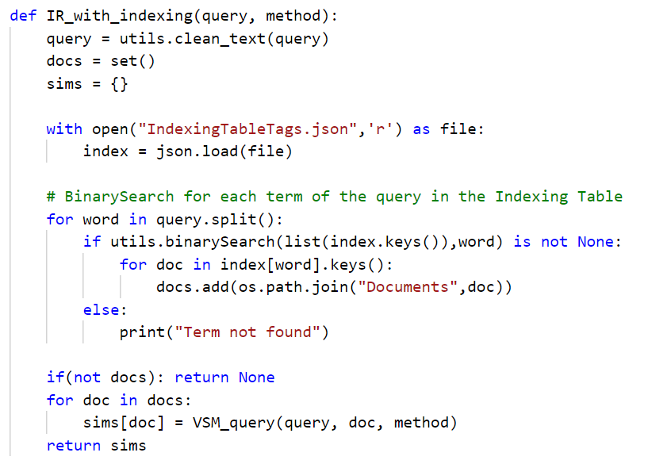
4. Querying – With indexing
Querying Key Words:
Clean the query input
Load the corresponding indexing table
Applying binary search for each term to speed up the process, add the documents containing these terms to a set (no duplicates)
Compute the similarity (VSM) of the query with every document related to it using tag-based approach

Slide 17
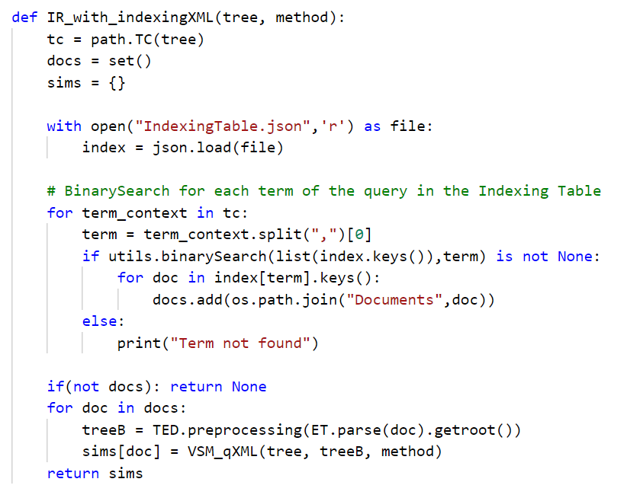
4. Querying – With indexing
Querying XML files:
Compute the (term,contexts) of the tree
Load the corresponding indexing table
Apply binary search for each term,context to speed up the process, add the documents containing these terms to a set (no duplicates)
Compute the similarity (VSM) of the tree with every document related to it using term-context approach

Slide 18
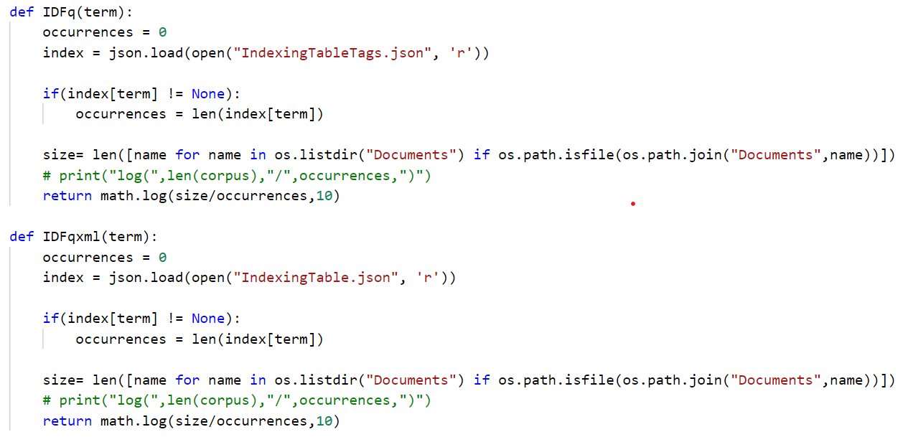
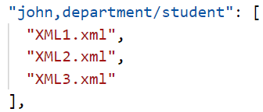
4. Perks of Indexing
Not only will the indexing help us compare our input with a limited number, which will make our engine faster, but we will also use it to compute the IDF faster (for each term, it is easy to get the number of docs in which it occurred)
N = 3

Slide 19
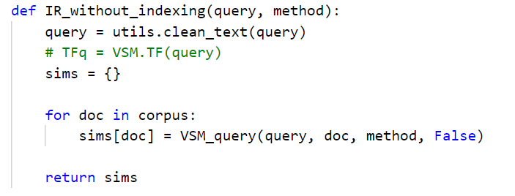
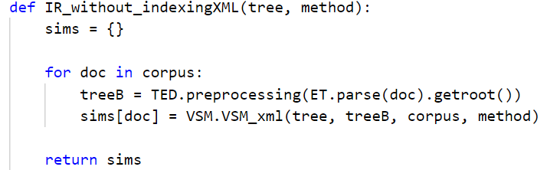
4. Querying – With no indexing
Here, we are comparing our query/xml input with every single document in the corpus

Slide 20
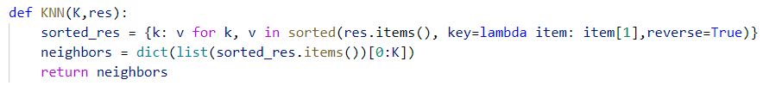
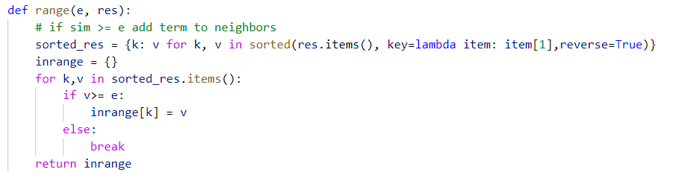

Data Selection Operators
K-th Nearest Neighbor
Range Operator
Combining KNN and Range Operator

Slide 21
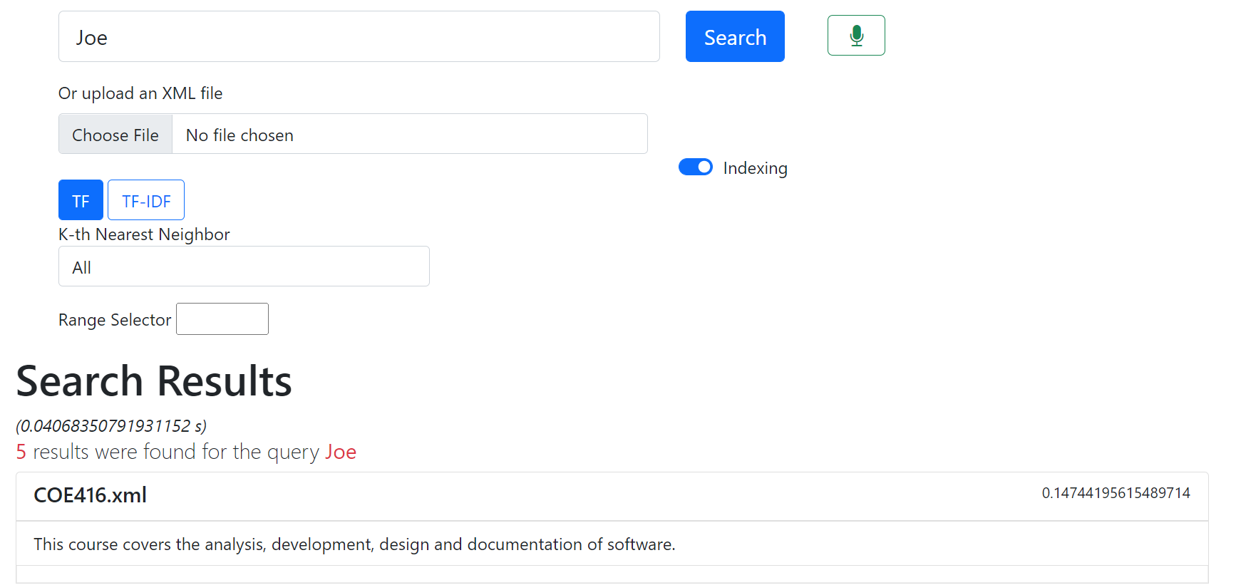
4. Querying Interface

Slide 22
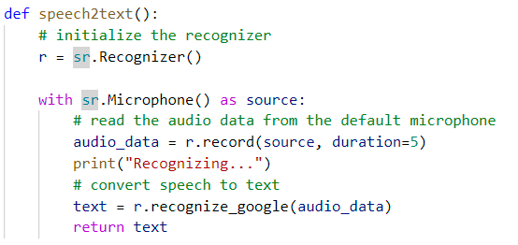

Speech recognition model

Slide 23
Thank you!

