Slide 1
The Mechanics of
Distributed Denial of Service Attacks
Ralfe Poisson
ZaCon 2009
blog.sudopoint.com

Slide 2
“An attempt to make a computer resource unavailable to its intended users.”
- wikipedia
Denial of Service Attack

Slide 3
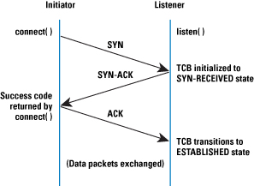
TCP Handshake
http://bit.ly/11ygeH

Slide 4
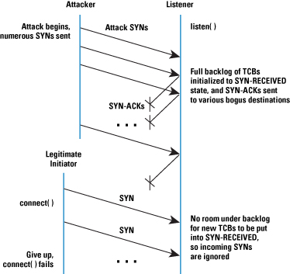
IP Handshake | DoS

Slide 5
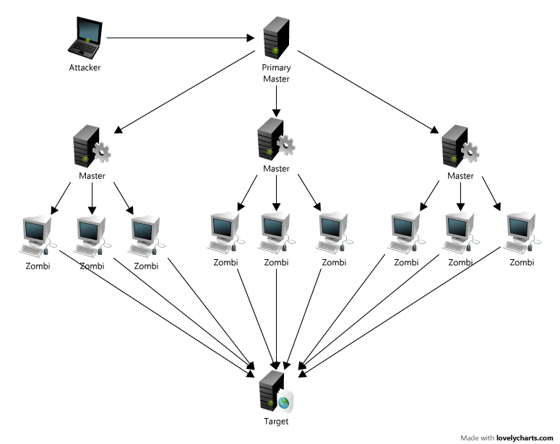
DDoS Architecture

Slide 6
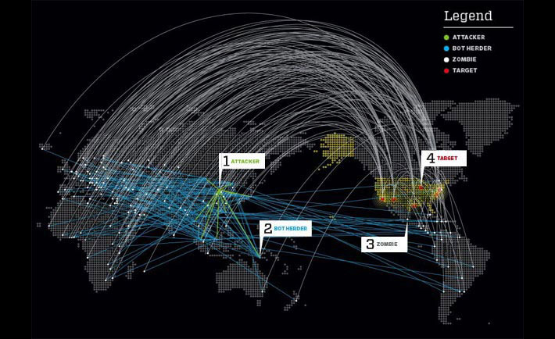
DDoS Example
http://bit.ly/ZnCCz

Slide 7
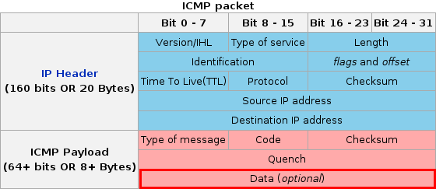
ICMP Packet
http://bit.ly/2pG4mI

Slide 8
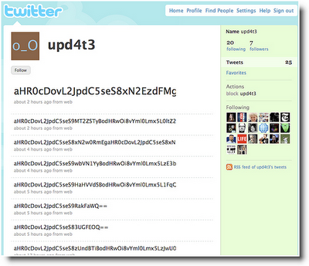
C&C via Social Media
http://bit.ly/2sxljS

Slide 9
IRC C&C Log Time-Lapse Visualization
http://bit.ly/18OE0s

Slide 10
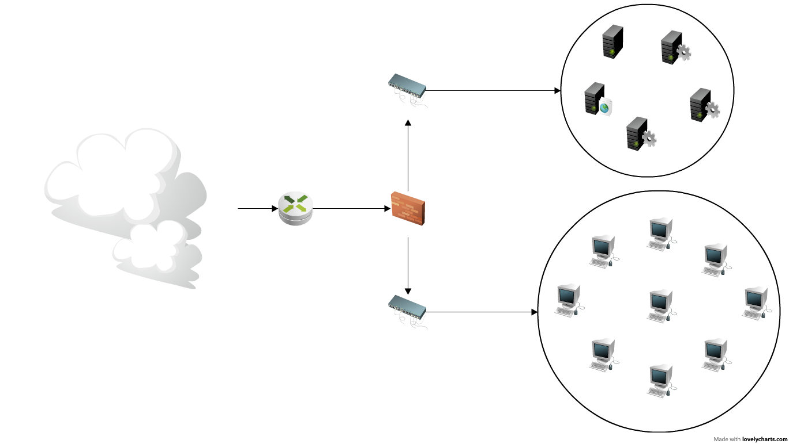
Traditional Corporate Network Layout

Slide 11
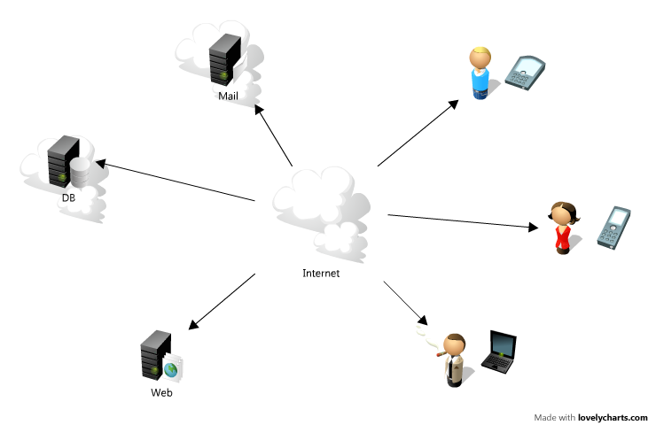
Deperimieterization

Slide 12
Resource Consumption
Log Injection
Expensive SQL Queries
Computational Overload
Modern DDoS Attack Vectors

Slide 13
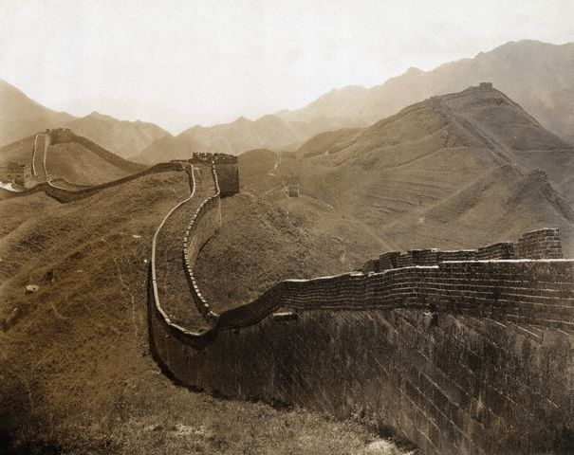
Get the Basics Right
Increase Resources
Aggregate-based Congestion Control (ACC)
[Ioannidis, J, Bellovin, S. 2002, AT&T Labs]
De-centralize your network
ISP's take more responsibility in traffic monitoring.
Load Balancing (eg: Apache's mod_proxy_balancer)
Defences

Slide 14
}
Ralfe Poisson
ZaCon 2009
blog.sudopoint.com

