Slide 1
Basics of stochastic
mechanics
Project „Group B“
WS12/13
Egger Philipp, Fuchs Michael, Lampert Ralf

Slide 2
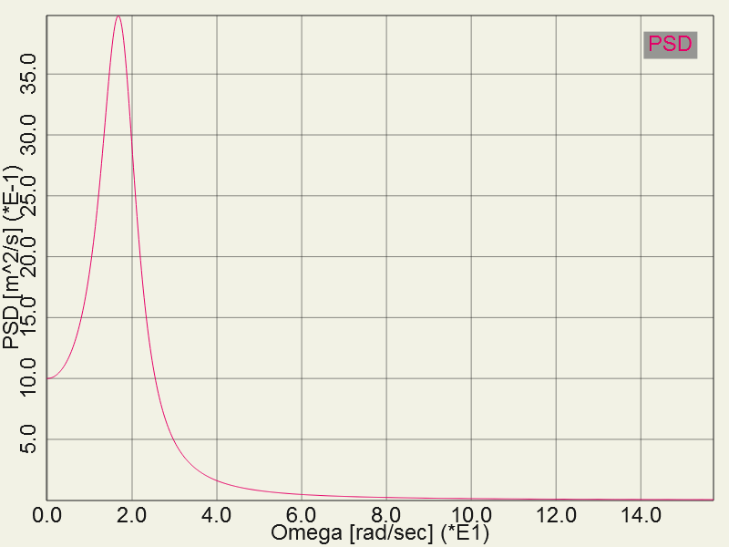
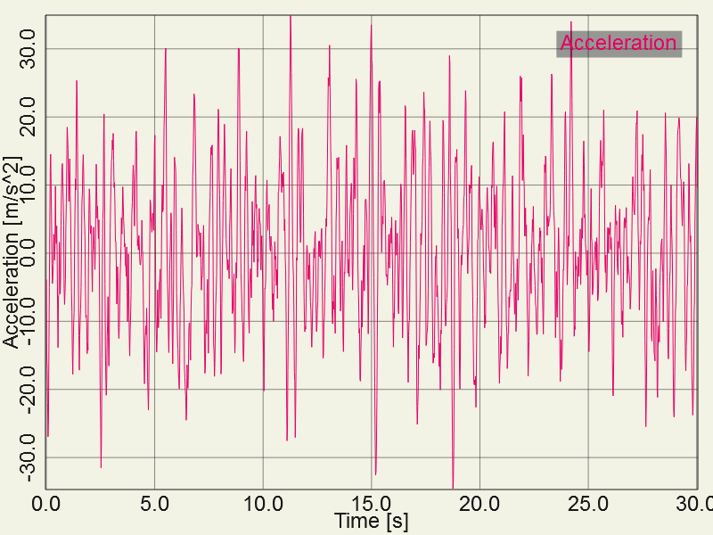
Getting started
Power Spectral Density
Time Series after IFFT

Slide 3
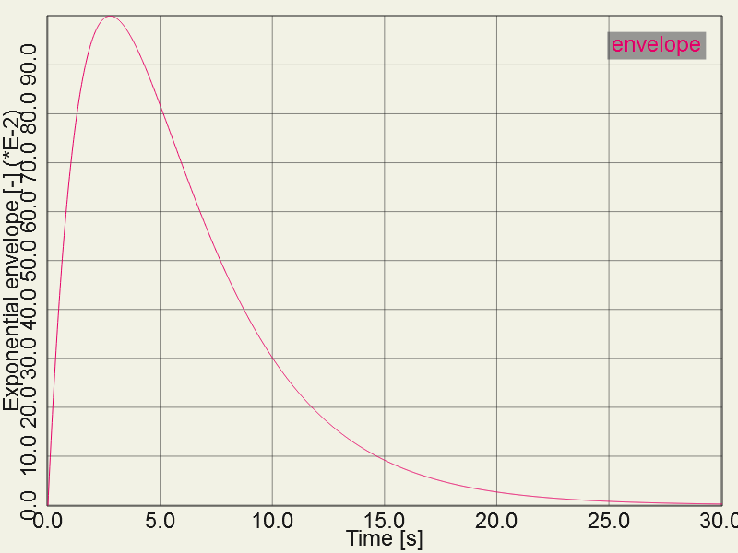
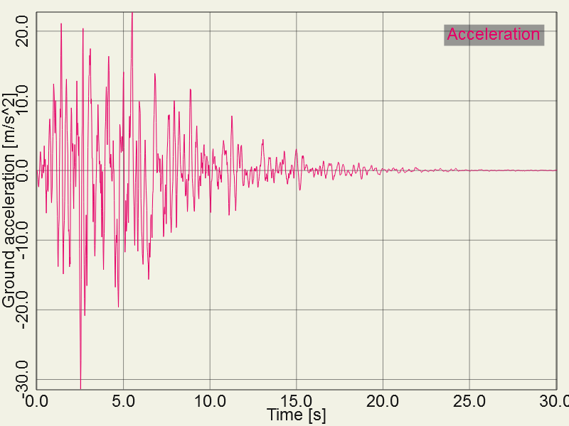
Getting started
Filter Function
Ground Acceleration

Slide 4
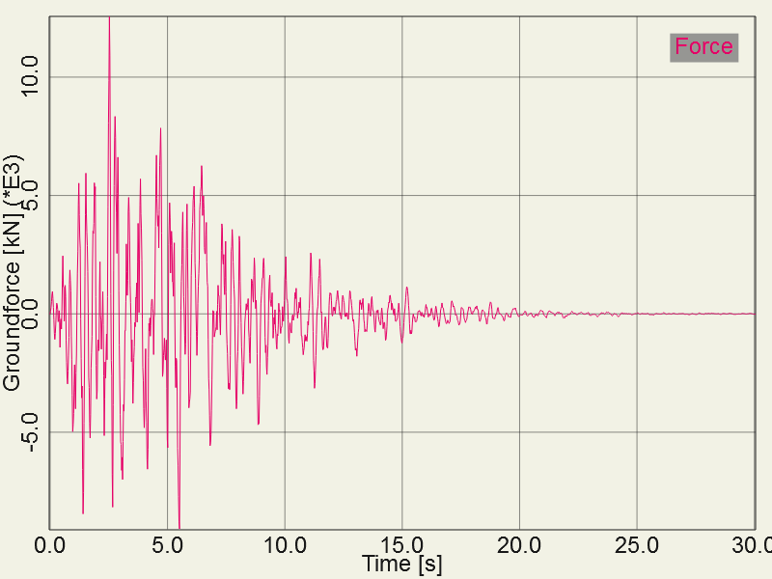
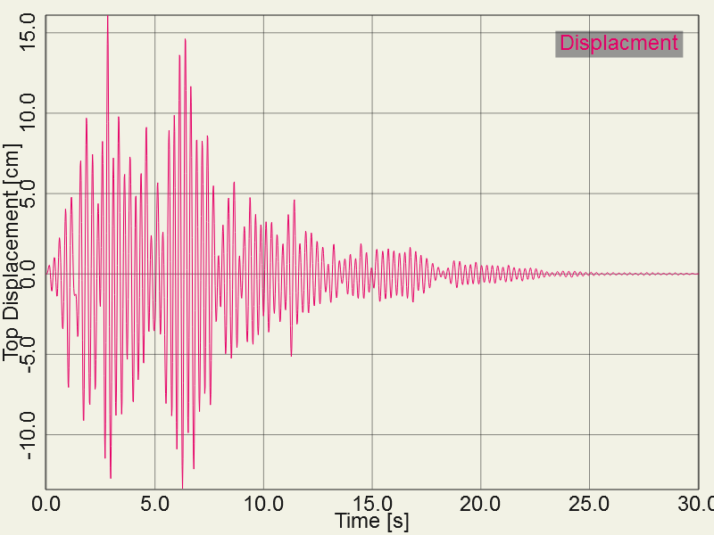
Getting started
Groundforce
Top Displacement of Mass

Slide 5
The Solution:
Experienced data:
Optimizing for costs, Velox thickness goes to minimum and concrete goes to a maximum
If optimized for costs Velox has to be cheaper than 80€/m³ to be considered at all
Optimizing for weight, thickness of wood goes to maximum and all others to minimum
Conclusion:
Velox has a bad ratio of material properties to its price
To improve the results this ratio has to improve too

