Slide 1
MO-SS036 SCIENCE, TECHNOLOGY & SOCIETY • TERMINAL ASSESSMENT
WHERE FLEXIBLE PACKAGING GOES
Flexible E-Commerce Plastic Packaging Recovery in the Philippines
Parcel arrives
Mailers, bubble wrap, films
Discarded at home
Low resale value
Mixed with household waste
Milestone 1: Problem Definition
Milestone 2: Solution Ideation, Evaluation & Selection
Uneven collection and segregation
Dumps, burning, leakage
Recovery pathway
Active contributor: Ralf Kevin I. Piano
BSIT-AI-Powered Product Dev't • Section S2103 • November 2026
Where it can end up
Fails to re-enter
Pathway [2–4]. Modeled 2022 loss: 11.79 kt [1]
Notes:
Good day. I am Ralf Kevin I. Piano. This presentation covers Milestone 1, Problem Definition, and Milestone 2, Solution Ideation, Evaluation and Selection. It asks why discarded flexible e-commerce packaging fails to return to recovery in the Philippines. I explain the problem and its root causes, show how six solutions were developed and compared, and present producer-funded recovery as the preferred approach. The result is a proposed community recovery framework with success indicators and recommendations for Philippine EPR.

Slide 2
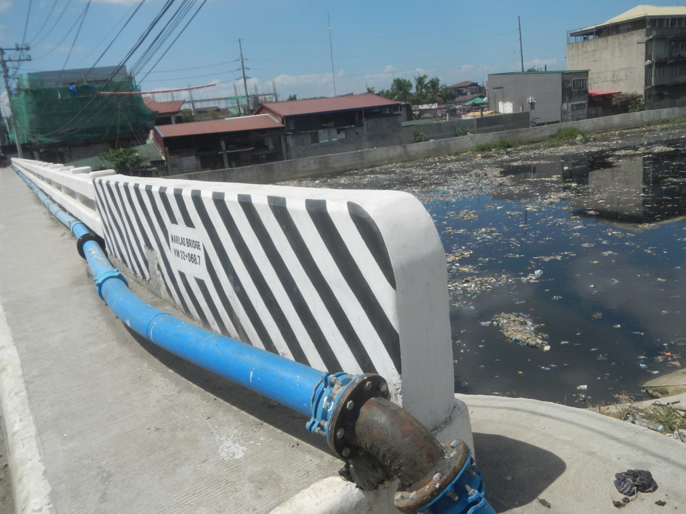
Problem Statement, Context & Scope
Why low-value flexible e-commerce packaging fails to be recovered
PROBLEM STATEMENT
Discarded flexible packaging (bubble wrap, poly mailers, protective films) fails to re-enter recovery pathways and can end up in dumpsites, open burning or waterways [1, 3].
CONTEXT
Online shopping grew after COVID-19 within about 1.7 Mt/year of Philippine post-consumer plastic, while collectors favor higher-value rigid plastics [2, 3].
SCOPE
Marilao River: general plastic pollution [24]
Philippine flexible e-commerce packaging, studied through secondary evidence. The outcome is a community-scale recovery framework [22].
Notes:
Flexible e-commerce packaging, such as courier bags, bubble wrap and protective film, often costs more to handle than it earns at resale. Collectors favor higher-value rigid plastics, so flexible film stays in household waste. Philippine research reports about 1.7 million tonnes of post-consumer plastic waste a year, and a fate model estimates 11.79 kilotonnes of e-commerce packaging loss in 2022. The scope is Philippine flexible e-commerce packaging, studied through secondary evidence. The outcome is a community-scale recovery framework.

Slide 3
Impact & Stakeholders
Three kinds of impact, and who must work together to fix them
ENVIRONMENT • MODELED
Stakeholder | Core system role
Producers / PROs | Finance recovery under EPR law
LGUs & waste workers | Collect, sort and aggregate films
Households & sellers | Separate clean mailers, return them
Recyclers | Process and verify accepted output
DENR / NSWMC / DTI | Oversight, compliance and data
7.47 kt land, 424 t ocean
Modeled 2022 release [1]
SOCIETY • LITERATURE
Open-burning health risks
Documented health risks of open burning [23]
ECONOMY • REPORTED
US$790–890M per year
Value lost across four national resins [3]
Notes:
Impacts fall on the environment, society and the economy. The model places 7.47 kilotonnes on land and 424 tonnes in the ocean in 2022. Open burning creates documented health risks for workers and communities. Four national resin streams lose 790 to 890 million US dollars of value each year. Four groups must work together: producers and their organizations finance recovery, local governments and waste workers deliver collection, households separate clean material, and recyclers process it and confirm what they accept.

Slide 4
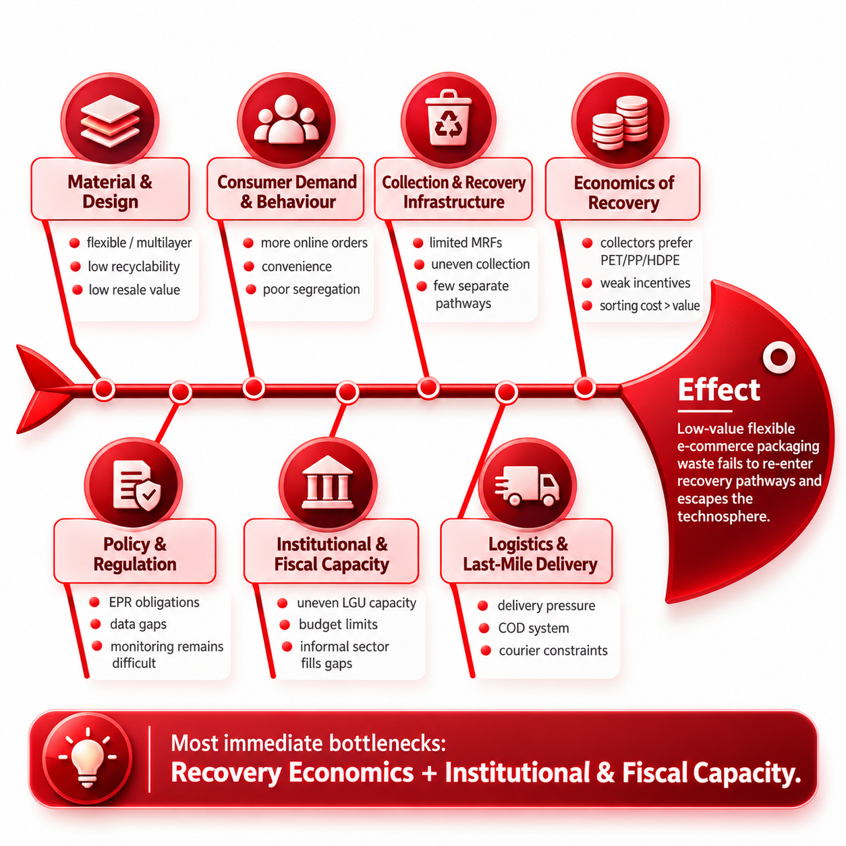
Root Causes: Seven Interconnected Barriers
Technique: qualitative fishbone (Ishikawa) synthesis of seven literature-based causes [22]
1
MAIN BOTTLENECK
Recovery economics
Collectors favor PET, PP and HDPE. Scrap resale rarely covers the cost of handling low-value film [3].
2
MAIN BOTTLENECK
Institutional & fiscal capacity
Local governments lack funds, staff and equipment for separate collection [2].
The other five causes (material, behavior, collection, policy, logistics) are shown on the diagram.
Notes:
I used a qualitative fishbone, or Ishikawa, synthesis to organize seven causes from the literature: material design, consumer behavior, collection infrastructure, recovery economics, policy and data, institutional and fiscal capacity, and last-mile logistics. The fishbone on the left is my original Milestone 2 diagram. Two causes stand out as the main bottlenecks. Recovery economics: collectors favor PET, PP and HDPE, and resale rarely covers the cost of handling low-value film. Institutional and fiscal capacity: local governments lack funds, staff and equipment. The proposed framework targets these two first.

Slide 5
Data & Evidence: Verified Figures & Limits
Gathered from published studies and reports, arithmetic re-checked; each figure labeled by type [1, 2, 5, 22]
MODELED [1]
ONLINE ORDERS PER PERSON PER MONTH [5]
7.47 kt (63.4%)
8.49 kt (72%)
to land
Mismanaged
11.79 kt
424 t (3.6%)
directly to the ocean
total loss, 2022
Four years of data: an early signal
3.30 kt (28%)
~594 t (~5%)
Unaccounted (fate unknown)
possibly burned (derived)
% OF BARANGAYS WITH A SORTING FACILITY [2]
Barangays with operating MRFs, 2021
44% / 20% (MM)
OBSERVED [2]
Multilayer + LDPE, selected Pasig litter
62.68%
OBSERVED [2]
Counts facilities; film recycling is unmeasured
HOW FIGURES ARE LABELED IN THIS DECK
OBSERVED Empirical data, subnational studies
MODELED Published fate-model output [1]
PROGRAMME-REPORTED Programme-published
RESEARCHER-DERIVED AHP and inferences [22]
Notes:
These are the key figures, each labeled by type. The fate model estimates 11.79 kilotonnes of packaging loss in 2022: 8.49 mismanaged and 3.30 unaccounted. About 7.47 kilotonnes went to land, 424 tonnes to the ocean, and roughly 594 tonnes were possibly burned, which is my own inference. Online orders per person in Dasmariñas rose from 1.3 to 4.4 a month over four years, an early signal. In 2021, 20 percent of Metro Manila barangays and 44 percent nationwide had a sorting facility; film recycling itself is unmeasured. Multilayer plastics and LDPE made up 62.68 percent of selected Pasig litter. The sources are published studies and reports, and I re-checked the model arithmetic.

Slide 6





Desired Outcome & Solution Ideation
A community planning toolkit, built through a four-stage ideation workflow [7–11, 22]
DESIRED OUTCOME: A PRACTICAL COMMUNITY TOOLKIT
Film Recovery Toolkit
Handling guidelines
Excel tracking tool
Preliminary costs
Readiness checklist
How to segregate, collect, store and handle film.
Batch logs of collected, rejected and accepted film.
Equipment, manpower, logistics and financing.
Six conditions to check before any pilot.
HOW THE SOLUTIONS WERE DEVELOPED
01
Reverse brainstorming
02
Benchmarking
03
Credibility checks
04
Screening & AHP
Imagine the worst case for each root cause, then reverse it into an action [7].
Study mechanisms from 3 Philippine and 6 international programmes [8].
Appraise sources (AACODS) and test fit to Philippine conditions [9, 22].
Score six options, then compare them pair by pair [10, 11].
Notes:
The desired outcome is a practical planning toolkit for a barangay, school or community: handling guidelines, an Excel tracking tool, a preliminary cost assessment and a readiness checklist. Four stages developed the solutions. First, reverse brainstorming, which I show next. Second, benchmarking three Philippine programmes and six international systems. Third, a credibility check with the AACODS checklist and seventeen transferability checks. Fourth, screening and AHP. Seven root causes produced six alternatives: cashback, a producer-funded contract, community aggregators, packaging redesign, an EPR ledger and courier reverse logistics. The toolkit carries the working name Film Recovery Toolkit, shown with its logo at the top right: a green shipping parcel with a leaf sprouting from it, for parcel plastics made new. The toolkit is a planning proposal; actual waste reduction and recycling results come later, with a pilot.

Slide 7
Reverse Brainstorming: Turning Failures into Actions
Four of the seven root causes, pushed to their worst case, then reversed [7, 22]
Root cause | Worst case | Reversed into action
Economics of recovery | Pay nothing for low-value film | Producer service payments and rewards
Policy & regulation | Count tonnes without batch proof | Trace batches to recycler output
Institutional & fiscal capacity | Assign unfunded work to LGUs | Specify who pays staff and transport
Consumer behavior | Make returns inconvenient | Clear instructions and easy drop-off hubs
Notes:
Reverse brainstorming pushed each root cause to its worst case, then reversed it into an action. I show four examples. Paying nothing for low-value film becomes producer service payments. Counting tonnes without batch proof becomes tracing batches to recycler output. Assigning unfunded work to local governments becomes specifying who pays staff and transport. Making returns inconvenient becomes easy drop-off hubs with clear instructions. The other three causes, material design, collection infrastructure and logistics, followed the same method.

Slide 8
Benchmark Programmes and Documented Results
Nine programmes; their rates use different streams, years and denominators [12–20]
Programme / case | Programme-reported result | Transferable mechanism
Quezon City Trash-to-Cashback [12] | 869.7 t mixed materials; 94,080 transactions (Feb 2026) | Point rewards and staffed weigh-ins
Robinsons Las Piñas and Plastic Flamingo [13, 14] | 90–100% tenant participation; accepted-grade drop points | Hosted hubs and strict sorting rules
Germany and Netherlands [15, 20] | 69.4% all packaging (DE); 49% plastic packaging (NL) | Producer fees and audit registries
South Korea and Taiwan [16, 18] | 87% broad rate (KR); 626 registered recyclers (TW) | Recycling fund pays local collectors
Japan and Singapore [17, 19] | 19.3% municipal (JP); 52% overall (SG) | Clear boundaries, mandatory reporting
Notes:
Nine programmes show how recovery systems work. Quezon City reports about 869.7 tonnes of mixed materials and 94,080 transactions as of February 2026. Robinsons Las Piñas reports tenant participation of 90 to 100 percent. Plastic Flamingo documents accepted collection grades. Germany and the Netherlands run producer fees with audited registries. South Korea funds local collectors, and Taiwan registers 626 recyclers. Japan and Singapore define clear boundaries and require reporting. Their rates cover different streams, years and denominators, so each result stands on its own. The lesson from all nine is the mechanism: financing, access and reporting.

Slide 9
Screening and AHP Criteria & Weights
Six alternatives screened, then weighed on five criteria; judgments are researcher-derived [10, 11, 22]
STEP 1 · SCREENING SCORE (MAX 15)
STEP 2 · AHP CRITERIA WEIGHTS
Solution considered | Score
S1 E-Drop & Cashback | 13
S2 Producer-funded contract | 13
S3 Community aggregators | 13
S4 Seller packaging redesign | 12
S5 Material-level EPR ledger | 13
S6 Courier reverse logistics | 10
Criterion | Weight | Interpretation
Root-cause fit | 29.79% | Fixes structural barriers
Recovery impact | 29.79% | Captures eligible film
Feasibility | 15.78% | Local actors can run it
Measurability | 15.78% | Outputs can be verified
Affordability | 8.85% | Cost is manageable
85
pairwise judgments
< 1%
consistency ratio
Notes:
Screening came first. Each option scored one to five on relevance, documentary support and practicality, maximum fifteen. Cashback, producer funding, community aggregators and the ledger scored thirteen. Redesign scored twelve and courier reverse logistics ten, because return-route costs and film acceptance are uncertain. All six moved on to AHP, which weights five criteria. Root-cause fit and expected recovery impact each carry 29.79 percent. Feasibility and measurability carry 15.78 percent each, and affordability 8.85 percent. One criteria matrix and five alternative matrices produce eighty-five pairwise judgments. All six consistency ratios fall below one percent, so my judgments are internally coherent. These are my own judgments, and stakeholder review would add external validation.

Slide 10
Solution Scorecard, Ranking & Selection
Normalized local AHP priorities (%); global = Σ (local priority × criterion weight) [22]
Option | Root-cause fit | Recovery impact | Feasibility | Measurability | Affordability | Global
Criterion weight | 29.79% | 29.79% | 15.78% | 15.78% | 8.85%
1 S2 Producer funding | 32.64 | 34.06 | 10.00 | 28.32 | 13.58 | 27.12
2 S3 Aggregators | 18.85 | 19.32 | 20.00 | 9.00 | 25.89 | 18.24
3 S1 Cashback | 18.85 | 19.32 | 20.00 | 16.35 | 7.47 | 17.77
4 S5 EPR ledger | 9.89 | 6.03 | 20.00 | 28.32 | 13.58 | 13.57
5 S4 Redesign | 9.89 | 10.63 | 20.00 | 9.00 | 25.89 | 12.98
6 S6 Courier returns | 9.89 | 10.63 | 10.00 | 9.00 | 13.58 | 10.31
Notes:
The scorecard lists normalized local AHP priorities for each criterion. The producer-funded contract ranks first at 27.12 percent, then community aggregators at 18.24 and cashback at 17.77. The ledger, redesign and courier logistics follow at 13.57, 12.98 and 10.31. Producer funding scores highest on fit and impact and lower on feasibility, because contracts take effort to arrange. It ranks first because producer fees finance the collection that film resale leaves unpaid. The preferred approach pairs producer finance with local collection, incentives and tracking. Close ranks call for sensitivity checks and partner review.

Slide 11
Proposed Pilot, Indicators & First Prototype
A producer-funded community recovery pilot, with a working prototype of its tracking tool [22]
HOW THE PILOT WORKS
PRODUCERS / PROs
LOCAL WORKERS
RECYCLER
FIRST-STAGE PROTOTYPE
Film Recovery Toolkit
Fund recovery tasks and verification
Collect, sort, weigh and log batches
Confirms accepted grades and output
A working web app for a community pilot. Log each batch, track the four indicators, estimate costs, and check six readiness requirements. Records export to Excel and CSV.
PROPOSED PILOT INDICATORS
Indicator | How it is measured
Recycler-accepted share | Accepted kg ÷ collected kg
Rejection rate | Rejected kg ÷ sorted kg
Traceable batches | Batches with a recycler record ÷ all batches
Actual cost per tonne | Operating records vs preliminary estimate
Still being iterated: peso figures are placeholders and it has not yet been tested with users.
LIVE PROTOTYPE
ralfpiano2-netizen.github.io/STS-project
Notes:
The selected approach becomes a proposed pilot. Producers fund defined recovery tasks, households return clean material, local workers collect, sort and log batches, and a recycler confirms what it accepts. Four indicators track the pilot: recycler-accepted share, rejection rate, traceable batches and actual cost per tonne. The card on the right is the first-stage prototype of the tracking tool, the Film Recovery Toolkit, which calculates those four indicators from a batch log. It is a working prototype with sample data, still being iterated, and the live link is on the slide. Peso figures are placeholders, and it has not been tested with users. Measurement of real results starts with the pilot, and success means verified recycler output.

Slide 12
Limitations & Philippine EPR Recommendations
Producer-funded recovery leads the evaluation, but implementation remains conditional [22]
STUDY LIMITATIONS
EPR RECOMMENDATIONS (RA 11898)
Secondary and local evidence only [1, 5]
Local series covers 4 years [5, 22]
AHP judgments are the researcher's [22]
Pilot and verified budget still to come [22]
Fund low-value film collection through producer service payments [2–4, 21]
Report collected and recycler-accepted tonnes separately [4, 6]
Build LGU and MRF capacity; protect workers [2]
Verify pilot costs before scaling up [22]
Notes:
The study has four limitations: the evidence is secondary, the local series covers four years, the AHP judgments are mine, and a pilot with a verified budget is still to come. For Philippine EPR, I recommend funding low-value film collection through producer service payments, reporting collected and recycler-accepted tonnes separately, building local government and MRF capacity while protecting workers, and verifying costs before scaling. Six gates come before any pilot: recycler acceptance, committed funding, agreed site roles, worker pay and safeguards, traceable batches and verified costs. Lessons: check source arithmetic, keep figure types separate, count recovery only when a recycler records it, and get stakeholder checks. The recommendations rest on secondary evidence.

Slide 13


Summary & Conclusion
What the slides show, in one view
Problem definition
Solution development
Way forward
Low-value flexible film has no profitable path back to recycling [1–3]
Modeled 2022 loss is 11.79 kt, and 72% of it is mismanaged [1]
Recovery economics and institutional & fiscal capacity are the two main bottlenecks [22]
Nine benchmark programmes show how financing, access and reporting work [12–20]
Six alternatives were screened; AHP weighted five criteria from 85 judgments [10, 11, 22]
Producer-funded contract ranks first at 27.12% [22]
Pilot producer-funded recovery with community delivery after six readiness gates [22]
Track recycler-accepted share, rejection rate, traceable batches and cost per tonne [22]
Strengthen RA 11898 with service payments, batch records and worker protection [2–4, 21]
Notes:
To summarize. On the problem, low-value flexible film has no profitable path back to recycling, the modeled loss is 11.79 kilotonnes with 72 percent mismanaged, and recovery economics and institutional and fiscal capacity are the two main bottlenecks. On solutions, nine benchmark programmes showed how financing, access and reporting work, screening kept six alternatives, and AHP ranked the producer-funded contract first at 27.12 percent. Going forward, the pilot starts after six readiness gates, tracks four indicators, and the recommendations strengthen RA 11898 with service payments, batch records and worker protection. Thank you for listening.

Slide 14
References (1 of 2)
Citations 1–12; the box on the right shows which slides cite each one
1
Huan, K. C., Martin, C., Ocampo, D., & Gue, I. H. V. (2023). Estimating e-commerce plastic waste of the Philippines through fate modelling. Chemical Engineering Transactions, 103, 289–294. doi.org/10.3303/CET23103049
SLIDES
1–3, 5, 12, 13
7
Hagen, M., Bernard, A., & Grube, E. (2016). Do it all wrong! Using reverse-brainstorming to generate ideas, improve discussions, and move students to action. Management Teaching Review, 1(2), 85–90. doi.org/10.1177/2379298116634738
SLIDES
6, 7
2
World Bank. (2024). Guidance on the development of a roadmap for managing plastic waste and reduction of non-recyclable single-use plastics in the Philippines. openknowledge.worldbank.org
SLIDES
1, 2, 4, 5, 12, 13
8
Ohinata, Y. (1994). Benchmarking: The Japanese experience. Long Range Planning, 27(4), 48–53. doi.org/10.1016/0024-6301(94)90055-8
SLIDES
6
3
World Bank Group. (2021). Market study for the Philippines: Plastics circularity opportunities and barriers. documents1.worldbank.org
SLIDES
1–4, 12, 13
9
Tyndall, J. (2010). AACODS checklist. Flinders University. library.sydney.edu.au
SLIDES
6
4
WWF Philippines. (2020). EPR scheme assessment for plastic packaging waste in the Philippines. archive.wwf.org.ph
SLIDES
1, 12, 13
10
Saaty, R. W. (1987). The analytic hierarchy process—What it is and how it is used. Mathematical Modelling, 9(3–5), 161–176. doi.org/10.1016/0270-0255(87)90473-8
SLIDES
6, 9, 13
5
Sadie, N. T., Falcutila, S. P. L., Florentino, A. A. S. P., & Diola, M. B. L. D. (2024). Assessment of e-commerce plastic waste management during the COVID-19 pandemic in Dasmariñas, Cavite. Techno-Science Research Journal, 12(Special Issue), 49–56. techno-srj.itc.edu.kh
SLIDES
5, 12
11
Forman, E. H., & Gass, S. I. (2001). The analytic hierarchy process—An exposition. Operations Research, 49(4), 469–486. doi.org/10.1287/opre.49.4.469.11231
SLIDES
6, 9, 13
6
World Bank. (2023). Combating the plastic waste crisis: EPR in the Philippines, lessons from Korea. documents1.worldbank.org
SLIDES
12
12
Quezon City Government. (2026). Trash to Cashback. quezoncity.gov.ph
SLIDES
8, 13
Notes:
These are references 1 to 12. Each number matches the bracketed citations on the slides, and the box on the right of each card lists the slides that cite it. For example, reference 22 is my own Milestone 2 study records and appears on most analytical slides. Links are clickable in the file.

Slide 15
References (2 of 2)
Citations 13–24; the box on the right shows which slides cite each one
13
Robinsons Land Foundation. (2021, December 31). Robinsons Las Piñas's solid waste program in partnership with USAID. robinsonslandfoundation.com
SLIDES
8, 13
19
National Environment Agency, Singapore. (2026). Mandatory packaging reporting; Beverage container return scheme; Waste statistics and overall recycling
SLIDES
8, 13
14
The Plastic Flamingo. (n.d.). Collection of plastic wastes. theplaf.com
SLIDES
8, 13
20
Verpact. (2025). Public report 2024. publieksverslag2024.verpact.nl
SLIDES
8, 13
15
German Environment Agency. (2026). Recycling of packaging at input to the final recycling process, data for 2023. umweltbundesamt.de
SLIDES
8, 13
21
Republic Act No. 11898. (2022). Extended Producer Responsibility Act of 2022. elibrary.judiciary.gov.ph
SLIDES
12, 13
16
Asian Development Bank. (2024, September 20). Turning waste into wealth: The Republic of Korea's experience. adb.org
SLIDES
8, 13
22
Piano, R. K. I. (2026). Researcher-developed synthesis, screening and AHP judgments [Milestone 1 and 2 presentations, Worksheet 2 and AHP workbook; unpublished study records].
SLIDES
2, 4–7, 9–13
17
Ministry of the Environment, Government of Japan. (2026, March 27). Municipal solid waste generation and disposal in FY2024. env.go.jp
SLIDES
8, 13
23
Velis, C. A., & Cook, E. (2021). Mismanagement of plastic waste through open burning with emphasis on the Global South: A systematic review of risks to occupational and public health. Environmental Science & Technology, 55(11), 7186–7207. doi.org/10.1021/acs.est.0c08536
SLIDES
3
18
Ministry of Environment, Taiwan. (2024, September 12 update). Resource recycling (Four-in-One overview). moenv.gov.tw
SLIDES
8, 13
24
JFVelasquez Floro. (2021, March 25). 1078Garbage-plastic pollution in Marilao River 02 [Photograph; CC0]. Wikimedia Commons. commons.wikimedia.org
SLIDES
2
Image sources: the photograph on slide 2 is by JFVelasquez Floro, CC0, Wikimedia Commons [24]. The fishbone on slide 4 is the author's own Milestone 2 figure [22]. All other visuals are original diagrams, charts and tables made for this deck.
Notes:
References 13 to 24 continue here. The benchmark programmes are 12 to 20, and the Marilao River photograph on slide 2 is reference 24, a credited CC0 work. The fishbone on slide 4 is my own Milestone 2 figure, and every other visual is an original diagram, chart or table made for this deck. I am happy to take questions.

