Slide 1
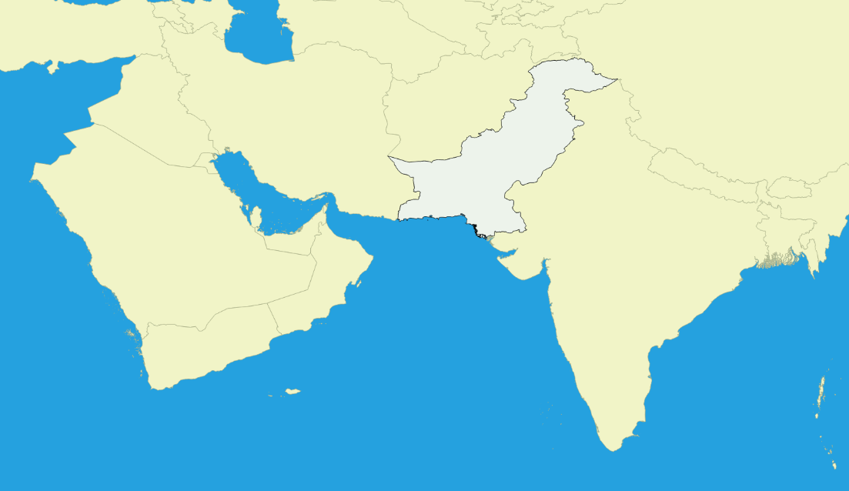
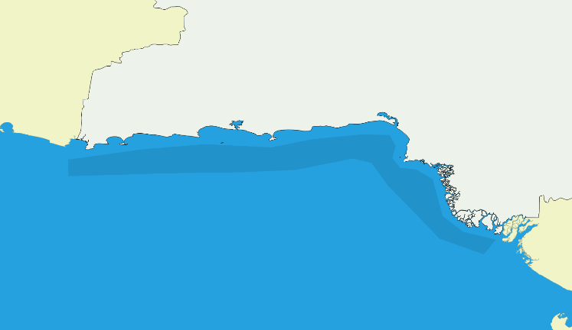
China
Iran
Afghanistan
Pakistan
India
Arabian Sea
Karachi Harbor

Slide 2
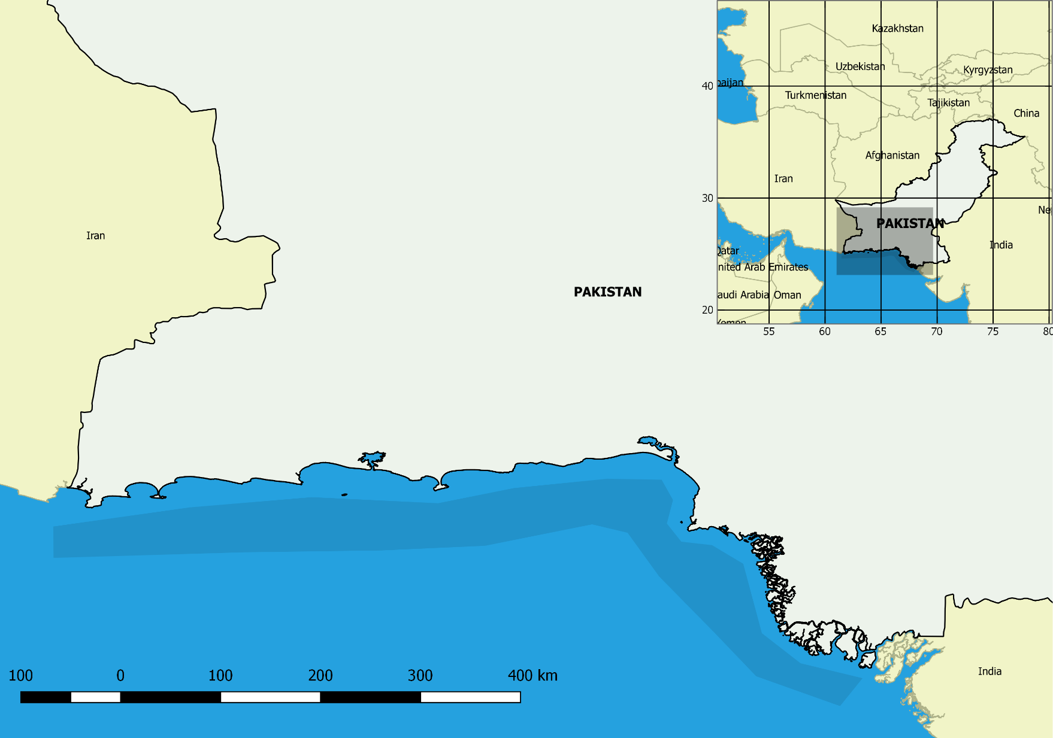
Karachi Harbor

Slide 3
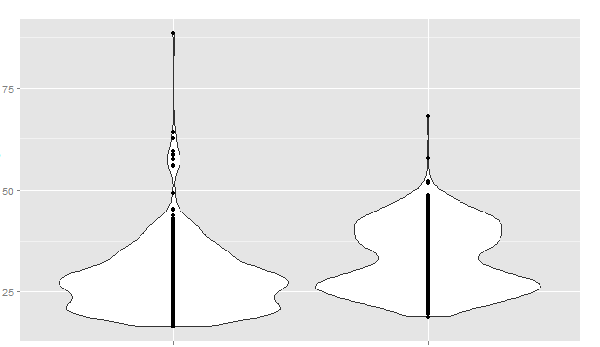
Length (cm)
Scomberoides commersiannus
Scomberoides tol

Slide 4
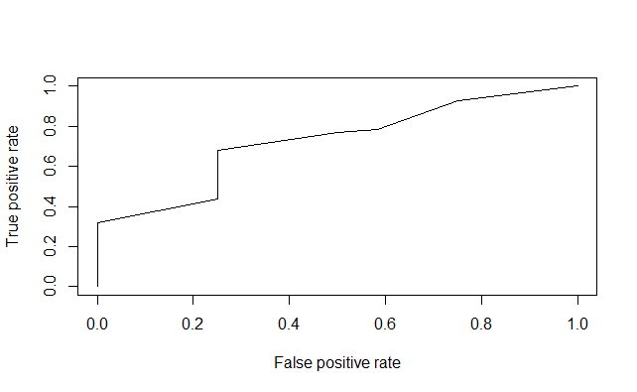

Slide 5
Scomberoides commersianus
Average Weight (g)
Scomberoides tol

