Slide 1
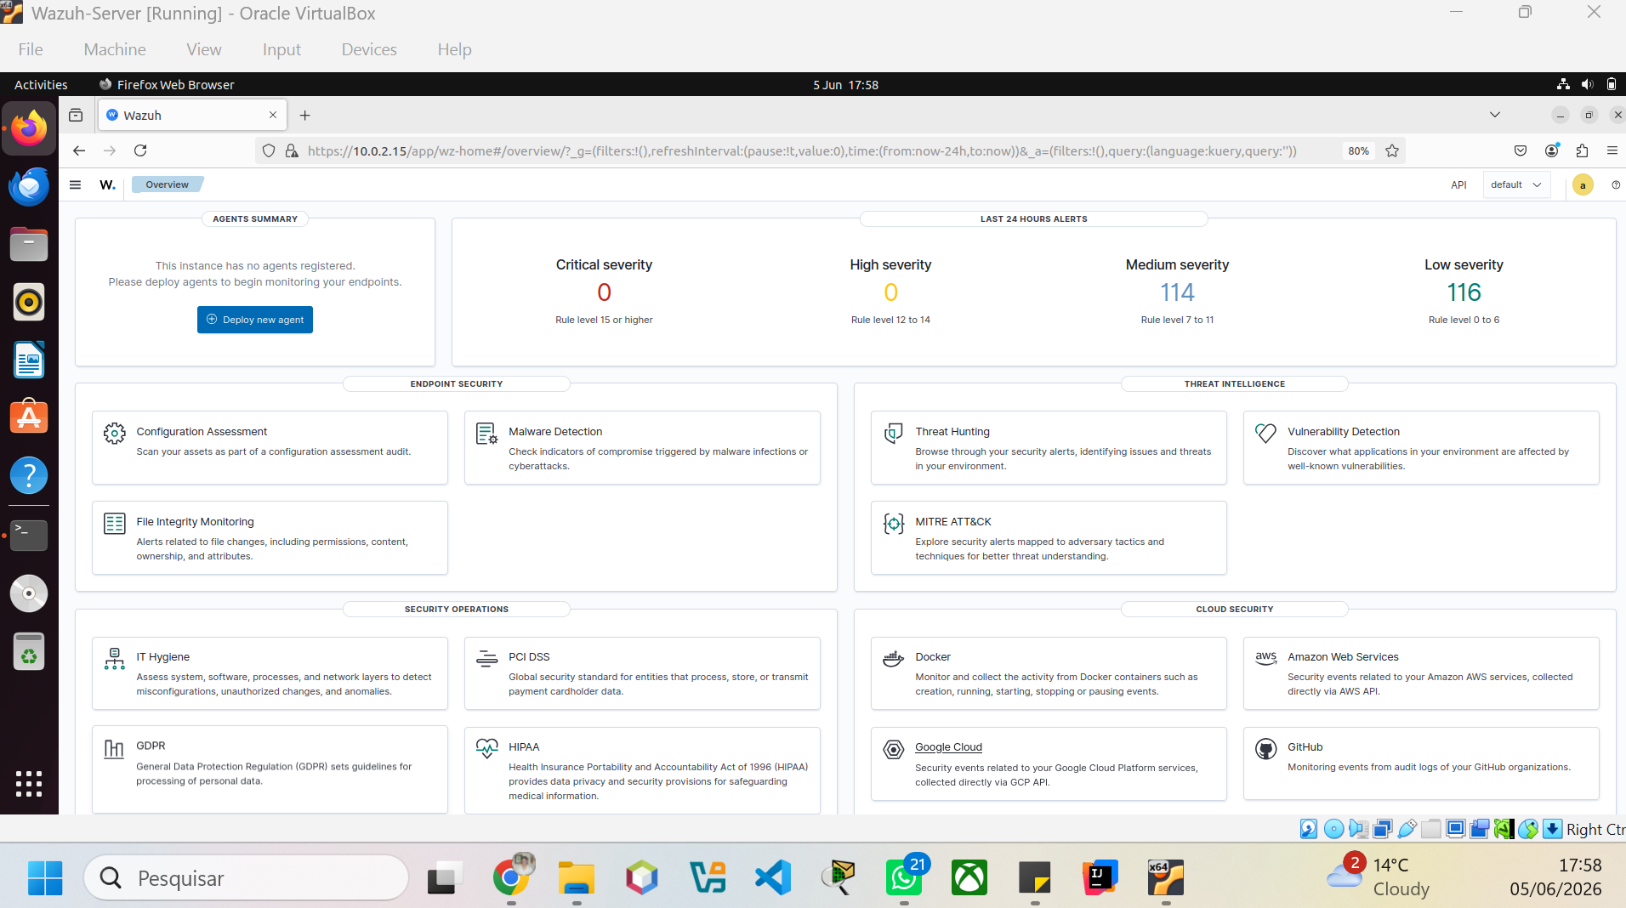
Project Introduction
Business Goal: Build a functional SIEM lab using Wazuh to simulate a SOC environment. The objective was to centralize logs, onboard endpoints, perform threat hunting, detect suspicious activity, and other functionalities.

Slide 2
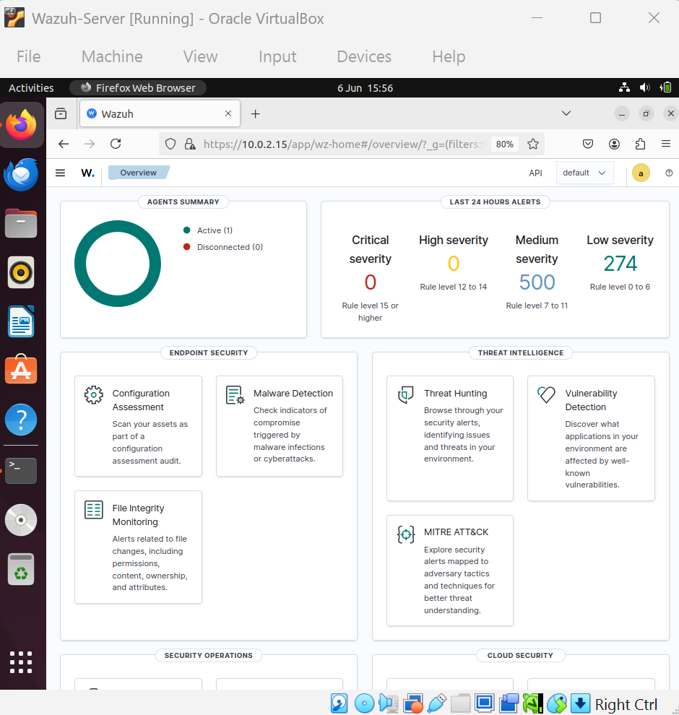
Wazuh Deployment Successful
After deploying Wazuh 4.14.5 on Ubuntu 22.04, the dashboard became operational. This confirmed that the Manager, Indexer, and Dashboard components were functioning correctly. The environment was now ready to receive endpoint telemetry.

Slide 3
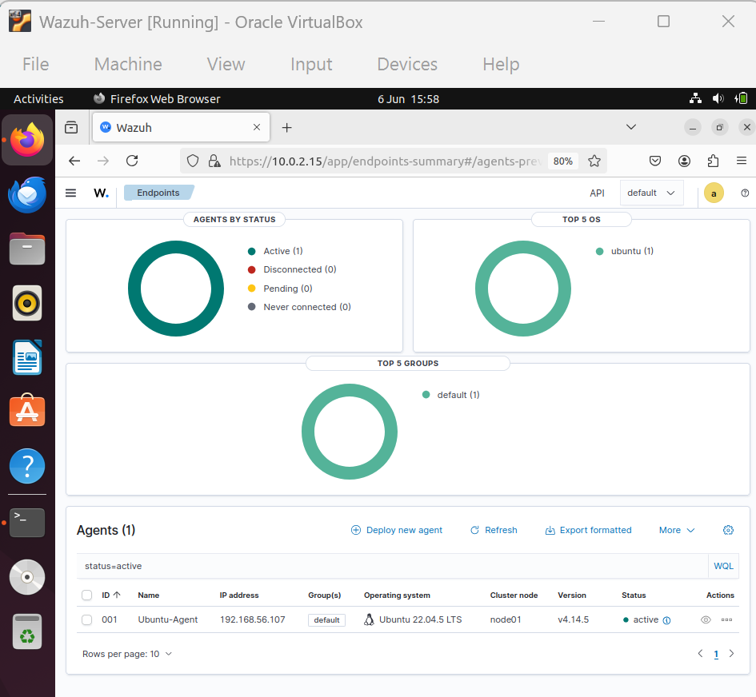
Endpoint Enrollment
A second Ubuntu VM was configured as a monitored endpoint. Multiple networking and enrollment issues were investigated and resolved. The endpoint was successfully registered with the Wazuh Manager.

Slide 4
Endpoint Visibility Confirmed
The Endpoints dashboard confirms successful onboarding. Agent ID 001 is active and communicating with the manager. This validates connectivity, agent registration, and telemetry collection.

Slide 5
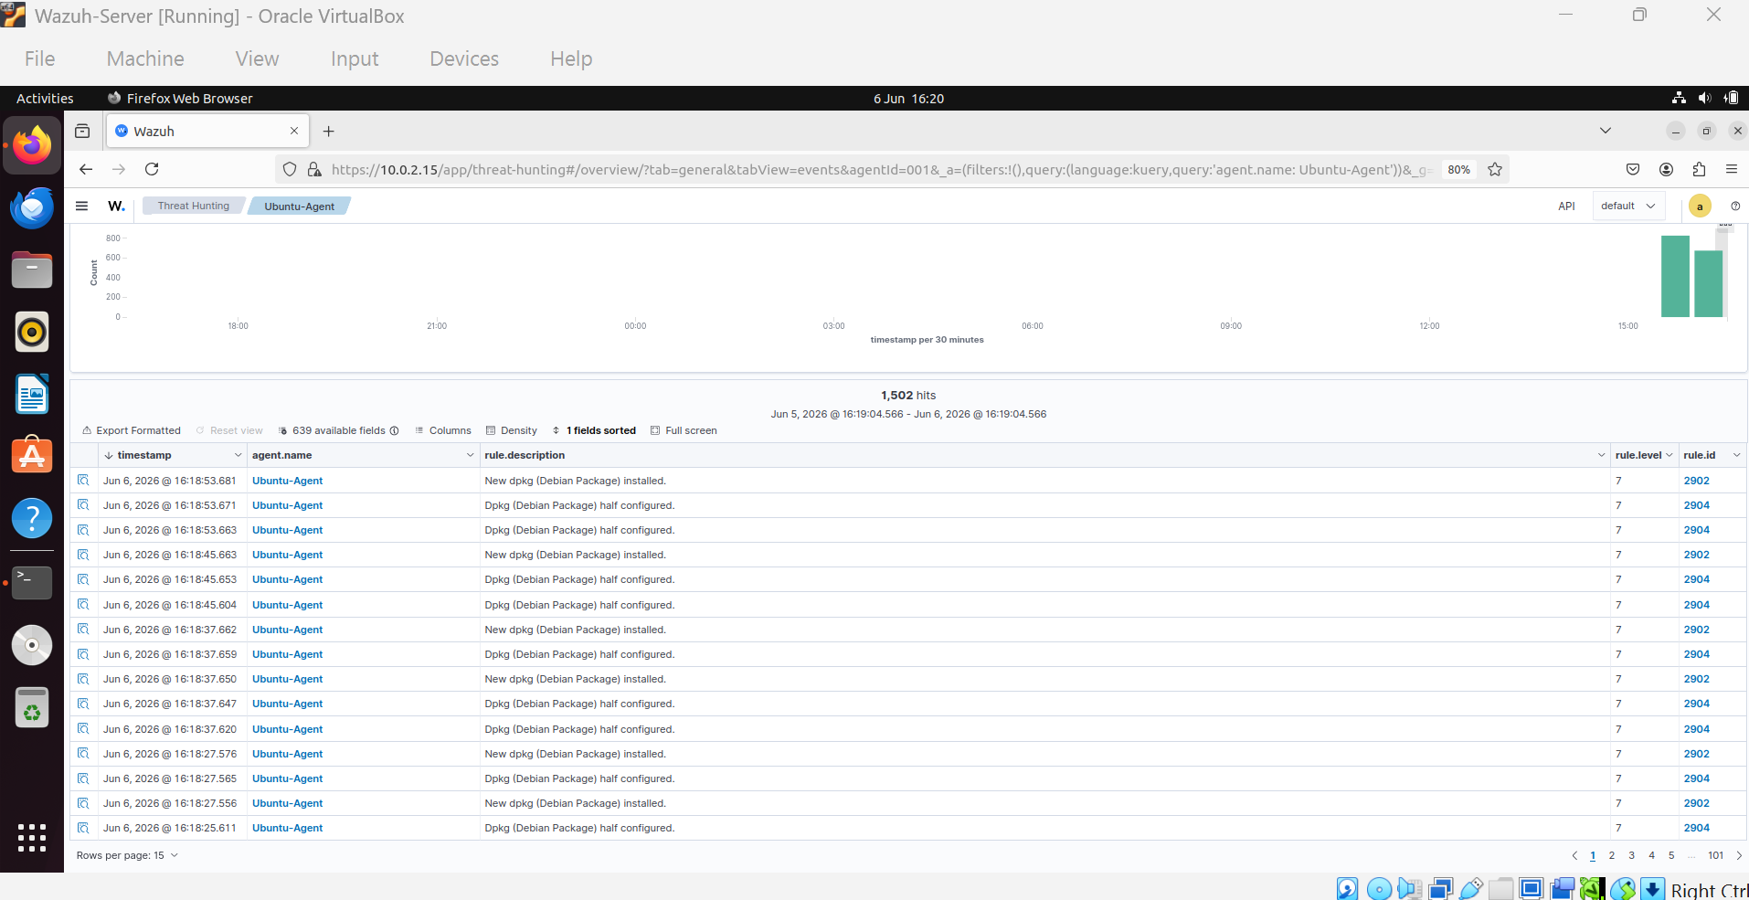
Threat Hunting Validation
Threat Hunting was used to validate log ingestion. Package installation and system activity logs generated by the endpoint were indexed and searchable. This proves successful event collection and storage.

Slide 6
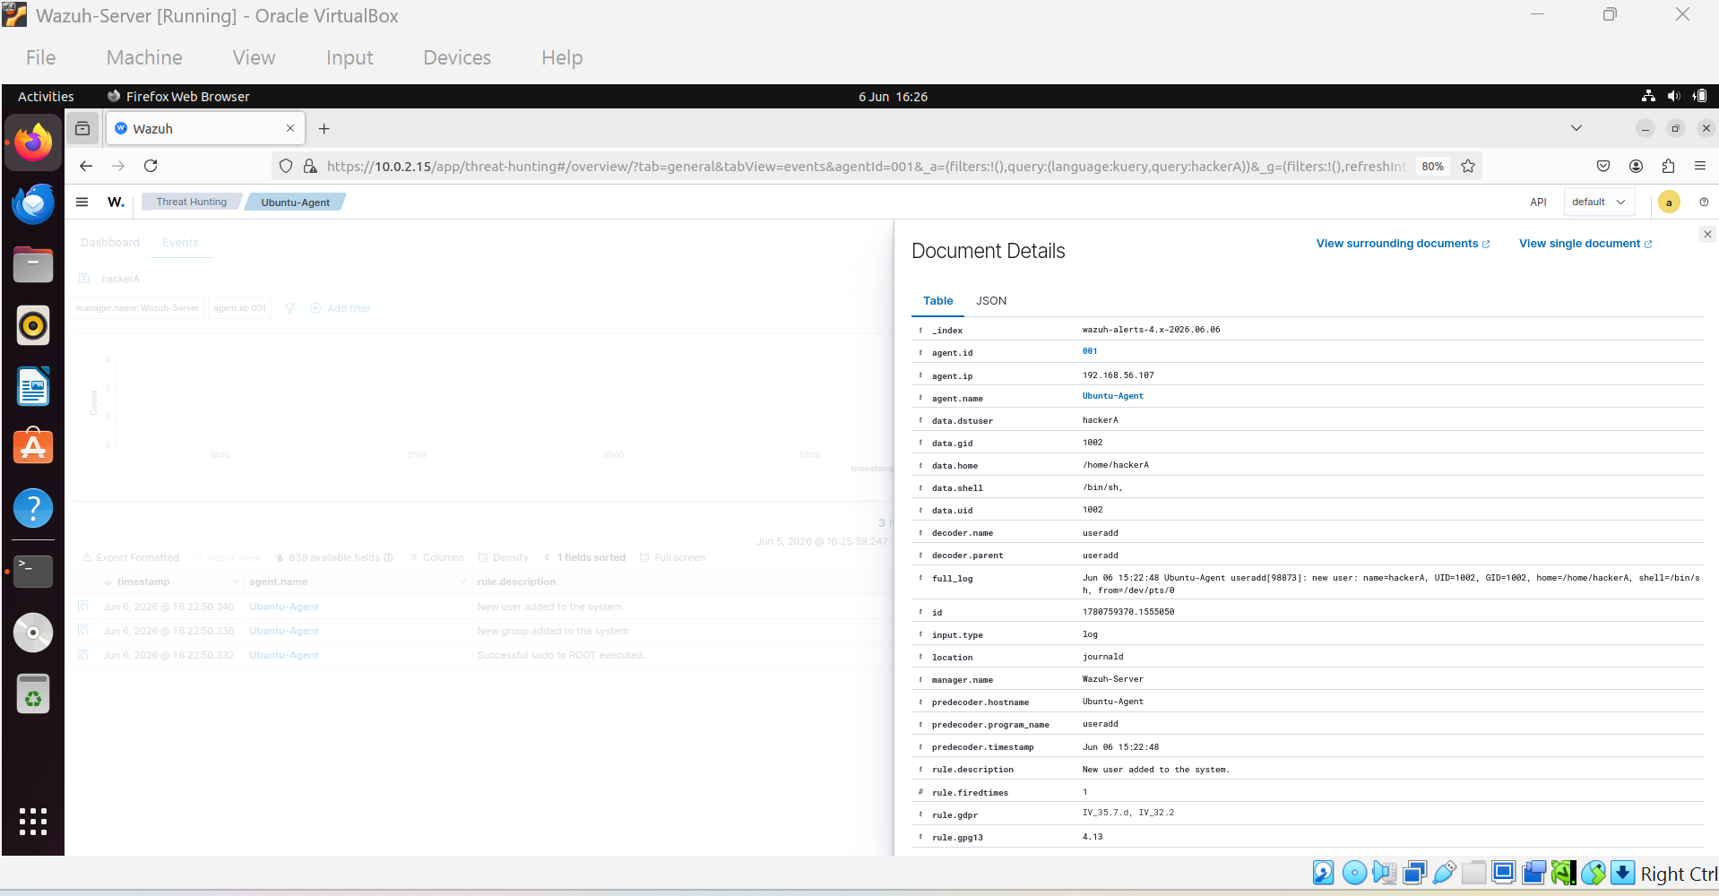
User Creation Detection
A new local user (hackerA) was intentionally created to generate a security-relevant event. Wazuh immediately detected the action and recorded username, UID, GID, shell, and home directory details.

Slide 7
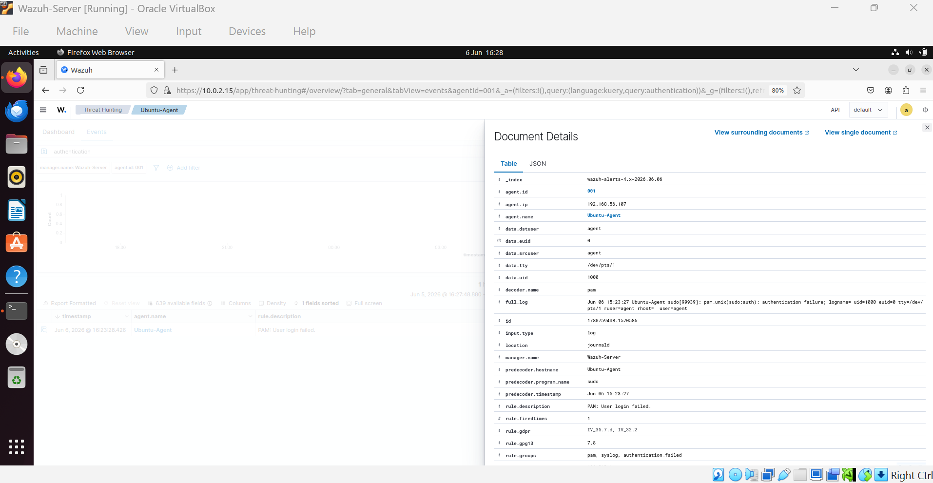
Authentication Failure Detection
Failed authentication attempts were generated using incorrect sudo credentials. Wazuh identified the event as a PAM authentication failure and captured user, session, source host, and timestamp information.

Slide 8
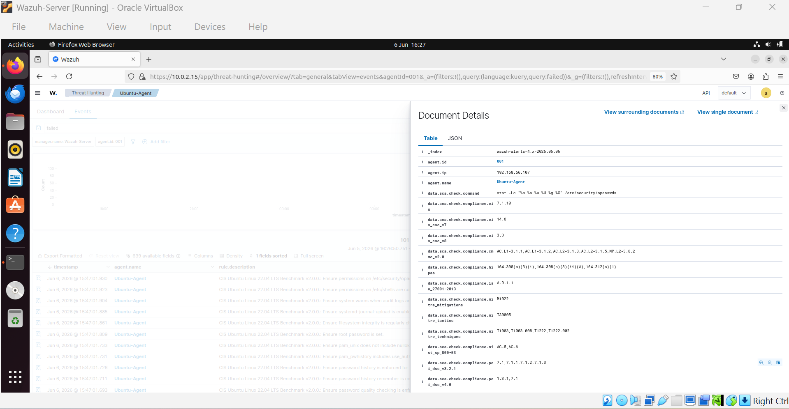
Security Configuration Assessment
The CIS Ubuntu benchmark checks demonstrate Wazuh's ability to perform security posture assessments. This helps identify configuration weaknesses, hardening opportunities, and compliance gaps.

Slide 9
SOC Analyst Activities Demonstrated
This project demonstrates endpoint onboarding, alert monitoring, threat hunting, log analysis, authentication monitoring, account monitoring, Linux administration, SIEM operations, and incident investigation workflows.

Slide 10
Project Outcome
The final environment successfully collected and analyzed endpoint events. The SIEM detected user creation activity, authentication failures, package installations, and configuration assessment findings. The project provided practical SOC-focused experience using industry-relevant tooling.

